Slide 1


Slide 2
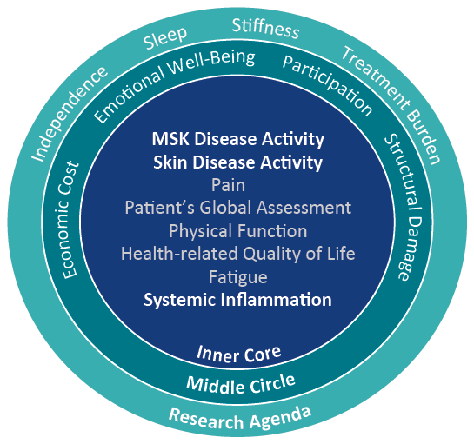
PsA Core Domain Set
OMERACT-GRAPPA 2016
MSK disease activity =
Peripheral arthritis
Enthesitis
Dactylitis
Axial symptoms
Orbai AM, et al. J Rheumatol. 2017;44:1522-1528.
Notes:
Updated 2016 psoriatic arthritis (PsA) core domain set. Musculoskeletal (MSK) disease activity includes peripheral joints, enthesitis, dactylitis and spine symptoms; skin activity includes skin and nails; patient global is defined as patient-reported disease-related health status. The inner circle (core) includes domains that should be measured in all PsA randomised controlled trials (RCTs) and longitudinal observational studies (LOS). The middle circle includes domains that are important but may not be feasible to assess in all RCTs and LOS. The outer circle or research agenda includes domains that may be important but need further study.

Slide 3
PsA Manifestations and Comorbidities
Extra-Articular and Extra-Cutaneous
Need for teamwork with PCP, Ophthalmology, GI, Psych
Uveitis (1.55%)¹
Ulcerative colitis (1.28%)¹
Cerebrovascular disease (7.32%)¹
Metabolic syndrome
  Obesity (16.45%), hypertension (47.28%), hyperlipidemia (47.47%)¹
Fatty liver/NASH (5.77%)¹
Depression (21.2%)¹, suicidal ideation (0.48%)¹
Fatigue (15.8%)²
Fibromyalgia (16.58%)¹
Osteoporosis (9.33%)¹
1. Shah K, et al. RMD Open. 2017;3:e000588.
2. Kaine J, et al. J Manag Care Spec Pharm. 2019;25:122-132.

Slide 4
Delayed Diagnosis of PsA
Worse Long-Term Outcomes
*
Association of clinical features† with >6-month delay in diagnosis
(univariate analysis model)
10.6 (1.4–80.6)
*p<0.05; **p<0.01; ***p<0.001
***
Odds ratio (95% CI)
4.6 (2.5–8.2)
*
**
**
2.3 (1.2–4.4)
2.2 (1.3–3.6)
1.1 (1.0–1.1)
*
0.4 (0.2–0.9)
†Clinical features recorded as percent, unless otherwise stated.
DMARD, disease-modifying antirheumatic drug; HAQ, health assessment questionnaire; OR, odds ratio.
Haroon M, et al. Ann Rheum Dis. 2015;74:1045-1050.
Notes:
The presence of arthritis mutilans, which is considered as the most severe end of PsA-related joint damage, was significantly associated with all studied intervals of the diagnostic delays on univariate analysis (>6 months, >1, >2 years),
and was significantly associated with a diagnostic delay of >1 year after adjusting for the confounders.’

Slide 5
PsA Clinical Trials
Outcomes Measures
Domains | Instruments
Joint Assessment | 68/66 T/S joint count, ACR, DAS, PsARC, PsAJAI, DAPSA, cDAPSA
Axial Assessment | BASDAI, BASFI, BASMI
Skin Assessment | PASI, target lesion, global, PSI, PSD
Composite (holistic) | MDA, VLDA, PASDAS, CPDAI, AMDF
Pain | VAS, NRS
Patient Global | VAS (joint global, skin + joints global)
Physician Global | VAS (joint global, skin + joints global)
Function | HAQ, HAQ-S, PSAID
HRQoL | SF-36, PsAQoL, DLQI, PSAID
Fatigue | FACIT, Krupp, MFI, VAS
Enthesitis Assessment | Leeds, SPARCC, MASES, 4-point
Dactylitis Assessment | Leeds, present/absent, acute/chronic
Acute Phase Reactant | ESR, CRP
Imaging | X-ray (modified Sharp or van der Heijde–Sharp), MRI, US
Work/Home Productivity | WPAI, WPS
Mease P. Arthritis Care Res. 2011;63:64-85; Mease P, et al. Ann Rheum Dis. 2005;64:ii49-ii54;
Mease P, van der Heijde D. Int J Adv Rheum. 2006;4:38-48.

Slide 6
PsA
GRAPPA Recommendations: 2015
Overarching Principles
Achieve lowest possible level of disease activity in all domains of disease
  Optimize functional status, improve QoL, and prevent structural damage
Assessment requires consideration of all major disease domains, including peripheral arthritis, axial disease, enthesitis, dactylitis, psoriasis, and nail disease
  The impact of disease on pain, function, QoL, and structural damage should be examined
  In addition, activity in other potential related conditions and comorbidities should be considered including CVD, uveitis, IBD, obesity, metabolic syndrome, gout, diabetes, liver disease, depression, and anxiety
  Patient-reported measures with a comprehensive history and physical examination, often supplemented by laboratory tests and imaging techniques, should also be included
Therapeutic decisions need to be individualized
Ideally, patients should be reviewed promptly
  Early diagnosis and treatment are likely to be of benefit
Coates L, et al. Arthritis Rheumatol. 2016;68:1060-1071.

Slide 7
PsA
EULAR Recommendations: 2015 Update
Overarching Principles
Treatment should maximize HRQoL through control of symptoms, prevention of structural damage, and normalization of function and social participation
  Abrogation of inflammation is an important component necessary to achieve these goals
  Aim should be best care based on a shared decision between patient and rheumatologist, considering efficacy, safety, and costs
Because of its heterogeneity and potential severity, multidisciplinary treatment may be required
  Rheumatologists should primarily care for musculoskeletal manifestations; in the presence of clinically significant skin involvement a rheumatologist and a dermatologist should collaborate in diagnosis and management
  Extra-articular manifestations, metabolic syndrome, CVD and other comorbidities should also be taken into account
Gossec L, et al. Ann Rheum Dis. 2016;75:499-510.

Slide 8
PsA
Nonpharmacologic Strategies
Education
  Patient
  Family
  Allied health professionals
Counselling
Diet/weight loss
Physical/occupational therapy
Exercise
Smoking cessation

Slide 9
PsA
GRAPPA Treatment Recommendations 2015
Which domains are involved?
Peripheral arthritis
Axial disease
Enthesitis
Dactylitis
Skin
Nails
DMARDs (MTX, SSZ, LFN), TNFi or PDE4i
NSAIDs only
NSAIDs
NSAIDs
Topicals (keratolytics, steroids, vit. D analogues, emollients, calcineurin i)
Biologics (TNFi, IL12/23i, IL17i) or PDE4i
Biologics (TNFi IL12/23i, IL17i) or PDE4i
DMARDs (MTX, LEF, SSZ) or PDE4i
TNFi, IL17i or *IL12/23i
Physiotherapy and NSAIDs
Biologics (TNFi, IL12/23i IL17i) or PDE4i
Topical or procedural or DMARDs (CSA, LEF, MTX, acitretin)
Physiotherapy
NSAIDs and IAI corticosteroids as indicated
Switch biologic (TNFi, IL17i or *IL12/23i)
Biologics (TNFi, IL12/23i)
Phototherapy or DMARDs (MTX, CSA, acitretin, fumaric acid esters) or PDE4i
Assess activity, impact and prognostic factors
Corticosteroid injections as indicated
Switch biologic (TNFi, IL12/23i, IL17i) or PDE4i
Topicals as indicated
Switch biologic (TNFi, IL12/23i or IL17i)
Switch biologic (TNFi, IL12/23i, IL17i) or PDE4i
Biologics (TNFi, IL12/23i, IL17i) or PDE4i
Switch biologic (TNFi, IL12/23i, IL17i) or PDE4i
No direct evidence for therapies in axial PsA recommendations based on axial SpA literature
CS injections: consider on an individual basis due to potential for serious side effects; no clear evidence for efficacy
Switch biologics (TNFi, IL12/23i, IL17i) or PDE4i
Standard therapeutic route
Expedited therapeutic route
Coates LC, et al. Arthritis Rheumatol. 2016;68:1060-1071.
Notes:
ABSTRACT NUMBER: 7L
Group for Research and Assessment of Psoriasis and Psoriatic Arthritis (GRAPPA): Treatment Recommendations for Psoriatic Arthritis 2015
Laura C Coates^{1,2}, Arthur Kavanaugh³, Philip J. Mease⁴, Enrique R. Soriano⁵, M Laura Acosta-Felquer⁶, April W Armstrong⁷, Wilson Bautista-Molano⁸, Wolf-Henning Boehncke⁹, Willemina Campbell¹⁰, Alberto Cauli¹¹, Luis Espinoza¹², Oliver FitzGerald¹³, Dafna D. Gladman¹⁴, Alice B. Gottlieb¹⁵, Philip S. Helliwell², M. Elaine Husni¹⁶, Thorvardur Love^{17,18}, Ennio Lubrano¹⁹, Neil J McHugh²⁰, Peter Nash²¹, Alexis Ogdie-Beatty²², Ana-Maria Orbai²³, Andrew Parkinson²⁴, Denis O'Sullivan²⁵, Cheryl F Rosen²⁶, Sergio Schwartzman²⁷, Evan Siegel²⁸, Sergio Toloza²⁹, William Tuong³⁰ and Christopher T. Ritchlin³¹, ¹Medicine, University of Rochester, Rochester, NY, ²Leeds Institute of Rheumatic and Musculoskeletal Medicine, University of Leeds, Leeds, United Kingdom,³University of California San Diego, La Jolla, CA, ⁴Rheumatology Research, Swedish Medical Center, Seattle, WA, ⁵Rheumatology, Hospital Italiano de Buenos Aires, Buenos Aires, Argentina, ⁶Rheumatology Unit, Internal Medicine Service, Hospital Italiano de Buenos Aires, Buenos Aires, Argentina, ⁷Keck School of Medicine, University of Southern California, Los Angeles, CA, ⁸Department of Rheumatology, Faculty of Medicine HMC/UMNG, Bogota, Colombia, Bogotá, Colombia, ⁹Department of Dermatology,, Geneva University Hospital, Geneva, Switzerland, ¹⁰Toronto Western Hospital, Toronto, ON, Canada, ¹¹University of Cagliari, Cagliari, Italy, ¹²Medicine-Section of Rheumatology, LSU Medical Center, New Orleans, LA, ¹³Department of Rheumatology, St. Vincent’s University Hospital, UCD School of Medicine and Medical Sciences and Conway Institute of Biomolecular and Biomedical Research, University College Dublin, Dublin, Ireland,¹⁴Division of Rheumatology, Toronto Western Hospital and University of Toronto, Toronto, ON, Canada, ¹⁵Tufts Medical Center, Boston, MA, ¹⁶Rheumatology Dept A50, Cleveland Clinic, Cleveland, OH, ¹⁷Faculty of Medicine, University of Iceland, Reykjavik, Iceland, ¹⁸Landspitali University Hospital, Reykjavík, Iceland, ¹⁹Cattedra di Reumatologia, Università del Molise, Campobasso, Italy, ²⁰Royal National Hospital for Rheumatic Diseases, Bath, United Kingdom, ²¹Department of Medicine, University of Queensland, Brisbane, Australia, ²²Medicine/Rheumatology, Epidemiology and Biostatistics, University of Pennsylvania, Philadelphia, PA, ²³Rheumatology, Johns Hopkins University, Baltimore, MD, ²⁴Chapel Allerton Hospital, Leeds, United Kingdom, ²⁵St. Vincent’s University Hospital, Dublin, Ireland, ²⁶Division of Dermatology, Toronto Western Hospital, University of Toronto, Toronto, ON, Canada, ²⁷Rheumatology, Hospital for Special Surgery, New York, NY, ²⁸Arthritis & Rheumatism Assoc, Wheaton, MD, ²⁹Rheumatology, Ministry of Health, San Fernando del Valle de Catamarca, Argentina, ³⁰Department of Dermatology, University of California David, Davis, CA, ³¹Allergy, Immunology and Rheumatololgy Division, University of Rochester Medical Center, Rochester, NY
Background/Purpose: Since
the 2009 GRAPPA treatment recommendations were published, therapeutic options
and management strategies for psoriatic arthritis (PsA) have advanced considerably.
We updated and improved these recommendations through development of
overarching management principles and evidence based guidance for treatment of
the different manifestations of PsA including associated comorbidities.
Methods: GRAPPA
rheumatologists, dermatologists, and patient research partners (PRPs) drafted
overarching principles for the management of adult PsA patients by consensus. We
updated systematic literature reviews based on data publicly available through
November 2014. Six separate literature reviews were performed covering
treatment for the key clinical manifestations of PsA (arthritis, spondylitis,
enthesitis, dactylitis, skin, and nail disease), and we reviewed a new topic
(PsA related comorbidities). Evidence was assessed, and the GRADE system was
applied to generate strong or conditional recommendations for therapies within
the domain groups and for the management of comorbidities. These
recommendations were then incorporated into an overall treatment schema. Consensus
for the overarching principles and treatment recommendations was obtained among
GRAPPA members with an online questionnaire.
Results: GRAPPA members
voted on six overarching principles developed through multiple iterations with significant
agreement among both health care professionals (HCPs; n=135, agreement
83.7-92.6% for individual principles) and PRPs (n=10, agreement 80-100%). Evidence
was assessed from the published literature reviews and formally evaluated with
the GRADE system to provide treatment recommendations (table 1). Based on the evidence,
individual groups developed treatment recommendations which were incorporated
into an overall schema including principles for management of arthritis,
spondylitis, enthesitis, dactylitis, skin, and nail disease, and comorbidities in
PsA (figure 1). Consensus amongst the GRAPPA members was 87.2% agreement
(n=176) for the treatment recommendations and 87.9% (n=176) for the schema.
Conclusion: Based on the results of the literature review and GRADE assessment of the evidence, we developed updated comprehensive treatment recommendations for the key manifestations of PsA, including related comorbidities. These recommendations are supplemented by overarching principles developed by consensus of GRAPPA members (rheumatologists, dermatologists, other HCPs, and PRPs).

Slide 10
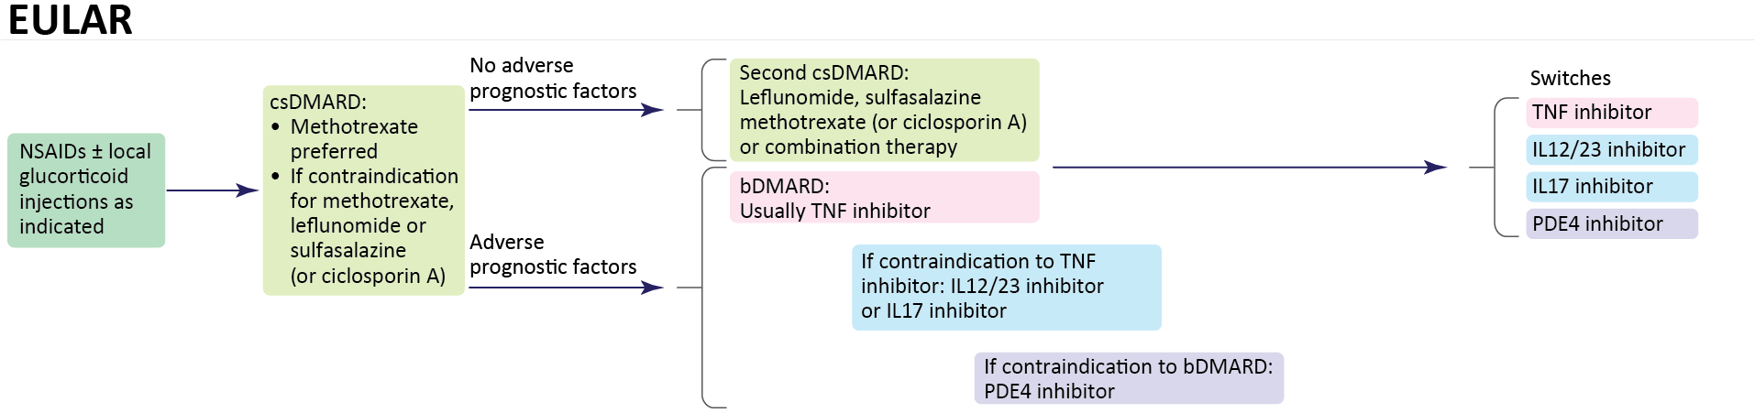
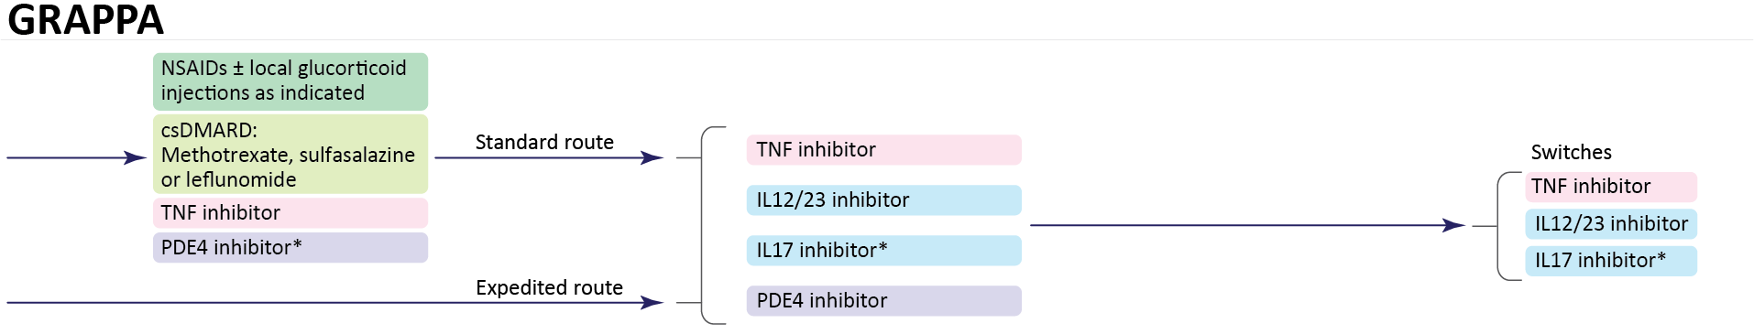
Predominant Peripheral PsA
EULAR 2015 vs GRAPPA 2015 Recommendations
*Conditional recommendation in the guidelines for drugs without current regulatory approval or where recommendations are based on abstract data only.
Gossec L, et al. Nat Rev Rheumatol. 2016;12:743-750.

Slide 11
PsA EULAR Recommendations
Update
Polyarthritis
Rapid use of csDMARD (MTX if psoriasis)
Biologics if 1 csDMARD failure (TNFi, IL17,
IL12/23)
Prefer IL17, IL12/23 if severe psoriasis
Oligoarthritis
Consider DMARD if poor prognostic factors (erosions, ⬆ CRP, steroid, nails)
Biologics if 1 csDMARD failure (TNFi, IL17,
IL12/23)
Enthesitis
No evidence for csDMARDs
First-line biologics
Axial
No evidence for csDMARDs
First-line biologics
(TNFi or IL17)
IL17 if severe psoriasis
Switch to alternative biologic (TNFi, IL17, IL12/23, abatacept) or JAKi
Apremilast for mild arthritis/skin where other options are not appropriate
Consider cautious tapering for patients with sustained remission
Gossec L, et al. EULAR 2019, Madrid.

Slide 12
Treatment-Naïve Active PsA
ACR/NPF Treatment Recommendations
Begin with TNFi over OSMs, IL17, or IL12/23
Continued active disease?
Switch to different TNFi*
Continued active disease?
Switch to IL17i*
Continued active disease?
Switch to IL12/23i*
Methotrexate or other OSMs can be employed if indicated by cost or other reasons, depending on local situation as monotherapy or in combination with biologics or tsDMARDs to bolster effect or combat immunogenicity
*Biologic therapy is recommended over biologic-with-MTX combination therapy
Singh A, et al. Arth Rheum. 2019;71;5-32.

Slide 13
Active PsA Post-OSM
ACR/NPF Treatment Recommendations
Begin with TNFi over OSMs, IL17, or IL12/23
Continued active disease?
Switch to different TNFi*
Continued active disease?
Switch to IL17i*
Continued active disease?
Switch to IL12/23i*
Tofacitinib may be considered if the patient prefers an oral therapy
*Biologic therapy is recommended over biologic-with-MTX combination therapy
Singh A, et al. Arth Rheum. 2019;71;5-32.

Slide 14
PsA With Predominant Enthesitis
ACR/NPF Treatment Recommendations
Start oral NSAIDs, TNFi biologic, or tofacitinib
over an OSM (specifically apremilast)
Continued active disease?
Switch to TNFi over IL17i, IL12/23i or another OSM
Continued active disease?
Switch to IL17i over IL12/23i or another OSM
Continued active disease?
Switch to IL12/23i over another OSM
*Biologic therapy is recommended over biologic-with-MTX combination therapy
Singh A, et al. Arth Rheum. 2019;71;5-32.

Slide 15
PsA
Risks of Therapy
Serious infections
TB/opportunistic infections
Neoplasia/lymphoma
Autoimmune disease
  Lupus
  MS
CHF-exacerbation
Liver toxicity
Hematologic toxicity
IBD
Shah K, et al. RMD Open. 2017;3:e000588; Kaine J, et al. J Manag Care Spec Pharm. 2019;25:122-132.

Slide 16
PsA
Treatment Strategies
Treat-to-target
  What target?
    MDA/VLDA
    DAPSA remission/LDA
    PASDAS remission/LDA
    CPDAI remission/LDA
    Etc
  TICOPA
Controlled taper
Controlled withdrawal

Slide 17
Minimal Disease Activity (MDA)
GRAPPA Criteria
A patient is classified as having MDA when they meet 5 out of 7 of the following criteria:
  Tender joint count ≤1
  Swollen joint count ≤1
  PASI ≤1 or BSA ≤3
  Patient pain VAS ≤15
  Patient global activity VAS ≤20
  HAQ ≤0.5
  Tender entheseal points ≤1
Coates LC, et al. Ann Rheum Dis. 2010;69;48-53.

Slide 18
TICOPA: Tight Control/T2T in PsA
Study Design
Radiograph hands/feet
Radiograph hands/feet
Safety visit
Wk
-4
0
4
8
12
16
20
24
28
32
36
40
44
48
52
TC (n=101)
Assessments
Q12 wks
in both groups; additional review
Q4 wks in tight control only
DMARD naive early PsA (n=206)
MDA
MDA
MDA
MDA
MDA
MDA
MDA
MDA
R: 1:1
StdC
(n=105)
Blinded assessment of clinical and PROs
T2T: Treatment escalation if MDA not reached
TC: Start on MTX
(n=101)
↑ MTX to 25 mg at
Wk 6 if tolerated
↑ To combination DMARDs
if MDA not reached
↑ To anti-TNF if ≥3 tender/swollen
joints or alternative DMARD + MTX
if no MDA but with <3 active joints
StdC (n=105)
Treatment at rheumatologist’s
discretion; no set protocol
0
6
12
24
48
Coates LC, et al. BMC Musculoskelet Disord. 2013 Mar 21;14:101.

Slide 19
TICOPA: Tight Control/T2T in PsA
ACR Responses
Tight control was associated with significantly greater improvements in signs and symptoms of disease at week 48.
Primary outcome: complete case analysis
Tight control
Standard care
ITT with multiple imputations
Outcome measure | OR | Lower 95% CI | Upper 95% CI | P
ACR20 | 1.91 | 1.03 | 3.55 | 0.0392
ACR50 | 2.36 | 1.25 | 4.47 | 0.0081
ACR70 | 2.64 | 1.32 | 5.26 | 0.0058
Coates LC, et al. BMC Musculoskelet Disord. 2013 Mar 21;14:101.

Slide 20
TICOPA
PASI Responses
Tight control
Reduction in psoriasis severity was achieved in a higher proportion of patients in the tight control arm.
Standard care
Outcome measure | OR | Lower 95% CI | Upper 95% CI | P
PASI75 | 2.92 | 1.51 | 5.65 | 0.0015
Coates LC, et al. BMC Musculoskelet Disord. 2013 Mar 21;14:101.

Slide 21
TICOPA
AEs and SAEs Incidence: Up to Week 48
 | Tight control | Standard care
Any AE, # | 622 | 249
AE related to study drug (%) | 423 (68.0) | 179 (71.8)
Common AEs
Nausea | 54 | 38
LFT abnormality | 37 | 39
URTI – common cold | 46 | 14
GI upset | 35 | 13
Fatigue | 33 | 8
Deaths | 0 | 0
SAE | 25 (14 pts) | 8 (6 pts)
Drug-related SAE | 8 | 2
Coates LC, et al. BMC Musculoskelet Disord. 2013 Mar 21;14:101.

Slide 22
PsA ⎼ Silver Line
Summary
Complex, polygenic, autoimmune disease
PsA core domain set (OMERACT-GRAPPA 2016)
Risks of PsA
PsA manifestations and comorbidities (extra-articular and extra-cutaneous)
Delayed diagnosis associated with worse long-term outcomes
Outcomes measures
Goals of therapy (GRAPPA/EULAR recommendations and overarching principles)
Non-pharmacologic strategies
GRAPPA, EULAR, ACR/NPF treatment recommendations 2015 (overall, and in view
of comorbidities)
Risks of therapy
Treatment strategies (treat-to-target, targets: MDA, etc, TICOPA)

Slide 23
Case: 45-Year-Old Female
8 yr Hx PsO + 6 mo Hx Musculoskeletal Symptoms
Referred by PCP
MSK manifestations
  Oligoarticular arthritis: knee, 3 metatarsophalangeal joints tender and swollen
  Enthesitis: at insertion sites of Achilles tendon, plantar fascia, and inferior patella, all on left side
  Dactylitis: left 4th toe
  Complains of low back pain
  Skin: scalp, left elbow, and leg PsO (2% BSA)
  CRP: 3.2 mg/dl
  PROs: Pain 40/100, Pt Global 40/100, HAQ 1.0

Slide 24
PsA Clinical Trials
Outcome Measures
Domains | Instruments
Joint assessment | 68/66 T/S joint count, ACR, DAS, PsARC, PsAJAI, DAPSA, cDAPSA
Axial assessment | BASDAI, BASFI, BASMI
Skin assessment | PASI, target lesion, global, PSI, PSD
Composite (holistic) | MDA, VLDA, PASDAS, CPDAI, AMDF
Pain | VAS, NRS
Patient global | VAS (joint global, skin + joints global)
Physician global | VAS (joint global, skin + joints global)
Function | HAQ, HAQ-S, PSAID
HRQoL | SF-36, PsAQoL, DLQI, PSAID
Fatigue | FACIT, Krupp, MFI, VAS
Enthesitis assessment | Leeds, SPARCC, MASES, 4-point
Dactylitis assessment | Leeds, present/absent, acute/chronic
Acute phase reactant | ESR, CRP
Imaging | X-ray (modified Sharp or van der Heijde–Sharp), MRI, US
Work/home productivity | WPAI, WPS
Mease P. Arthritis Care Res. 2011;63 Suppl 11:S64-85;
Mease P, et al. Ann Rheum Dis. 2005;64:ii49-ii54;
Mease P, van der Heijde D. Int J Adv Rheum. 2006;4:38-48.

Slide 25
Dactylitis
LDI
Assessed for a total score (0-3)
  Circumference
    Affected fingers
    Contralateral fingers
  Tenderness
    Affected fingers
Mease P. Arthritis Care Res. 2011;63 Suppl 11:S64-85.

Slide 26
PsA
Body Surface Area
Body surface area (BSA) commonly used
1% BSA = 1 handprint
PATIENT’s hand!
Includes thumb
Mease P. Arthritis Care Res. 2011;63 Suppl 11:S64-85.

Slide 27
Case: 45-Year-Old Female
Initially treated with MTX to 20 mg/wk
Symptoms lessened in most domains
  Oligoarticular arthritis: now 2 swollen and tender joints
  Enthesitis: 2 sites
  Dactylitis: persistent
  Complains of low back pain
  Skin: 2% BSA
  PROs: Pain 30/100, Pt Global 25/100, HAQ 0.8

Slide 28
Case: 45-Year-Old Female
What Further Workup Would You Do Now?
Has she achieved a state of MDA?
CRP: 2.1 mg/dl
Ultrasound to rule out “smoldering” synovitis or enthesitis
Further workup of spine – how to approach?

Slide 29
MDA Criteria
GRAPPA
A patient is classified as in MDA when they meet 5 of 7 of the following criteria:
  Tender joint count ≤1 No
  Swollen joint count ≤1 No
  PASI ≤1 or BSA ≤3 Yes
  Patient pain VAS ≤15 No
  Patient global activity VAS ≤20 No
  HAQ ≤0.5 No
  Tender entheseal points ≤1 No
Coates L, et al. Ann Rheum Dis. 2010;69:48-53.

Slide 30
PsA
Treatment Strategies
Treat-to-target
  What target?
    MDA/VLDA
    DAPSA remission/LDA
    PASDAS remission/LDA
    CPDAI remission/LDA
    Etc
  TICOPA
Controlled taper
Controlled withdrawal

Slide 31
TICOPA: Tight Control/T2T in PsA
ACR Responses
Tight control was associated with significantly greater improvements in signs and symptoms of disease at week 48.
Primary outcome: complete case analysis
Tight control
Standard care
ITT with multiple imputations
Outcome measure | OR | Lower 95% CI | Upper 95% CI | P
ACR20 | 1.91 | 1.03 | 3.55 | 0.0392
ACR50 | 2.36 | 1.25 | 4.47 | 0.0081
ACR70 | 2.64 | 1.32 | 5.26 | 0.0058
Coates LC, et al. BMC Musculoskelet Disord. 2013 Mar 21;14:101.

Slide 32
TICOPA
PASI Responses
Reduction in psoriasis severity was achieved in a higher proportion of patients in the tight control arm.
Outcome measure | OR | Lower 95% CI | Upper 95% CI | P
PASI75 | 2.92 | 1.51 | 5.65 | 0.0015
Coates LC, et al. BMC Musculoskelet Disord. 2013 Mar 21;14:101.

Slide 33
TICOPA
AEs and SAEs Incidence: Up to Week 48
 | Tight control | Standard care
Any AE, # | 622 | 249
AE related to study drug (%) | 423 (68.0) | 179 (71.8)
Common AEs
Nausea | 54 | 38
LFT abnormality | 37 | 39
URTI – common cold | 46 | 14
GI upset | 35 | 13
Fatigue | 33 | 8
Deaths | 0 | 0
SAE | 25 (14 pts) | 8 (6 pts)
Drug-related SAE | 8 | 2
Coates LC, et al. BMC Musculoskelet Disord. 2013 Mar 21;14:101.

Slide 34
Case: 45-Year-Old Female
Encouraged to Strive for a Target of MDA
Biologic or tsDMARD are possible options (a TNFi or IL-17i could be chosen here)
Six-month evaluation demonstrated improvements in clinical domains
  Left knee tender at joint line (1 T, 0 S)
  Left distal patella tender (1/6 Leeds enthesitis index)
  Psoriasis BSA 1% - elbow, knees
  HAQ 0.6
  Patient global – 10, patient pain – 10
  Back pain considered to be due to degenerative spine disease and not PsA spondylitis

Slide 35
MDA Criteria
GRAPPA
A patient is classified as in MDA when they meet 5 of 7 of the following criteria:
  Tender joint count ≤1 Yes
  Swollen joint count ≤1 Yes
  PASI ≤1 or BSA ≤3 Yes
  Patient pain VAS ≤15 Yes
  Patient global activity VAS ≤20 Yes
  HAQ ≤0.5 No
  Tender entheseal points ≤1 Yes
Coates L, et al. Ann Rheum Dis. 2010;69:48-53.

Slide 36
PsA
Pharmacologic Therapeutic Classes
Conventional synthetic DMARDs (cs-DMARDs)
  Methotrexate, sulfasalazine, leflunomide
TNF inhibitors (TNFi)
  Etanercept, infliximab, adalimumab, golimumab, certolizumab
IL12/23i
  Ustekinumab
IL17i
  Secukinumab, ixekizumab, brodalumab, bimekizumab
IL23i
  Guselkumab, risankizumab, tildrakizumab
T cell modulator
  Abatacept
Targeted synthetic DMARDs (ts-DMARDs)
  PDE4i (apremilast)
  JAKi (tofactinib, baricitinib, upanacitinib, filgotinib)
Mease PJ. Rheum Dis Clin North Am. 2015;41;723-738.

Slide 37
PsA
MIPA Trial
Double-blind, parallel-group randomized controlled trial (N = 221)
Patients randomized to receive MTX (target dose 15 mg/week) or PBO
There was no difference between groups in CRP/ESR, SJC, or TJC at 3 months or 6 months
There were significant differences in improvement in patient and physician global assessment and PASI scores (P = 0.02, 0.01, and 0.02, respectively)
There was no evidence MTX improves inflammatory synovitis in active PsA, and that it has true DMARD activity
Global Index | OR (95% CI) | P
PsARC (primary endpoint) | 1.77 (0.97, 3.23) | 0.06
ACR 20 responders | 2.00 (0.65, 6.22) | 0.23
DAS28 responders | 1.70 (0.90, 3.17) | 0.10
Kingsley GH, et al. Rheumatology. 2012;51:1368-1377.

Slide 38
Methotrexate Efficacy in Early PsA
TICOPA Trial Subanalysis
Study of T2T/tight control treatment paradigm in early PsA
  Tight control arm: MTX monotherapy for 12 weeks, then therapy adjusted to reach MDA through 48 weeks
  Standard care arm: predominantly MTX throughout study
  188 pts took oral MTX 12 weeks
  MTX dose: 175 ≥15 mg; 122 ≥20 mg; 86 to 25 mg
At 12 weeks:
    ACR 20 41% at 12 wks
    Minimal disease activity (MDA) achieved by 22%
    Dactylitis improvement 62%
    Enthesitis improvement 25%
    Minimal benefit in nails
Coates LC, et al. EULAR 2015, Rome, #SAT0556.
Notes:
METHOTREXATE EFFICACY IN EARLY PSORIATIC ARTHRITIS - OPEN LABEL DATA FROM THE TICOPA STUDY
L. C. Coates^{1,*}, P. S. Helliwell¹
¹Leeds Institute of Rheumatic and Musculoskeletal Medicine, UNIVERSITY OF LEEDS, Leeds, United Kingdom
Background: Methotrexate (MTX) is a common first line DMARD in psoriatic arthritis (PsA) but until recently no RCTs evaluating its efficacy in PsA were available. The MIPA trial found no significant difference in arthritis outcomes at 6 months but was criticised as the target dose was only 15mg.
Objectives: The aim of this analysis was to investigate clinical outcomes in patients with early PsA treated with MTX in the TICOPA study.
Methods: Within the Tight Control of Psoriatic Arthritis, patients (in either arm) could be treated with methotrexate. All patients in the tight control arm received MTX as first line monotherapy for the first 12 weeks while patients in the standard care arm the majority of the patients in the standard care arm also received MTX. Clinical outcomes were recorded at the 12 week visit including joint counts, PASI, NAPSI, enthesitis and dactylitis measures.
Results: Of the 206 patients enrolled in TICOPA, 188 received oral methotrexate in the first 12 weeks of the trial. Of these, 175 patients reached a dose of at least 15mg by 12 weeks, with 122 reaching a dose of at least 20mg and 86 reaching the top dose of 25mg.
The proportions of patients achieving the ACR outcomes at 12 weeks were ACR20 40.8%, ACR50 18.8% and ACR70 8.6% with 22.4% achieving minimal disease activity (MDA). Improvements were also seen in PASI scores with 27.2% reaching a PASI75. For those with enthesitis at baseline (n=148) the median change in enthesitis score was 0 (IQ range -1, 0 for LEI and IMPACT, -2, 1 for MASES). For those with baseline dactylitis (n=59), there was a median change in LDI scores of -59.7 (-157.4, -26.4). 117 patients had nail involvement and these patients showed a median change in mNAPSI score of -2 (IQ range -8, 0) with changes more commonly in the nail bed due to the short follow up time.
Slightly higher proportions of patients receiving 180mg MTX or more over the 12 week period (equivalent to an average of 15mg per week) achieved ACR20, 50 and PASI 75 but the numbers were small so this did not reach significance.
Conclusions: Despite this data being open-label, it does show improvements in multiple clinical outcomes associated with MTX use in PsA. The proportion reaching ACR20 is slightly higher than that in MIPA (41 vs 34%) but no comparative data are available for the other outcomes. There is a suggestion of better responses with doses above 15mg per week but the dose-response is harder to assess in such a study where confounding exists as patients doing well may be left on lower doses.

Slide 39
PsA
TNFα Inhibitors*
Chimeric mAb
Human recombinant receptor/Fc fusion protein
Humanized Fab’ fragment
Human recombinant Abs
Receptor
VL
VH
CL
CDR
CH1
Mouse
Human
Constant 2
Fc
Constant 3
Infliximab
IgG1
Adalimumab
IgG1
Golimumab
IgG1
Etanercept
IgG1
PEG
PEG
Certolizumab
*Structural differences do not indicate differences in efficacy or safety. No head-to-head trials of these agents have been conducted.
Mease PJ. Rheum Dis Clin North Am. 2015;41;723-738.

Slide 40
TNFi Therapies in PsA
Other Outcomes at Primary Time Point
Psoriasis
  ~60% PASI 75 response with monoclonal constructs; lesser with soluble receptor
Enthesitis
  ~60%–75% improvement
  Assessment methods: 4-point, MASES, Leeds, SPARCC
Dactylitis
  ~60% improvement
  Assessment methods: Count, score, Leeds dactylometer
Function
  Significant improvement achieved as assessed by HAQ
QoL
  Significant improvements in SF-36, PsAQoL, DLQI, EQ-5D
Fatigue
  Significant improvement observed
Structural damage progression
  Inhibited per Sharp-van der Heijde method
Mease P. Ann Rheum Dis. 2011;70:77-84; Mease P. Arth Care & Research. 2011:63;64-85.

Slide 41
SEAM-PsA
ETN and MTX as Monotherapy or in Combination
Primary results from a double-blind phase 3 RCT
Methods
851 biologic-naïve patients randomized to:
  ETN 50 mg + MTX 20 mg weekly (Combo; n=283)
  ETN 50 mg + MTX 20 mg weekly (Combo; n=283)
  ETN 50 mg + oral PBO weekly (ETN-Mono; n=284)
  MTX 20 mg + injectable PBO weekly (MTX-Mono; n=284)
  48 weeks follow-up
Results
  Median PsA duration 0.6 y
  Wks 4-24, MTX arm maintained mean dose >18.8 mg (median 20 mg)
  More reports of nausea in MTX arms; no other safety differences
MDA
MTX monotherapy
ETN monotherapy
ETN + MTX
Responders (%)
†
‡
†
‡
*
†
‡
†
*
*
4
8
MTX effective in all endpoints.
Greater efficacy with ETN vs MTX monotherapy in ACR responses, PsA-specific composite measures, and radiographic endpoints
No benefit from concomitant MTX
*P <0.05; †P <0.01; ‡ P≤0.001; unadjusted. Observed data
Mease P, et al. Arthritis Rheumatol. 2019. 71:1112-1124.
Notes:
Background/Purpose: Methotrexate (MTX) and tumor necrosis factor inhibitors (TNFi) such as etanercept (ETN) are often prescribed for psoriatic arthritis (PsA) either alone or in combination, but fundamental gaps in knowledge about their optimal use remain. This study examined the efficacy of MTX monotherapy relative to ETN monotherapy and the value of adding MTX to ETN in key clinical domains of PsA, including progressive joint damage.
Methods: This phase 3, randomized controlled, double-blind international study enrolled patients with active PsA based on Classification Criteria for Psoriatic Arthritis (CASPAR). They were naïve to biologic drugs with no prior MTX for PsA. A total of 851 patients were randomized to 3 groups for 48 weeks: ETN 50 mg plus MTX 20 mg weekly (Combo; N = 283); ETN 50 mg plus oral placebo weekly (ETN-mono; N = 284); or MTX 20 mg plus injectable placebo weekly (MTX-mono; N = 284). The primary endpoint was the American College of Rheumatology (ACR)20 response at week 24. The key secondary endpoint was Minimal Disease Activity (MDA) response at week 24. The study was powered to detect a treatment difference in ACR20 and MDA at week 24 between the Combo and the MTX-mono arms and between the ETN-mono and MTX-mono arms, test ed in a Bonferroni-based gatekeeping chain procedure. Additional endpoints included other measures of inflammatory arthritis, radiographic progression, severity of non-articular disease manifestations, and patient-reported outcomes.
Results: Baseline characteristics were well balanced in the 3 study arms. Mean (SD) age was 48.4 (13.1) years, most patients were white, and median PsA duration was 0.6 years (mean [SD] 3.2 [6.3] years). From weeks 4 to 24, the MTX-containing arms maintained a mean MTX dose >18.8 mg. ACR20 and MDA response rates at week 24 were significantly greater for ETN-mono vs MTX-mono (ACR20: 60.9% vs 50.7% [P=0.029]; MDA: 35.9% vs 22.9% [P=0.005]) and for Combo vs MTX-mono (ACR20: 65.0% vs 50.7% [P=0.005]; MDA: 35.7% vs 22.9% [P= 0.005]). At week 48, the Combo and ETN-mono arms showed less radiographic progression compared with the MTX-mono arm (Table). Other secondary outcomes are shown in the Table. Overall, the Combo and ETN-mono arms had similar results, with some differences in skin outcomes. Aside from GI events, adverse event rates were similar in the 3 study arms. No new safety signals were seen.
Conclusion: This is the first head-to-head comparison of MTX and a TNFi to address fundamental questions in the treatment of PsA. ETN monotherapy or ETN in combination with MTX showed greater efficacy compared with MTX monotherapy. Addition of MTX to ETN did not appear to improve efficacy compared with ETN alone. These results support the use of ETN as monotherapy for PsA.

Slide 42
SEAM-PsA
Primary Results: ACR
ACR20
*
†
‡
†
‡
†
‡
*
*
Responders (%)
‡
†
‡
1° endpoint
4
8
16
Weeks
ACR50
ACR70
†
*
Responders (%)
‡
†
†
†
*
Responders (%)
‡
†
‡
‡
†
‡
‡
‡
‡
†
‡
‡
‡
‡
‡
†
‡
‡
‡
4
8
16
4
8
16
Weeks
Weeks
*P <0.05; †P <0.01; ‡P ≤0.001; unadjusted. Observed data
Mease P, et al. Arthritis Rheumatol. 2019. 71:1112-1124.
Notes:
Background/Purpose: Methotrexate (MTX) and tumor necrosis factor inhibitors (TNFi) such as etanercept (ETN) are often prescribed for psoriatic arthritis (PsA) either alone or in combination, but fundamental gaps in knowledge about their optimal use remain. This study examined the efficacy of MTX monotherapy relative to ETN monotherapy and the value of adding MTX to ETN in key clinical domains of PsA, including progressive joint damage.
Methods: This phase 3, randomized controlled, double-blind international study enrolled patients with active PsA based on Classification Criteria for Psoriatic Arthritis (CASPAR). They were naïve to biologic drugs with no prior MTX for PsA. A total of 851 patients were randomized to 3 groups for 48 weeks: ETN 50 mg plus MTX 20 mg weekly (Combo; N = 283); ETN 50 mg plus oral placebo weekly (ETN-mono; N = 284); or MTX 20 mg plus injectable placebo weekly (MTX-mono; N = 284). The primary endpoint was the American College of Rheumatology (ACR)20 response at week 24. The key secondary endpoint was Minimal Disease Activity (MDA) response at week 24. The study was powered to detect a treatment difference in ACR20 and MDA at week 24 between the Combo and the MTX-mono arms and between the ETN-mono and MTX-mono arms, test ed in a Bonferroni-based gatekeeping chain procedure. Additional endpoints included other measures of inflammatory arthritis, radiographic progression, severity of non-articular disease manifestations, and patient-reported outcomes.
Results: Baseline characteristics were well balanced in the 3 study arms. Mean (SD) age was 48.4 (13.1) years, most patients were white, and median PsA duration was 0.6 years (mean [SD] 3.2 [6.3] years). From weeks 4 to 24, the MTX-containing arms maintained a mean MTX dose >18.8 mg. ACR20 and MDA response rates at week 24 were significantly greater for ETN-mono vs MTX-mono (ACR20: 60.9% vs 50.7% [P=0.029]; MDA: 35.9% vs 22.9% [P=0.005]) and for Combo vs MTX-mono (ACR20: 65.0% vs 50.7% [P=0.005]; MDA: 35.7% vs 22.9% [P= 0.005]). At week 48, the Combo and ETN-mono arms showed less radiographic progression compared with the MTX-mono arm (Table). Other secondary outcomes are shown in the Table. Overall, the Combo and ETN-mono arms had similar results, with some differences in skin outcomes. Aside from GI events, adverse event rates were similar in the 3 study arms. No new safety signals were seen.
Conclusion: This is the first head-to-head comparison of MTX and a TNFi to address fundamental questions in the treatment of PsA. ETN monotherapy or ETN in combination with MTX showed greater efficacy compared with MTX monotherapy. Addition of MTX to ETN did not appear to improve efficacy compared with ETN alone. These results support the use of ETN as monotherapy for PsA.

Slide 43
SEAM-PsA
Primary Results: Skin
MTX-Mono ETN-Mono ETN + MTX Combo
sPGA status “Clear” or
“Almost clear” (0/1)ª
BSA improvementª
*
Patients (%)
Patients (%)
Week 24
Week 48
Mease P, et al. Arthritis Rheumatol. 2019. 71:1112-1124.
Notes:
Background/Purpose: Methotrexate (MTX) and tumor necrosis factor inhibitors (TNFi) such as etanercept (ETN) are often prescribed for psoriatic arthritis (PsA) either alone or in combination, but fundamental gaps in knowledge about their optimal use remain. This study examined the efficacy of MTX monotherapy relative to ETN monotherapy and the value of adding MTX to ETN in key clinical domains of PsA, including progressive joint damage.
Methods: This phase 3, randomized controlled, double-blind international study enrolled patients with active PsA based on Classification Criteria for Psoriatic Arthritis (CASPAR). They were naïve to biologic drugs with no prior MTX for PsA. A total of 851 patients were randomized to 3 groups for 48 weeks: ETN 50 mg plus MTX 20 mg weekly (Combo; N = 283); ETN 50 mg plus oral placebo weekly (ETN-mono; N = 284); or MTX 20 mg plus injectable placebo weekly (MTX-mono; N = 284). The primary endpoint was the American College of Rheumatology (ACR)20 response at week 24. The key secondary endpoint was Minimal Disease Activity (MDA) response at week 24. The study was powered to detect a treatment difference in ACR20 and MDA at week 24 between the Combo and the MTX-mono arms and between the ETN-mono and MTX-mono arms, test ed in a Bonferroni-based gatekeeping chain procedure. Additional endpoints included other measures of inflammatory arthritis, radiographic progression, severity of non-articular disease manifestations, and patient-reported outcomes.
Results: Baseline characteristics were well balanced in the 3 study arms. Mean (SD) age was 48.4 (13.1) years, most patients were white, and median PsA duration was 0.6 years (mean [SD] 3.2 [6.3] years). From weeks 4 to 24, the MTX-containing arms maintained a mean MTX dose >18.8 mg. ACR20 and MDA response rates at week 24 were significantly greater for ETN-mono vs MTX-mono (ACR20: 60.9% vs 50.7% [P=0.029]; MDA: 35.9% vs 22.9% [P=0.005]) and for Combo vs MTX-mono (ACR20: 65.0% vs 50.7% [P=0.005]; MDA: 35.7% vs 22.9% [P= 0.005]). At week 48, the Combo and ETN-mono arms showed less radiographic progression compared with the MTX-mono arm (Table). Other secondary outcomes are shown in the Table. Overall, the Combo and ETN-mono arms had similar results, with some differences in skin outcomes. Aside from GI events, adverse event rates were similar in the 3 study arms. No new safety signals were seen.
Conclusion: This is the first head-to-head comparison of MTX and a TNFi to address fundamental questions in the treatment of PsA. ETN monotherapy or ETN in combination with MTX showed greater efficacy compared with MTX monotherapy. Addition of MTX to ETN did not appear to improve efficacy compared with ETN alone. These results support the use of ETN as monotherapy for PsA.

Slide 44
SEAM-PsA
Primary Results: Radiographic
MTX-Mono ETN-Mono ETN + MTX Combo
mTSS
mTSS
non-progression^{b}
MTX-Mono
ETN-Mono
ETN + MTX Combo
Change from
BL in mTSS
Mean change
from BL
Patients (%)
Cumulative probability
Mease P, et al. Arthritis Rheumatol. 2019. 71:1112-1124.
Notes:
Background/Purpose: Methotrexate (MTX) and tumor necrosis factor inhibitors (TNFi) such as etanercept (ETN) are often prescribed for psoriatic arthritis (PsA) either alone or in combination, but fundamental gaps in knowledge about their optimal use remain. This study examined the efficacy of MTX monotherapy relative to ETN monotherapy and the value of adding MTX to ETN in key clinical domains of PsA, including progressive joint damage.
Methods: This phase 3, randomized controlled, double-blind international study enrolled patients with active PsA based on Classification Criteria for Psoriatic Arthritis (CASPAR). They were naïve to biologic drugs with no prior MTX for PsA. A total of 851 patients were randomized to 3 groups for 48 weeks: ETN 50 mg plus MTX 20 mg weekly (Combo; N = 283); ETN 50 mg plus oral placebo weekly (ETN-mono; N = 284); or MTX 20 mg plus injectable placebo weekly (MTX-mono; N = 284). The primary endpoint was the American College of Rheumatology (ACR)20 response at week 24. The key secondary endpoint was Minimal Disease Activity (MDA) response at week 24. The study was powered to detect a treatment difference in ACR20 and MDA at week 24 between the Combo and the MTX-mono arms and between the ETN-mono and MTX-mono arms, test ed in a Bonferroni-based gatekeeping chain procedure. Additional endpoints included other measures of inflammatory arthritis, radiographic progression, severity of non-articular disease manifestations, and patient-reported outcomes.
Results: Baseline characteristics were well balanced in the 3 study arms. Mean (SD) age was 48.4 (13.1) years, most patients were white, and median PsA duration was 0.6 years (mean [SD] 3.2 [6.3] years). From weeks 4 to 24, the MTX-containing arms maintained a mean MTX dose >18.8 mg. ACR20 and MDA response rates at week 24 were significantly greater for ETN-mono vs MTX-mono (ACR20: 60.9% vs 50.7% [P=0.029]; MDA: 35.9% vs 22.9% [P=0.005]) and for Combo vs MTX-mono (ACR20: 65.0% vs 50.7% [P=0.005]; MDA: 35.7% vs 22.9% [P= 0.005]). At week 48, the Combo and ETN-mono arms showed less radiographic progression compared with the MTX-mono arm (Table). Other secondary outcomes are shown in the Table. Overall, the Combo and ETN-mono arms had similar results, with some differences in skin outcomes. Aside from GI events, adverse event rates were similar in the 3 study arms. No new safety signals were seen.
Conclusion: This is the first head-to-head comparison of MTX and a TNFi to address fundamental questions in the treatment of PsA. ETN monotherapy or ETN in combination with MTX showed greater efficacy compared with MTX monotherapy. Addition of MTX to ETN did not appear to improve efficacy compared with ETN alone. These results support the use of ETN as monotherapy for PsA.

Slide 45
Ustekinumab
PSUMMIT 1 Trial
Treatment response at Week 24
ACR20
ACR50
ACR70
60
60
60
*
49.5
*
42.4
40
40
40
Patients (%)
*
24.9
*
27.9
22.8
20
20
20
*
12.2
*
14.2
8.7
2.4
0
0
0
*P <0.001
Placebo (n=206)
Ustekinumab 45 mg (n=205)
Ustekinumab 90 mg (n=204)
McInnes IB, et al. Lancet. 2013;382:780-789.

Slide 46
Ustekinumab
PSUMMIT 1 and PSUMMIT 2 Trials
PSUMMIT 1
PSUMMIT 2
Week 24¹
Week 52¹
Week 24²
(n=137)
(n=140)
(n=148)
(n=122)
(n=133)
(n=142)
0
(n=73)
(n=72)
(n=76)
0
0
0
0
−20
−40
−33.3
Median change (%)
−42.9
p=0.098
p=0.002
−50.0
−48.3
−60
p<0.001
p=0.008
−80
−74.2
−83.3
−87.5
−100
Placebo
Placebo→ustekinumab 45 mg
Ustekinumab 45 mg
Ustekinumab 90 mg
Enthesitis scoring based on Modified MASES Index.
Includes only randomized patients with enthesitis at baseline.
1. McInnes IB, et al. Lancet. 2013;382:780-789;
2. Ritchlin CT, et al. ACR/AHRP 2012, November 10-14, Washington, DC, USA. Abs 2557.

Slide 47

Secukinumab
FUTURE 5
ACR20 Response (Primary Outcome)
62.6%
59.5%
*
*
*
*
*
63.5%
*
*
*
*
*
53.2%
*
*
*
*
*
53.2%
*
*
*
55.5%
Responders, %
*
*
*
27.4%
‡
‡
§
23.5%
§
1
2
3
4
8
12
16
20
24
Primary
endpoint
Weeks
Secukinumab 300 mg (n = 222)
Secukinumab 150 mg (n = 220)
Secukinumab 150 mg No Load (n = 222)
Placebo (n = 332)
*P < 0.0001; †P < 0.001; §P < 0.01 vs placebo. Statistical analysis was based on logistic regression.
Missing values and placebo patients rescued at week 16 were imputed as nonresponders.
Mease PJ, et al. 2017 ACR Annual Meeting. November 3-8, 2017, San Diego, CA. P17L.

Slide 48
FUTURE 5
ACR50/70 Response
ACR50
ACR70
39.6%
*
*
35.9%
43.7%
Responders, %
*
*
*
Responders, %
*
*
39.1%
*
36.0%
*
*
*
20.3%
*
*
*
*
*
18.2%
25.7%
*
*
*
32.0%
*
*
*
24.1%
*
*
*
*
*
18.5%
†
§
8.1%
§
*
*
*
‡
‡
8.7%
‡
‡
*
*
4.2%
14.9%
‡
3.9%
16
16
Weeks
Weeks
Secukinumab 300 mg (naïve, n = 154; IR, n = 68)
Secukinumab 150 mg (naïve, n = 155; IR, n = 65)
Secukinumab 150 mg No Load (naïve, n = 158; IR, n = 64)
Placebo (naïve, n = 234; IR, n = 98)
*P < 0.0001; †P < 0.001; §P < 0.01 vs placebo. Statistical analysis was based on logistic regression. Missing values and placebo patients rescued at week 16 were imputed as nonresponders.
Mease PJ, et al. 2017 ACR Annual Meeting. November 3-8, 2017, San Diego, CA. P17L.

Slide 49
FUTURE 5
ACR20 Response by Anti-TNFi Exposure
Anti-TNF-naïve
Anti-TNF-IR
67.7%
*
*
*
*
*
*
68.2%
67.5%
*
*
62.0%
*
*
57.4%
*
*
51.5%
*
*
*
*
*
*
*
52.9%
*
*
*
57.4%
*
*
*
*
†
†
50.8%
43.1%
Responders, %
§
Responders, %
§
§
*
†
*
§
‡
†
§
39.1%
31.3%
31.2%
25.6%
‡
§
‡
§
§
§
§
§
18.4%
18.4%
16
16
Weeks
Weeks
Secukinumab 300 mg (naïve, n = 154; IR, n = 68)
Secukinumab 150 mg (naïve, n = 155; IR, n = 65)
Secukinumab 150 mg No Load (naïve, n = 158; IR, n = 64)
Placebo (naïve, n = 234; IR, n = 98)
*P < 0.0001; †P < 0.001; §P < 0.01 vs.placebo. Statistical analysis was based on logistic regression. Missing values and placebo patients rescued at week 16 were imputed as nonresponders.
Mease PJ, et al. 2017 ACR Annual Meeting. November 3-8, 2017, San Diego, CA. P17L.

Slide 50
FUTURE 5
Change From Baseline vdH-mTSS
Overall Population at 24 Weeks
‡
§
Mean change in vdH-mTSS from baseline
n = 217
n = 213
n = 296
n = 210
§
300 mg
+ Load
150 mg
+ Load
150 mg
No Load
Placebo
Secukinumab
§P < 0.01; ‡P < 0.05 vs placebo.
Statistical analysis was based on a nonparametric ANCOVA. Linear extrapolation was applied if a baseline and week 16 value were available.
Mease PJ, et al. 2017 ACR Annual Meeting. November 3-8, 2017, San Diego, CA. P17L.

Slide 51
FUTURE 5
Resolution of Enthesitis and Dactylitis
Resolution of Enthesitis
Resolution of Dactylitis
65.9%
55.7%
57.5%
63.7%
54.6%
61.4%
†
*
*
†
*
†
63.4%
*
*
†
54.6%
§
*
†
§
61.2%
Patients, %
†
Patients, %
*
§
41.9%
‡
†
§
‡
47.3%
56.3%
34.4%
33.9%
35.4%
32.3%
16
16
Weeks
Weeks
Secukinumab 300 mg
Secukinumab 150 mg
Secukinumab 150 mg No Load
Placebo
§P < 0.01; ‡P < 0.05 vs placebo.
Statistical analysis was based on a nonparametric ANCOVA. Linear extrapolation was applied if a baseline and week 16 value were available.
Mease PJ, et al. 2017 ACR Annual Meeting. November 3-8, 2017, San Diego, CA. P17L.

Slide 52
Ixekizumab
SPIRIT-P1 Primary Outcome: ACR20
*P <.05 for IXE Q4W, IXE Q2W, and ADA vs PBO
Mease P, et al. Ann Rheum Dis. 2017;76:79-87.

Slide 53
Ixekizumab
SPIRIT-P1: IXE in TNFi-Naive Active PsA
Radiographs analyzed for patients taking same IXE dose for full 52 weeks
Little radiographic change with either dose
ACR responders, Week 52 (mNRI)
Observed mTSS ∆ from BL, Week 52
20
IXE q4w (n=97; Nx=81)
IXE q2w (n=96; Nx=83)
15
Nx, number of patients with non-missing change from baseline data
10
mTSS change from BL (Week 52)
5
0
20
40
60
80
100
–5
Cumulative percentage
Mease P, et al. ACR 2016, Washington DC, 959; Van der Heijde D, et al. EULAR 2017, Madrid, OP0221;
Mease P, et al. Ann Rheum Dis. 2017;76:79-87.

Slide 54
Ixekizumab in TNFi-IR PsA
SPIRIT-P2
24-week RCT in 363 pts with TNFi intolerance or inadequate response
IXE 80 mg q2w or q4w vs PBO after single 160-mg loading dose
56% failed 1 TNFi, 35% failed 2 TNFi,
9% intolerance
PASI 75 response
62†
†
†
60†
†
57†
†
†
56†
†
†
10
15
*
1
2
*P ≤0.01 vs PBO; †P ≤0.001 vs PBO
Mease P, et al. ACR 2016, Washington DC, 959; Van der Heijde D, et al. EULAR 2017, Madrid, OP0221;
Mease P, et al. Ann Rheum Dis. 2017;76:79-87.

Slide 55
Ixekizumab vs Adalimumab
SPIRIT-H2H: bDMARDs-Naive Patients
Open-label (assessor-blinded), randomized (1:1) to IXE or ADA for 52 wks (on-label dosing based on presence/absence of
moderate-to-severe psoriasis)
566 pts with PsA, BSA ≥3%,
bDMARD-naive
Primary endpoint: % patients simultaneously achieving ACR50 and PASI 100 (NRI)
Primary Endpoint
Response rate (%)
Week
*P <0.05, †P <0.01; ‡P ≤0.001 vs ADA
Mease P, et al. EULAR 2019, Madrid, LB0005; Mease PJ, et al. Ann Rheum Dis. 2019. [Epub ahead of print]

Slide 56
SPIRIT-H2H
Secondary Endpoints
60%‡
72%
69%
ACR20
51%
‡
‡
‡
51%
47%
ACR50
47%
‡
47%
32%
26%
ACR70
Week
Week
Week
ADA (n=283)
IXE (n=283)
*P <0.05, †P <0.01; ‡P ≤0.001 vs ADA
Mease P, et al. EULAR 2019, Madrid, LB0005; Mease PJ, et al. Ann Rheum Dis. 2019. [Epub ahead of print]

Slide 57
SPIRIT-H2H
Health Outcomes: Week 24
*P <0.05; †P <0.01; ‡P ≤0.001 vs ADA
Mease P, et al. EULAR 2019, Madrid, LB0005; Mease PJ, et al. Ann Rheum Dis. 2019. [Epub ahead of print]

Slide 58
SPIRIT-H2H
AEs
AEs of special interest, n (%) | IXE (n=283) | ADA (n=283)
Infections | 102 (36.0) | 87 (30.7)
Serious infections | 4 (1.4) | 8 (2.8)
Candida infections | 7 (2.5) | 2 (0.7)
Injection-site reactions | 27 (9.5) | 9 (3.2)
Discontinuation due to ISR | 1 (0.4) | 3 (1.1)
Allergic/hypersensitivity reactions | 7 (2.5) | 11 (3.9)
Potential anaphylaxis | 0 | 0
AEs of special interest, n (%) | IXE (n=283) | ADA (n=283)
Cytopenias | 5 (1.8) | 11 (3.9)
Cerebrocardiovascular events | 3 (1.1) | 5 (1.8)
Malignancies | 0 | 3 (1.1)
Pulmonary tuberculosis | 0 | 0
Depression | 3 (1.1) | 7 (2.5)
IBD | 2 (0.7) | 0
Ulcerative colitis | 1 (0.4) | 0
Crohn’s disease | 1 (0.4) | 0
*P <0.05, †P <0.01; ‡P ≤0.001 vs ADA
Mease P, et al. EULAR 2019, Madrid, LB0005; Mease PJ, et al. Ann Rheum Dis. 2019. [Epub ahead of print]

Slide 59
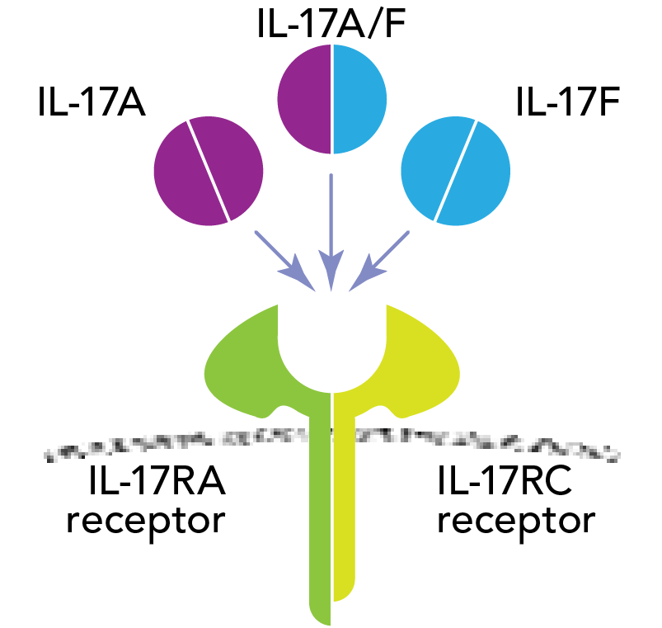
Bimekizumab
Proof-of-Concept Study in PsA
Monoclonal antibody directed against both IL-17A and IL-17F
  In vitro human assay showed additive effects of IL-17A and IL-17F inhibition
4 doses at 0, 3, 6 weeks compared with placebo, primary endpoint
ACR-N at Week 8
  40, 80, 160, 320 mg iv, with double dose at baseline
Glatt S, et al. EULAR 2016, London, #OP0108.

Slide 60
Bimekizumab
Proof-of-Concept Study in PsA: ACR Responses
ACR20, ACR50, and ACR70 through Week 8
PBO (n=12)
Bimekizumab (n=30)*
Week 8: ACR20=80%
100
100
100
*Top 3 doses
80
80
80
60
60
60
ACR (95% CI) response rate (%)
40
40
40
20
20
20
0
0
0
0
1
2
3
4
6
8
0
1
2
3
4
6
8
0
1
2
3
4
6
8
Weeks
Weeks
Weeks
100% PASI 75 at Week 8
No significant safety signals. 3 SAEs in 1 patient related to a fall
Bimekizumab demonstrated high efficacy for skin and joints, and no major safety signals, in this early proof-of-concept study in PsA.
Glatt S, et al. EULAR 2016, London, #OP0108.

Slide 61
Guselkumab
Phase 2 Trial
Human monoclonal Ab against P19 subunit of IL-23
Double-blind randomized placebo-controlled trial: 149 pts active PsA despite SOC, randomized 2:1 to GUS 100 mg sc vs PBO at 0, 4, then q8 wks
  9% received prior TNFi
  44% concomitant MTX
IL-23
IL-12
GUS
p19
p40
UST
p35
p40
UST
IL-23R
IL-12Rβ1
IL-12Rβ2
IL-12Rβ1
JAK2
P
P
TYK2
JAK2
P
P
TYK2
STAT3
STAT4
STAT4
STAT4
Deodhar A, et al. ACR 2016, Washington DC, #4L; Teng MW, et al. Nat Med. 2015;21:719-729.

Slide 62
Guselkumab
Responses at Week 24
‡
‡
Significant improvements in HAQ, MDA, other composite endpoints
No deaths, malignancies, SIEs
‡
*
†
‡
†
*
1° endpoint
Guselkumab effective for all aspects of disease
*P ≤0.05, †P <0.01, ‡P <0.001 vs PBO
Deodhar A, et al. ACR 2016, Washington DC, #4L; Teng MW, et al. Nat Med. 2015;21:719-729.

Slide 63
Risankizumab (Selective IL-23p19 mAb)
Phase 2 Trial
185 patients, stratified by prior TNFi use and concurrent MTX use randomized 2:2:2:1:2 to RZB (4 arms) or PBO
At Week 24, RZB-treated patients achieved:
  Significantly higher MDA responses than PBO
  SPARCC enthesitis score discriminated between RZB and PBO; LEI did not
  No difference in Δ dactylitis count vs PBO
  No new or unexpected safety issues
RZB effective in active PsA, including inhibition of damage; will proceed into phase 3
Mease PJ, et al. EULAR 2018, Amsterdam, OP0307.

Slide 64
Risankizumab (Selective IL-23p19 mAb)
Phase 2 Trial Responses
ΔmTSS at Week 24 (ANCOVA)
ACR20/50/70 responses at Week 24 (NRI)
  †
Responders (%)
  †
*
LS mean change from BL
PASI responses at Week 24 (NRI)
*
  ‡
  ‡
  ‡
  †
  †
  †
  †
  ‡
Responders (%)
*
  †
*
  †
*P <0.05, †P <0.01, ‡P <0.001 vs PBO
Mease PJ, et al. EULAR 2018, Amsterdam, OP0307.

Slide 65

Tildrakizumab (Selective IL-23p19 mAb)
Phase 2b Trial
Double-blind randomized placebo-controlled trial of 391 patients treated with 4 dose regimens TIL vs PBO
Dosed through week 16, followed to week 24
IL-23
IL-12
TIL
p19
p40
p35
p40
IL-23R
IL-12Rβ1
IL-12Rβ2
IL-12Rβ1
JAK2
P
P
TYK2
JAK2
P
P
TYK2
STAT3
STAT4
STAT4
STAT4
Mease P, et al. EULAR 2019, Madrid, LB0002.

Slide 66
100
Tildrakizumab
ACR Responses
ACR50
80
60
52.6
  Primary endpoint: ACR20 at Week 24
†
†
50.6
Response rate (%)
†
*
45.5
100
40
*
79.5
‡
†
39.7
†
†
80
†
77.2
*
†
24.1
‡
‡
20
*
*
73.1
*
*
*
*
‡
*
71.4
60
*
0
Response rate (%)
*
*
*
*
50.6
1
4
8
12
16
20
24
*
Week
40
*
100
20
ACR70
80
0
60
1
4
8
12
16
20
24
Week
Response rate (%)
TIL 200 mg q4w (n=78)
40
29.1
TIL 200 mg q12w (n=79)
‡
*
28.2
TIL 100 mg q12w (n=77)
*
*
22.1
TIL 20 mg q12w (n=78)
20
*
*
*
*
*
*
16.7
PBO q4w (n=79)
*
10.1
Shown for randomised patients who received ≥1 dose of study drug.
*P <0.05; †P <0.001; ‡P <0.0001 vs PBO
0
1
4
8
12
16
20
24
Week
Mease P, et al. EULAR 2019, Madrid, LB0002.

Slide 67
Tildrakizumab
PASI and LEI Score
PASI 75 (NRI)
100
90
80
‡
79.6
70
‡
‡
60
‡
64.2
‡
55.6
Response rate (%)
Change from BL ± SD total LEI score (%)
50
*
*
*
46.3
40
*
*
*
30
20
*
16.7
10
0
1
4
12
16
24
Week
*
TIL 200 mg q4w
*P <0.05 vs PBO; values at x = 0 represent baseline
TIL 200 mg q12w
TIL 100 mg q12w
TIL 20 mg q12w
PBO q4w
Shown for randomised patients who received ≥1 dose of study drug.
*P <0.05; †P <0.001; ‡P <0.0001 vs PBO
Mease P, et al. EULAR 2019, Madrid, LB0002.

Slide 68
Abatacept
Phase 3 Trial: ACR Responses
213 ABA 125 mg sc weekly vs 211 PBO (PBO 24 weeks → open-label ABA)
~60% had prior TNFi exposure
TNFi-naïve ACR responders at Week 24
TNFi-exposed ACR responders at Week 24
‡
§
Responders (%)
Responders (%)
*P <0.001 vs PBO; †95% CI of estimate of difference in ACR50 response for ABA vs PBO did not cross 0 Nominal P-value 0.003‡, 0.012§ vs PBO.
Nominal P-values were not calculated for ACR50/70.
Mease P, et al. Ann Rheum Dis. 2017;76: 1550-1558.

Slide 69
Abatacept
Phase 3 Trial: ACR Responses (cont.)
ACR Responses to Week 44
Early escape
to open-label
ACR20
Wk 24
39%*
22%
19%†
12%
10%
7%
ACR50
Responders (%)
ACR70
24
Double-blind
Open-label
Week
*P <0.001 vs PBO; †95% CI of estimate of difference in ACR50 response for ABA vs PBO did not cross 0 Nominal P-value 0.003‡, 0.012§ vs PBO.
Nominal P-values were not calculated for ACR50/70.
Mease P, et al. Ann Rheum Dis. 2017;76: 1550-1558.

Slide 70
Abatacept
Phase 3 Trial: Additional Outcomes
HAQ-DI respondersª
Complete resolution of enthesitis and dactylitis at Weeks 24 and 52^{b}
PASI 75 responders at Wk 24
P=0.097
Responders (%)
Patients (%)
Responders (%)
n= 55
51
91
97
Week 24
Week 52
No unexpected safety findings relative to RA experience
ªHAQ-DI response was defined as a score reduction of ≥0.35 from BL²
^{b}In patients with enthesitis/dactylitis at baseline
Mease P, et al. Ann Rheum Dis. 2017;76: 1550-1558; Mease P, et al. J Rheum. 2011;38:2461-2465.

Slide 71
Abatacept
Phase 3 Trial: Radiographic Responses
Radiographic nonprogressors
P =0.03
Patients with mSvdH
score Δ from BL ≤0 (%
ªHAQ-DI response was defined as a score reduction of ≥0.35 from BL²
^{b}In patients with enthesitis/dactylitis at baseline
Mease P, et al. Ann Rheum Dis. 2017;76: 1550-1558; Mease P, et al. J Rheum. 2011;38:2461-2465.

Slide 72
Apremilast in Active PsA
Effects on ACR Response, Enthesitis, and Dactylitis
Per-Protocol Population, NRI
Data pooled from PALACE 1–3 Week 24
*P <0.05
*
*
*
302
297
310
193
201
210
*
*
*
Patients Achieving ACR Response (%)
*
n=
*P =0.02 vs placebo,
†P =0.01 vs placebo.
PALACE 1
PALACE 2
PALACE 3
†
Placebo Apremilast 20 mg BID Apremilast 30 mg BID
Gladman DD, et al. ACR 2013, San Diego, #816.

Slide 73
Apremilast in Active PsA
Efficacy on Psoriasis Skin Lesions
PASI 75 at Week 16
*
*
(n=88)
(n=89)
(n=87)
(n=88)
Treatment
*P <0.001 vs placebo
Oral administration; Phase 2b
Papp K, et al. Presented at ESDR 2011, Barcelona.

Slide 74
Tofacitinib: Phase 3 OPAL Broaden (NRI)
ACR Responses
422 randomized TNFi-naïve pts (with an inadequate response to at least one csDMARD), 88% concomitant MTX
1° endpoints: Month 3 ACR20 and HAQ-DI
ACR responders at Month 3
ACR responders at Month 12
*P ≤0.05, †P <0.001, ‡P < 0.0001 vs PBO at Month 3
Mease P, et al. N Engl J Med. 2017;377:1537-1550.

Slide 75
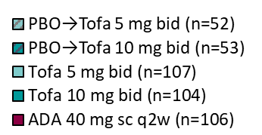
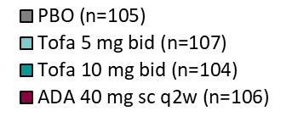
Tofacitinib: Phase 3 OPAL Broaden (NRI)
Other Responses
PASI 75 responders
HAQ-DI, mean Δ from BL
Radiographic non-progressors
‡
‡
†
−0.18
Patients with mTSS
increase ≤0.5 (%)
−0.35
*
−0.38
†
−0.40
†
MDA with tofacitinib ~26% at Month 3 and ~37%–43% at Month 12
*P ≤0.05, †P <0.001, ‡P <0.0001 vs PBO at Month 3
Mease P, et al. N Engl J Med. 2017;377:1537-1550.

Slide 76
Tofacitinib: Phase 3 OPAL Broaden (NRI)
Enthesitis
Mean change from BL
−0.4
−0.8
−1.1
*
−1.5
†
−1.4
−1.7
−1.6
−1.6
−1.9
*P ≤0.05, †P <0.001 vs PBO at Month 3
Mease P, et al. N Engl J Med. 2017;377:1537-1550.

Slide 77
Tofacitinib: Phase 3 OPAL Broaden (NRI)
Dactylitis
Mean change from BL
−2.0
−3.5
−4.0
−5.5
*
−6.1
−6.7
−7.7
−7.4
−7.5
*P≤0.05, †P<0.001 vs PBO at Month 3
Mease P, et al. N Engl J Med. 2017;377:1537-1550.

Slide 78
Tofacitinib: Phase 3 OPAL Broaden (NRI)
AEs of Special Interest
AE | n | Tx group
Serious infection | 1 | Tofa 10 mg
 | 1 | ADA 40 mg
 | 2 | PBO → Tofa 5 mg
Herpes zoster | 2 | Tofa 5 mg
 | 2 | Tofa 10 mg
Malignancy | 3 | Tofa 5 mg
 | 1 | Tofa 10 mg
Cardiovascular (MACE) | 1 | PBO → Tofa 5 mg
 | 2 | ADA 40 mg
GI perforation | 1 | PBO → Tofa 5 mg
Hepatic | 2 | ADA 40 mg
No unexpected laboratory findings relative to RA experience
Mease P, et al. N Engl J Med. 2017;377:1537-1550.

Slide 79
Tofacitinib in PsA post-TNFi
Phase 3 OPAL Beyond
395 randomized pts, 394 treated, 361 (92%) completed Month 3, 345 (88%) completed Month 6
All pts had prior TNFi use (1 prior TNFi: 63%; 2 prior TNFi: 24%; ≥3 TNFi: 13%)
1° endpoints: Month 3 ACR20 and HAQ-DI
Gladman D, et al. N Engl J Med. 2017;377:1525-1536.

Slide 80
Phase 3 OPAL Beyond
ACR Response Rates
Week 2
Month 3
Month 6
Gladman D, et al. N Engl J Med. 2017;377:1525-1536.

Slide 81
Phase 3 OPAL Beyond
Other Responses
HAQ-DI, mean Δ from BL
PASI 75 responders
Month
PBO
‡
*
PBO → Tofa 5 mg bid
†
Tofa 5 mg bid
LS mean ΔHAQ-DI
*
†
*
PBO → Tofa 10 mg bid
‡
‡
Tofa 10 mg bid
*P ≤0.05, †P <0.001, ‡P <0.0001 vs PBO
Gladman D, et al. N Engl J Med. 2017;377:1525-1536.

Slide 82
Filgotinib (Oral Selective JAK1i)
Phase 2 EQUATOR
Methods
131 PsA patients randomized to FILG
200 mg qd (n=65) or PBO (n=66) for 16 weeks
Safety
1 pneumonia (fatal), 1 herpes zoster with FILG
No changes in hematology parameters
Patients (%)
Significant difference from PBO observed in
ACR20 response as early as Week 1
PBO
FILG
‡P <0.001.
Mease PJ, et al. ACR 2018, Chicago, #1821; Mease P, et al. Lancet. 2018;392:2367-2377.

Slide 83
Phase 2 EQUATOR
ACR50/70 and PASI75 Responses
Patients (%)
Patients (%)
n= 40 42
PBO
FILG
*P <0.05; †P <0.01; ‡P <0.001.
Mease PJ, et al. ACR 2018, Chicago, #1821; Mease P, et al. Lancet. 2018;392:2367-2377.

Slide 84
Phase 2 EQUATOR
MDA and LEI Responses
n= 43 33
Patients (%)
Mean (SE) LEI Δ BL
PBO
FILG
*P <0.05; †P <0.01; ‡P <0.001. LEI, Leeds Enthesitis Index
Mease PJ, et al. ACR 2018, Chicago, #1821; Mease P, et al. Lancet. 2018;392:2367-2377.

Slide 85
Key Compounds for the Treatment of PsA
Projected US Approval Timeline
2017 | 2018 | 2019 | 2020 | 2021 | 2022+
Q1 | Q2 | Q3 | Q4 | Q1 | Q2 | Q3 | Q4 | Q1 | Q2 | Q3 | Q4 | Q1 | Q2 | Q3 | Q4 | Q1 | Q2 | Q3 | Q4 | Q1 | Q2 | Q3 | Q4
guselkumab
MorphoSys/ Janssen
Risankizumab
AbbVie/ Boehringer
Tildrakizumab
Sun Pharma
Xeljanz (tofacitinib)
Pfizer
Upadacitinib AbbVie
Olumiant (baricitinib)
Lilly/Incyte
Taltz (ixekizumab)
Lilly
filgotinib
Galapagos/ Gilead
Simponi Aria (golimumab)
Janssen
Submitted December2016
bimekizumab
UCB
Orencia (abatacept)
BMS
(CD 80 inhibitor)
Submitted November 2016
MoA
TNF inhibitor
IL-6 inhibitor
IL-23 inhibitor
IL-17 inhibitor
JAK inhibitor
Other

Slide 86
Case: 45-Year-Old Female
8 yr Hx PsO + 6 mo Hx Musculoskeletal Symptoms
Referred by PCP
MSK manifestations
  Oligoarticular arthritis: knee, 3 metatarsophalangeal joints tender and swollen
  Enthesitis: at insertion sites of Achilles tendon, plantar fascia, and inferior patella, all on left side
  Dactylitis: left 4th toe
  Complains of low back pain
  Skin: scalp, left elbow, and leg PsO (2% BSA)
  CRP: 3.2 mg/dl
  PROs: Pain 40/100, Pt Global 40/100, HAQ 1.0

Slide 87
PsA Clinical Trials
Outcome Measures
Domains | Instruments
Joint assessment | 68/66 T/S joint count, ACR, DAS, PsARC, PsAJAI, DAPSA, cDAPSA
Axial assessment | BASDAI, BASFI, BASMI
Skin assessment | PASI, target lesion, global, PSI, PSD
Composite (holistic) | MDA, VLDA, PASDAS, CPDAI, AMDF
Pain | VAS, NRS
Patient global | VAS (joint global, skin + joints global)
Physician global | VAS (joint global, skin + joints global)
Function | HAQ, HAQ-S, PSAID
HRQoL | SF-36, PsAQoL, DLQI, PSAID
Fatigue | FACIT, Krupp, MFI, VAS
Enthesitis assessment | Leeds, SPARCC, MASES, 4-point
Dactylitis assessment | Leeds, present/absent, acute/chronic
Acute phase reactant | ESR, CRP
Imaging | X-ray (modified Sharp or van der Heijde–Sharp), MRI, US
Work/home productivity | WPAI, WPS
Mease P. Arthritis Care Res. 2011;63 Suppl 11:S64-85;
Mease P, et al. Ann Rheum Dis. 2005;64:ii49-ii54;
Mease P, van der Heijde D. Int J Adv Rheum. 2006;4:38-48.

Slide 88
Case: 45-Year-Old Female
Initially treated with MTX to 20 mg/wk
Symptoms lessened in most domains
  Oligoarticular arthritis: now 2 swollen and tender joints
  Enthesitis: 2 sites
  Dactylitis: persistent
  Complains of low back pain
  Skin: 2% BSA
  PROs: Pain 30/100, Pt Global 25/100, HAQ 0.8

Slide 89
Case: 45-Year-Old Female
What Further Workup Would You Do Now?
Has she achieved a state of MDA?
CRP: 2.1 mg/dl
Ultrasound to rule out “smoldering” synovitis or enthesitis
Further workup of spine – how to approach?

Slide 90
MDA Criteria
GRAPPA
A patient is classified as in MDA when they meet 5 of 7 of the following criteria:
  Tender joint count ≤1 No
  Swollen joint count ≤1 No
  PASI ≤1 or BSA ≤3 Yes
  Patient pain VAS ≤15 No
  Patient global activity VAS ≤20 No
  HAQ ≤0.5 No
  Tender entheseal points ≤1 No
Coates L, et al. Ann Rheum Dis. 2010;69:48-53.

Slide 91
PsA
Treatment Strategies
Treat-to-target
  What target?
    MDA/VLDA
    DAPSA remission/LDA
    PASDAS remission/LDA
    CPDAI remission/LDA
    Etc
  TICOPA
Controlled taper
Controlled withdrawal

Slide 92
Case: 45-Year-Old Female
Encouraged to Strive for a Target of MDA
Biologic or tsDMARD are possible options (a TNFi or IL-17i could be chosen here)
Six-month evaluation demonstrated improvements in clinical domains
  Left knee tender at joint line (1 T, 0 S)
  Left distal patella tender (1/6 Leeds enthesitis index)
  Psoriasis BSA 1% - elbow, knees
  HAQ 0.6
  Patient global – 10, patient pain – 10
  Back pain considered to be due to degenerative spine disease and not PsA spondylitis

Slide 93
MDA Criteria
GRAPPA
A patient is classified as in MDA when they meet 5 of 7 of the following criteria:
  Tender joint count ≤1 Yes
  Swollen joint count ≤1 Yes
  PASI ≤1 or BSA ≤3 Yes
  Patient pain VAS ≤15 Yes
  Patient global activity VAS ≤20 Yes
  HAQ ≤0.5 No
  Tender entheseal points ≤1 Yes
Coates L, et al. Ann Rheum Dis. 2010;69:48-53.

Slide 94
Case: 42-Year-Old White Female
1 yr hx PsA + 10 yr hx PsO
Initial presentation of PsA:
  Joint count: 28 T/3S (out of 68/66)
  Enthesial assessment: 5/6 (Leeds index)
  Dactylitis: 2 toes swollen and tender mid-shaft
  Lumbar and cervical pain present
  Skin: 4% BSA
  Nails: Nail pitting present
  PROs: Pain 60/100, Pt Global 60/100, fatigue 50/100
Initial treatment: MTX titrated to 20 mg/wk

Slide 95
Case: 42-Year-Old White Female
After 6 mos of Adalimumab + MTX Therapy
  Joint count: 16 T/0 S (out of 68/66)
  Enthesial assessment: 4/6 (Leeds index)
  Dactylitis: resolved
  Lumbar and cervical pain present
  Skin: 1% BSA
  Nails: Nail pitting resolved
  PROs: Pain 30/100, Pt Global 30/100, fatigue 20/100
Patient states she is better but does not feel that she has had an adequate response, and you note that she has not achieved target of MDA.
Switch from adalimumab to secukinumab and continue MTX.

Slide 96
Case: 42-Year-Old White Female
After 6 mos of Secukinumab + MTX Therapy
  Joint count: 16 T/0 S (out of 68/66)
  Enthesial assessment: 3/6 (Leeds index)
  Dactylitis: resolved
  Lumbar and cervical pain present
  Skin: 1% BSA
  Nails: Nail pitting resolved
  PROs: Pain 25/100, Pt Global 25/100, fatigue 20/100
Patient feels she is somewhat better, however, you note that she has not achieved target of MDA.
What next?

Slide 97
Case: 42-Year-Old White Female
Next Treatment Options?
Switch to a JAK inhibitor
Switch to ustekinumab
Do tender point assessment for fibromyalgia
Apply Widespread Pain Index and Symptom Severity Scale to assess for central sensitization
Suggest treatment with duloxetine
Suggest treatment with pregabalin
Suggest multidisciplinary treatment for central sensitization

Slide 98
Rheumatic Diseases
Comorbid “Central Sensitization”
Comorbid Condition | Author | Prevalence of FM (%)
SLE | Valencia-Flores Grafe Neumann, Buskila | 10 30 65
RA | Wolfe, Michaud | 17
Sjogren’s | Bonafede | 50
OA | Wolfe, Cathey | 6.7
SpA | Wallis D Aloush V Azevedo V | 6 (AS) 14 (nr-axSpA) 50 (Fem AS) 15 (AS)
PsA | Husted, Gladman Brikman Salaffi Graceffa | 22 17.8 17.2 (axPsA) 16
Weir PT, et al. J Clin Rheumatol. 2006;12:124-128.
Wallis D, et al. J Rheum. 2013. 40:2038-2041.
Aloush V, et al. Rheumatol Int . 2007; 27:865-8.
Azevedo V, et al. Bras J Rheumatol . 2010;50(6):646-54.
Mease PJ. Curr Opin Rheumatol. 2017;29:304-310.
Brikman S, et al. J Rheum. 2016; doi:10.3899/jrheum.151491.
Salaffi F, et al. Rheumatol Int. 2014;34:1103-10.
Graceffa D, et al. Clin Exp Dermatol. 2015;40:136-41.
Husted JA, et al. J Rheumatol 2013; 40;1349-1356.

Slide 99
CSS
Assessment
Chronic Widespread Pain Index (CWI) + Symptom Severity Scale (SSS)
  19 body areas assessed for pain
  Also assesses fatigue, sleep quality, dyscognition, other sxs
painDETECT Questionnaire (PDQ)
  Graded 12 item questionnaire
Fibromyalgia Rapid Screening Tool (FIRST) questionnaire
  6 questions
Tender point exam
Quantitative sensory testing
Neuroimaging, eg, fMRI
Mease PJ. Curr Opin Rheumatol. 2017;29:304-310; Mease P. Neurobiology of Pain. Oxford Textbook of Osteoarthritis. 2018

Slide 100
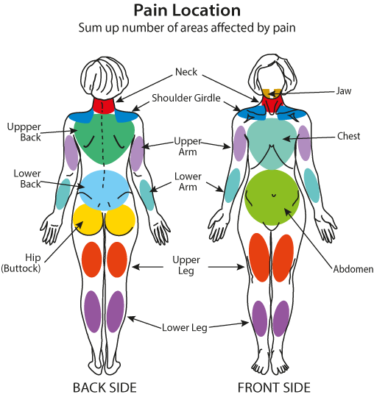
FM
ACR Preliminary Diagnostic Criteria
FDC composed of
  1) Widespread Pain Index (WPI)
    Establishes presence/absence of pain in up to 19 body areas
  2) Symptom Severity Scale (SS)
  Grading of 3 additional symptom domains: fatigue, sleep, and cognition
  Grading of overall symptom burden of additional clinical features
1) Widespread pain index (WPI): note the number of areas in which the patient has had pain over the last week. Score 0-19
Shoulder girdle, left Shoulder girdle, right Upper arm, left Upper arm, right Lower arm, left Lower arm, right | Hip (buttock, trochanter), left Hip (buttock, trochanter), right Upper leg, left Upper leg, right Lower leg, left Lower leg, right | Jaw, left Jaw, right Chest Abdomen | Upper back Lower back Neck
Wolfe F, et al. Arthritis Care Res. 2010;62:600-610. Figure adapted by Fibromyalgia Network.

Slide 101
PsA
Enthesitis or “Enthesalgia”?
Enthesitis: active immunologic inflammation at enthesial insertion site
“Enthesalgia” (Mease definition): tenderness at enthesial insertion site on physical exam and the examiner has no way of knowing how much of the tenderness is due to an “it is,” how much “mechanical-degenerative,” or how much may be contributed to by central sensitization (aka FM)
Brikman S, et al. J Rheumatol. 2016;43:1749-1754.

Slide 102
PsA and Central Sensitization
A Prospective Cohort Study
Objectives: ascertain the prevalence of CS in a group of PsA pts initiating treatment and the relationship of CS and clinical and ultrasound findings
Methods
  69 Danish PsA pts initiating csDMARD or bDMARD
  Clinical and US evaluations at BL and 4 months
  WP defined as Widespread Pain Index ≥4 and pain in ≥4/5 regions; painDETECT questionnaires to identify central pain sensitization
  Treatment response assessed by ACR20, DAPSA 50, MDA
Hojgaard P, et al. Arthritis Care Res. 2019;71:798-810.

Slide 103
PsA and Central Sensitization
A Prospective Cohort Study (continued)
Results
  WP in 24 (35%) patients at BL; associated with worse PROs and composite scores at BL
  At 4 months, no WP+ subject achieved MDA vs 20% of WP- subjects (P = .02)
  In WP+ subjects, there was lack of correlation between tender joints and enthesia and ultrasound findings of synovitis or enthesial inflammation
Conclusion
  CS is common in PsA and its presence negatively influences ability to achieve treatment targets
  Joint and enthesial tenderness may not represent presence of inflammation when CS present
Hojgaard P, et al. Arthritis Care Res. 2019;71:798-810.

Slide 104
Case: 42-Year-Old White Female
Next Treatment Options
Switch to a JAK inhibitor
Switch to ustekinumab
Do tender point assessment for fibromyalgia
Apply Widespread Pain Index and Symptom Severity Scale to assess for central sensitization
Suggest treatment with duloxetine
Suggest treatment with pregabalin
Suggest multidisciplinary treatment for central sensitization

Slide 105
CASPAR
ClASsification Criteria for Psoriatic ARthritis
Inflammatory musculoskeletal disease (arthritis, spondylitis, enthesitis)
with 3 or more points from the following:
Evidence of psoriasis: Current psoriasis Personal history of psoriasis Family history of psoriasis | 2 1 1
Psoriatic nail dystrophy | 1
Negative Rheumatoid Factor | 1
Dactylitis (current or recorded by a rheumatologist) | 1
Radiographic evidence of juxta-articular new bone formation | 1

Slide 106
PsA Outcome Measures
PROs
Health Assessment Questionnaire (HAQ)
Short Form 12 (SF12) and/or 36 (SF36)
Routine Assessment of Patient Index Data (RAPID3)
Psoriatic Arthritis Impact of Disease (PsAID)
Bath Ankylosing Spondylitis Disease Activity Index (BASDAI)
Functional Assessment of Chronic Illness Therapy (FACIT)-Fatigue
PsA Quality of Life (PsAQoL)
Dermatology Life Quality Index (DLQI)
Work Limitations Questionnaire (WLQ)
Work Productivity & Activity Impairment (WPAI)
Orbai AM, Ogdie A. Rheum Dis Clin North Am. 2016;42:265-283.
Notes:
Multiple PROs and provider-assessed outcomes were collected at baseline.
PROs included the RAPID3, SF12, PSAID, BASDAI, FACIT-Fatigue, PsAQoL, DLQI, and two work-related questionnaires, the WLQ and WPAI.
A comprehensive set of provider-assessed outcomes were also collected, including swollen and tender joint counts.

Slide 107
PsA Outcome Measures
Provider-Assessed Outcomes
Swollen joint counts
Tender joint counts
Physician assessment of arthritis
Physician assessment of skin disease (PASI, BSA, IGA, etc)
Dactylitis
Enthesitis
Nails
Orbai AM, Ogdie A. Rheum Dis Clin North Am. 2016;42:265-283.
Notes:
Multiple PROs and provider-assessed outcomes were collected at baseline.
PROs included the RAPID3, SF12, PSAID, BASDAI, FACIT-Fatigue, PsAQoL, DLQI, and two work-related questionnaires, the WLQ and WPAI.
A comprehensive set of provider-assessed outcomes were also collected, including swollen and tender joint counts.

Slide 108
PsA Outcome Measures
Labs & Imaging Outcomes
C-reactive protein
  Only elevated in approximately half of patients
  Obese patients are more likely to have an elevated CRP
X-rays
  Not necessarily helpful to do x-rays more than once a year, and not all physicians follow them on a regular basis
    There are no specific recommendations about how often to get x-rays
  Assessment of the sacroiliac joints can be helpful in patients who have low back pain because it can tell if the patient has an axial disease as well
    Patients with low back pain that seems inflammatory and a negative x-ray may need an MRI of the pelvis to assess for active inflammation sacroiliac joints
Orbai AM, Ogdie A. Rheum Dis Clin North Am. 2016;42:265-283.
Notes:
Multiple PROs and provider-assessed outcomes were collected at baseline.
PROs included the RAPID3, SF12, PSAID, BASDAI, FACIT-Fatigue, PsAQoL, DLQI, and two work-related questionnaires, the WLQ and WPAI.
A comprehensive set of provider-assessed outcomes were also collected, including swollen and tender joint counts.

Slide 109
X-Rays
Usefulness in PsA?
SI joints: to assess axial involvement (see axial disease workup)
Hand/feet x-rays: can be helpful at baseline, most patients don’t change so no need to regularly follow unless clinical suspicion
Factors associated with development of x-ray changes: tender or swollen joint
Siannis F, et al. Ann Rheum Dis. 2006;65:478-481.

Slide 110
Inflammatory Back Pain
Clinical Features
Insidious onset
Pain worse at night and in the morning (with stiffness)
Age <40 at onset
Improves with activity
Not relieved with rest / (OTC NSAIDs are helpful)
Braun J, Inman R. Ann Rheum Dis. 2010;69:1264-1268.

Slide 111
Axial Disease
Assessments
SI joint films (dedicated)
  Don’t expect to get the windows on the pelvis/hip films or L spine films
  Normal L spine films aren’t the end of the story!
MRI pelvis without contrast (but w/STIR)
  Nope, you won’t see them on the L-spine MRI

Slide 112
Psoriatic Nail Involvement
Nail Bed Psoriasis
Onycholysis
Splinter hemorrhages
Hyperkeratosis
Oil drop dyschromia
Ogdie A, Weiss P. Rheum Dis Clin North Am. 2015;41:545-568.

Slide 113
PsA
PROs as The Primary Outcomes
Reflects the patient experience, regardless of disease features
  Isn’t the ultimate goal to improve how the disease impacts the patient?
Easy! Opens options for data collection
One of the best options for pragmatic trials

Slide 114
RAPID3
OVER THE LAST WEEK, were you able to: | without ANY difficulty | with SOME difficulty | with MUCH difficulty | UNABLE to do
Dress yourself, including tying shoelaces and doing buttons? | __ 0 | __ 1 | __ 2 | __ 3
Get in and out of bed? | __ 0 | __ 1 | __ 2 | __ 3
Lift a full cup or glass to your mouth? | __ 0 | __ 1 | __ 2 | __ 3
Walk outdoors on flat ground? | __ 0 | __ 1 | __ 2 | __ 3
Wash and dry your entire body? | __ 0 | __ 1 | __ 2 | __ 3
Bend down to pick up clothing from the floor? | __ 0 | __ 1 | __ 2 | __ 3
Turn regular faucets on and off? | __ 0 | __ 1 | __ 2 | __ 3
Get in and out of a car, bus, train, or airplane? | __ 0 | __ 1 | __ 2 | __ 3
Walk two miles or three kilometers, if you wish? | __ 0 | __ 1 | __ 2 | __ 3
Participate in recreational activities and sports as you would like, if you wish? | __ 0 | __ 1 | __ 2 | __ 3
Get a good night’s sleep? | __ 0 | __ 1.1 | __ 2.2 | __ 3.3
Deal with feelings of anxiety or being nervous? | __ 0 | __ 1.1 | __ 2.2 | __ 3.3
Deal with feelings of depression or feeling blue? | __ 0 | __ 1.1 | __ 2.2 | __ 3.3
How much pain have you had because of your condition OVER THE PAST WEEK? 0–10
Considering all the ways in which illness and health conditions may affect you at this time, please indicate how you are doing: 0–10

Slide 115
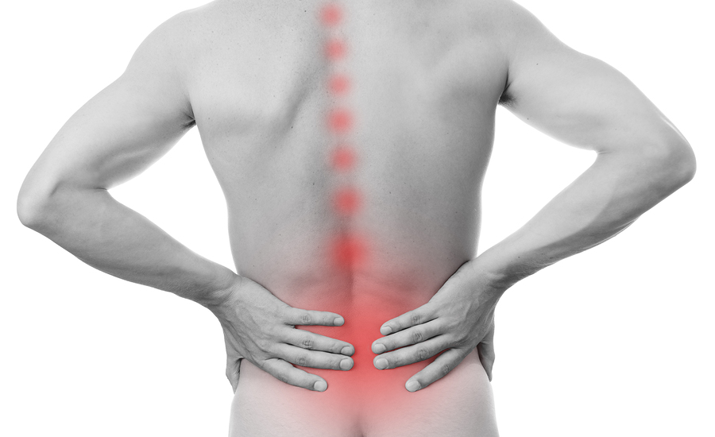
PROs as the Clinical Trial Outcomes
ASAS20
20+% improvement and ≥ 1 unit change (scale 0–10) in at least 3 of 4 ASAS domains and no worsening:
  Patient Global Assessment of Disease
  Total Back Pain
  Function (Bath AS Functional Index [BASFI])
  Inflammation domain (mean of 2 Bath AS Disease Activity Index NRS Questions #5 and #6 for morning stiffness)
Credit: staras/Bigstock

Slide 116
Routine Assessment of Patient Index Data-3
RAPID3
Well-known PRO; easily and quickly administered; most commonly used rheumatology PRO in the United States
Domains: physical function, pain, global health
Range 0-30 (or 0–10)
Developed and validated in RA; now assessed in AS and PsA as well

Slide 117
PsA Impact of Disease (PsAID)
Questionnaire
Specific to PsA
Designed by a patient panel; includes all of the areas of impact important to patients
Simple index: 12 questions designed for practice, 9 for trials; range for both is 0–10
Set of individual items for different domains and each item related to PsA
Gossec L, et al. Ann Rheum Dis. 2014;73:1012-1019.

Slide 118
PsA Impact of Disease (PsAID)
Questionnaire (cont.)
“Circle the number that best describes the way you felt due to your psoriatic arthritis during the last week: 0–10 NRS”
Pain
Fatigue
Skin problems
Work and/or leisure activities
Functional capacity
Discomfort
Sleep Disturbance
Coping
Anxiety, fear, uncertainty
Embarrassment and/or shame*
Social participation*
Depression*
Gossec L, et al. Ann Rheum Dis. 2014;73:1012-1019.

Slide 119
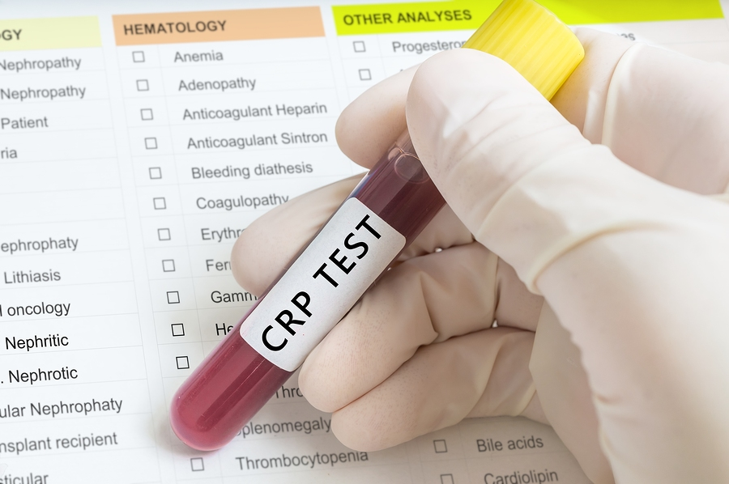
CRP
To Test or Not to Test?
Only elevated in ~1/2 of pts
May be more strongly related to obesity
Some predictive value in terms of progression
Not all that responsive to treatment in PsA
Credit: vchal/Bigstock
Elmamoun M, et al. J Rheumatol. 2019;46:266-273; Siebert S, et al. Arthritis Rheumatol. 2019;71:1660-1669.

Slide 120
PsA Treatment Targets
MDA/VLDA
Minimal Disease Activity (MDA) defined as 5/7 of the following:
Tender joint count ≤ 1
Swollen joint count ≤ 1
PASI ≤ 1 or BSA ≤ 3
Patient pain VAS ≤15
Patient global activity VAS ≤ 20
HAQ ≤ 0.5
Tender entheseal points ≤ 1
Very Low Disease Activity (VLDA) defined as 7/7 criteria above
Coates LC, Helliwell PS. Curr Rheumatol Rep. 2015;17:517.

Slide 121
PsA Treatment Targets
DAPSA
Disease Activity in PsA (DAPSA):
Tender joint count +
Swollen joint count +
Patient pain (1-10) +
Patient global activity (1-10) +
CRP
Coates LC, Helliwell PS. Curr Rheumatol Rep. 2015;17:517.

Slide 122
PsA ⎼ Orange Line
Summary
Outcome Measures (PROs, provider-assessed outcomes, lab & imaging)
Manifestations (peripheral arthritis, dactylitis, enthesitis, nail Involvement, axial disease)
Patient experience (PROs as the primary outcomes, PROs as the clinical trial outcomes, RAPID3, PsAID questionnaire, PROs as problem/solution)
Clinical utility of lab & x-rays
Treatment targets (MDA/VLDA, DAPSA)

Slide 123

PsA
Comorbidities
Eye involvement (Uveitis)
Depression
Aorta Root Dilatation
Aortic Insufficiency
BBB/Conduction
Decreased LVEF
Interstitial Lung Disease
Cardiovascular Disease
Gut inflammation/IBD
Skin:
Psoriasis
Constitutional
Fever
Weight loss
Fatigue

Slide 124
PsA Comorbidities
Increased Incidence
Cardiovascular disease
  Myocardial infarction
  Cerebrovascular disease
Diabetes/insulin resistance
Crohn’s disease
Liver disease
Venous thromboembolism
Ogdie A, et al. Curr Opin Rheumatol. 2015;27:118-126;
Ogdie A, Weiss P. Rheum Dis Clin North Am. 2015;41:545-568.

Slide 125
PsA Comorbidities
Increased Prevalence
Metabolic syndrome
Obesity
Hypertension
Dyslipidemia
Diabetes
Fatty liver disease
Depression/anxiety
Ulcerative colitis
Eye disease
  Uveitis
  Keratoconjunctivitis sicca
Hypothyroidism
Giant cell arteritis
Pulmonary fibrosis
Ogdie A, et al. Curr Opin Rheumatol. 2015;27:118-126;
Ogdie A, Weiss P. Rheum Dis Clin North Am. 2015;41:545-568.

Slide 126
PsA Care
Traditional Model
PsA
Psoriasis
Obesity
Diabetes
Depression
Sarcopenia
Pain and Fatigue

Slide 127

PsA Care
Personalized Medicine
PsO/PsA
Pain and Fatigue
Obesity
Sarcopenia
Diabetes
Depression

Slide 128
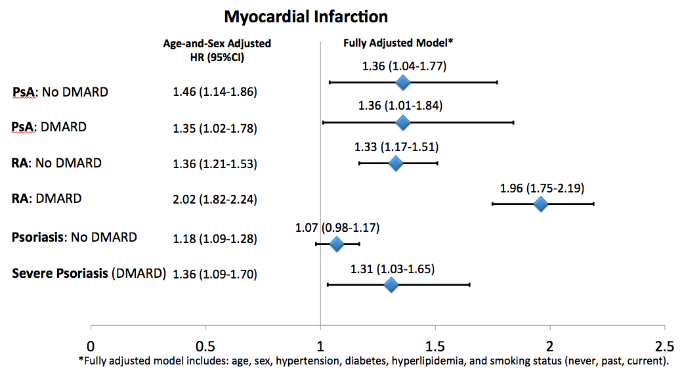
PsA Comorbidities
Increased Risk of Myocardial Infarction
Ogdie A, et al. Ann Rheum Dis. 2015;74:326-332.

Slide 129
PsA Comorbidities
Higher Prevalence of Cardiovascular Risk Factors
Controls
PsA
RA
Age at cohort entry
Age at cohort entry
Jafri K, et al. Arthritis Care Res (Hoboken). 2017;69:51-57.

Slide 130
PsA Comorbidities
Higher Prevalence of Cardiovascular Risk Factors (cont.)
Controls
PsA
RA
Age at cohort entry
Age at cohort entry
Jafri K, et al. Arthritis Care Res (Hoboken). 2017;69:51-57.

Slide 131
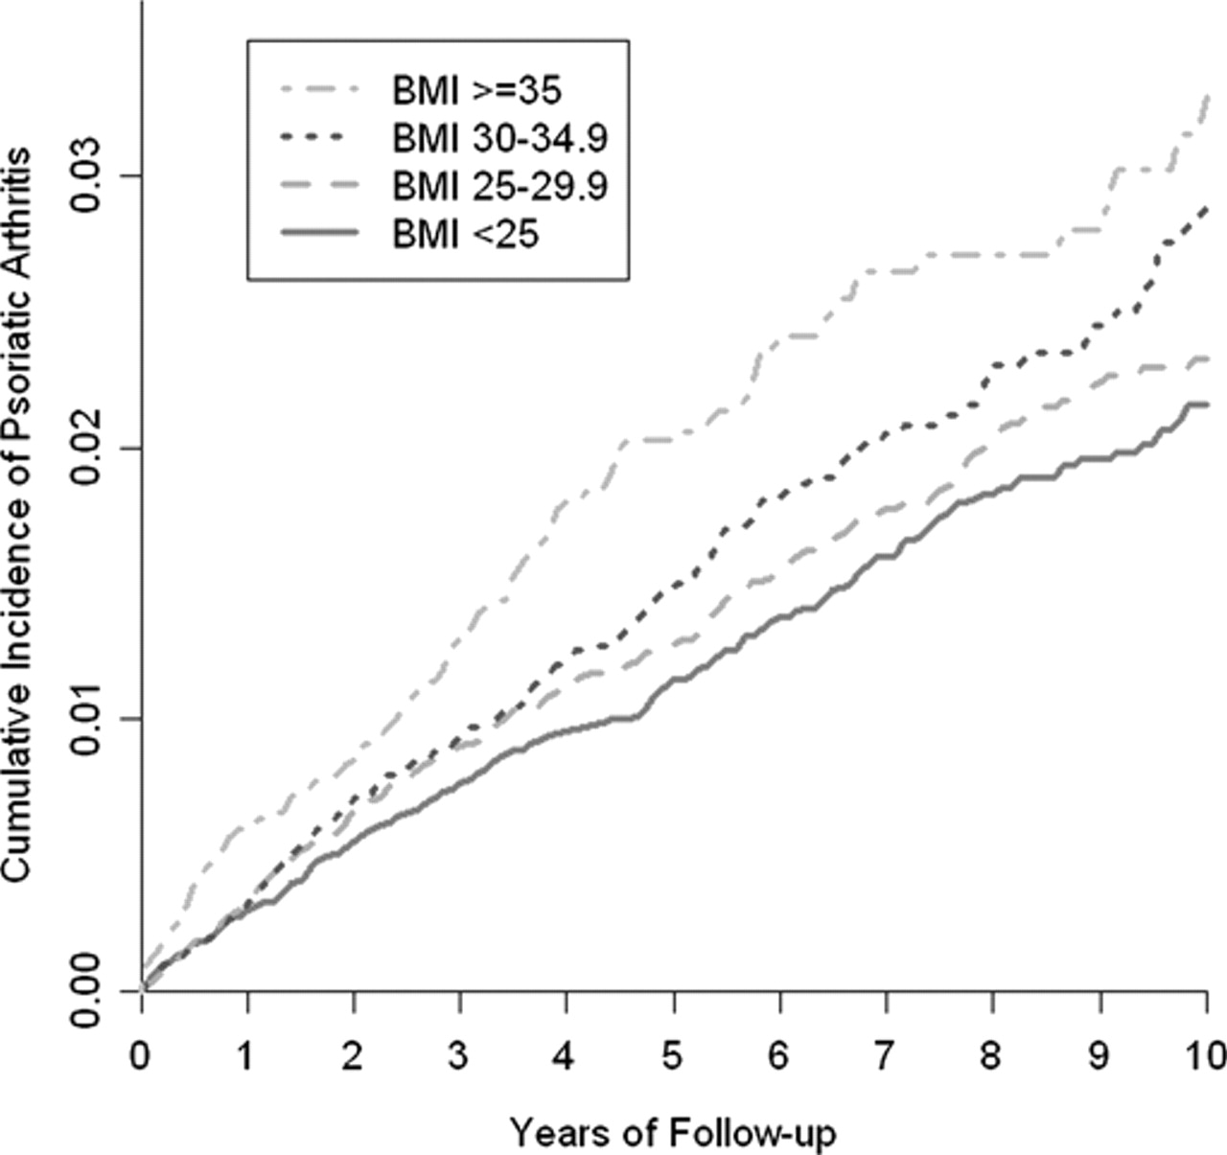
PsA Risk Factors
Obesity
HR 1.48 (1.20-1.81)
HR 1.22 (1.02-1.47)
HR 1.09 (0.93-1.28)
Love TJ, et al. Ann Rheum Dis. 2012;71:1273-1277.

Slide 132
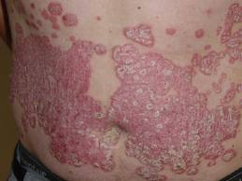

Systemic Inflammation & Altered Metabolic State
Prothrombotic state
Increased Adhesion Molecules
Liver production of Acute Phase Reactants
Increased Angiotensin
Adipocytes
TNF blocks insulin signaling
Low HDL
High Triglycerides
Hypertension
Alterations in Adipokine Transcription:
Increased Leptin
Insulin Resistance Hyperglycemia
Altered Metabolic State and Increased Cardiovascular Risk
Davidovici BB, et al. J Invest Dermatol. 2010;130:1785-1796; Papagoras C, et al. Clin Exp Rheumatol. 2013;31:612-620; Russolillo A, et al. Rheumatology (Oxford). 2013;52:62-67; Ghazizadeh R, et al. Int J Med Sci. 2010;7:284-289; Boehncke S, et al. Br J Dermatol. 2007;157:1249-1251; Armstrong AW, et al; J Am Acad Dermatol. 2013;68:654-662; Gelfand JM, Yeung H. J Rheumatol Suppl. 2012;89:24-28.

Slide 133
PsA and Metabolic Disease
Metabolic Disease
Psoriatic Disease
Ogdie A, Eder L. Int J Clin Rheumtol. 2015;10:451-459.

Slide 134
PsA and Obesity
Age at cohort entry
Jafri K, et al. Arthritis Care Res (Hoboken). 2017;69:51-57.

Slide 135
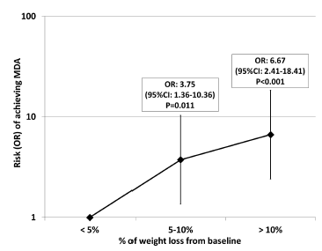
PsA Comorbidities
Weight Reduction Improves Response
% Weight Loss from Baseline
di Minno MN, et al. Arthritis Care Res. 2013;65:141-147.

Slide 136
PsA Comorbidities
Depression and Anxiety
 | Psoriasis N=135 | PsA N=306 | P-value
Anxiety | 33 (24.4%) | 112 (36.6%) | 0.01
Depression | 13 (9.6%) | 68 (22.3%) | 0.002
Both | 9 (6.7%) | 54 (17.7%) | 0.002
McDonough E, et al. J Rheumatol. 2014;41:887-896.

Slide 137
PsA Comorbidities
Increased Risk for Suicide
 | Unexposed | PsA | RA
Suicide | 40 | 12 | 31
Deaths (%) | 0.61 | 1.41 | 0.20
Incidence | 0.93 | 2.44 | 1.29
Age- and Sex-Adjusted HR | REF | 3.03 (1.56-5.90) | 2.47 (1.51-4.04)
Ogdie A, et al. Rheumatology (Oxford). 2017;56:907-911.

Slide 138
PsA Comorbidities
Crohn’s Disease
Nurses Health Study I and II
 | Person-years | Cases | Age-Adjusted RR | Multivariable-Adjusted RR
No psoriasis | 2,401,946 | 174 | REF | REF
Psoriasis | 41960 | 11 | 3.74 (2.03-6.89) | 3.49 (1.89-6.44)
Psoriasis/PsA | 5661 | 3 | 7.99 (2.55-25.08) | 6.54 (2.07-20.65)
Li WQ, et al. Ann Rheum Dis. 2013;72:1200-1205.

Slide 139
PsA Comorbidities
Ophthalmic Disease
Eye conditions associated with PsA
Risk for Uveitis
Uveitis
Keratoconjunctivitis sicca
Keratitis
Blepharitis
Conjunctivitis
Episcleritis
Scleritis
 | IRR
Mild Psoriasis | 1.38 (1.11-1.70)
Severe Psoriasis | 1.40 (0.70-2.81)
Psoriatic arthritis | 2.50 (1.53-4.08)
*Adjusted for age, sex, comorbidities, and socioeconomic status
Egeberg A, et al. JAMA Dermatol. 2015;151:1200-1205; Lima FB, et al. Clinics (Sao Paulo). 2012;67:249-253;
Zeboulon N, et al. Ann Rheum Dis. 2008;67:955-959.

Slide 140
PsA Comorbidities
Screening Considerations
Cardiovascular Disease | Check blood pressure, lipid panel Encourage smoking cessation
Obesity | Council patients on the benefits of weight loss
Diabetes | Check fasting glucose or hemoglobin A1c
Inflammatory Bowel Disease | Ask about gastrointestinal symptoms in the ROS
Ophthalmic Disease | Ask about ophthalmic symptoms in the ROS
Malignancy | Consider yearly or periodic skin check for patients with a history of UV light therapy
Liver and Kidney Disease | Check LFTs, Cr, HBV/HCV serologies before starting therapy
Depression and Anxiety | Ask about symptoms of depression and anxiety
Ogdie A, et al. Curr Opin Rheumatol. 2015;27:118-126.

Slide 141
Comorbidities Influence Treatment Selection
Comorbidity | Non-steroidal Anti-inflammatory Drugs | Glucocorticoids | Hydroxychloroquine | Sulfasalazine | Methotrexate | Leflunomide | Cyclosporine | Etanercept | Adalimumab | Infliximab | Certolizumab | Golimumab | Ustekinumab | Apremilast | Secukinumab
Cardiovascular Disease | C | ? |  |  |  |  |  |  |  |  |  |  | ?
Congestive Heart Failure |  |  |  |  |  |  |  | ? | ? | ? | ? | ?
Obesity |  |  |  |  | C
Metabolic Syndrome |  | C |  |  | C
Diabetes |  | C |  |  | C
Inflammatory Bowel Disease | ? |  |  |  |  |  |  |  |  |  |  |  |  |  | C
Uveitis |  | P |  |  |  |  |  | ? | P | P
Osteoporosis |  | C
Malignancy |  |  |  |  |  |  |  | C | C | C | C | C | ?
Fatty Liver Disease | C |  |  | C | C | C
Chronic HBV or HCV | C |  |  |  | C | C |  | SM/P | SM | SM | SM | SM | ?
HIV |  |  |  |  |  |  |  | SM | SM | SM | SM | SM | ?
Chronic Kidney Disease | C |  |  |  | C | ? | SM
Depression |  |  |  |  |  |  |  |  |  |  |  |  |  | C
C | Caution
? | Data insufficient, concerns raised
P | Preferred therapy
SM | Requires special monitoring
Coates LC, et al. Arthritis Rheumatol. 2016;68:1060-1071; Ogdie A, et al. J Rheumatol. 2014;41:2315-2322.

Slide 142
PsA ⎼ Red Line
Summary of Covered Topics
PsA extra-articular manifestations
PsA Comorbidities (incidence/prevalence and screening)
Risk factors and their management
Systemic inflammation & altered metabolic state (obesity as a risk factor and its effect on response to therapy)
Depression & anxiety
Crohn’s disease
Ophthalmic Disease
Comorbidities & treatment selection

Slide 143
Case: 40-Year-Old Woman with Psoriasis
Initial Presentation
Presents to the rheumatology clinic with new joint pain for evaluation of potential PsA
  She reports that she began having toe pain and swelling intermittently approximately 3 months ago
  Then, about 6 weeks ago she developed knee swelling and subsequently a swollen finger
  Today the toes are fine
  She notes experiencing morning stiffness for about 1 hour
Her past therapies include primarily topicals, some prior phototherapy for legs, and currently she’s taking naproxen 500 mg bid prn as prescribed by PCP

Slide 144
Case: 40-Year-Old Woman with Psoriasis
Exam & Labs
She has mild hypertension (BP 145/95), she is obese (BMI 32), and has normal HR, RR, and temperature
She has psoriasis with ~5% BSA, mostly on her lower extremities and scalp
She has nail pitting with some onycholysis of 1 nail
She has 3 swollen joints, 3 tender joints, 1 tender lateral epicondyle and right troch bursa tenderness (2 entheses on SPARCC index), and dactylitis of the right second finger
No spine or SI joint tenderness or pain on ROM of the spine
Labs are remarkable for elevated CRP 5 mg/dl (<3 normal), and her fasting glucose is 110

Slide 145
Case: 40-Year-Old Woman with Psoriasis
Treatment Options
Which therapy should you begin?
  Discussion could include avoiding methotrexate due to obesity and diabetes, moderate psoriasis, more aggressive arthritis
  Would start TNFi by current recommendations

Slide 146
Case: 40-Year-Old Woman with Psoriasis
Further Workup Before Initiating Therapy
Diabetes
Lipids
Consider full cardiovascular risk assessment
Depression, anxiety

Slide 147
Case: 40-Year-Old Woman with Psoriasis
3-Month Follow-Up
She returns 3 months after starting a TNFi
She’s feeling better, but she continues to have some joint pain
On ROS, she ascribes to some depression
Not exercising much due to fear of worsening arthritis
RAPID3 declines from 12 to 7, suggesting she’s had a good improvement
On exam, no significant swelling although the dactylitis is still not completely resolved
Knee pain intermittent as well, but no significant swelling on exam

Slide 148
Case: 40-Year-Old Woman with Psoriasis
Follow-Up Management Plan
Obese patients likely to have inadequate response (but she’s done OK)
  Weight loss is an important discussion here
  Consider referring her to the nutritionist
Also important to discuss management of depression
Physical activity important as well
Physical therapy may be a good place to start!

Slide 149
Case: Tina
46-Year-Old Business Owner
SJC | 5
TJC | 4
Enthesitis | 0
Dactylitis | 2
Psoriasis | <1%
Spine | no
Impact | Can’t use fingers, trouble typing, severe pain in dactylitic fingers, pain causes her to be grumpy, affects relationship with husband

Slide 150
Case: Tina
Follow-Up Management Plan
Treatment of inflammatory arthritis reduced her overall level of pain
We adopted personalized/holistic approach
  To improve her sleep, she enrolled into a sleep study (it turned out, she had sleep apnea)
    Improved sleep helped with depression
  Addressed fatigue and sarcopenia with exercise
  Physical therapy may be a good place to start!

