Slide 1
2017 ELN Risk Stratification by Genetics
Risk Category* | Genetic Abnormality
Favorable | Chromosomal rearrangements t(8;21)(q22;q22.1), RUNX1-RUNX1T1 inv(16)(p13.1 q22) or t(16;16)(p13.1;q22), CBFB-MYH11 | Mutations Mutated NPM1 without FLT3-ITD or with FLT3-ITD^{low†} Biallelic mutated CEBPA
Intermediate | Chromosomal rearrangements t(9;11)(p21.3;q23.3), MLLT3-KMT2A‡ Cytogenetic abnormalities not classified as favorable or adverse | Mutations Mutated NPM1 and FLT3-ITD^{high†} Wild-type NPM1 without FLT3-ITD or with FLT3-ITD^{low†} (without adverse-risk genetic lesions)
Adverse | Chromosomal rearrangements t(6;9)(p23;q34.1), DEK-NUP214t(v;11q23.3), KMT2A rearranged t(9;22)(q34.1;q11.2); BCR-ABL1 inv(3)(q21.3q26.2) or t(3;3)(q21.3;q26.2), GATA2,MECOM(EVI1) -5 or del(5q), -7, -17/abn(17p) Complex karyotype,§ monosomal karyotype‖ | Mutations Wild-type NPM1 and FLT3-ITD^{high†} Mutated RUNX1¶ Mutated ASXL1¶ Mutated TP53#
*Prognostic impact of a marker is treatment-dependent and may change with new therapies. †Low, low allelic ratio (,0.5); high, high allelic ratio (<0.5); semiquantitative assessment of FLT3-ITD allelic ratio (using DNA fragment analysis) is determined as ratio of the area under the curve “FLT3-ITD” divided by area under the curve “FLT3-wild type”; recent studies indicate that AML with NPM1 mutation and FLT3-ITD low allelic ratio may also have a more favorable prognosis and patients should not routinely be assigned to allogeneic HCT. ‡The presence of t(9;11)(p21.3;q23.3) takes precedence over rare, concurrent adverse-risk gene mutations. §Three or more unrelated chromosome abnormalities in the absence of 1 of the WHO-designated recurring translocations or inversions, that is, t(8;21), inv(16) or t(16;16), t(9;11), t(v;11)(v;q23.3), t(6;9), inv(3) or t(3;3); AML with BCR-ABL1. ‖Defined by the presence of 1 single monosomy (excluding loss of X or Y) in association with at least 1 additional monosomy or structural chromosome abnormality (excluding core-binding factor AML). ¶These markers should not be used as an adverse prognostic marker if they cooccur with favorable-risk AML subtypes. #TP53 mutations are significantly associated with AML with complex and monosomal karyotype.
Dohner H, et al. Blood. 2017;129:424-447.

Slide 2
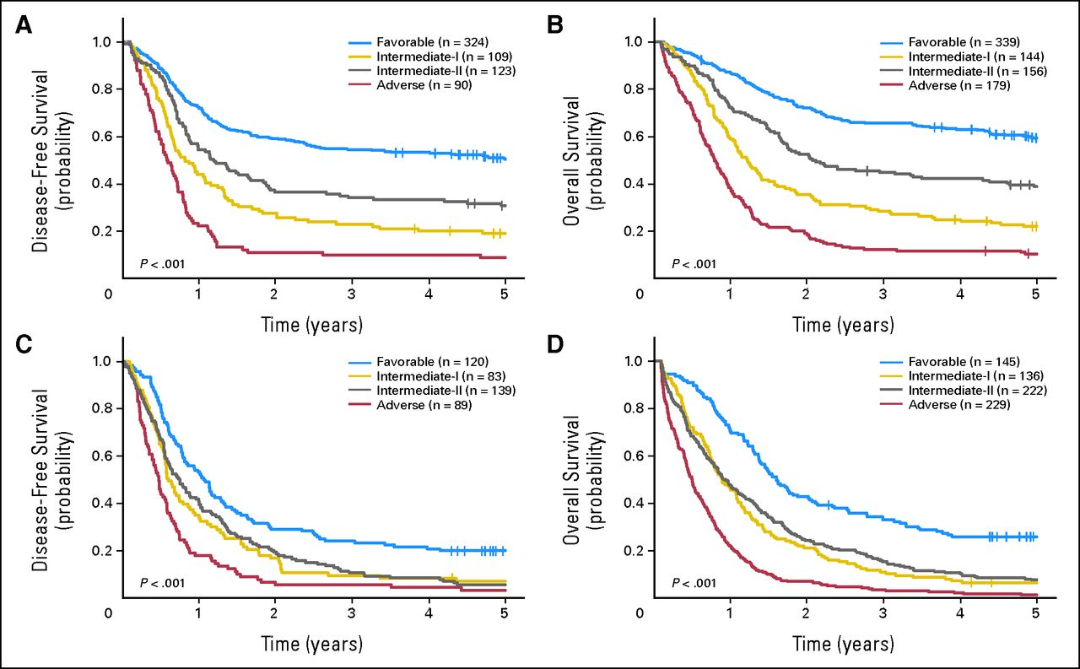
FLT3 Tyrosine Kinase Inhibition
2017 ELN Classification
2010 ELN Classification
Risk Category | Mutation
Favorable | Mutations Mutated NPM1 without FLT3-ITD or with FLT3-ITD^{low†} Biallelic mutated CEBPA
Intermediate | Mutations Mutated NPM1 and FLT3-ITD^{high†} Wild-type NPM1 without FLT3-ITD or with FLT3-ITD^{low†} (without adverse-risk genetic lesions)
Adverse | Mutations Wild-type NPM1 and FLT3-ITD^{high†} Mutated RUNX1¶ Mutated ASXL1¶ Mutated TP53#
Dohner H, et al. Blood. 2017;129:424-447. Mrozek K, et al. J Clin Oncol. 2012;30:4515-4523.

