Slide 1
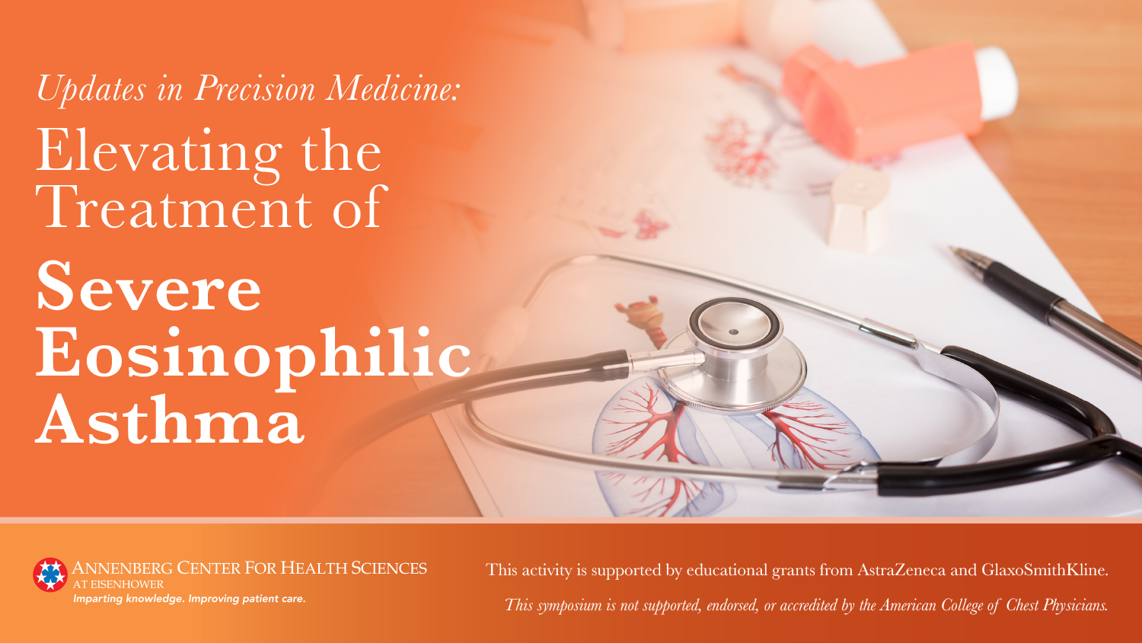

Slide 2
Asthma: A Highly Prevalent and Often Inadequately Controlled Disease
26.5 million people
in the US have asthma¹
20.4 million adults
have asthma¹
3.3 million children and 9.1 million adults have inadequately controlled asthma¹
1. Centers for Disease Control and Prevention (CDC). https://www.cdc.gov/asthma/most_recent_data.htm. Accessed August 14, 2018.

Slide 3
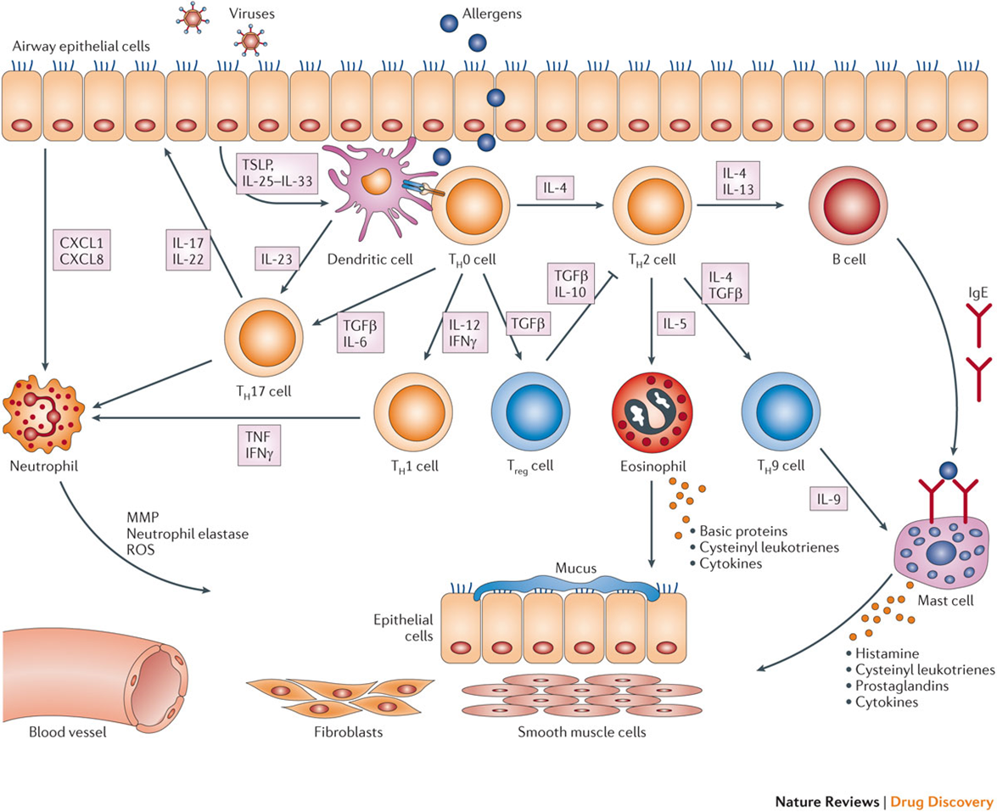
Immunobiology of Asthma
Pelaia G, et al. Nature Rev Drug Discov. 2012;11(12): 958–972.

Slide 4
Pathophysiology of Severe Asthma
Basis for Biologic Therapies
Type 2 Inflammation
Non-Type 2 Inflammation
Antigens
Irritants, pollutants, microbes,
and viruses
TSLP
IL-25
IL-33
IL-6
CXCL8
CRTh2
IL-13
TGF-β
GM-CSF
Th2
cell
Th17
cell
IL-23
Th1
cell
IL-4, IL-5, IL-13
ILC2
CRTh2
GATA3
IFN-γ
TNF
IL-4
IL-5
CRTh2
IL-6, IL-17, IL-8
B cell
CXCR2
IgE
Lipoxin
BLT₂
Mast cell
IL-3, IL-4, IL-5, IL-9
Eosinophil
ALX
Neutrophil
LX, lipoxin A4 receptor; BLT₂, leukotriene B receptor 2; CRTh2, chemoattractant receptor homologue from Th2 cells; CXCL8, CXC motif chemokine ligand 8; CXCR3, CXC chemokine receptor 3; GM-CSF, granulocyte–macrophage colony-stimulating factor; IFN-γ, interferon γ; PGD2, prostaglandin D2; ILC2, innate lymphoid cells; PGD2, prostaglandin D2; TSLP, thymic stromal lymphopoietin; TGF-β, transforming growth factor-β.
Adapted from Israel E, et al. N Engl J Med. 2017;377(10):965-976.

Slide 5
Definition of Severe Asthma
ERS/ATS 2014¹ | GINA²
Asthma which requires treatment with high-dose ICS plus a second controller and/or systemic corticosteroids to prevent it from becoming ‘uncontrolled’ or which remains ‘uncontrolled’ despite this therapy | Asthma that requires step 4 or 5 treatment, eg, high-dose ICS/LABA, to prevent it from becoming ‘uncontrolled’, or asthma that remains ‘uncontrolled’ despite this treatment
 |  | Step 4 | Step 5
 | Preferred controller | Med-/High-dose ICS/LABA | Refer for add-on treatment, eg, tiotropium*†, anti-IgE, anti-IL-5*
 | Other controller options | Add tiotropium*† Med-/High-dose ICS + LTRA (or + theophylline*) | Add low-dose OCS
 | Reliever | As-needed SABA or low-dose ICS/formoterol#
ICS, inhaled corticosteroid; LABA, long-acting beta-agonist; LTRA, leukotriene receptor antagonist; OCS, oral corticosteroid; SABA, short-acting beta-agonist
*Not for children age <12 y
#Low-dose ICS/formoterol is the reliever medication for patients prescribed low-dose budesonide/formoterol or low-dose beclomethasone/formoterol maintenance and reliever therapy
†Tiotropium by mist inhaler is an add-on treatment for patients with a history of exacerbations; it is not indicated in children age <12y
1. Chung KF, et al. Eur Respir J. 2014;43:343-373.
2. Global Initiative for Asthma. https://ginasthma.org/2018-gina-report-global-strategy-for-asthma-management-and-prevention/. Accessed September 5, 2018.

Slide 6
Differentiating Severe from Uncontrolled Asthma: Assess Comorbidities and Contributing Factors
Comorbidities
Rhinosinusitis/(adults) nasal polyps
Psychological factors
Vocal cord dysfunction
Obesity
Smoking and related diseases
Obstructive sleep apnea
Hyperventilation syndrome
Hormonal influences
Gastroesophageal reflux disease
Medications
Others
Contributing Factors
Poor treatment adherence
Poor inhaler technique
Environmental exposure
1. Chung KF, et al. Eur Respir J. 2014;43:343-373.
2. Global Initiative for Asthma. https://ginasthma.org/2018-gina-report-global-strategy-for-asthma-management-and-prevention/. Accessed September 5, 2018.

Slide 7
Differentiating Severe from Uncontrolled Asthma
● Watch patient using their inhaler
● Discuss adherence and barriers to use
● Confirm the diagnosis of asthma
● If possible, remove potential risk factors
● Assess and manage comorbidities
● Consider treatment step-up
● Refer to a specialist or severe asthma clinic
Global Initiative for Asthma. https://ginasthma.org/2018-gina-report-global-strategy-for-asthma-management-and-prevention/.
Accessed September 5, 2018.

Slide 8
Severe Asthma: Clinical Features
Frequent or persistent asthma symptoms
Frequent exacerbations
Persistent loss of lung function
Substantial impairment of quality of life
Troublesome comorbidities, eg, anxiety or depression
1. Chung KF, et al. Eur Respir J. 2014;43:343-373.
2. Global Initiative for Asthma. https://ginasthma.org/2018-gina-report-global-strategy-for-asthma-management-and-prevention/.
Accessed September 5, 2018.

Slide 9
Factors That May Contribute to the Phenotype of Severe Asthma
Chung KF, et al. Eur Respir J. 2014;43:343-373.

Slide 10
Severe Asthma: Phenotypes
Phenotype | Associations
Early-onset severe allergic | Blood and sputum eosinophils High serum IgE High FeNO
Late-onset eosinophilic | Blood and sputum eosinophils Recurrent exacerbations High FeNO
Late-onset non-atopic steroid-dependent asthma with fixed airways obstruction | Airway wall remodeling as increased airway wall thickness
Frequent exacerbators | Sputum eosinophils in sputum Reduced response to ICS and/or OCS
Late-onset obese (primarily women) | Moderate FEV₁ reduction Frequent OCS use
FeNO, exhaled nitric oxide fraction; ICS, inhaled corticosteroid; OCS, oral corticosteroid
1. Chung KF, et al. Eur Respir J. 2014;43:343-373.
2. Global Initiative for Asthma. https://ginasthma.org/2018-gina-report-global-strategy-for-asthma-management-and-prevention/.
Accessed September 5, 2018.

Slide 11
Goals of Asthma Management: Reduce Current Impairment and Future Risk
Symptom control (daytime symptoms,
night-time awakening)
Exacerbations
Emergency visits
Management of comorbidities
Treatment-related AEs
Improve
Reduce
Lung Function
Hospitalization
Functional Status
Disease Progression/Prevention
Quality of Life
Mortality

Slide 12
Management of Severe Asthma
Optimization of ICS/LABA dose
Oral corticosteroids
Add-on without phenotyping
Sputum-guided treatment
Non-pharmacologic
Add-on with phenotyping
Global Initiative for Asthma. https://ginasthma.org/2018-gina-report-global-strategy-for-asthma-management-and-prevention/.
Accessed September 5, 2018.

Slide 13
Management of Severe Asthma (cont)
Optimization of ICS/LABA dose
Some may respond to higher doses of ICS than routinely used; risk of systemic side effects
Step down slow at 3-6 month intervals
Oral corticosteroids
Some may benefit from low-dose, maintenance OCS
Monitor for osteoporosis
Add-on without phenotyping
Selected patients with uncontrolled symptoms and persistent airflow limitation despite moderate-/high-dose ICS and LABA
Consider add-on tiotropium; alternatively, theophylline or LTRA
If ≥3 months → lifestyle counseling, Rx for preventing osteoporosis
ICS, inhaled corticosteroid; LTRA, leukotriene receptor antagonist; LABA, long-acting beta agonist; OCS, oral corticosteroid; Rx, prescription
Global Initiative for Asthma. https://ginasthma.org/2018-gina-report-global-strategy-for-asthma-management-and-prevention/.
Accessed September 5, 2018.

Slide 14
How do the guidelines compare regarding use of oral corticosteroids for patients with severe asthma?
NHLBI¹
  Chronic OCS should only be considered from the most severe difficult-to-treat asthma
  Minimizing OCS dose and maximizing other modes of therapy is preferred
ERS/ATS guidelines², if continuous OCS therapy is warranted:
  Monitor weight, blood pressure, blood glucose, eyes, and bone density
  Use prophylactic measures to prevent loss of bone density
GINA³
  Some patients may benefit from low-dose maintenance OCS, but long-term benefit:risk ratio should be considered
  Monitor patients to prevent bone loss
  PCPs are encouraged to refer to specialty care if ≥2 courses of OCS/year
1. National Heart, Lung, and Blood Institute. https://www.nhlbi.nih.gov/sites/default/files/media/docs/asthgdln_1.pdf. Accessed August 15, 2018.
2. Chung KF, et al. Eur Respir J. 2014;43:343-373.
3. Global Initiative for Asthma. https://ginasthma.org/2018-gina-report-global-strategy-for-asthma-management-and-prevention/. Accessed September 5, 2018.

Slide 15
Management of Severe Asthma (cont)
Sputum-guided treatment
Adjust treatment based on sputum eosinophil count
Specialized centers
Add-on with phenotyping
For patients with severe asthma uncontrolled on step 4
Individualize treatment based on phenotype
Non-pharmacologic
Bronchial thermoplasty in selected patients
Psychological interventions may be helpful
Global Initiative for Asthma. https://ginasthma.org/2018-gina-report-global-strategy-for-asthma-management-and-prevention/.
Accessed September 5, 2018.

Slide 16
Selected Biomarkers Used in Asthma
Biomarker | Source | Phenotype | Associated Biologic
Immunoglobulin E | Serum | Allergic (early onset) | Omalizumab
Eosinophil | Blood, sputum | Eosinophilic (late onset)- allergic and non-allergic | Benralizumab Mepolizumab Reslizumab Dupilumab*
Neutrophil | Sputum | Neutrophilic
Exhaled nitric oxide | Breath | Type 2 inflammation | Omalizumab Dupilumab Librikizumab* Tralokinumab*
Periostin | Serum, sputum | Type 2 Inflammation | Omalizumab Dupilumab*
*Not approved for asthma/Investigational
Kim H, et al. Allergy Clin Immunol. 2017;13:48.
Gauthier M, et al. Am J Respir Crit Care Med. 2015;192(6):660-668.

Slide 17
Exploring the Effects of Omalizumab in Allergic Asthma: An Analysis of Biomarkers in the EXTRA Study
FeN0
Eosinophils
Periostin
40
<19.5 ppb
≥19.5 ppb
<260/µL
≥260/µL
<50 ng/mL
≥50 ng/mL
20
0
–16
–9
–3
–30
Reduction in protocol-defined asthma exacerbation rate (mean %, 95% CI)
–32
–20
–53
–40
–60
n = 193
P=0.45*
n = 201
P=0.001*
n = 383
P=0.54*
n = 414
P=0.005*
n = 279
P=0.94*
n = 255
P=0.07*
–80
*Exacerbation reduction P-values; omalizumab vs placebo in each biomarker subgroup.
Hanania NA, et al. Am J Respir Crit Care Med. 2013;187(8):804-811.
Notes:
Abstract
RATIONALE:
For many patients with asthma, allergic airway inflammation is primarily a Th2-weighted process; however, heterogeneity in patterns of inflammation suggests phenotypic distinctions exist that influence disease presentation and treatment effects.
OBJECTIVES:
To assess the potential of fractional exhaled nitric oxide (FE(NO)), peripheral blood eosinophil count, and serum periostin as biomarkers of Th2 inflammation and predictors of treatment effects of omalizumab.
METHODS:
The EXTRA omalizumab study enrolled patients (aged 12-75 yr) with uncontrolled severe persistent allergic asthma. Analyses were performed evaluating treatment effects in relation to FE(NO), blood eosinophils, and serum periostin at baseline. Patients were divided into low- and high-biomarker subgroups. Treatment effects were evaluated as number of protocol-defined asthma exacerbations during the 48-week treatment period (primary endpoint).
MEASUREMENTS AND MAIN RESULTS:
A total of 850 patients were enrolled. Data were available from 394 (46.4%), 797 (93.8%), and 534 (62.8%) patients for FE(NO), blood eosinophils, and serum periostin, respectively. After 48 weeks ofomalizumab, reductions in protocol-defined exacerbations were greater in high versus low subgroups for all three biomarkers: FE(NO), 53% (95% confidence interval [CI], 37-70; P = 0.001) versus 16% (95% CI, -32 to 46; P = 0.45); eosinophils, 32% (95% CI, 11-48; P = 0.005) versus 9% (95% CI, -24 to 34; P = 0.54); and periostin, 30% (95% CI, -2 to 51; P = 0.07) versus 3% (95% CI, -43 to 32; P = 0.94).
CONCLUSIONS:
The difference in exacerbation frequency between omalizumab and placebo was greatest in the three high-biomarker subgroups, probably associated with the greater risk for exacerbations in high subgroups. Additional studies are required to explore the value of these biomarkers in clinical practice. Clinical trial registered with www.clinicaltrials.gov (NCT00314574).

Slide 18
Exploring the Effects of Omalizumab in Allergic Asthma: An Analysis of Biomarkers in the Real-World STELLAR Study
Humbert M, et al. Eur Respir J. 2018;51(5).
Notes:
Abstract
Omalizumab is a monoclonal anti-IgE antibody used to treat severe allergic asthma (SAA).
The aim of the STELLAIR study was to determine the importance of pre-treatment blood eosinophil
count as a predictive measure for response to omalizumab.
This retrospective real-life study was conducted in France between December 2015 and September 2016
using medical records of SAA omalizumab-treated patients. Response to omalizumab was assessed by
three criteria: physician evaluation, reduction of ⩾40% in annual exacerbation rate and a combination of
both. Response rate was calculated according to blood eosinophil count measured in the year prior to
omalizumab initiation.
872 SAA omalizumab-treated patients were included by 78 physicians (723 adults (age ⩾18 years) and
149 minors (age 6–17 years)). Blood eosinophil count was ⩾300 cells·μL−1 in 52.1% of adults and 73.8% of
minors. By physician evaluation, 67.2% of adults and 77.2% of minors were responders and 71.1% adults
and 78.5% minors had a ⩾40% reduction in the exacerbation rate. In adults, the response rate for
combined criteria was 58.4% (95% CI 53.2–63.4%) for blood eosinophils ⩾300 cells·μL−1 (n=377) and
58.1% (95% CI 52.7–63.4%) for blood eosinophils <300 cells·μL−1 (n=346).
This study shows that a large proportion of patients with SAA have a blood eosinophil count ⩾300
cells·μL−1, and suggests that omalizumab effectiveness is similar in “high” and “low” eosinophil subgroups.

Slide 19
Novel Therapeutic Targets for Severe Asthma
Fevipiprant*
Dupilumab*
Dupilumab*
DP2
IL-4
IL-13
APC
Th0 Cell
Th2 Cell
B cell
Mepolizumab
Reslizumab
Benralizumab
IL-5
TSLP
IgE
Tezepelumab*
Eosinophil
Omalizumab
APC = antigen presenting cells
Blue boxes indicate investigational therapies that have not been approved by the FDA for severe asthma.
Bice JB, et al. Ann Allergy Asthma Immunol. 2014;112(2):108-115.
Ziegler SF, et al. Nat Immunol. 2010;11(4):289-293.
Notes:
Ann Allergy Asthma Immunol. 2014 Feb;112(2):108-15. doi: 10.1016/j.anai.2013.12.013.
Biologic targeted therapy in allergic asthma.
Bice JB¹, Leechawengwongs E², Montanaro A³.

Slide 20
Targeted Biologics Approved for Severe Asthma
Medication | Type | Indication
Omalizumab¹ (Xolair) | Anti-IgE mAb | Moderate to severe persistent asthma in patients with a positive skin test or in vitro reactivity to a perennial aeroallergen and symptoms that are inadequately controlled with inhaled corticosteroids | Age ≥6 y
Mepolizumab² (Nucala) | IL-5 antagonist mAb (IgG1 kappa) | Add-on maintenance treatment of patients with severe asthma with an eosinophilic phenotype | Age ≥12 y
Reslizumab³ (Cinqair) | IL-5 antagonist mAb (IgG4 kappa) |  | Age ≥18 y
Benralizumab⁴ (Fasenra) | IL-5 receptor alpha-directed cytolytic mAb (IgG1 kappa) |  | Age ≥12 y
IL-5, interleukin-5; mAb, monoclonal antibody
1. Xolair [package insert]. South San Francisco, CA: Genentech, Inc.; May 2018.
2. Nucala [package insert]. Research Triangle Park, NC: GlaxoSmithKline LLC; December 2017.
3. Cinqair [package insert]. Frazer, PA: Teva Pharmaceutical Industries Ltd; June 2016.
4. Fasenra [package insert]. Wilmington, DE: AstraZeneca Pharmaceuticals LP; November 2017.

Slide 21
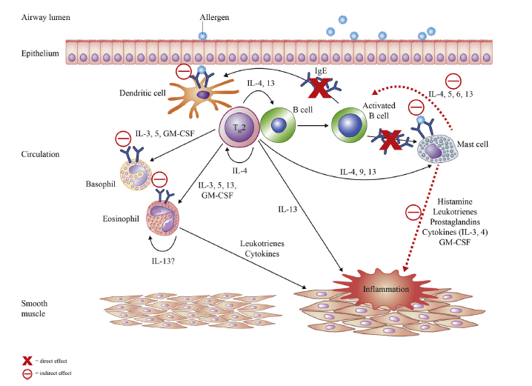
Targeting IgE
Humbert M, et al. J Allergy Clin Immunol Pract. 2014;2(5):525-536.e1

Slide 22
Omalizumab in Severe Asthma As Add-on to Standard Therapy
P=0.006
Mean Asthma Symptom Score
AQLQ(S) Score
AQLQ(S), Asthma Quality of Life Questionnaire score
Hanania NA, et al. Ann Intern Med. 2011;154:573-582.

Slide 23
Omalizumab in Severe Asthma: Real-World Evidence
Change in FEV₁
Impact on School/Work Absence
Change in Asthma Symptoms
ACQ, Asthma Control Questionnaire; FEV₁, forced expiratory volume in 1 second
N=195
Schumann C, et al. Clin Respir J. 2012;6:215-227.
Notes:
Background and Aims: Although the efficacy and safety of omalizumab (OMA) in
uncontrolled severe allergic asthma has been demonstrated in several randomised
controlled trials (RCTs), information on the treatment in a practice-related setting
is limited. Thus, the purpose of this prospective multi-centre study (XCLUSIVE)
was to investigate the efficacy, compliance and utilisation of OMA therapy in
real-life clinical practice in Germany.
Methods: One hundred ninety-five asthmatic patients initiated on anti-
Immunoglobulin E (IgE) IgE treatment were followed-up for 6 months. Forced
expiratory volume in 1 s (FEV1), exacerbation rate, days of absence, asthma symptoms
[Asthma Control Questionnaire (ACQ)], a Global Evaluation of Treatment
Effectiveness (GETE) and medication use were assessed.
Results: Measured outcome variables improved after a 16-week treatment period
with OMA (FEV1 +13.7% predicted P < 0.05, exacerbation rate -74.9% P < 0.0001,
days of absence -92.1% P < 0.001, ACQ -43.7% P < 0.0001). Investigators evaluated
the effectiveness of OMA by GETE in 78.8% as excellent or good (responder),
and in 12.6%/8.6% as moderate/poor or worse (non-responder). Responders demonstrated
better improvement of FEV1, exacerbation rate, days of absence, ACQ
and reduction of oral corticosteroids compared with non-responders.
Conclusion: Results of effectiveness strongly suggest that the efficacy demonstrated
in RCTs can be transposed to a clinical practice-related setting.

Slide 24
Omalizumab: Clinical Evidence
>10 years of randomized control trials, post-marketing, real-life studies as well as pharmacovigilance data showed that omalizumab:
1. | Exacerbations | decreases the rates of exacerbations
2. | Quality of life | improves quality of life of patients Improves asthma symptom control Improves lung function
3. | Health care utilization | reduces emergency room visits and hospitalizations
4. | Steroid use | reduces the use of corticosteroids (both OCS and ICS)
5. | Safety | remains safe and well-tolerated in adults and children

Slide 25
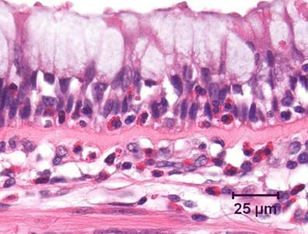
Eosinophilic Asthma
Asthma can be classified phenotypically as eosinophilic (40%-60% of cases) or non-eosinophilic¹
Symptom severity is increased in eosinophilic asthma¹⁻³
Interleukin-5 (IL-5) regulates proliferation, maturation, migration, and effector functions of eosinophils^{1,4}
IL-5 mRNA is increased in patients with asthma, correlates with asthma severity, and is inducible by allergen exposure¹
Corren J. Discov Med. 2012;13(71):305-312.
Miranda C, et al. J Allergy Clin Immunol. 2004;113(1):101-108.
Wenzel SE. Lancet. 2006;368(9537):804-813.
Kouro T, et al. Int Immunol. 2009;21(12):1303-1309.
Notes:
Source of image: http://www.frontiersin.org/Respiratory_Physiology/10.3389/fphys.2012.00312/full
Caption: Bronchus from an asthmatic patient, demonstrating numerous eosinophils, both within the airway epithelium and in the underlying lamina propria.
Mark-up – page 2 of Corren Word doc; pages 1 & 2 of Kouro; and Miranda abstract.

Slide 26


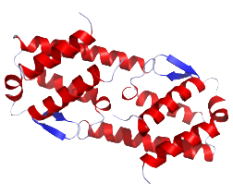
The Targets: IL-5 or Eosinophils (IL-5Rα)
Benralizumab
Mepolizumab
Reslizumab
Eosinophil
IL-5
Raised levels are present in 40–60% of asthmatics.
Release toxins that promote airway inflammation in asthmatic patients
Principal eosinophilic regulatory cytokine
Involved in the maturation, differentiation, survival, and activation of eosinophils

Slide 27
Effect of Anti-IL-5 on Blood Eosinophil Count
10 m
g
/kg dose
Placebo
2–5 m
Allergen
g
/kg dose
challenge
Allergen
Allergen
challenge
challenge
0.8
Dose
0.7
0.6
0.5
Blood eosinophils (x10⁹/L)
0.4
0.3
0.2
0.1
0.0
ys
r
e
6 h
12 h
24 h
y
s
y
s
y
s
y
s
y
s
y
s
k
s
k
s
a
p
a
a
a
a
a
a
ee
ee
–14 days
–13 d
5 d
8 d
9 d
15 d
29 d
30 d
8
w
w
16
Time relative to dose
Leckie MJ, et al. Lancet. 2000;356(9248):2144-2148.

Slide 28
Mepolizumab in Severe Prednisone-Dependent Eosinophilic Asthma
Kaplan-Meier analysis of the proportion of patients without an asthma exacerbation during the study
Significant reduction in exacerbations (P=0.002)
Significant reduction in
steroid dose
  84% mepolizumab
  48% placebo
Sustained benefit x 8 weeks
Reduced eosinophils
No serious adverse events
100
90
Mepolizumab
80
70
60
Patients without exacerbations (%)
50
40
30
20
Randomization
10
Placebo
0
0
2
4
6
8
10
12
14
16
18
20
22
24
26
Weeks
No. at risk
Mepolizumab
9
9
8
7
7
7
7
7
Placebo
10
9
7
7
5
4
3
2
Nair P, et al. N Engl J Med. 2009;360(10):985-993.

Slide 29
Mepolizumab and Exacerbations of Refractory Eosinophilic Asthma
Significant reduction in exacerbations
No effect on lung function, symptom scores, or nitric oxide
6.0
P=0.02
Mepolizumab
100
P=0.29
5.5
Mepolizumab
120
108
109
FeNO (ppb)
Total AQLQ
100
Placebo
97
5.0
30
79
85
Placebo
Placebo
80
69
4.5
Start of treatment
Start of treatment
60
58
0.0
10
Cumulative exacerbations (no.)
47
57
0
1
2
3
4
5
6
7
8
9
10
11
0
1
2
3
4
5
6
7
8
9
10
11
12
49
55
Baseline
Baseline
40
34
40
44
25
33
36
Mepolizumab
10.0
90
20
14
21
27
P=0.70
P=0.35
4
7
13
3.0
Placebo
85
Mepolizumab
0
1
3
2
3
4
5
6
7
8
9
10
11
12
Postbronchodilator
FEV₁ (%)
S
t
art of
Month
PC₂₀ (mg/mL)
treatment
1.0
80
Mepolizumab
0.3
Start of treatment
75
Start of treatment
Placebo
AQLQ = Asthma Quality of Life Questionnaire
0.1
70
Baseline
0
1
2
3
4
5
6
7
8
9
10
11
Baseline
0
1
2
3
4
5
6
7
8
9
10
11
12
Month
Month
Haldar P, et al. N Engl J Med. 2009;360(10):973-984.

Slide 30
Dose-Ranging Efficacy of Mepolizumab in Reducing Exacerbation: The DREAM Study
300
Placebo
Mepolizumab 75
placebo
250
Mepolizumab 750
Mepolizumab 250
200
250 mg
75 mg
Number of clinically
significant exacerbations
750 mg
150
100
50
0
0
1
2
3
4
5
6
7
8
9
10
11
12
13
Total time from start of treatment (months)
Pavord ID, et al. Lancet. 2012;380(9842):651-659.

Slide 31
Mepolizumab: Impact on Asthma Endpoints
Asthma exacerbations¹
Change from baseline in glucocorticoid dose²
250
40
Placebo (N = 66)
Mai
n
t
enance
20
Mepolizumab (N = 69)
dose
200
0
Cumulative no.
Median change (%)
150
–20
O
p
timi
z
ed
100
–40
dose
50
–60
Placebo
0
–80
0
4
8
12
16
20
24
28
32
0
4
8
12
16
20
24
Mepolizumab 75 IV
Week
Week
Mepolizumab 100 SC
FEV₁¹
Asthma exacerbations²
75
70
Placebo
60
70
50
FEV₁ (% of predicted value)
Cumulative no.
40
Mepolizumab
65
30
IV, intravenous
SC, subcutaneous
20
60
10
0
0
4
8
12
16
20
24
28
32
0
0
4
8
12
16
20
24
Week
Week
1. Ortega HG, et al. N Engl J Med. 2014;371(13):1198-1207.
2. Bel EH, et al. N Engl J Med. 2014;371(13):1189-1197.

Slide 32
Reslizumab: BREATH Program
Eosinophil
inclusion criteria
Study design
Key objectives
& outcomes
Asthma with
eosinophils level unselected
16-week FEV₁ (study 3084)
3 mg/kg IV, ages 18–65, n = 492*
Primary—
lung function¹
16-week FEV₁ (study 3081)
3 mg/kg IV and 0.3 mg/kg, ages 12–75,
n = 311*
Primary—
lung function²
Asthma with elevated eosinophils
(≥400)
52-week exacerbation and FEV₁
(study 3082)
3 mg/kg IV, ages 12–75, n = 489*
Primary—
exacerbation³
52-week exacerbation (study 3083)
3 mg/kg IV, ages 12–75, n = 464*
Open-label safety extension (study 3085)
Enrolled patients from 3081, 3082, 3083
3 mg/kg IV, ages 12–75, n = 1052
Primary—
long-term safety⁴
*Numbers of participants include those taking placebo
Corren J, et al. Eur Resp J. 2014;44(suppl 58):4673.
Bjermer L, et al. Eur Resp J. 2014;44(suppl 58):P299.
Castro M, et al. Lancet Respir Med. 2015;3(5):355-66.
NCT01290887 (https://clinicaltrials.gov/ct2/show/NCT01290887?term=asthma%2C+reslizumab%2C+3085&rank=1)
Notes:
Reslizumab BREATH Program: Overview
The phase 3 BREATH Program is composed of 4 randomized, double-blind, placebo-controlled studies.
A 16-week study assessed the effect of Reslizumab 3 mg/kg on lung function in patients with moderate to severe asthma; patients were stratified by baseline blood eosinophil count (≥ or <400 cells/μL).¹
Two 52-week studies evaluated the efficacy and safety of Reslizumab 3 mg/kg in patients with inadequately controlled, moderate to severe asthma and elevated blood eosinophil count (≥400 cells/μL); the primary end point for both studies was the frequency of clinical asthma exacerbation.²
Finally, a 16-week study assessed the effect of Reslizumab 0.3 or 3 mg/kg on lung function in patients with uncontrolled asthma and elevated blood eosinophil count (≥400 cells/μL).^{3,4}
Corren J et al. Eur Resp J. 2014;44(suppl 58):4673.
Castro M et al. Lancet Respir Med. Published online ahead of print February 23, 2015.
Bjermer L et al. Eur Resp J. 2014;44(suppl 58):P299.
Maspero J et al. Ann Allergy Asthma Immunol. 2014;a21.

Slide 33
Improvement in FEV₁ With Reslizumab Is Dependent Upon Blood Eosinophil Count (≥400cells/µL)^{1,2}
Patients with baseline blood eosinophils ≥400 cells/µL treated with reslizumab demonstrated a significant improvement in FEV₁ vs placebo-treated patients
0.5
<Cutoff
≥Cutoff
P=0.0436
0.4
∆ 270 ml
Change in
FEV₁ (L)
0.3
0.2
All bars represent reslizumab vs placebo
0.1
0.0
100
200
300
400
0.0
Eosinophil cutoff (cells per µL)
–0.2
Change in
ACQ-7 score
–0.4
–0.6
∆ 0.49
–0.8
P=0.0634
Conclusion: A blood eosinophil count of ≥400 cells/µL identifies the reslizumab-responsive patient population.
1. Corren J, et al. Chest. 2016;150(4):799-810.
2. Study 3084; data on file.
Notes:
Study 3084: Changes in FEV₁ According to Blood Eosinophil Count
Pre-specified analysis of blood eosinophil cutoffs demonstrated a significant improvement (270 ml) in FEV₁ with Reslizumab versus control
In addition, the ACQ score was improved in this subgroup
In contrast, a significant Reslizumab treatment effect was noted in the subgroup of patients with blood eosinophil count ≥400 cells/μL.
No significant treatment effects were seen in the other baseline eosinophil categories (≥ or <300, 200, and 100 cells/μL).
Conclusion: A blood eosinophil count of ≥400 cells/µL identifies the Reslizumab responsive patient population
Study 3084. Data on file.

Slide 34
Efficacy of Reslizumab for Poorly Controlled Eosinophilic Asthma
106 patients randomized to reslizumab 3 mg/kg vs placebo (IV dosing at weeks 0, 4, 8, and 12)
Sputum eosinophil count reduced by 95.4% in
reslizumab group vs 38.7% in placebo
group (P=0.0068)
Mean change in FEV₁ was –0.08 in the placebo
group vs +0.18 in reslizumab group (P=0.0023)
Exacerbations reduced (P=0.08)
Greater change from baseline in patients with
nasal polyps –1.0 vs –0.1 with placebo (P=0.012)
Reslizumab
0.0
Placebo
-0.2
-0.4
Percent Change in ACQ Score
-0.6
-0.8
p=NS
p=NS
-1.0
p=NS
p=0.0007
-1.2
0
2
4
6
8
10
12
14
16
Week
Castro M, et al. Am J Respir Crit Care Med. 2011;184(10):1125-1132.
Notes:
Source: Berlin ad board slides (slide 16)
Figure 2A from Castro paper
Mark-ups: Castro page 4

Slide 35
Reslizumab—Effects on Exacerbations and Lung Function
Placebo; n = 244
Reslizumab 3.0 mg/kg; n = 245
HR = 0.575 (95% CI 0.440–0.750)
P<0.0001
100
0.40
Placebo
Reslizumab 3.0 mg/kg
90
80
0.30
70
†
†
†
†
†
†
†
†
60
*
†
†
50
0.20
†
*
Probability of not having CAE (%)
LS mean change from baseline in FEV₁ (L)
40
30
0.10
20
Placebo
Reslizumab
10
0
0
0
10
20
30
40
50
60
70
80
0
4
8
12
16
20
24
28
32
36
40
44
48
52
Endpoint
Visit (week)
Visit (week)
No. at risk
Placebo
244
169
138
112
107
97
0
0
0
Reslizumab
245
207
177
158
146
136
1
0
0
CAE = clinical asthma exacerbation; HR = hazard ratio; LS = least square (mean)
Castro M, et al. Lancet Respir Med. 2015;3(5):355-366.

Slide 36
Reslizumab Reduced Frequency of Asthma Exacerbations (Primary Endpoint)
CAEs per patient per year
*P<0.0001
*
*
*
*
*
*
Reslizumab was associated with a significant reduction in the clinical asthma exacerbation rate (primary endpoint) compared with placebo.
Adjudicated CAE Rate represents events per patient per year. Pooled data from 3082 and 3083.
Castro M, et al. Lancet Respir Med. 2015;3(5):355-366.
Notes:
Reslizumab Reduces Frequency of Asthma Exacerbations (primary)
In both studies, Reslizumab was associated with significant reduction in the clinical asthma exacerbation rate (primary end point), compared with placebo.
The majority of exacerbation events (>80%) were defined by the use of systemic corticosteroids for 3 or more days.
When data were pooled, clinical asthma exacerbation rate ratios remained significantly lower with Reslizumab.
This significant benefit was maintained regardless of the treatment patients were receiving at baseline (ie, OCS, ICS plus LABA, or ICS without LABA).
1. Castro M et al. Lancet Respir Med. Published online ahead of print February 23, 2015.

Slide 37
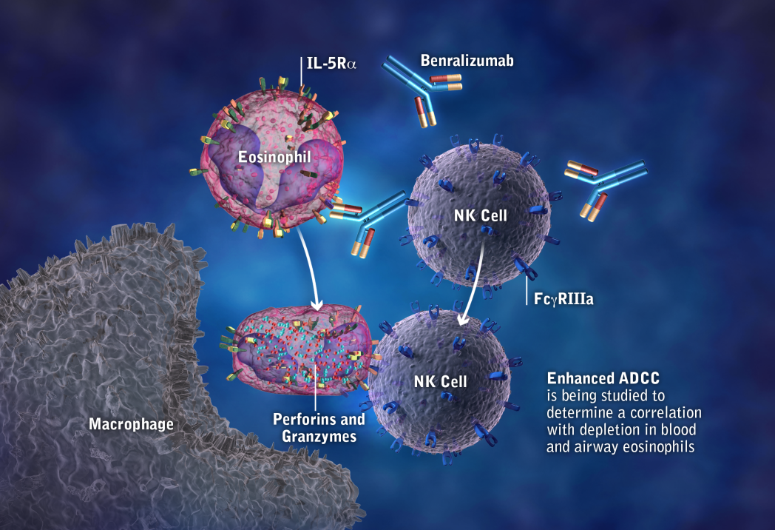
Benralizumab Depletes Eosinophils
Benralizumab depletes eosinophils in a different way from anti-IL-5 ligand approaches
It binds with high specificity to IL-5Rα on eosinophils and basophils, then…
It binds with increased affinity to Fc receptors on immune effector cells through the afucosylated (ie, lack of fucose sugar residues) Fc region of benralizumab
This results in increased ADCC and death of eosinophils and basophils via apoptosis (programmed cell death)
ADCC = antibody-dependent cell-mediated cytotoxicity; Fc = fragment, crystallizable (of immunoglobulin); IL-5Rα = interleukin-5 receptor α
Kolbeck R, et al. J Allergy Clin Immunol. 2010;125(6):1344-1353.
Notes:
ªAnti-IL-5 monoclonal antibodies bind to free IL-5 and thus prevent binding between IL-5 and IL-5R; other putative ligands could induce signalling and eosinophil activation in the presence of anti-IL-5 antibodies

Slide 38
Benralizumab Reduced Frequency of Asthma Exacerbations (Primary Endpoint)
Annual asthma exacerbation rate estimates at 48 weeks
according to baseline blood eosinophil concentrations
Eosinophil ≥300 cells per µL
Eosinophil <300 cells per µL
Percentage reduction
relative to placebo
Percentage reduction
relative to placebo
1.4 –
(1.12-1.58)
-45%
-51%
1.4 –
-30%
-17%
(0.96-1.52)
1.2 –
1.2 –
P=.269
(0.78-1.28)
1.0 –
1.0 –
P=.047
(0.65-1.11)
P<.0001
(0.60-0.89)
0.8 –
P<.0001
(0.53-0.80)
0.8 –
Annual Asthma Exacerbation
Rate Ratio (95% CI)
Annual Asthma Exacerbation
Rate Ratio (95% CI)
0.6 –
0.6 –
0.4 –
0.4 –
0.2 –
0.2 –
0 –
0 –
Placebo
(n=267)
Benralizumab
30 mg Q4W
(n=275)
Benralizumab
30 mg Q8W
(n=267)
Placebo
(n=140)
Benralizumab
30 mg Q4W
(n=124)
Benralizumab
30 mg Q8W
(n=131)
Bleecker ER, et al. Lancet. 2016;388(10056):2115-2127.
Notes:
Data for patients with baseline blood eosinophils (A) ≥300 cells per μL and (B) <300 cells per μL in the full analysis set are shown. Estimates were calculated using a negative binomial model, with adjustment for treatment, region, oral corticosteroid use at time of randomisation, and previous exacerbations. Q4W=every 4 weeks. Q8W=every 8 weeks (ﬁ rst three doses Q4W).

Slide 39
Benralizumab Reduced Oral Glucocorticoid Dose in Severe Asthma (Primary Endpoint)
Change from Baseline in Oral Glucocorticoid Dose
100
Placebo
Benralizu­mab 30 mg, every 4 wk
Benralizu­mab 30 mg, every 8 wk
75% median reduction from baseline in the final oral glucocorticoid dose in patients who received either of the benralizumab regimens, vs 25% in the patients who received placebo (P<.001 for both comparisons)
25
0
Median Change (%)
-25
-50
-75
-100
0
2
4
8
12
16
20
24
28
Week
No.
a
t Risk
Ben
r
ali
zu
72
70
70
69
69
68
66
68
-mab 30 mg Q4W
70
72
67
69
69
66
69
68
Ben
r
ali
zu
-mab 30 mg Q8W
Placebo
74
75
73
74
74
73
73
72
Nair P, et al. N Engl J Med. 2017;376(25):2448-2458.
Notes:
Trial Design:
Patients entering the run­in phase had their oral glucocorticoid dose reduced until the minimum effective dose without loss of asthma control was reached. All the patients then underwent randomization and entered the induc­tion phase, during which the dose established in the run­in phase was maintained. The oral glucocorticoid dose was further reduced, every 4 weeks, in the intervention period from weeks 4 to 24. The oral glucocorticoid dose that was reached at week 24, or the complete discontinuation of oral glucocorticoid therapy, was maintained until week 28. The last dose of benralizumab or placebo was administered at the week 24 visit.
he median reduction from baseline in the final oral glucocorticoid dose was 75% in pa-tients who received either of the benralizumab regimens, as compared with a reduction of 25% in the patients who received placebo (P<0.001 for both comparisons)
A total of 24 patients (33%) who received benraliz-umab every 4 weeks and 27 patients (37%) who received benralizumab every 8 weeks had a re-duction of 90% or more from baseline in their final oral glucocorticoid dose, as compared with 9 patients (12%) who received placebo

Slide 40
Benralizumab: Longer Time to Asthma Exacerbation
Time to First Asthma Exacerbation
Benralizu­mab administered every 4 weeks was associated with a longer time to the first exacerbation than placebo (HR, 0.39; 95% CI, 0.22 to 0.66; P<.001)
Benralizumab administered every
8 weeks was also associated with a longer time to the first exacerbation than placebo (HR, 0.32; 95% CI, 0.17 to 0.57; P<.001)
100
Placebo
Benralizu­mab 30 mg, every 4 wk
Benralizu­mab 30 mg, every 8 wk
90
80
70
60
Patients with an Exacerbation (%)
50
40
30
20
10
0
0
4
8
12
16
20
24
28
Week
No.
a
t Risk
Benralizumab 30 mg Q4W
72
69
68
62
61
56
51
45
Benralizumab 30 mg Q8W
73
68
66
60
58
56
55
51
Placebo
75
68
64
56
45
40
37
31
Nair P, et al. N Engl J Med. 2017;376(25):2448-2458.

Slide 41
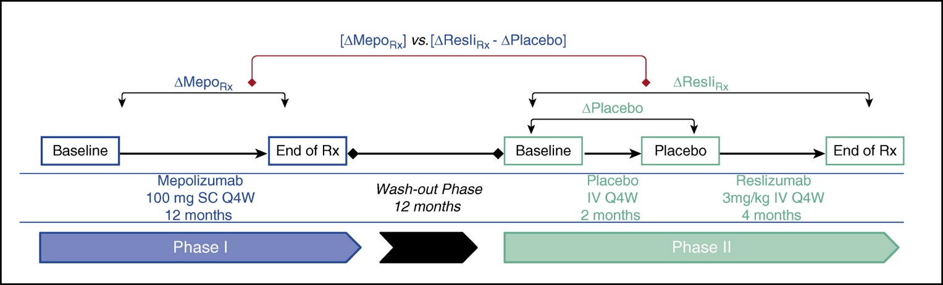
Mepolizumab vs Reslizumab
Mukherjee M, et al. Am J Respir Crit Care Med 2018;197(1):38-46.

Slide 42
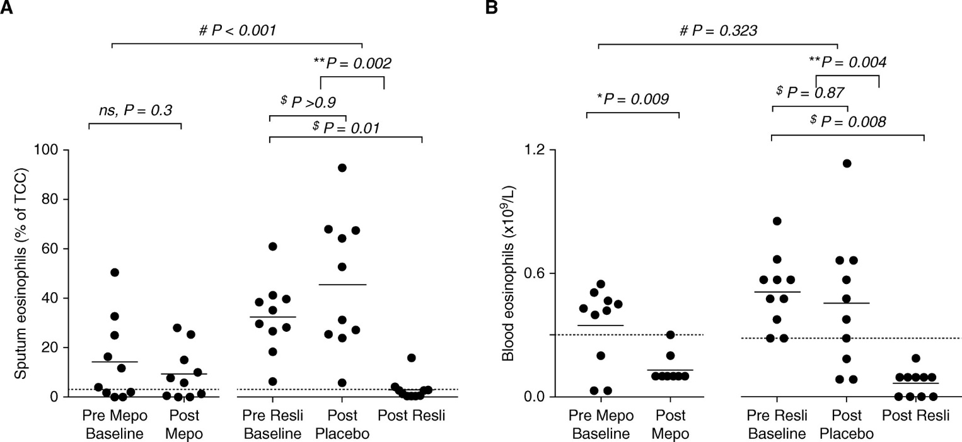
Mepolizumab vs Reslizumab (cont)
Mukherjee M, et al. Am J Respir Crit Care Med 2018;197(1):38-46.

Slide 43
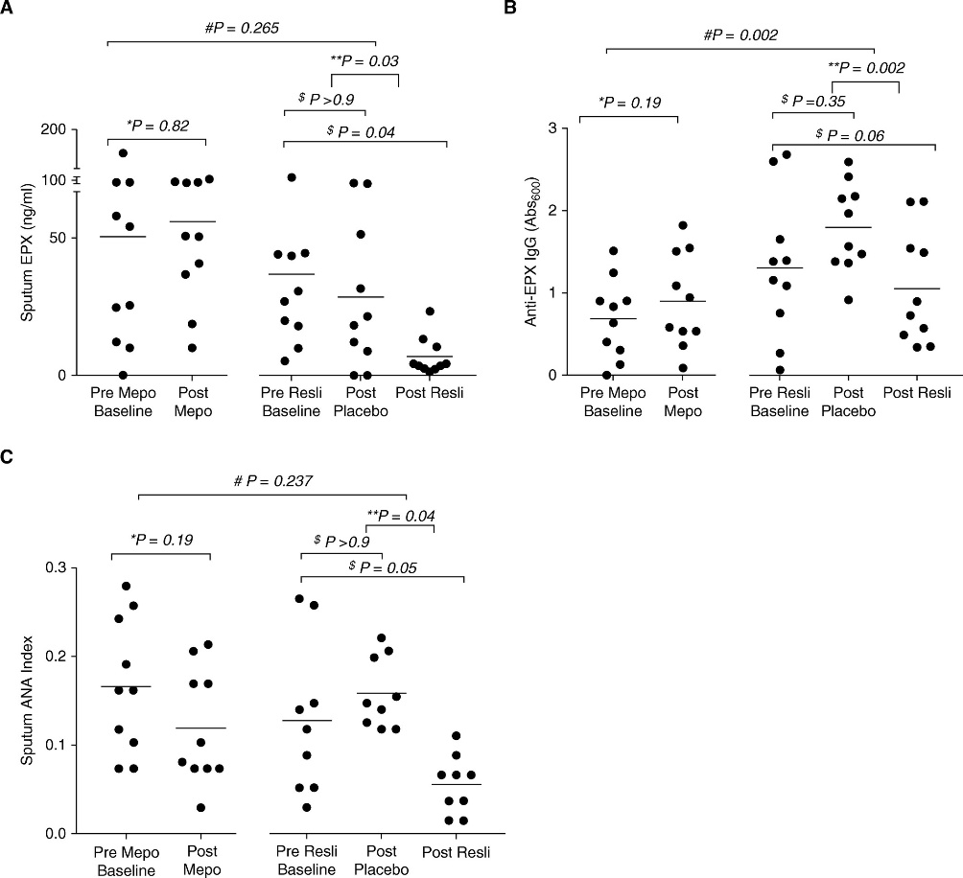
Mepolizumab vs Reslizumab (cont)
Mukherjee M, et al. Am J Respir Crit Care Med 2018;197(1):38-46.

Slide 44
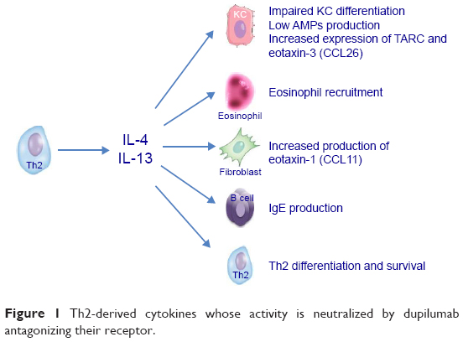
Dupilumab: IL-4/IL-13 Antibody Targeting T2 Pathway
Dupilumab is a fully human monoclonal antibody
that targets the IL-4Rα of the IL-4 and IL-13 receptors
Impaired KC differentiation
Low AMPs production
Increased expression of TARC and oxtaxin-3 (CCL26)
↑Airway inflammation
↑Mucus production
↑ Airway hyperresponsiveness
↑Airway remodeling
Eosinophil recruitment
Eosinophil
IL-4
IL-13
Increased production of eotaxin-1 (CCL11)
Fibroblast
IgE production
Th2 differentiation and survival
AMPs, antimicrobial peptides; KC, keratinocyte; TARC, thymus- and activation-regulated chemokine.
D’Erme AM. Drug Design Dev Ther. 2017;11:1473-1480.

Slide 45
Efficacy of Dupilumab in Patients with Asthma: LIBERTY ASTHMA Phase 3 Trials
QUEST Phase 3 Trial
1902 patients ≥ 12 years with uncontrolled, moderate-to-severe asthma
Placebo 1.14 mL
Dupilumab 200 mg q2w
Placebo 2 mL
Dupilumab 300 mg q2w
Reduction vs placebo
−48%
−46%
P < 0.001 at all timepoints
0.4
0.970
(0.810–1.160)
0.3
0.871
(0.724–1.048)
Adjusted annual severe exacerbations, event rate (95% CI)
***
***
Change from baseline in FEV₁ (L), LS mean (± SE)
0.524
(0.450–0.611)
0.2
0.456
(0.389–0.534)
0.1
0
n
0
2
4
6
8
10
12
16
20
24
28
32
36
40
44
48
52
Week
Dupilumab Q2W treatment arms more consistent and efficacious at improving time to first exacerbation, asthma control scores, quality of life, and FeNO values across patient subgroups
***P < 0.001 vs matched placebo. CI, confidence interval; ITT, intent-to-treat; LS, least squares; SE, standard error.
Castro M, et al. N Engl J Med. 2018;378(26):2486-2496.
Notes:
Dupilumab also improved FEV1 outcomes and ACQ-5 scores, and reduced hospitalization/ED visit rates.
Sub-analysis by blood eosinophils and FeNo levels show that dupilumab is most effective in patients with higher values at baseline

Slide 46
Dupilumab 300 mg Q2W* in Steroid-Dependent Moderate/Severe Uncontrolled Asthma
P<0.001
N=210
*Not approved for severe asthma in the United States
Rabe KF, et al. N Engl J Med. 2018;378(26):2475-2485

Slide 47
Limitations of Major Trials for New Biologics
The major trials for new biologics had limitations, including:
  Small sample size
    Additional studies with larger groups of patients are needed to confirm findings
  Short treatment period
    Limited data on durability of response exist
  Determination of most effective biomarkers to select responsive patients is still an unmet need
  Limited data on which biologic to try first
  No data on combination therapy with two biologics
Nair P, et al. N Engl J Med. 2009;360(10):985-993;
Haldar P, et al. N Engl J Med. 2009;360(10):973-984;
Corren J, et al. N Engl J Med. 2011;365(12):1088-1098;
Slager RE, et al. J Allergy Clin Immunol. 2012;130(2):516-522;
Piper E, et al. Eur Respir J. 2013;41(12):330-338.

Slide 48
Chest Foundation. SevereAsthmaTreatments.Chestnet.org. Accessed September 5, 2018.

Slide 49
Questions?

