Slide 2
Learning Objectives
Describe the relationship between the JAK-STAT signaling pathway and pathogenesis of inflammatory bowel disease.
Summarize the latest research developments in treatment of inflammatory bowel disease with JAK inhibitors.
Incorporate evidence-based research into clinical practice.
JAK, Janus kinase; STAT, signal transducer and activator of transcription.

Slide 3
Rationale for jak inhibitors in ibd
Module 1

Slide 4
Prevalence and Current Treatment of IBD
2015 prevalence data
3.1 million people (1.3%) ≥18 years have received a diagnosis of IBD (UC, CD)¹
Current treatments:
Aminosalicylates
Immunosuppressives
Corticosteroids
TNF antagonists
Induction and maintenance of remission remains challenging with conventional and biologic therapies²⁻⁴
~25% patients fail to achieve response
Decreased quality of life, substantial morbidity, and complications requiring hospitalizations and surgical procedures
IBD, inflammatory bowel disease; TNF, tumor necrosis factor; UC, ulcerative colitis; CD, Crohn’s disease.
Centers for Disease Control. https://www.cdc.gov/mmwr/volumes/65/wr/mm6542a3.htm
Scott FI, et al. Curr Treat Options Gastroenterol. 2016;14:91-102.
Cohen RD. Aliment Pharmacol Ther. 2002;16:1603–9.
Bewtra M, et al. Clin Gastroenterol Hepatol. 2007;5:597–601.

Slide 5
Pathogenesis of IBD
Multifactorial pathogenesis
Genetic, environmental, microbial
Involves dysfunctional response from the innate and adaptive immune system
Multiple inflammatory cytokines are overexpressed
Amplification of the immune response leads to phenotypic expression of the disease and tissue destruction
Mediate dysfunctional cell-cell interactions in innate and adaptive immune response pathways
Reprinted from Translational Research, Vol 167, Bamias G, Pizarro TT, Cominelli F, Pathway-based approaches to the treatment of inflammatory bowel disease, Pages 104-115, Copyright 2016, with permission from Elsevier.

Slide 6
Rationale for Targeting JAK-STAT Signaling
JAKs play a role in regulating cellular proliferation, differentiation, and immune cell functions
JAK-STAT is the major signaling cascade downstream from cytokine and growth factor receptors
JAK family = JAK1, JAK2, JAK3
STAT family = 7 transcription factors
JAKs serve to transduce signals from cytokine receptors
JAK inhibitors interfere with JAK-STAT signaling
Compete with ATP for binding to the kinase domain of JAKs and inhibit JAK1, JAK2, JAK3
JAK inhibitors are used effectively in other chronic inflammatory conditions (eg, rheumatoid arthritis, psoriasis)
JAK inhibition is a potential therapeutic target in IBD
JAK1/JAK3 involved in transduction processes of IL-2R and IL-6R (including IL-12 and IL-23)
JAK, Janus kinase family; STAT, signaling transducers and activators of transcription; IBD, inflammatory bowel disease.
Boland BS, et al. Gastroenterol Clin North Am. 2014;43:603-17. Villarino AV, et al. J Immunol. 2015;194:21-27.
Patterson H, et al. Clin Exp Immunol. 2014;176(1):1-10.

Slide 7
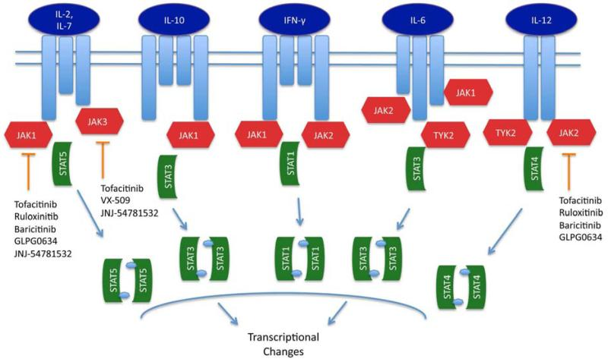
JAK Signaling Pathways in IBD and Therapeutic Targets of JAK Inhibitors
Reprinted from Gastroenterology Clinics of North America, Vol 43, Boland BS, Sanborn WJ, Chang JT, Update on Janus Kinase Antagonists in Inflammatory Bowel Disease, Pages 603-617, Copyright 2014, with permission from Elsevier.

Slide 8
Ongoing Studies of Small Molecule Inhibitors of JAK-STAT Signaling in IBD
Agent | Primary Inhibition | Ongoing Studies
Tofacitinib | JAK1, JAK3, >JAK2 | UC, CD, phase III
Filgotinib | JAK1 | CD, phase III; UC phase III
GLPG0634 | JAK1 > JAK2 & TYK2 | CD, phase II
Peficitinib (JNJ-54781532) | JAK1 & JAK3 | UC, phase II
Upadacitinib (ABT-494) | JAK1 | CD, phase II; UC phase III
UC, ulcerative colitis; CD, Crohn’s disease.
Boland BS, et al. Gastroenterol Clin North Am. 2014;43(3):603-617.
www.clinicaltrials.gov

Slide 9
efficacy
Module 2

Slide 10
Tofacitinib Efficacy in Ulcerative Colitis
From The New England Journal of Medicine, Sandborn WJ, Subrata G, Panes J, et al., Tofacitinib, an Oral Janus Kinase Inhibitor, in Active Ulcerative Colitis, Volume 367, Page 616-624, Copyright © 2012 Massachusetts Medical Society. Reprinted with permission from Massachusetts Medical Society.

Slide 11
Tofacitinib Efficacy in UC
Treated, tumor necrosis factor-alpha inhibitor treated; Healing, mucosal healing.
Sandborn WJ, et al. Abstract 767. Presented at Digestive Disease Week May 21-24, 2016; San Diego, California.

Slide 12
OCTAVE Sustain
Phase 3 trial of tofacitinib as maintenance therapy vs placebo in adult patients with moderate to severe UC
Patients (N=593) who had completed one of the OCTAVE Induction studies and had clinical response to induction therapy
Randomized to receive maintenance treatment with tofacitinib 5 mg BID, tofacitinib 10 mg BID, or placebo
Remission at 52 weeks (p<0.001 for both doses vs placebo)
Tofacitinib 5mg = 34.3%
Tofacitinib 10 mg = 40.6%
Placebo = 11.1%
Sandborn WJ, et al. New Engl J Med. 2017;376(18):1723-1736.

Slide 13
Filgotinib in Ulcerative Colitis: SELECTION Trial
Phase 2b/3 clinical trial investigating efficacy and safety of filgotinib (100 mg, 200 mg)
Induction and maintenance treatment for patients with moderately to severely active ulcerative colitis
Primary endpoint: proportion achieving remission at weeks 10 and 58
Currently recruiting
https://www.clinicaltrials.gov/ct2/show/NCT02914522?term=filgotinib&rank=2

Slide 14
Tofacitinib Efficacy in Crohn’s Disease: Phase 2 Study
CDAI, Crohn’s Disease Activity Index.
Sandborn WJ, et al. Clin Gastroenterol Hepatol. 2014;12(9):1485-1493.e1482.

Slide 15
Tofacitinib Efficacy in Crohn’s Disease: Phase 2b
CDAI, Crohn’s Disease Activity Index; *Or remission NRI, non-responder imputation.
Panes J, et al. Gut. 2017 [Epub March 2017] doi:10.1136/ gutjnl-2016-312735.

Slide 16
Filgotinib in Crohn’s Disease: FITZROY
CDAI, Crohn’s Disease Activity Index.
Vermeire S, et al. Lancet. 2017;389:266-275.

Slide 17
Filgotinib in Crohn’s Disease: FITZROY
CDAI, Crohn’s Disease Activity Index.
Vermeire S, et al. Lancet. 2017;389:266-275.

Slide 18
Safety
Module 3

Slide 19
Tofacitinib Tolerability and Side Effects (UC)
Dose-dependent hyperlipidemia and viral infections noted in highest tofacitinib dose group
AE, adverse event; SEA, serious adverse event.
Sandborn WJ, et al. N Engl J Med. 2012;367(7):616-624.

Slide 20
Tofacitinib Tolerability and Side Effects (CD)
Dose-dependent hyperlipidemia and viral infections noted in highest tofacitinib dose group
AE, adverse event; TEAE, treatment-emergent adverse event; SEA, serious adverse event.
Sandborn WJ, et al. Clin Gastroenterol Hepatol. 2014;12(9):1485-1493.e1482.

Slide 21
Filgotinib Pooled Safety Analysis (100mg + 200mg), Week 20
TEAE, treatment-emergent adverse event; STEAE, serious treatment-emergent adverse event.
Vermeire S, et al. Lancet. 2017;389:266-275.

Slide 22
Clinical Implications of JAK Inhibitors
Tofacitanib: UC/CD | Filgotinib: CD
Oral dosing
Low antibody risk
Increased infection risk Anemia Lipid elevations | Lower response rates in anti-TNF exposed patients Favorable lipid profile
Potential uses:
Salvage therapy?
In combinations?
As substitute for corticosteroids in first-line setting?
Shared decision-making is key

Slide 23
Summary
JAK-STAT inhibition is a promising therapeutic target in IBD
Tofacitinib has shown efficacy in UC and CD
Filgotinib has shown efficacy in CD
Both agents demonstrate tolerability
Dose dependent hyperlipidemia w/tofacitinib
Several trials are ongoing
Shared decision-making with patient will be key to effective use in clinical practice

