Slide 2
Introduction

Slide 3
Primary Biliary Cholangitis (PBC)
Immune-mediated disease → destruction of small bile ducts → chronic intrahepatic cholestasis
Incidence: 2.75 per 100,000 persons in North America
Female-to-male ratio: 5-to-1¹
Transplant-free survival²
Diminished quality of life due to³:
Fatigue
Pruritus
Right upper quadrant pain
Sicca syndrome
 | 10 years | 15 years
Untreated | 59% | 32%
Treated | 78% | 60%
Lleo A, et al. Sci Rep. 2016;6:25906.
Lammers WJ, et al. Gastroenterology. 2014;147:1338-1349.
Lindor KD, et al. Hepatology. 2019;69(1):394-419.

Slide 4
Epidemiology of Pruritus Associated With PBC
2019 UK-PBC epidemiologic study¹
74% of patients experienced pruritus
35% reported persistent itching
12% complained of severe pruritus
75% of patients complained of pruritus before diagnosis²
Pruritus may improve as the disease progresses to cirrhosis³
Hegade VS, et al. Clin Gastroenterol Hepatol. 2019;17(7):1379-1387.
Rishe E, et al. Acta Derm Venereol. 2008;88(1):34-37.
Talwalkar JA, et al. Clin Gastroenterol Hepatol. 2003;1:297-302.
Notes:
OK

Slide 5
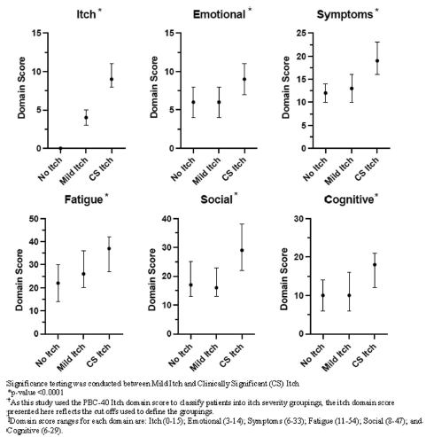
Patient Burden
Longitudinal observational cohort of patients with PBC in the US (N=211)
Completed the PBC-40, 5-D itch, PROMIS fatigue survey
Divided into 3 groups:
No itch
Mild itch
Clinically significant (CS) itch
Patients with clinically significant itch scored worse on:
All PBC-40 quality-of-life assessments
5-D disability and PROMIS fatigue scores
Reproduced without modification from: Mayo MJ, et al. Dig Dis Sci. 2023;68(3):995-1005 under the terms of Creative Commons license CC BY-NC 4.0. © The Authors 2022, corrected publication 2023.
Notes:
I don’t like the graphs here – any chance we can only change it to the part from the left?

Slide 6
Pathophysiology of Cholestatic Pruritus
Reproduced without modification from: Dull MM, et al. Clin Liver Dis. 2022;26(4):727-745 under the terms of Creative Commons license CC BY 4.0. © The Authors.
Notes:
Not fully known and may be multifaceted
Presence of cholephilic pruritogens in the enterohepatic circulation
Evidenced by improved pruritus by removing bile contents
The Mas-related G protein-coupled receptor family X4 (MRGPRX4) on sensory neurons that mediate itch can be activated by bile acid subspecies
Obeticholic Acid (OCA), a farnesoid X receptor (FXR) agonist approved to treat PBC, reduces bile acid synthesis and promotes choleresis. OCA can induce or intensify pruritus³
Formation, biotransformation, or secretion of potential pruritogens in the liver
Rifampin, which induces hepatic enzymatic activity and is a pregnane X receptor agonist, has been shown to reduce hepatic pruritus
Influence of pruritogens on endogenous opioid and serotonin receptors
Mild antipruritic effect in cholestatic pruritus of μ-opioid antagonists, κ-opioid agonists, and selective serotonin reuptake inhibitors (SSRIs)
Presence of potential pruritogens in the systemic circulation
Autotaxin (ATX) activity was correlated with itch intensity in patients with PBC

Slide 7
Diagnosis and Monitoring

Slide 8
Clinical Presentation^{1,2}
Follows a circadian rhythm with a higher intensity in the evening or night hours
Itch in the extremities focusing on the palms and soles
Can be generalized
No lesions
Can wax/wane in intensity over the course of the disease
1. Düll MM, et al. Clin Liver Dis. 2022;26(4):727-745.
2. Trivedi HD, et al. Am J Med. 2017;130(6):744.e1-744.e7.
Notes:
Usually presents with itch in the extremities involving the palms of the hands and soles of the feet
Can also be generalized
Can begin at any stage of PBC and is independent of PBC severity
Can wax/wane over the course of the disease
Follows a circadian rhythm with a higher intensity in the evening or night hours
The skin of patients with PBC-associated pruritus usually does not have any lesions

Slide 9
PBC Diagnosis
Evidence of 2 of the following:
Cholestasis based on elevated alkaline phosphatase level
Antimitochondrial antibodies
Nonsuppurative destructive cholangitis and destruction of interlobular bile ducts
Lindor KD, et al. Hepatology. 2019;69(1):394-419.
Notes:
Do we need this slide?

Slide 10
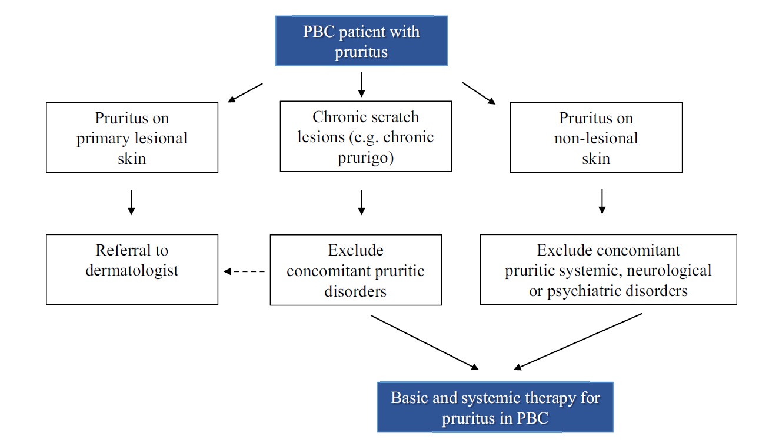
Diagnosis of Pruritus Associated With PBC
Reproduced without modification from: Dull MM, et al. Clin Liver Dis. 2022;26(4):727-745 under the terms of Creative Commons license CC BY 4.0. © The Authors.

Slide 11
Assessment Tools
Worst Itch Numerical Rating Scale (WI-NRS)¹
Scale of 0-10 (over past 7 d)
0 = no itch
10 = unbearable itch
Worst itch:___/10
Worst Itch Visual Analog Scale (WI-VAS)^{1,2}
PBC-40³
5-point Likert scale
1 = least burden
5 = greatest burden
Multi-dimensional
Symptoms, itch, fatigue, cognition, social, and emotional
Assesses:
How itch disturbed sleep
If scratching made the skin raw
How embarrassed the patient felt because of itching.
None
Unbearable
Elman S, et al. Br J Dermatol. 2010;162:587-593.
Hegade VS, et al. Frontline Gastroenterol. 2016;7:158-166.
Jacoby A, et al. Gut. 2005;54:1622-1629.

Slide 12
Treatment Overview

Slide 13
Goals for Treating Pruritus Associated With PBC
Ameliorate itch symptoms
Minimize treatment-related adverse events
Prevent PBC disease progression
Reduce disease burden
Improve quality of life

Slide 14
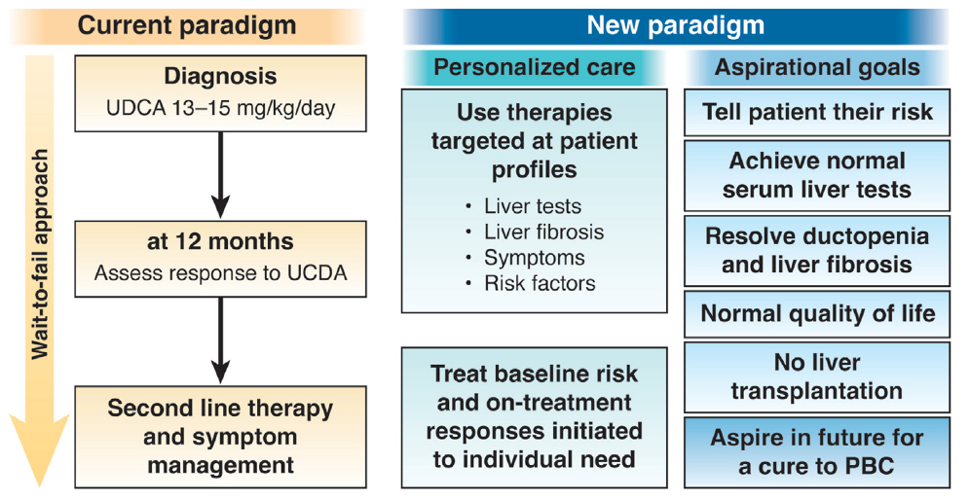
Treatment of Underlying PBC
At 12 months
Assess response to UDCA
UDCA, ursodeoxycholic acid
Reproduced without modification from: Levy C. et al. Clin Gastroenterol Hepatol. 2023;21:2076-2087 under the terms of Creative Commons license CC BY-NC-ND 4.0. © 2023 by the AGA Institute.
Notes:
Ok slide

Slide 15
Considerations for Treating Underlying PBC
Ursodeoxycholic acid does not improve itch¹
Bezafibrate* (fibric acid derivative)
Improves biochemical markers, relieves itch in PBC²
May be a role for fenofibrate**
Obeticholic acid (farnesoid X receptor agonist)
Improves biochemical markers in PBC; can make pruritis worse¹
Elafibranor and seladelpar (peroxisome-proliferator activated receptor- PPAR- agonists)
Recently approved for PBC, may improve itch^{3,4}
*Not available in U.S. **Not approved for PBC by the US Food and Drug Administration
Düll MM, et al. Clin Liver Dis. 2022;26(4):727-745.
Corpechot C, et al. N Engl J Med 2018;378:2171-2181
Kowdley KV, et al. N Engl J Med. 2024;390:795-805.
Hirschfield GM, et al. N Engl J Med. 2024;390:783-794.
Notes:
Ok – should we include a slide about meds that don’t change disease activity?

Slide 16
Key Concepts
UDCA is not effective for pruritus
Obeticholic acid may worsen pruritus
Fibric acid derivatives and PPAR agonists can improve liver biomarkers and may improve pruritus
Pruritus should be assessed with each PBC office visit using validated tools
A step-wise approach with 2-4 week follow up intervals should be taken to improve pruritus symptoms in patients with PBC

Slide 17
Current Treatment Options

Slide 18
General Measures for Itch Relief
Avoid:
Heat
Frequent bathing with hot water
Ice packs
Skin contact with irritants
Consumption of large amounts of hot/spicy food, hot drinks, or alcohol
Tight clothing or wool
Scented detergents
Extensive rubbing of the skin
Psychological factors like stress
Utilize/Promote:
Mild, nonalkaline soaps for bathing
Luke-warm water for bathing (<20 min)
Mild, moisturizing creams or lotions on the whole skin daily
Topical agents with anesthetic effects for pruritic skin areas
Soft, loose, permeable clothes
Trim fingernails to avoid skin damage when scratching
Relaxation techniques or autogenic training to disrupt the itch-scratch cycle
Reproduced with modification from: Dull MM, et al. Clin Liver Dis. 2022;26(4):727-745 under the terms of Creative Commons license CC BY 4.0. © The Authors.

Slide 19
Conventional Approach to Therapy^{1,2}
1 | R/O other systemic causes Assess QOL Provide interprofessional, multidisciplinary care Assess pruritus severity Consider conservative measures
2 | Cholestyramine
3 | Rifampin
4 | Opioid antagonist (naloxone, naltrexone)
5 | Sertraline
6 | Investigational therapies (phototherapy, plasmapheresis, albumin dialysis, nasobiliary drainage, clinical trial
7 | Consider liver transplantation
O n g o I n g A s s e s s m e n t
Use a step-wise approach
Cholestyramine is the only medication with an approved indication for pruritus associated with PBC
Most mild symptoms can be controlled with moisturizers and other general measures for itch relief
Antihistamines are not effective
Moderate to severe symptoms may need additional therapy
Start with a medication, follow up in 2-4 weeks and advance therapy until pruritus is managed
Refer to PBC experts for possible inclusion into clinical trials or other experimental therapies
Düll MM, et al. Clin Liver Dis. 2022;26:727-745.
Trivedi HD, et al. Am J Med. 2017;130(6):744.e1-744.e7.

Slide 20
Elafibranor*: ELATIVE Trial− Design
Phase 3, double-blind, placebo-controlled
Elafibranor 80 mg daily
Patients with PBC who had inadequate biochemical response or unacceptable side effects to UDCA (N=161)
Primary endpoint
% Patients achieving a biochemical response at 52 wks
Alkaline phosphate <1.67 x ULN and ≥15% reduction from baseline
Normal total bilirubin level
Secondary endpoints
Alkaline phosphatase WNL at 52 wks
Change in pruritus intensity (WI-NRS) at 24 and 52 wks
*Not approved for pruritus associated with PBC by the US Food and Drug Administration
Kowdley KV, et al. N Engl J Med. 2024;390:795-805.

Slide 21
Elafibranor*: ELATIVE Trial− Efficacy
 | Elafibranor | Placebo | Statistical Significance
% who achieved a biochemical response* | 51% | 4% | P<0.001
LSM change WI-NRS | -1.93 | -1.15 | Difference = -0.78 95% CI (-1.99 to 0.42)
LSM change from baseline in itch domain PBC-40** | -2.5 | -0.1 | Difference = -2.3 95% CI (-4.0 to -0.7)
LSM change from baseline in 5-D itch score** | -4.2 | -1.2 | Difference = -3.0 95% CI (-5.5 to –0.5)
Results after 52 weeks *Primary endpoint **Patients with baseline moderate-to-severe pruritus
CI, confidence interval; LSM, least square mean; WI-NRS, worst itch numerical rating scale
*Not approved for pruritus associated with PBC by the US Food and Drug Administration
Kowdley KV, et al. N Engl J Med. 2024;390:795-805.

Slide 22
Elafibranor*: ELATIVE Trial− Safety
Similar incidence of adverse events between the 2 groups
Most were mild or moderate in intensity
Selected AEs more common with elafibranor (vs placebo):
Elevated creatine phosphokinase
4 patients dropped out of the trial due to ↑ CPK
Arthralgia/Myalgia (11.1% vs 3.8%)
Ligament sprain, hip/wrist fracture (6.6% vs 0%)
*Not approved for pruritus associated with PBC by the US Food and Drug Administration
Kowdley KV, et al. N Engl J Med. 2024;390:795-805.

Slide 23
Elafibranor*: Safety
Package labeling lists the following cautions:
Elafibranor may cause fetal harm when administered during pregnancy
Drug-induced liver injury occurred in 1 patient who took 80mg of elafibranor and 2 patients who took 120mg
Increases of ALT or AST ≥ 5 times the upper limit of normal occurred equally (6%) of active and placebo treated patients
Hypersensitivity reactions
Avoid in patients with biliary obstruction
*Not approved for pruritus associated with PBC by the US Food and Drug Administration
Iqirvo. Prescribing information. Ipsen Biopharmaceuticals, Inc. Accessed December 13, 2024. https://www.accessdata.fda.gov/scripts/cder/daf/index.cfm?event=BasicSearch.process -

Slide 24
Seladelpar*: RESPONSE Trial− Design
Phase 3, double-blind, placebo-controlled trial
Seladelpar 10mg daily
Patients with PBC who had an inadequate biochemical response or were intolerant to UDCA (N=193)
Primary endpoint
% of patients achieving a biochemical response at 12 months
Alkaline phosphate <1.67 times the upper limit of normal and ≥ 15% reduction from baseline
Normal total bilirubin levels
Secondary endpoints
Normalization of alkaline phosphatase (ALP) levels at 12 months
Change in pruritus intensity (mean weekly pruritus NRS score) at 6 months in patients with moderate-to-severe pruritus
*Not approved for pruritus associated with PBC by the US Food and Drug Administration
Hirschfield GM, et al. N Engl J Med. 2024;390:783-794.

Slide 25
Seladelpar*: RESPONSE Trial− Efficacy
 | Seladelpar (N=128) | Placebo (N=65) | Statistical Significance
% who achieved a biochemical response at 12 months* | 61.7% | 20% | P<0.001
% who achieved normalization of ALP at 12 months | 25% | 0% | P<0.001
LSM change from baseline in the pruritus NRS score at 6 months** | -3.2 | -1.7 | Difference = -1.5 95% CI (-2.5 to -0.5)
*Primary endpoint **Patients with baseline moderate-to-severe pruritus
CI, confidence interval; LSM, least square mean; NRS, numerical rating scale
*Not approved for pruritus associated with PBC by the US Food and Drug Administration
Hirschfield GM, et al. N Engl J Med. 2024;390:783-794.

Slide 26
Seladelpar*: RESPONSE Trial− Safety
Event* | Seladelpar (N=128) | Placebo (N=65)
Any adverse event | 86.7% | 84.6%
Any serious adverse event | 7.0% | 6.2%
Adverse leading to discontinuation | 3.1% | 4.6%
Headache | 7.8% | 3.1%
Abdominal pain | 7.0% | 1.5%
Abdominal distention | 6.2% | 3.1%
Nausea | 6.2% | 4.6%
*Not approved for pruritus associated with PBC by the US Food and Drug Administration
*Adverse event occurring more frequently in the seladelpar group
Hirschfield GM, et al. N Engl J Med. 2024;390:783-794.

Slide 27
Seladelpar*: Safety
Cautions listed in the package labeling:
Fractures in 4% of patients
Elevated (>3 times ULN) ALT and AST levels occurred in patients taking higher than recommended dosages
Avoid using seladelpar in patients with biliary obstruction
*Not approved for pruritus associated with PBC by the US Food and Drug Administration
ULN, upper limit of normal
Livdelzi. Prescribing information. Gilead Sciences, Inc. Accessed December 13, 2024. https://www.accessdata.fda.gov/scripts/cder/daf/index.cfm?event=BasicSearch.process

Slide 28
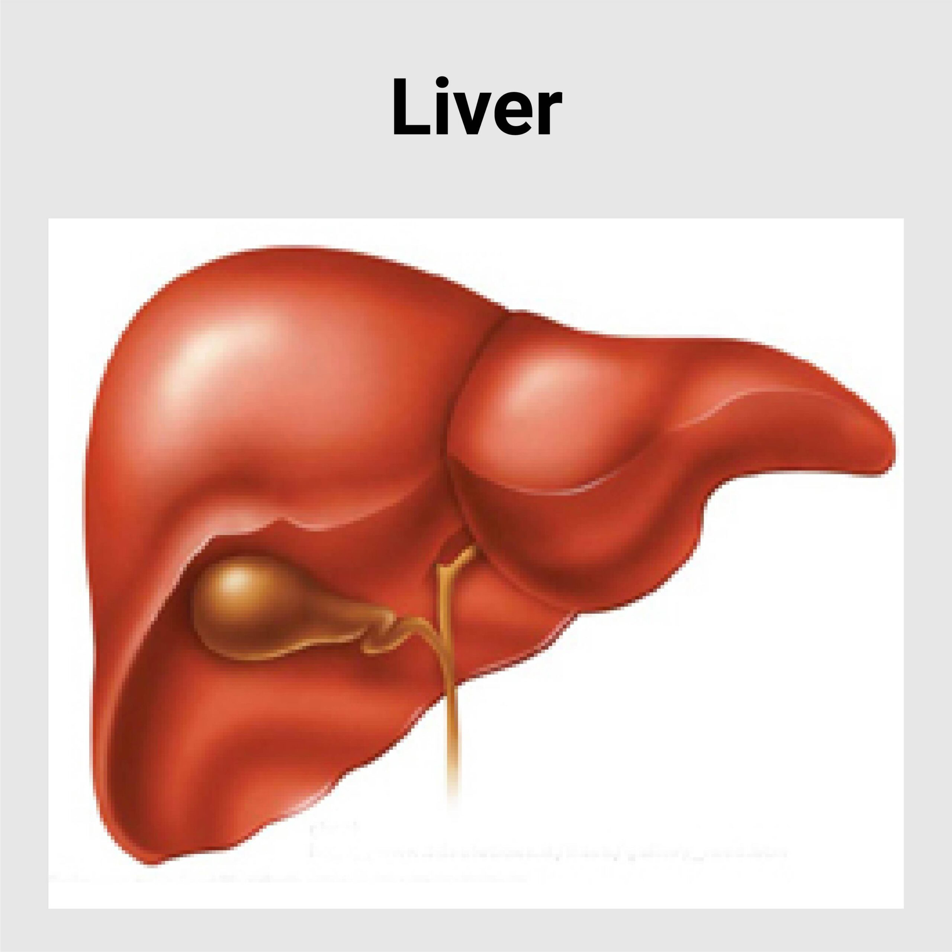
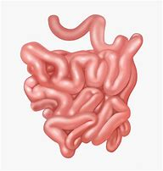
Ileal Bile Acid Transporter (IBAT) Inhibitor Mechanism of Action
Bile acid
Bile acid
Reabsorbed lipid
Enterocyte
IBAT
Inhibitor
Feces
Bedoyan SM, et al. Expert Opin Pharmacother. 2022;23:1771-1779.
Notes:
IBAT controls the reuptake of bile acids from the small intestine into the enterohepatic circulation
Inhibition of IBAT results in an increased amount of bile acid in the colon and less in the enterohepatic circulation

Slide 29
Maralixibat* and Odevixibat*
Ileal Bile Acid Transporter (IBAT) Inhibitors
Approved to treat cholestatic pruritus in patients with Alagille syndrome and progressive familial intrahepatic cholestasis
Clinical trials for PBC-associated pruritus are ongoing
*Not approved for pruritus associated with PBC by the US Food and Drug Administration
Jeyaraj R, et al. Lancet Child Adolesc Health. 2024;8:75-84.

Slide 30
Non-Pharmacologic Therapy
Phototherapy
Plasmapheresis
Albumin dialysis
Nasobiliary drainage
Liver transplantation
Patient education

Slide 31
Phototherapy
Ultraviolet B phototherapy
Mechanism is unknown
Observational study (N=13) in patients with different cholestatic liver disorders
Standard treatment with cholestyramine, rifampin, or naltrexone failed to control pruritus
Mean visual analogue score decreased from 8.0-2.0 (P<0.001) after a mean of 8 weeks and 26 treatments.
Treatment was generally well tolerated
Decock S, et al. J Hepatol. 2012;57:637-641.

Slide 32
Plasmapheresis
Removes pruritogens from systemic circulation
Observational study of PBC patients (N=17) who used plasmapheresis
Patients had refractory pruritus that did not respond to cholestyramine and rifampin
Patients had an average of 2 admissions each with 2-4 procedures performed during each admission
NRS score decreased to ≤ 5 in 35 admissions
Mean decrease in the NRS score from 8.3 to 3.1 (P<0.0001)
The reduction in itch lasted through the 90-day follow up period
Krawczyk M, et al. Liver Int. 2017;37:743-747.

Slide 33
Albumin Dialysis
Removes pruritogens from systemic circulation through a molecular adsorbent recirculating system (MARS)
Observational study of patients with cholestatic liver disease
Patients had severe pruritus refractory to cholestyramine, rifampin, or naltrexone
28 total treatments carried out in 20 patients
VAS scores decreased by 72% immediately after treatment and by 51% at 1 month
Considered to be safe and well tolerated
Pares A, et al. J Hepatol. 2010;53:307-312.

Slide 34
Nasobiliary Drainage
Transient effect on pruritus¹
Retrospective study in patients with severe cholestatic pruritus (N=27)²
Refractory to oral guideline recommended therapy
Nasobiliary drainage reduced itch in 89.6% of cases with complete resolution in 41.3% of cases
VAS scores decreased from 10.0 to 0.3 (P<0.0001)
Median duration of effect was 50 days
Most common adverse effect was mild post-endoscopic retrograde cholangiopancreatography pancreatitis
1. Kremer AD, et al. Acta Dermato Venereologica. 2009;89:702.
2. Hegade VS, et al. Aliment Pharmacol Ther. 2016;43:294-302.

Slide 35
Liver Transplantation
Transplant improves symptoms of pruritus and fatigue
Intractable pruritus is an indication for liver transplantation
Should only be considered when all other measures have failed
Trivedi HD, et al. Am J Med. 2017;130(6):744.e1-744.e7.

Slide 36
Patient Education
Some general itch remedies such as antihistamines may not work
Itch tends to be worse in the evening
Medications useful for PBC may not help with itch
Discuss general measures for itch relief
Watch for signs of infection
Itch journal

Slide 37
Key Concepts
Efficacy of treatment options must be weighed against ease of use and side effects
Regular assessment of pruritus with follow up is key for therapy adjustment to achieve patient-centered goals
Recently approved PPAR agonists may provide benefit for patients with pruritus while treating PBC

Slide 38
Investigational Therapies

Slide 39
Linerixibat*: GLIMMER Trial− Design
Phase 2b, multicenter, double-blind, randomized, parallel-group study
147 adults with PBC and moderate-to-severe pruritus (≥4 on a 0-10 NRS scale)
All patients received placebo for 4 weeks
Those who had an NRS-WI score ≥3 were randomized in a 3:1 ratio to 12 weeks of linerixibat or placebo
Linerixibat 20mg, 90mg, 180mg once daily or 40mg, 90mg twice daily, or placebo
Primary endpoint was the change from baseline in the mean worst daily itch (MWDI) NRS score at week 16 using 3 methods
Score <4
Reduction from baseline ≥ 30%
Reduction from baseline ≥ 2 points
Secondary endpoints included the mean change from baseline for all 6 domains of the PBC-40
*Investigational/Not approved by the US Food and Drug Administration
Levy C, et al. Clin Gastroenterol Hepatol. 2023;21(7):1902-1912.e13.

Slide 40
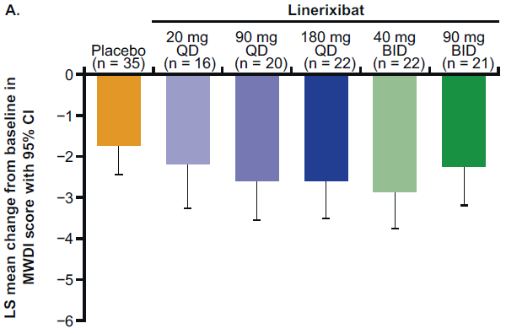
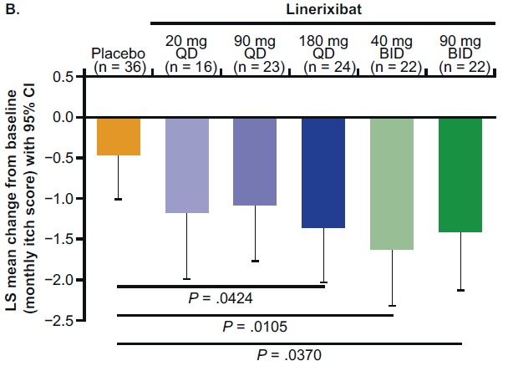
Linerixibat*: GLIMMER Trial− Efficacy
Change from baseline in the monthly itch score (vs placebo)
Linerixibat 180mg daily: -0.9
Linerixibat 40mg BID: -1.16
Linerixibat 90mg BID: -0.95
All groups including placebo reduced MWDI from baseline at week 16 (P=0.1106) in the intent to treat analysis.
*Investigational/Not approved by the US Food and Drug Administration
MWDI, mean worst daily itch
Reproduced without modification from: Levy C, et al. Clin Gastroenterol Hepatol. 2023;21(7):1902-1912.e13 under the terms of Creative Commons license CC BY 4.0. © 2023 by the AGA Institute.

Slide 41
Linerixibat*: GLIMMER Trial− Efficacy (cont)
Linerixibat 40mg BID group showed significant improvements compared to baseline at week 16 in the PBC-40 itch, social, and emotional domains
Itch scores, 5-D itch scores, and sleep scores improved vs baseline in all groups, including placebo
No consistent or clinically relevant improvement in fatigue scores
High concordance between improvements in itch and sleep
*Investigational/Not approved by the US Food and Drug Administration
Levy C, et al. Clin Gastroenterol Hepatol. 2023;21(7):1902-1912.e13.

Slide 42
Linerixibat*: GLIMMER Trial− Safety
Drug-related adverse events (AEs) occurred in 19% of the placebo group and 31% to 78% of patients in the linerixibat groups
Most common AEs were diarrhea and abdominal pain
Diarrhea: 11% for placebo; 38% to 68% for the linerixibat groups
Abdominal pain: 8% for placebo; 9% to 30% for linerixibat
Dose-response relationship observed for diarrhea and abdominal pain
Treatment-related adverse events → discontinuation of therapy
Diarrhea (n=10)
Abdominal pain (n=5)
Abnormal liver function tests (n=1)
*Investigational/Not approved by the US Food and Drug Administration
Levy C, et al. Clin Gastroenterol Hepatol. 2023;21(7):1902-1912.e13.

Slide 43
Linerixibat*: GLISTEN Trial− Preliminary Findings
Phase 3, randomized, placebo-controlled trial
Adults with moderate-severe PBC-associated pruritus
Receiving stable dose of guideline-recommended therapy for pruritus or treatment naïve or previously treated
Linerixibat met primary endpoint
Statistically significant reduction in monthly itch score at 24 wks vs placebo
Safety findings consistent with previous investigations
*Investigational/Not approved by the US Food and Drug Administration
GlaxoSmithKline. Published November 19, 2024. Accessed November 25, 2024. https://www.gsk.com/en-gb/media/press-releases/linerixibat-shows-positive-phase-iii-results-in-cholestatic-pruritus/

Slide 44
Volixibat*: VANTAGE PBC Trial− Design
Phase 2b multicenter, double-blind study in adult patients with PBC (N=50)
Compared volixibat 20mg daily, 80mg daily or 20+80mg daily to placebo
Primary outcome was the mean reduction in itch score based on the Adult ItchRO scale
*Investigational/Not approved by the US Food and Drug Administration
Mirum Pharmaceuticals, Inc. Published June 17, 2024. Accessed November 25, 2024. https://ir.mirumpharma.com/news-events/News/news-details/2024/Mirums-Volixibat-Achieves-Positive-Interim-Analyses-in-VANTAGE-PBC-and-VISTAS-PSC-Studies/default.aspx#xd_co_f=NzlmOThkOGYtZGVlMy00Nzk4LTlkNTItZDY1Zjk4YmM1YjVh~

Slide 45
Volixibat*: VANTAGE PBC Trial− Efficacy
Interim Results
Mean change in Adult ItchRO score* | Volixibat |  |  | Placebo (n=10)
 | 20 mg (n=10) | 80 mg (n=10) | 20+80 mg (n=20)
LSM (SE) | -3.84 (0.609) P<0.0001 | -3.79 (0.564) P<0.0001 | -3.82 (0.414) P<0.0001 | -1.50 (0.585) P=0.0149
Difference between VLX and PBO | -2.34 P=0.0090 | -2.29 P=0.0075 | -2.32 P=0.0026
*Adult ItchRO is a 0-10 numerical rating scale; MMRM weekly averaged worst daily itch score, assessed over weeks 17-28 of the treatment period. LSM, least-squares mean; PBO, placebo; VLX, volixibat
*Investigational/Not approved by the US Food and Drug Administration
Mirum Pharmaceuticals, Inc. Published June 17, 2024. Accessed November 25, 2024. https://ir.mirumpharma.com/news-events/News/news-details/2024/Mirums-Volixibat-Achieves-Positive-Interim-Analyses-in-VANTAGE-PBC-and-VISTAS-PSC-Studies/default.aspx#xd_co_f=NzlmOThkOGYtZGVlMy00Nzk4LTlkNTItZDY1Zjk4YmM1YjVh~

Slide 46
Volixibat*: VANTAGE PBC Trial− Safety
Adverse events were similar between the 20mg and 80mg treatment groups
77% of patients experienced mild to moderate diarrhea
1 patient discontinued due to diarrhea
No clinically significant changes in liver function tests
*Investigational/Not approved by the US Food and Drug Administration
Mirum Pharmaceuticals, Inc. Published June 17, 2024. Accessed November 25, 2024. https://ir.mirumpharma.com/news-events/News/news-details/2024/Mirums-Volixibat-Achieves-Positive-Interim-Analyses-in-VANTAGE-PBC-and-VISTAS-PSC-Studies/default.aspx#xd_co_f=NzlmOThkOGYtZGVlMy00Nzk4LTlkNTItZDY1Zjk4YmM1YjVh~

Slide 47
Key Concepts
IBAT inhibitors show promise in providing another tool to treat patients with pruritus associated with PBC
Additional study is needed to provide clarity on the appropriate dose, efficacy, place in therapy, and safety of IBAT inhibitors

Slide 48
Interprofessional Patient Care

Slide 49
Patient Case
A 38-yo Hispanic female presents with complaints of fatigue and pruritus that started 18 mos ago. She was diagnosed with PBC after an extensive workup and started on UDCA. Liver biomarkers have improved, but she complains of persistent itch. She is tearful as she describes not having energy for activities with her 2 young children because of poor sleep due to nocturnal severe itching. She has failed a trial of gabapentin and sertraline.
PE: Severe excoriation on the palms of her hands with swelling and redness present; vital signs WNL
PMH: type 1 diabetes, hypertension; both well controlled with medication

Slide 50
Patient Case (cont)
Medication history:
Ursodiol 600mg BID
Obeticholic acid 5mg daily
SC Insulin pump
OTC hydrocortisone cream PRN for itching
Itch scores
WI-NRS = 8
PBC-40
Fatigue = 4
Itch = 4
Cognition = 2
Social = 4
Emotional = 4
Other = 3
Laboratory:
ALP = 150 U/L
AST = 40 U/L
ALT = 50 U/L
Bilirubin = 1.5 mg/dL
A1C = 7.2%

