Slide 1
Managing Patients With Neurotrophic Keratitis: Improve Outcomes Through Recognition, Applying Updated Staging, Evidence-Based Treatment, and Team-Based Follow-Up

Slide 2
Objectives
Distinguish the unique signs and symptoms associated with neurotrophic keratitis (NK)
Explain the diagnostic criteria necessary for NK
Employ evidence-based strategies for treating patients with NK
Communicate and collaborate with other healthcare team members to provide patient education and ensure appropriate treatment and follow-up for NK

Slide 3
Definition
Neurotrophic keratitis and neurotrophic keratopathy are often used interchangeably¹
Neurotrophic keratopathy is:
Degenerative disease of corneal epithelium resulting from impaired corneal innervation²
Impairment/Loss of corneal sensory innervation is the hallmark of the disease and is responsible for epithelial defects, ulceration, and perforation
Dysfunction of corneal innervation that results in dysregulation of corneal and/or cellular function³
Characterized by loss of corneal sensation and neuronal homeostasis → eventual corneal epithelial breakdown and ultimately keratolysis if untreated
Dua H, et al. Prog Retin Eye Res. 2018;66:107-131.
Bonini S, et al. Eye. 2003;17:989-995.
Neurotrophic Keratopathy Study Group. Ocul Surf. 2023;30:129-138.

Slide 4
Epidemiology
Classified as a rare or orphan disease
US prevalence: 21:100,000 population
Mean age of onset = 68 y
59% are women
Concomitant diagnosis
Herpetic keratitis (34%)
Diabetes (32%)
Corneal transplant (14%)
Bian Y, et al. Ophthalmology. 2022;129:1255-1262.

Slide 5
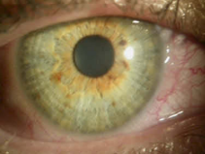
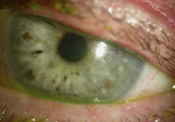
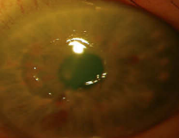
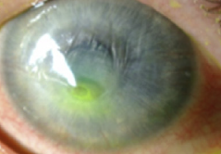
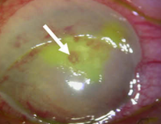
Natural History^{1,2}
Nerve Damage
Impaired corneal sensitivity
Tear secretion is reduced or nonexistent
Lack of Trophic Factors
Reduced epithelial cell turnover
Epithelial irregularity and grayish appearance
Epithelial Damage
Chronic epithelial instability
Epithelial defect
Surface dryness, inflammation and epithelial damage exposes the stroma to damage and possible melting
Stromal Damage
Perforation
Functional and anatomical loss of the eye
End Stage
Images provided with modification from Sheha H, et al. Clin Ophthalmol. 2019;13:1973-1980 under Creative Commons license CC BY-NC 3.0 DEED (Attribution-NonCommercial 3.0 Unported).
Dua H, et al. Prog Retin Eye Res. 2018;66:107-131.
Sheha H, et al. Clin Ophthalmol. 2019;13:1973-1980.

Slide 6
Natural History (continued)
Corneal Epithelium
Tear Film
Reduced Mitosis
Reduced cell turnover
Reduced cell vitality in central cornea
Increased epithelial permeability
Reduced tear production due to decreased nerve stimuli
Mild
Stage 1
Decreased epithelial turnover, increased amount of epithelial-toxic agents
Decreased epithelial thickness in central cornea
Epithelial damage by lid friction
Fine or course punctate erosions
Decreased tear film thickness
Low protection against lid margin/wiper stress
Moderate Stage 2
Nonhealing epithelial defects
Damage to Bowman’s membrane
Exposed stroma – vulnerable to enzymatic digestion
Tear film instability – Evaporative tear loss
Severe Stage 3
Hyperosmolarity
Increase in proinflammatory cytokines
Stromal involvement
Matrix metalloproteases(MMP) activator/inhibitor imbalance
Matrix metalloprotease (MMP) activation
Stromal lysis
Risk of perforation and loss of eye
Increase in inflammatory mediators
Further MMP activation
Dua H, et al. Prog Retin Eye Res. 2018;66:107-113.

Slide 7
Patient Burden^{1,2}
Dry eyes
Redness
Sensitivity to light
Loss of vision
Decreased activities of daily living such as driving, reading, watching TV
Emotional impacts such as concerns with vision loss and frustration
Murray L, et al. J Patient Rep Outcomes. 2020;4:30.
Dua H, et al. Prog Retin Eye Res. 2018;66:107-131.

Slide 8
Clinical Manifestations^{1,2}
Patients may not complain of symptoms due to loss of sensation
Decreased corneal sensitivity
Dry eyes
Burning sensation
Fluctuating vision
Dua H, et al. Prog Retin Eye Res. 2018;66:107-131.
Neurotrophic Keratopathy Study Group. Ocul Surf. 2023;30:129-138.

Slide 9
Possible Candidates for Screening^{1,2}
Genetic | Systemic | Central Nervous System
Riley-Day syndrome Goldenhar-Gorlin syndrome Mobius syndrome Familial corneal hypoesthesia | Diabetes mellitus Leprosy Vitamin A deficiency Amyloidosis Multiple sclerosis Use of systemic anticholinergic medications | Neoplasm Aneurysm Stroke Alzheimer's Parkinson's Neurosurgical procedures
Dua H, et al. Prog Retin Eye Res. 2018;66:107131.
Neurotrophic Keratopathy Study Group. Ocul Surf. 2023;30:129-138.

Slide 10
Possible Candidates for Screening^{1,2} (continued)
Ocular
Post-herpes infections Acanthamoeba with nerve damage related to keratoneuritis Chemical or physical burns Overuse of topical anesthetics Toxicity due to topical timolol, betaxolol, diclofenac sodium, sulfacetamide Chronic ocular surface injury or inflammation Ocular surgery Use of contact lenses Orbital neoplasia Corneal dystrophies
Dua H, et al. Prog Retin Eye Res. 2018;66:107-131.
Neurotrophic Keratopathy Study Group. Ocul Surf. 2023;30:129-138.

Slide 11
Tools to Test Corneal Sensitivity^{1,2}
Critical to confirm diagnosis
Central testing required for diagnosis, but 4 quadrant testing may provide additional pathologic information
Cotton wisp application (subjective)
Cochet-Bonnet esthesiometer (quantitative)
Belmonte noncontact gas esthesiometer (quantitative)
Tool used is not as important as early diagnosis – use what you have
Dua H, et al. Prog Retin Eye Res. 2018;66:107-131.
Neurotrophic Keratopathy Study Group. Ocul Surf. 2023;30:129-138.

Slide 12
Subjective Corneal Sensitivity Testing
Cotton tip applicator stretched and twisted into a wisp
Tissue corner rolled up
Unwaxed plain dental floss
Reference scale
Normal – blink with corneal sensation
Hypoesthesia – no blink with corneal sensation
Anesthesia – no blink and no corneal sensation
Neurotrophic Keratopathy Study Group. Ocul Surf. 2023;30:129-138.

Slide 13
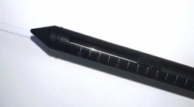
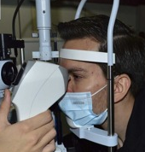
Quantitative Corneal Sensitivity Testing^{1,2}
Cochet-Bonnet Esthesiometer
Belmonte Noncontact Gas Esthesiometer
Quantifies by the length of the filament required to induce a blink or patient response
↑ filament size = ↑ sensitivity
Stimulates the cornea with a calibrated gas emission
Mounted on a slit-lamp with the gas injection tip perpendicular to the cornea
Images provided without modification from Vera-Duarte GR, et al. Surv Ophthalmol. 2024. doi: 10.1016/j.survophthal.2024.04.004 under terms of Creative Commons license CC BY 4.0 DEED
Golebiowski B, et al. Exp Eye Res. 2011;92(5):408-413.
Vera-Duarte G, et al. Surv Ophthalmol. 2024. doi: 10.1016/j.survophthal.2024.04.004

Slide 14
Other Clinical Testing^{1,2}
Cranial nerve examination
Orbital, adnexal, and eyelid examination
Tear film evaluation
Slit lamp exam
In vivo confocal microscopy (IVCM)
Blood work (glucose, thyroid)
Imaging
Mackie I, et al. Current Ocular Therapy, 4th ed. 1995:452-454.
Dua H, et al. Prog Retin Eye Res. 2018;66:107-131.

Slide 15
Diagnostic Algorithm
Presenting symptoms and clinical history
Suspect NK?
Yes
Corneal sensation present?
Consider other causes
Yes
No
High Likelihood of NK
Neurotrophic Keratopathy Study Group. Ocul Surf. 2023;30:129-138.

Slide 16
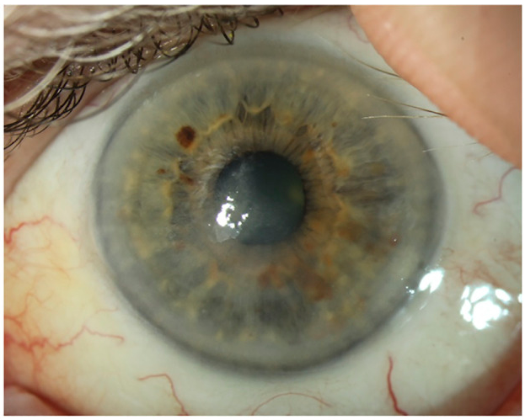
Conventional NK Staging (Mackie)^{1,2}
Stage 1 (Mild)
Rose Bengal staining of the palpebral conjunctiva
Decreased break-up time
Increased viscosity of tear mucus
Punctate corneal keratopathy
Dellen
Small facets of drying epithelium
Superficial vascularization
Stromal scarring
Epithelial hyperplasia and irregularity
Hyperplastic precorneal membrane
Image provided without modification from Koay SU, et al. Front Pharmacol. 2022;13:796854 under Creative Commons license CC BY 4.0 DEED
Mackie I, et al. Current Ocular Therapy. 4th ed. 1995:452-454.
Dua H, et al. Prog Retin Eye Res. 2018;66:107-131.
Notes:
(a) Slit lamp broad beam illumination showing central, confluent punctate lesions giving the central cornea a dull lacklustre appearance following photorefractive keratectomy (ocular surface syndrome) (OSS). (b) The same cornea stained with fluorescein showing that most of the lesions take up stain highlighting the epitheliopathy. (c) OSS following laser in-situ keratomileusis. Fluorescein stain of the cornea shows coarse, centrally located, almost confluent ‘keratitis’.

Slide 17
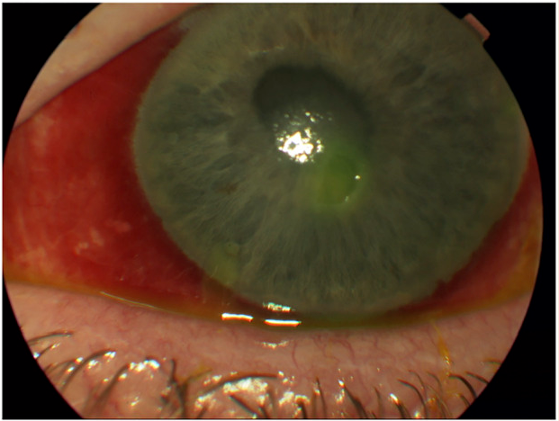
Conventional NK Staging (Mackie)^{1,2}
Stage 2 (Moderate)
Epithelial defect
Surrounding rim of loose epithelium
Stromal edema
Anterior chamber inflammatory reaction
Edges of the defect become smooth and rolled with time
Image provided without modification from Koay SU, et al. Front Pharmacol. 2022;13:796854 under Creative Commons license CC BY 4.0 DEED
Mackie I, et al. Current Ocular Therapy. 4th ed. 1995:452-454.
Dua H, et al. Prog Retin Eye Res. 2018;66:107-131.
Notes:
(d) The central cornea shows a diffuse haze with a large epithelial defect. (e) The central cornea is hazy with an epithelial defect with superficial and deep stromal vessels. (f) There is a large corneal epithelial defect with a relatively clear stroma. The white, rolled margins of the defects is a typical sign of a non-healing epithelial defect

Slide 18
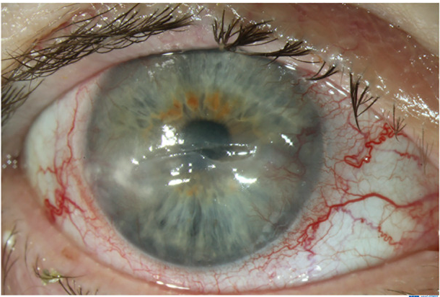
Conventional NK Staging (Mackie)^{1,2}
Stage 3 (Severe)
Corneal ulcer
Stromal melting
Perforation
Image provided without modification from Koay SU, et al. Front Pharmacol. 2022;13:796854 under Creative Commons license CC BY 4.0 DEED
Mackie I, et al. Current Ocular Therapy. 4th ed. 1995:452-454.
Dua H, et al. Prog Retin Eye Res. 2018;66:107-131.
Notes:
(g) Slit view showing stromal melting to mid depth in a case of herpes zoster keratitis. (h) Deep stromal ulceration in a child with congenital anesthetic cornea. (i) A large corneal ulcer in a case of treated acanthamoeba keratitis. Inset illustrates the stromal roughening, over which the epithelium did not migrate. Note the absence of corneal vascularization.

Slide 19
Neurotrophic Keratopathy Study Group Classification^{1,2}
Image provided without modification from Vera-Duarte GR, et al. Surv Ophthalmol. 2024. doi: 10.1016/j.survophthal.2024.04.004 under terms of Creative Commons license CC BY 4.0 DEED
Neurotrophic Keratopathy Study Group. Ocul Surf. 2023;30:129-138.
Vera-Duarte G, et al. Surv Ophthalmol. 2024

Slide 20
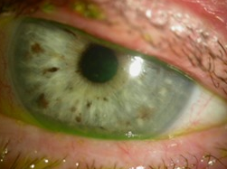
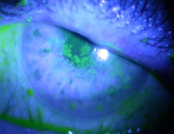
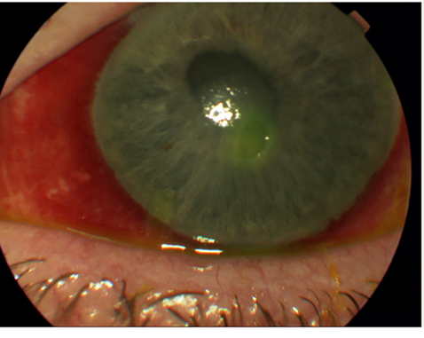
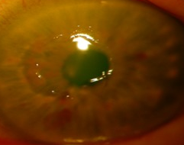
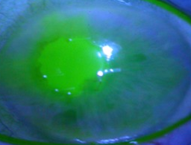
Neurotrophic Keratopathy Study Group Classification
Mild, Stage 2
Moderate, Stage 3
Moderate, Stage 4
Epitheliopathy (PEK) without stromal haze
Persistent/recurrent epithelial defects without stromal haze
Epitheliopathy (PEK) or persistent/recurrent epithelial defects with stromal haze
Images provided with modification from Sheha H, et al. Clin Ophthalmol. 2019;13:1973-1980 under Creative Commons license CC BY-NC 3.0 DEED (Attribution-NonCommercial 3.0 Unported).
Image provided without modification from Koay SU, et al. Front Pharmacol. 2022;13:796854 under Creative Commons license CC BY 4.0 DEED
Images provided with modification from Sheha H, et al. Clin Ophthalmol. 2019;13:1973-1980 under Creative Commons license CC BY-NC 3.0 DEED (Attribution-NonCommercial 3.0 Unported).
Neurotrophic Keratopathy Study Group. Ocul Surf. 2023;30:129-138.

Slide 21
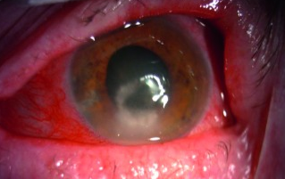
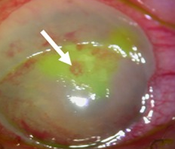
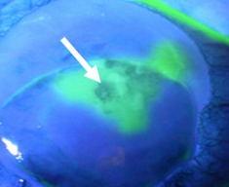
Neurotrophic Keratopathy Study Group Classification
Severe, Stage 5
Severe, Stage 6
Persistent/recurrent epithelial defect with corneal ulceration
Corneal perforation
Images provided with modification from Sheha H, et al. Clin Ophthalmol. 2019;13:1973-1980 under Creative Commons license CC BY-NC 3.0 DEED (Attribution-NonCommercial 3.0 Unported).
Image provided without modification from Wróbel-Dudzińska D, et al. J Ophthalmol. 2018;2018:3538764 under Creative Commons license CC BY 4.0 DEED
Neurotrophic Keratopathy Study Group. Ocul Surf. 2023;30:129-138.

Slide 22
Considerations for Referral
Essential to begin treatment as soon as possible to avoid complications and progression
Non-ophthalmologists should refer quickly if there is a suspicion of NK
Basic care such as lubricating eye drops and treating infections should be initiated
Ophthalmologists can diagnose and start treatment according to their comfort level and the severity of the patient’s disease
All others should be referred to a corneal specialist

Slide 23
Team Responsibilities
Primary care | Optometrist | General ophthalmol-ogist | Corneal specialist | Allied health professionals
Recognize signs and symptoms and refer Optimize contributing disease states | Recognize signs and symptoms and refer | Recognize signs and symptoms and diagnose Start treatment for early stages Refer for later stages | Confirm diagnosis Determine the optimal treatment Educate patient Coordinate follow-up | Help to recognize early signs Assist with education, administration, compliance, and insurance coverage

Slide 24
Treatment Considerations
Most patients should receive basic preventative and symptomatic care, as well as active treatment in certain cases
Targeted/Advanced treatment should begin in NKSG stage 2 to prevent progression¹
Considerations for choice of treatment
Patient adherence
Cost
Risk of adverse effects
Treatment goal²:
Arrest progression and reverse NK changes that have occurred
Maintain comfort and optimize vision
Neurotrophic Keratopathy Study Group. Ocul Surf. 2023;30:129-138.
Dua H, et al. Prog Retin Eye Res. 2018;66:107-131.

Slide 25
Prevention^{1,2}
Discontinue
any eye drops that contain preservatives
irritating eye drops
medications that cause dry eyes
Avoid irritating cosmetics
Consider increasing dietary omega-3 fatty acids
Treat /control any underlying systemic/nervous system diseases
Dua H, et al. Prog Retin Eye Res. 2018;66:107-131.
Neurotrophic Keratopathy Study Group. Ocul Surf. 2023;30:129-138.

Slide 26
Symptomatic Care^{1,2}
Conventional dry eye therapy
Use preservative free preparations
Prescription dry eye therapies (cyclosporine, lifitegrast, PFHO, etc)
Treat active ocular infections
Treat any active ocular inflammatory process
Treat lid abnormalities
Serum eye drops
Platelet-rich plasma
Amniotic membrane transplantation
Dua H, et al. Prog Retin Eye Res. 2018;66:107-131.
Neurotrophic Keratopathy Study Group. Ocul Surf. 2023;30:129-138.

Slide 27
FDA-Approved Medication
Cenegermin-bkbj (Oxervate)
Topical human recombinant nerve growth factor
Approved for treating NK
Studied in all 3 Mackie stages (NKSG stage 2 and above)
Sheha H, et al. Clin Ophthalmol. 2019;13:1973-1980.

Slide 28
Cenegermin: Safety and Efficacy
48 patients with stage 2 or 3 NK
Randomized to:
Cenegermin 20mcg/mL or vehicle
1 drop in the affected eye 6 times/d x 8 wks
Primary outcome: corneal healing of the neurotrophic lesion
Conventional <0.5 mm of fluorescein staining
Conservative = 0.0 mm of staining
Secondary endpoints
Corneal healing at wk 4
Change in best corrected distant visual acuity (BCVD)
Change in corneal sensitivity
Percentage of patients experiencing deterioration
Pflugfelder SC, et al. Ophthalmology. 2020;127:14-26.

Slide 29
Cenegermin: Safety and Efficacy (continued)
Metric | Cenegermin (N=23) | Vehicle (N=24) | P Value
Conventional staining (<0.5mm)* | 16 (69.6%) | 7 (29.2%) | 0.006
Conservative staining (0.0mm)* | 15 (65.2%) | 4 (16.7%) | <0.001
Corneal healing at 4 wks | 14 (58.3%) | 3 (12.5%) | <0.001
BCVD change (15-letter gain) | 3 (13%) | 4 (16.7%) | 0.727
Corneal sensitivity change | 0.81 to 2.91 | 0.65 to 1.83 | 0.207
Patients experiencing deterioration | 6 (26.1%) | 12 (50%) | 0.092
*Primary endpoint
Pflugfelder SC, et al. Ophthalmology. 2020;127:14-26.

Slide 30
Cenegermin: Safety and Efficacy (continued)
Cenegermin was well tolerated during the blinded and follow-up periods
Eye pain: most common adverse effect
Cenegermin (3 patients) vs vehicle (1 patient)
Serious adverse effect in 7 patients; not considered related to the study treatment
No deaths
No clinically significant patterns in vital signs, ophthalmic parameters, and laboratory results
Pflugfelder SC, et al. Ophthalmology. 2020;127:14-26.

Slide 31
Cenegermin – Place in Therapy
The step-ladder approach from Dua, et al, lists cenegermin as a therapy for Mackie stage 2 and 3¹
The NK Study Group states that there is currently not enough information to specifically recommend treatments for individual etiologies²
Cenegermin is one of 2 direct modalities that address the underlying etiology of NK^{1,2}
Cenegermin has shown positive results in NKSG stage ≥2²
Dua H, et al. Prog Retin Eye Res. 2018;66:107-131.
Neurotrophic Keratopathy Study Group. Ocul Surf. 2023;30:129-138.

Slide 32
Cenegermin – Cost of Therapy
Cost (8-wk treatment)
Retail: $131,997¹
Medicare (2020): $5791²
Manufacturer has a program to assist patients to navigate insurance coverage, authorizations, and cost³
Medication is only available through Accredo Health Group Inc.³
Frozen drug is sent directly to the patient every 2 wks
1. Cenegermin-bkbj. REDBOOK Online. IBM Micromedex [database online]. Truven Health Analytics/IBM Watson Health; 2024.
Dai X, et al. Am J Ophthalmol.2023;250:12-19.
https://oxervate.com/getting-and-storing-oxervate/

Slide 33
Cenegermin – Storage and Administration
Storage
Must refrigerate (36°F to 46°F) within 5h of receipt
Vials are good for 14 d refrigerated
Administration
Wash hands and remove contact lenses, if applicable
Remove plastic cap from the vial, peel off the backer from the vial adapter blister pack
Without removing the adapter from the blister pack, connect the vial adapter to the vial by firmly pushing it down over the top of the vial until it snaps into place.
After the vial adapter is connected to the vial, the vial can be stored up to 77°F for 12 h
Oxervate. Package insert. Dompé U.S. Inc; 2023.

Slide 34
Cenegermin – Storage and Administration (continued)
Remove a pipette from its protective packaging and screw into the connector part of the adapter
Make sure the pipette plunger is pushed all the way down
Turn the vial upside down and gently pull the plunger until it stops
If air-bubbles are visible, push the plunger back in and gently pull it out again until it stops
Unscrew the pipette from the vial connector and pull it straight up to remove it
Oxervate. Package insert. Dompé U.S. Inc; 2023.

Slide 35
Cenegermin – Storage and Administration (continued)
Pull down lower eyelid and gently push the plunger down until at least a drop is released onto the eye
Be careful to not touch the pipette to the eye
With the head still tilted back, blink a few times to make sure the medicine covers the surface of the eye
Throw away the used pipette
If wearing contacts, wait 15 min before reinserting the contact lenses
Administer 15 min prior to using any eye ointment, gel, or other eye drops
After 2 h, prepare a new pipette with the same vial
Continue using the same vial throughout the day. Throw the vial away at the end of the day – even if there is still some solution left in the vial
Dose is 1 drop to the affected eye every 2 h for 6 doses/d for 8 wks
Oxervate. Package insert. Dompé U.S. Inc; 2023.

Slide 36
Cenegermin – Storage and Administration
For further information:
https://Oxervate.com

Slide 37
Corneal Neurotization^{1,2}
Complex surgery to innervate the cornea by rerouting or relocating a healthy sensory nerve
Sensation recovery may take 3-6 months and nerve regeneration may take 6-12 months
A meta-analysis of 54 eyes that underwent corneal neurotization showed improvement in visual acuity and corneal sensation. Corneal scarring occurred in 32% of patients³
Dua H, et al. Prog Retin Eye Res. 2018;66:107-131.
Neurotrophic Keratopathy Study Group. Ocul Surf. 2023;30:129-138.
Park J, et al. Ophthalmic Plast Reconstr Surg. 2020;36(5):431-437.

Slide 38
Other Therapies^{1,2}
Tarsorrhaphy
Punctual occlusion
Therapeutic contact lenses
Conjunctival flap
Dua H, et al. Prog Retin Eye Res. 2018;66:107-131.
Neurotrophic Keratopathy Study Group. Ocul Surf. 2023;30:129-138.

Slide 39
Therapies Under Investigation
ReGeneraTing Agents (RGTA)
Large polymers replace broken heparan-sulfate molecules and create a cellular environment favorable to healing
Larger studies are needed to confirm efficacy
Topical insulin
Topical thymosin β4
Oral nicergoline
Substance P-derived peptide with insulin-like growth factor 1
Neurotrophic Keratopathy Study Group. Ocul Surf. 2023;30:129-138.

Slide 40
Case: Vision Loss and Diabetes
A 67-year-old female with uncontrolled type 2 diabetes presents to her ophthalmologist with complaints of decreased vision
Notes:
Dr. Gupta will take the first bullet point and Dr. Beckman will take the final 2 points

Slide 41
Case: I Feel Worse With Treatment
A patient with postherpetic neuralgia who lives in a rural setting started cenegermin 4 wks ago and comes to the pharmacy complaining of eye pain
Notes:
Dr. Conway-Allen will take the first 2 bullet points and Dr. Beckman can take the 3rd

