Slide 2
Editor’s Note
These are the slides for the presentation on November 9, 2022. They have been edited and condensed for clarity.
To obtain CE credit click here.

Slide 3
Faculty
Andrew S. Bomback, MD, MPH
Director of Clinical Research
Division of Nephrology
Columbia University Irving Medical Center
New York, New York
Carla M. Nester MD, MSA
Jean E. Robillard MD, Chair in Pediatric Nephrology
Director, Division of Pediatric Nephrology, Dialysis and Transplantation
Associate Director, Molecular Otolaryngology and Renal Research Laboratory
University of Iowa Stead Family Children’s Hospital
Iowa City, Iowa

Slide 4
Andrew S. Bomback, MD, MPH Achillion/Alexion, Apellis, Catalyst, ChemoCentryx, Novartis, Q32 Bio, Silence, Visterra
Disclosures
Carla M. Nester, MD, MSA
Apellis, BioCryst, ChemoCentryx, Kira, Novartis, Retrophin

Slide 5
Learning Objectives
After participating in this activity, learners will be better able to:
Discuss recent guideline recommendations on glomerular disease management.
Describe the epidemiology and pathophysiology of C3G.
Identify the appropriate imaging and testing for diagnosis of C3G.
Construct treatment plans for patients diagnosed with C3G.
Describe the safety and efficacy of targeted therapies undergoing late-phase clinical trial evaluation in patients with C3G.

Slide 6
Module 1: Glomerular Disease

Slide 7
Glomerular Disease
Global annual incidence: 0.2-2.5/100,000
Comprises 25% to 30% of end-stage renal disease population
Third leading cause of CKD within the United States
Defined by intraglomerular inflammation and cellular proliferation and often associated with hematuria and HTN
Cell-mediated damage specific to etiology and type of disease
Target of immune, metabolic, vascular, and malignant disorders
Decline in kidney function is observed over time
Rare cases of rapid deterioration
CKD, chronic kidney disease; HTN, hypertension
Hricik DE, et al. New Engl J Med. 1998;339(13):888-899.
McGrogan A, et al. Nephrol Dial Transplant. 2011;26(2):414-430.
Wetmore JB, et al. Kidney Int. 2016;90(4):853-860.

Slide 8
Causes of Glomerulonephritis (GN)
Primary | Secondary
IgA nephropathy | Malignancy
Focal sclerosing | Infectious Bacterial (endocarditis, post-streptococcal) Viral (HBV, HCV, HIV) Fungal Parasitic
Crescentic | Vascular Diabetes mellitus Hypertension Lupus nephritis
Congenital nephrotic disease | Medications (NSAIDs, penicillinamine)
 | Goodpasture Syndrome
HBV, hepatitis B virus; HCV, hepatitis C virus; HIV, human immunodeficiency virus; NSAIDs, nonsteroidal anti-inflammatory drugs
Chadban SJ, et al. Lancet. 2005;365(9473):1797-1806.

Slide 9
GN Pathophysiology
Deposition causes glomerular inflammation via:
Cell-mediated cytotoxicity
Activating infiltrating and intrinsic kidney cells
Activating complement
Antibody Deposition
Complement
Coagulation
Leucocytes
Intrinsic kidney cells
Inflammation from release of cytokines and chemokines observed within mesangial cells
Initiation of the signaling cascade generates anaphylatoxins and membrane attack complex (C5b-9)
Cell recruitment and proliferation lead to deposit of macrophages and T lymphocytes within the interstitum of the glomeruli
Activation from tissue factor results in thrombin formation and fibrin deposition within the glomerulus
Chadban SJ, et al. Lancet. 2005;365(9473):1797-1806.
Boyle JJ. Clin Exp Immunol. 2004;137:529-537.
Hsu S, et al. J Am Soc Nephrol. 2003;14:S186-S191.

Slide 10
Presentation and Diagnosis
Nonspecific Symptoms
Fatigue
Headache
Dyspnea on exertion
Confusion
Specific to Underlying Disease
Arthralgias (systemic lupus erythematosus)
Pulmonary hemorrhage (Goodpasture)
Previous infectious symptoms
Specific Symptoms
Hypertension
Edema
Hematuria
Azotemia
KDIGO Workgroup. Kidney Int. 2021;100(4S):S1-276.

Slide 11
Presentation and Diagnosis (continued)
Untreated glomerulonephritis may progress to end-stage kidney disease with associated complications
Acid-base disorders, anemia, bone mineral abnormalities, cardiovascular disease
Kidney biopsy considered the gold standard for diagnosis of glomerular diseases
KDIGO Workgroup. Kidney Int. 2021;100(4S):S1-276.

Slide 12
Treatment
Lifestyle Modifications
Salt restriction (<2g/d or <90 mmol/d)
Weight normalization
Regular exercise
Smoking cessation
Management of hypertension and/or proteinuria
ACEi or ARB titrated to the maximally tolerated dose
Target SBP <120 mmHg and/or protein reduction to <1g/d
Periodic monitoring for development of acute kidney injury and hyperkalemia
Do not stop therapy with increase in SCr (up to 30%)
Stop therapy if kidney function worsens (>30%) or refractory hyperkalemia
ACEi, angiotensin converting enzyme inhibitor; ARB, angiotensin II receptor blocker; SCr, serum creatinine
KDIGO Workgroup. Kidney Int. 2021;100(4S):S1-276.

Slide 13
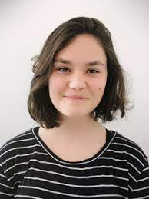
Patient Case
SL is a 24-year-old female who presents with a chief complaint of hematuria. Her diagnostic workup reveals an elevated blood pressure of 160/100 mmHg and urine analysis significant for 4+ protein and 2+ blood. Dysmorphic red blood cells are detected on microscopic exam. Other than experiencing occasional fatigue, she indicates she generally feels well.

Slide 14
Module 2: C3 Glomerulopathy (C3G)

Slide 15
Classification
Glomerulonephritis (GN)
Minimal Change
Focal Segmental
Membranous
IgA Nephropathy
Rapidly Progressive
Membrano-
proliferative
Post Infectious
C3 Glomerulopathy
C3 Glomerulonephritis
(C3GN)
Dense Deposit Disease (DDD)
KDIGO Workgroup. Kidney Int. 2021;100(4S):S1-276.

Slide 16
C3 Glomerulopathy (C3G)
Classified as a rare kidney disease
2-3 cases/million in United States; 0.2-1 case/million in Europe
Characterized by dysregulation of the alternative complement pathway and deposition of C3 complexes in the glomeruli
Increase in C3 convertase causes hyperactivity and ensuing GN
Prevalence of C3GN to DDD is approximately 4:1
Worse prognosis among DDD patients with half progressing to ESRD in 10 y
Servais A, et al. J Med Genet. 2007;44(3):193-199.
Smith RJH, et al. Nat Rev Nephrol. 2019;15(3):129-143.
Bomback AS, et al. Kidney Int. 2018;93(4):977-985.

Slide 17
Classical and Lectin Pathways
Alternative Pathway
C3
C3 convertase
(C4b2a)
C3 convertase
(C3bBb)
C3a
C3b
C5
C5 convertase (C4b2aC3b)
C5 convertase
(C3bBbC3b)
C5a
C5b
C6, C7, C8, C9
C5b-9
Membrane Attack Complex
Ahmad SB, et al. Adv Chronic Kidney Dis. 2020;27(2):104-110.

Slide 18
Spectrum of Infection in C3G (n = 84)
Cause | Incidence (%)
Pyrexia of Unknown Organism | 6.72
Skin Infection/Ulcers | 6.72
Urinary Tract Infection | 5.04
Tuberculosis | 3.36
Viral Hepatitis | 2.52
Typhoid | 1.68
Surgeries | 1.68
Diarrhea | 0.84
Malaria | 0.84
Streptococcus GN | 0.84
Kumar A, et al. J Nephrol. 2020;33:539-550.

Slide 19
C3 Prognosis
Progression to end-stage kidney disease within 10 y of diagnosis
30% to 50% of adults; 70% of children with C3G
Despite kidney transplantation, recurrence occurs in the vast majority
Associated with allograft loss within 10 y after kidney transplantation
Regunathan-Shenk R, et al. Am J Kidney Dis. 2019;73(2):316-322.
Zand L, et al. J Am Soc Nephrol. 2014;25(5):1110-1117.

Slide 20
The Voice of the Patient
The National Kidney Foundation held a patient-focused drug development meeting on C3G in August 2017
Attendees included patients living with C3G and their caregivers
Key Themes:
Symptoms negatively affecting daily quality of life
Insecurity about their health and available therapies
Experiences with current treatment options
Insight on kidney transplantation
Willingness to participate in clinical trials and new therapies
Voice of the Patient. Published March 26, 2018. Accessed October 1, 2022. https://www.kidney.org/sites/default/files/C3G_EL-PFDD_VoP-Report_3-29-18.pdf

Slide 21
The Voice of the Patient (continued)
“It’s horrible all around. You know it’s going to get worse.”
“[Eculizumab had] great results throughout the trials but seeing my kidney function plummet back to pretrial levels at the end of the trial was difficult.”
“We need a way to avoid a lifetime of dependence on a dialysis machine or a series of failed transplants. We need timely and effective treatment to preserve the function of both native and transplanted kidneys.”
“That’s what I want: just some stability.”
Voice of the Patient. Published March 26, 2018. Accessed October 1, 2022. https://www.kidney.org/sites/default/files/C3G_EL-PFDD_VoP-Report_3-29-18.pdf

Slide 22
Module 3: Diagnosis of C3G

Slide 23
Monoclonal Gammopathies
Positive Ig +/- C3
Infections
Autoimmune Diseases
Idiopathic
MPGN Pattern
Complement-mediated
C3 Glomerulopathy
C4 Glomerulopathy
Antiphospholipid Antibody Syndrome
Hemolytic Uremic Syndrome
Thrombotic Microangiopathy
Negative Ig, C3
Sickle Cell Anemia
Polycythemia
MPGN, membranoproliferative glomerulonephritis
KDIGO Workgroup. Kidney Int. 2021;100(4S):S1-276.

Slide 24
Diagnosis
C3G is not specific to 1 age range; it may present at anytime
Average age at time of diagnosis is late teenage and early adulthood
Diagnosis may be delayed due to similarity in symptoms to other forms of GN
Smith RJH, et al. Nat Rev Nephrol. 2019;15(3):129-143.
Sethi S, et al. Kidney Int. 2012;82(4):465-473.
Ahmad SB, et al. Adv Chronic Kidney Dis. 2020;27(2):104-110.

Slide 25
Symptoms
Spectrum of symptoms dependent on the duration and severity of disease
Hematuria
Proteinuria
HTN
Edema
Drusen in the eyes
Lipodystrophy
Nonspecific symptoms may be observed
Fatigue
Upper respiratory infection reported among children and young adults
KDIGO Workgroup. Kidney Int. 2021;100(4S):S1-276.
Riedl M, et al. Pediatr Nephrol. 2017;32(1):43-57.
Master Sankar Raj V, et al. Front Pediatr. 2016;4(May 6):45.

Slide 26
Clinical and Laboratory Findings in Histology Groups (Data at Onset)
 | C3G | DDD | C3GN
N | 73 | 21 | 52
Gender, male | 41% | 38% | 42%
Age, y | 15.0 ± 11.9 | 15.9 ± 11.4 | 14.6 ± 12.1
Microhematuria | 86% | 90% | 84%
Gross hematuria | 38% | 38% | 38%
Proteinuria | 90% | 86% | 92%
Renal impairment | 14% | 5% | 17%
Trigger event | 42% | 41% | 42%
Low serum C3 & normal C4 | 74% | 86% | 69%
Plasma C5b-9, ng/mL | 417 (228-1033) | 353 (252-623) | 486 (215-1140)
Iatropoulos P, et al. Mol Immunol. 2016;71:131-142.

Slide 27
Challenges to Diagnosis
C3G may be unconsciously omitted from workup of a patient with GN due to limited knowledge and rare nature of the disease
Suboptimal and/or nonspecific treatment(s) may be prescribed
Failure of targeting the underlying disease process
Access to centers specializing in the diagnosis and treatment of C3G
Recommended testing may not be available at routine laboratory centers
Genetic, whole-genome sequencing
Logistics may serve as a barrier to patients and their caregivers
Hari P, et al. Pediatr Nephrol. 2021;36:3493-3497.
Ahmad SB, et al. Adv Chronic Kidney Dis. 2020;27(2):104-110.

Slide 28
Initial Presentation
Labs
Basic metabolic panel
Complete blood count
Serum complement (C3, C4)
UPCR
Hepatitis, HIV
ANCA, anti-GBM
Kidney Biopsy
Proteinuria (>500 mg/d)
Reduced eGFR
Low complement
UPCR, urine protein:creatinine ratio; ANCA, antineutrophil cytoplasmic antibody; GBM, glomerular basement membrane; eGFR, estimated glomerular filtration rate
Ahmad SB, et al. Adv Chronic Kidney Dis. 2020;27(2):104-110.

Slide 29
Further Evaluation of C3G
Comprehensive assessment of overall complement activity
Serves to establish if targeted therapeutic(s) may be feasible
Screening for autoantibodies
Nephritic factors, Factor H AutoAb, Factor B AutoAb
Genetic testing is recommended for most patients
CFB, CFH, CFI, CFHR5
Whole-genome sequencing
CFB, complement factor B; CFH, complement factor H; CFI, complement factor I; CFHR5, complement factor H related 5
Smith RJH, et al. Nat Rev Nephrol. 2019;15(3):129-143.
Marinozzi MC, et al. Kidney Int. 2017;92:1232-1241.
Meri S, et al. J Exp Med. 1992;175:939-950.

Slide 30
Further Evaluation of C3G (continued)
Electron Microscopy
Assess density and appearance of deposits within glomerular basement membrane
Distinguishes two major types of C3G (C3GN and DDD)
DDD: Electron-dense, osmophilic, intramembranous deposits
C3GN: Lesser intensity, mesangial, capillary wall deposits
Immunofluorescence
At least 2 orders of magnitude of C3 deposition greater than any other immune reactant
KDIGO Workgroup. Kidney Int. 2021;100(4S):S1-276.

Slide 31
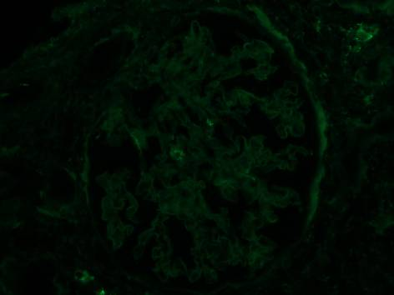
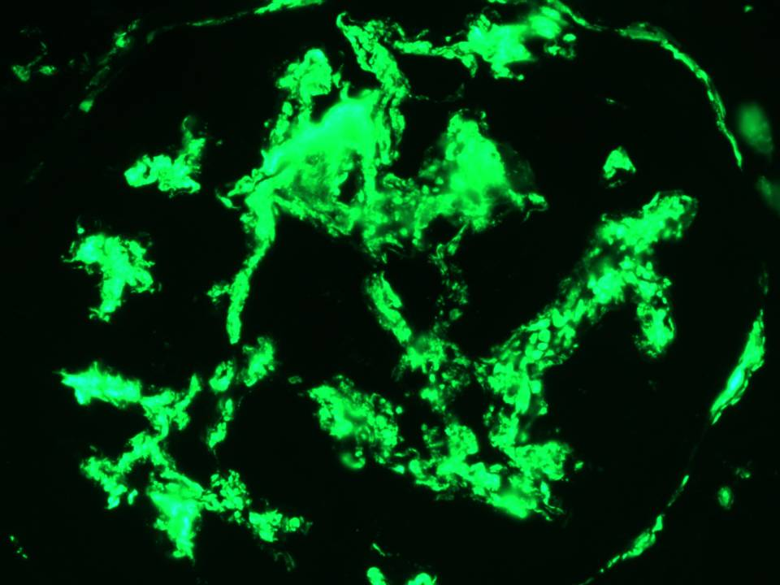
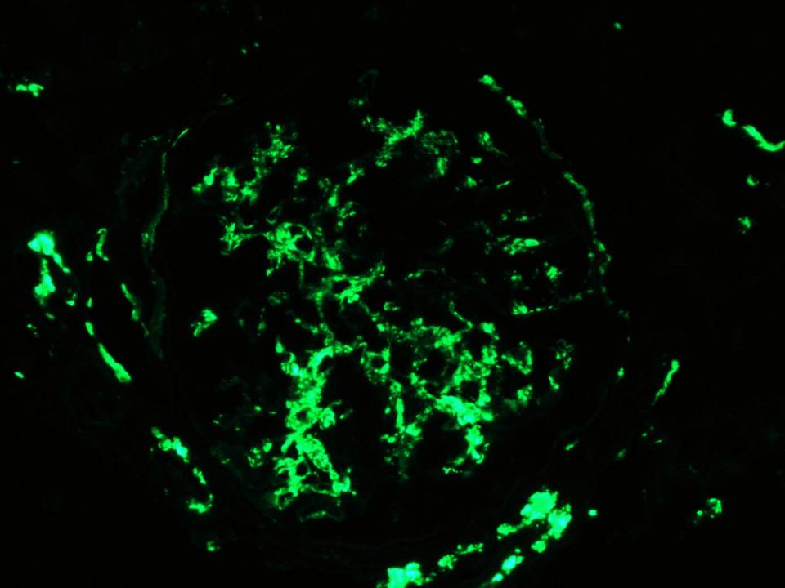
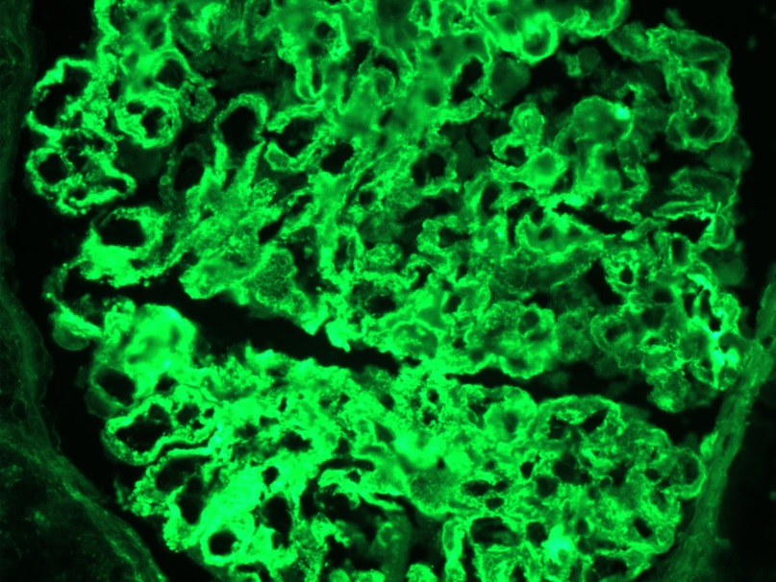
Further Evaluation of C3G (continued)
Normal Kidney
C3G
C3
C3
Membrane Attack Complex
Membrane Attack Complex
Herlitz LC, et al. J Am Soc Nephrol. 2012;23(7):1229-1237.

Slide 32
Return to Patient Case – Diagnosis
SL is a 24-year-old female who presents with a chief complaint of hematuria. Her diagnostic workup reveals an elevated blood pressure of 160/100 mmHg and urine analysis significant for 4+ protein and 2+ blood. Dysmorphic red blood cells are detected on microscopic exam. Other than experiencing occasional fatigue, she indicates she generally feels well.
What specific testing should be ordered for SL to diagnose C3G?
Kidney biopsy warranted if proteinuria (>500 mg/d), reduced eGFR, and low complement

Slide 33
Module 4: Treatment of C3G

Slide 34
Treatment Options*
Supportive
ACEi
ARB
General Immunosuppressive/Immunomodulatory
Corticosteroids
Cyclosporine
Cyclophosphamide
Mycophenolate
Tacrolimus
Rituximab
Plasma Exchange
C5-Directed Therapies
Eculizumab
Raviluzumab
Avacopan
*Note that none of the medications have been approved by the US Food and Drug Administration for C3G
C3-Directed Therapies
Iptacopan
Pegcetacoplan

Slide 35
Supportive Care
Measures that support a healthy lifestyle should be encouraged
ACEi or ARB should be initiated and continued in C3G patients without contraindications to therapy
First line-therapy for proteinuria and blood pressure control
Improved renal survival demonstrated in a cohort of C3G patients
Lipid-lowering therapies may also be considered to achieve low-density lipoprotein and cholesterol goals
SGLT2i may be utilized in chronic disease management
Sustained GFR <60 +/- proteinuria
SGLT2i, sodium-glucose cotransporter-2 inhibitors
KDIGO Workgroup. Kidney Int. 2021;100(4S):S1-276.
Smith RJH, et al. Nat Rev Nephrol. 2019;15(3):129-143.
Servais A, et al. Kidney Int. 2012;82:454-464.

Slide 36
General Immunomodulatory
Plasma Exchange
Data limited in the treatment of C3G
Efficacy reported among identified genetic variant in factor H
Reduction in circulating C3 nephritic factor observed during thrice-weekly exchanges
Transient effect observed due to continued production of autoantibodies outside of treatment sessions
Logistical considerations of permanent patient access and inpatient hospitalization or outpatient infusion center for administration of therapy
Licht C, et al. Am J Kidney Dis. 2005;45:415-421.
Kurtz KA, et al. J Clin Apher. 2022;135-137.

Slide 37
General Immunosuppression
C3
Inhibit cellular immune response in C3G
Reduction in C3a and C5a to limit autoantibody production
Glucocorticoids
Reported efficacy variable
Improvement in 10 y renal survival observed among 70 patients with C3GN or DDD progressing to ESRD within 28 mos
Failure to reduce progression to ESRD among 32 patients with receipt of corticosteroids alone (68.8%) or in combination (31.2%)
C3a
C3b
C5b-9
Membrane Attack Complex
Ahmad SB, et al. Adv Chronic Kidney Dis. 2020;27(2):104-110.
Medjeral-Thomas RN, et al. Clin J Am Soc Nephrol. 2014;9:46-53.

Slide 38
General Immunosuppression (continued)
Combination Therapy
Comparison of remission rates in 73 patients receiving nonspecific, pharmacologic immunosuppression
Highest response among MMF + corticosteroids as compared to calcineurin inhibitors, rituximab, or alkylating agents in combination with corticosteroids
Rates of progression to ESRD variable among receipt of immunosuppressive regimens in 60 patients
Requirement of dialysis
MMF + corticosteroids: 0%; other immunosuppression: 16.7%; control: 35%
Rates of remission
MMF + corticosteroids: 86.3%; other immunosuppression: 50%
MMF, mycophenolate mofetil
Avasare RS, et al. Clin J Am Soc Nephrol. 2018;13(3):406-413.
Rabasco C, et al. Kidney Int. 2015;88(5):1153-1160.

Slide 39
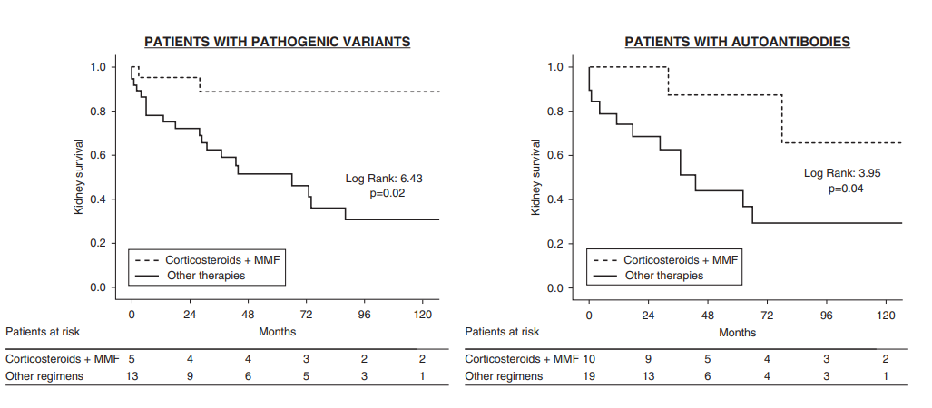
General Immunosuppression (continued)
Higher response rate observed with MMF + corticosteroid treatment in C3nef (+) vs. C3nef (-) patients
C3nef, C3 nephritic factor
Caravaca, et al. Clin J Am Soc Nephrol. 2020;15(9):1287-1298.

Slide 40
Eculizumab
Monoclonal antibody targeted against C5
Prevents assembly of C5b-9 membrane attack complex
Administered as an intermittent intravenous infusion
Role in reduction of proteinuria and glomerular inflammation
C5
Eculizumab
C5a
C5b
C6, C7, C8, C9
C5b-9
Membrane Attack Complex
KDIGO Workgroup. Kidney Int. 2021;100(4S):S1-276.

Slide 41
Eculizumab (continued)
Initial efficacy reported in several case reports and case series
Reduction in serum creatinine, proteinuria, and soluble C5b-9 levels
Histopathologic evidence of improvement on repeat biopsies
Retrospective cohort study of 26 children and adults
Treated with eculizumab for a median duration of 14 mos
6 (23%) with global clinical response
Reduced eGFR and higher incidence of progressive disease at baseline
6 (23%) with partial clinical response
Bomback AS, et al. Clin J Am Soc Nephrol. 2012;7:748-756.
Le Quintrec M, et al. Am J Kidney Dis. 2018;72:84-92.
Smith RJH, et al. Nat Rev Nephrol. 2019;15(3):129-143.

Slide 42
Eculizumab (continued)
Available through a Risk Evaluation and Mitigation Strategy (REMS) program
Prescriber enrollment
Package labeling includes warning for life-threatening and fatal meningococcal infections
Recommendation for vaccination ≥2 wks prior to receipt of first eculizumab dose
Serious infections from Neisseria species have been reported
Blockage of terminal complement activation may increase risk of infections caused by encapsulated bacteria
Eculizumab [package insert]. Boston, MA. Alexion Pharmaceuticals, Inc; November 2020.

Slide 43
Avacopan
C5a receptor antagonist approved for the treatment of ANCA-associated vasculitis
ACCOLADE
Design | Randomized, double blind, placebo-controlled phase 2 study
Methods | Evaluate efficacy and safety of avacopan 30 mg twice daily or matching placebo for the first 26 wks All participants will receive avacopan for the following 26 wks Patients followed for 8 wks without study drug treatment
Primary Outcome | Percent change from baseline in C3G Histologic Index for disease activity Kidney biopsy taken at baseline and after 26 wks of treatment
Avacopan [package insert]. Cincinnati, OH. ChemoCentryx, Inc; October 2021.
Clinicaltrials.gov. Updated September 30, 2022. Accessed October 1, 2022. https://clinicaltrials.gov/ct2/show/NCT03301467?cond=C3+Glomerulopathy&phase=12&fund=2&prcd_s=01%2F01%2F2021&prcd_e=12%2F31%2F2024&draw=2&rank=1

Slide 44
Iptacopan
Factor B inhibitor
Design | Randomized, open-label, 2-cohort phase II study
Methods | Evaluated efficacy and safety of iptacopan in addition to existing therapy for 12 wks Cohort A: Patients with C3G Cohort B: Patients who underwent kidney transplantation with subsequent C3G recurrence in the transplanted organ
Outcomes | Cohort A (16 patients) demonstrated 45% proteinuria reduction as compared to baseline as measured by 24-hour UPCR (P < 0.001) Cohort B (7 patients) demonstrated reduction in C3 protein deposits as measured by immunofluorescence microscopy (P = 0.03).
Conclusion | Iptacopan demonstrated clinically important reductions in proteinuria and C3 protein deposits in patients with C3G and recurrence following transplantation
Clinicaltrials.gov. Updated August 10, 2022. Accessed October 1, 2022. https://clinicaltrials.gov/ct2/show/results/NCT03832114

Slide 45
Iptacopan (continued)
The use of this figure constitutes a fair-use of copyrighted material as provided for in section 107 of the US copyright law. Reproduced without modification under the Creative Commons Attribution-NonCommercial-NoDerivatives 4.0 International license from: Bomback AS, Kavanagh D, Vivarelli M, Meier M, Wang Y, Webb NJA, Trapani AJ, Smith RJH. Kidney Int Rep. 2022;7:2150-2159. ©2022 International Society of Nephrology. Published by Elsevier Inc.

Slide 46
Pegcetacoplan
C3 inhibitor approved for the treatment of paroxysmal nocturnal hemoglobinuria
NOBLE
Efficacy and safety in post-transplant recurrence of C3G or IC-MPGN
Reduction in C3c staining on kidney biopsy at 12 and 52 wks
VALIANT
Efficacy and safety in C3G or IC-MPGN
Reduction from baseline in UPCR >50% at 26 wks
Clinicaltrials.gov. Updated April 13, 2022. Accessed November 11, 2022. https://clinicaltrials.gov/ct2/show/NCT04572854?cond=C3+Glomerulopathy&phase=12&fund=2&prcd_s=01%2F01%2F2021&prcd_e=12%2F31%2F2024&draw=1&rank=7
https://clinicaltrials.gov/ct2/show/NCT05067127?term=valiant&cond=c3+glomerulopathy&draw=2&rank=1

Slide 47
Kidney Transplantation
Kidney transplantation may serve as an option for patients who have failed pharmacologic treatment
Ongoing dysregulation of the alternative complement system present
Reported outcomes on 19 patients who underwent kidney transplantation for ESRD due to C3G
Median follow-up of 76 mos
Recurrent disease observed in 16/19 (84.2%) patients
Median time to recurrence: 14 mos (C3GN) vs 15 (DDD) mos
Graft failure more frequent in patients with DDD (85.7%) vs C3GN (25%)
Median 42 mos posttransplantation
KDIGO Workgroup. Kidney Int. 2021;100(4S):S1-276.
Regunathan-Shenk R, et al. Am J Kidney Dis. 2018;73(3):316-323.

Slide 48
Return to Patient Case – Treatment
Based on the labs and testing recommended, SL is diagnosed with C3G.
Which therapies should be initiated for the treatment of C3G?
ACEi or ARB should be initiated
First-line therapy for proteinuria and blood pressure control
Based on the available evidence, MMF + glucocorticoid may be considered as an initial option
Consideration of enrollment into clinical trials of C3 targeting drugs

Slide 49
Module 5: Supportive Measures and Faculty Summary

Slide 50
Patient Resources
Voice of the Patient: Externally Led Patient Focus Drug Development Meeting on C3G
National Organization for Rare Disorders, Inc.
National Kidney Foundation
Nephcure Kidney International
Family support groups

Slide 51
Supportive Measures
Global effects of complement system dysregulation may be underrecognized
Important physiologic role in the maintenance of host innate defenses
Concomitant health issues may be related to underlying disease process
Role of specialists in comanagement
Access to specialized center in the research and treatment of patients with C3G
Geography and distance
Patient education on location of these centers
Consider clinical trial enrollment in applicable patient populations
Smith RJH, et al. Nat Rev Nephrol. 2019;15(3):129-143.

Slide 52
Faculty Summary
Hypertension and proteinuria management should be considered in patients with glomerular disease
C3G remains a rare and difficult disease to identify
Kidney biopsy is the gold standard for diagnosis of C3G
Complement-directed treatments at C3 and C5 are undergoing current evaluation in clinical trial setting
Consider available resources and support options for patients and caregivers

