Slide 2
Faculty
Hilary Baldwin, MD
Julie Harper, MD
Medical Director, Acne Treatment & Research Center
Brooklyn, New York
Clinical Associate Professor of Dermatology Rutgers Robert Wood Johnson Medical Center New Brunswick, New Jersey
Owner, The Dermatology and Skin Care Center of Birmingham
Birmingham, Alabama

Slide 3
Disclosure
Hilary Baldwin, MD Almirall, Cutera, EPI, Galderma, Journey, LRP, Bausch, Sun
Julie Harper, MD Almirall, Cassiopeia, Cutera, EPI, Galderma, Journey, LaRoche-Posay, Ortho, Sol Gel, Sun, Vyne

Slide 4
Learning Objectives
After participating in this CME activity, the learner should be able to:
Describe the psychological burden associated with pediatric facial and truncal acne
Discuss new antibiotic-sparing treatment strategies for facial and truncal acne, including recent clinical data
Create evidence-based treatment plans for pediatric patients with facial and truncal acne, considering the limitations of commonly used therapies and the overuse of antibiotics
Collaborate with pediatric patients and/or caregivers to individualize therapy for facial and truncal acne that encourages treatment adherence, manages treatment expectations, and limits sequelae

Slide 5
Acne Background
Most common skin condition in the United States affecting up to 50 million annually
Affects 40% of patients aged 7-11 years
Affects approximately 85% of people aged 12-24 years
Results in 14% of primary care office visits
Results in 27% of dermatology visits
Eichenfield DZ, et al. JAMA. 2021;326:2055-2067.
American Academy of Dermatology (AAD). Skin conditions by the numbers: acne. 2022. Accessed August 13,, 2022. https://www.aad.org/media/stats-numbers
Bhate K, Williams HC. Epidemiology of acne vulgaris. Br J Dermatol. 2013;168:474-485.
Greydanus DE, et al. Dis Mon. 2021;67:101103.

Slide 6
Acne Pathophysiology
Increased sebum production
Follicular hyperkeratinization
Skin bacterial colonization
Cutibacterium acnes
Inflammation
O’Neill AM, et al. Microbiome. 2018;6:1-16.
Eichenfield DZ, et al. JAMA. 2021;326:2055-2067.

Slide 7
Lesions of Acnes of acne
Comedones
Inflammatory papules and pustules
Nodules
Macular hyperpigmentation and macular erythema
Scarring
Can be present on face, chest, or back
Approximately 50% have truncal lesions
Ashton R, Weinstein M. Acne vulgaris in the pediatric patient. Pediatr Rev. 2019;40:577-589.
Zaenglein AL, et al. J Am Acad Dermatol. 2016;74(5):945-973.
Del Rosso JQ, et al. J Drugs Dermatol. 2019;18:205-1208.

Slide 8
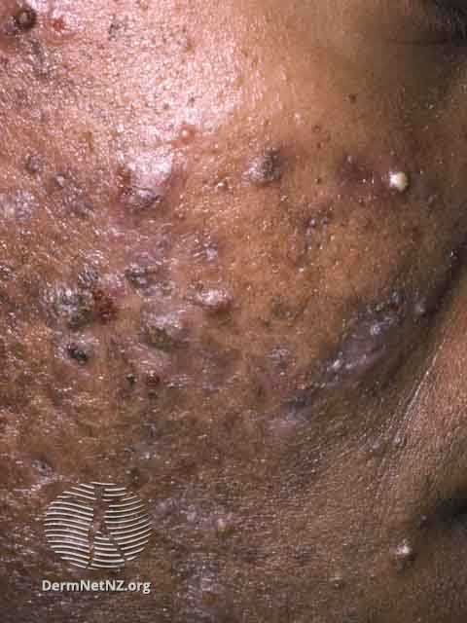
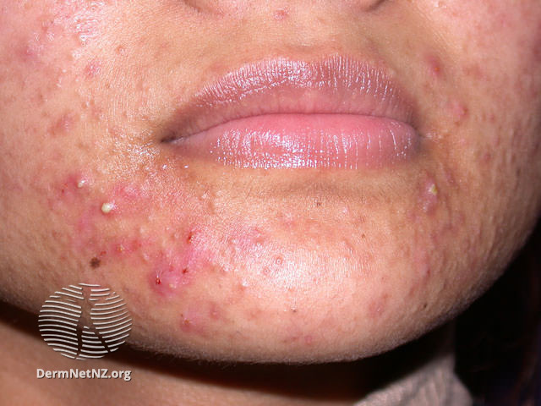
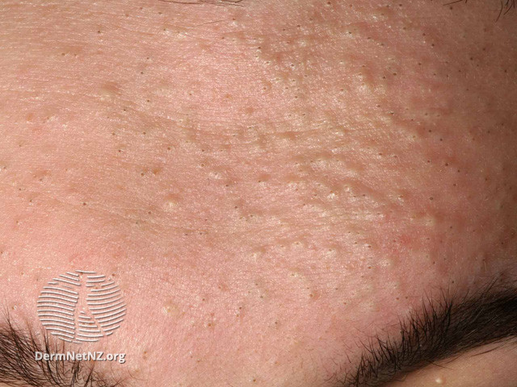
Lesions of Acne
Comedones^{1, 2}
Pustules²
Papules and nodules³
Images from: DermNet.org may be be accessed from:
1. © Professor Raimo Suhonen DermNet. Comedonal Acne. April 2014. Accessed August 26, 2022. https://dermnetnz.org/topics/comedonal-acne
2 © DermNet.. DermNet. Pustular Skin Conditions. September 2021. Accessed August 26, 2022.. https://dermnetnz.org/topics/pustular-3. skin-conditions
3. © Dr Richard Ashton. DermNet. Nodulocystic Acne. August 2021. Accessed August 26, 2022. https://dermnetnz.org/topics/nodulocystic-acne
DermNet. Comedonal Acne. April 2014. Accessed August 26, 2022. https://dermnetnz.org/topics/comedonal-acne
DermNet. Pustular Skin Conditions. September 2021. Accessed August 26, 2022. https://dermnetnz.org/topics/pustular-skin-conditions
DermNet. Nodulocystic Acne. August 2021. Accessed August 26, 2022. https://dermnetnz.org/topics/nodulocystic-acne

Slide 9
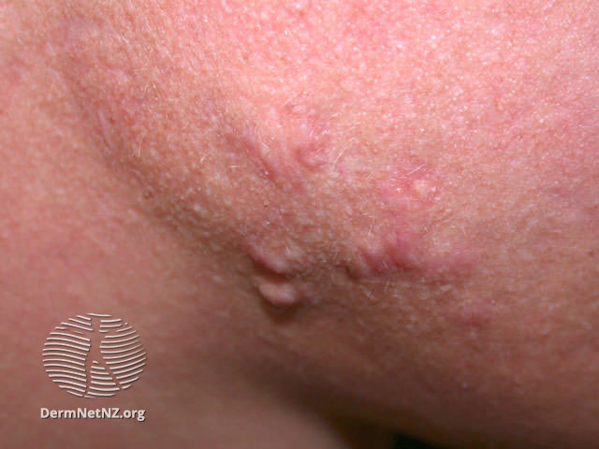
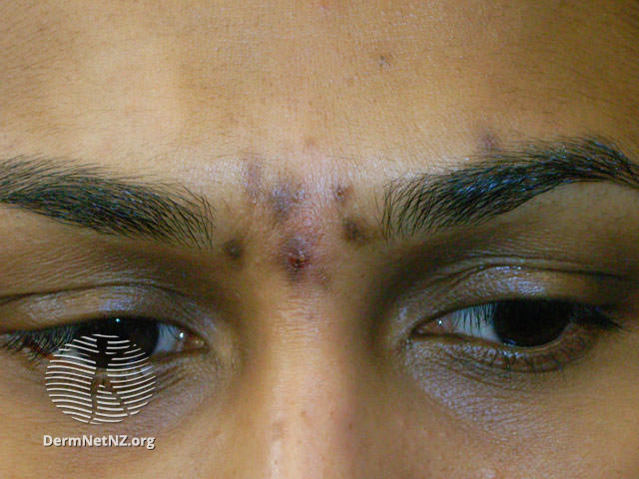
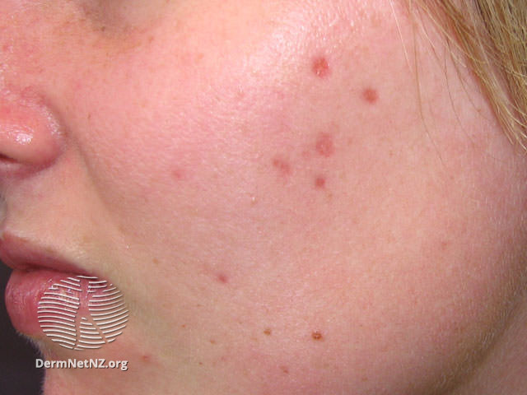
Acne Sequelae
Scarring
Hyperpigmentation
Erythema
Images from: DermNet.org may be accessed from:
© DermNet. DermNet. Acne scaring. June 2014. Accessed August 26, 2022. https://dermnetnz.org/topics/acne-scarring
DermNet. Acne scaring. June 2014. Accessed August 26, 2022. https://dermnetnz.org/topics/acne-scarring

Slide 10
Impact of Acne on Quality of life
Reduced self-esteem¹
Dermatologic disease has been associated with increased odds of:²
Anxiety
Depression +/- suicidal ideation
Patients with acne have been shown to have increased risk of major depressive disorder in the 5 years following acne diagnosis³
1. Dréno B, et al. Acta Derm Venereol. 2021;101:adv00495
2. Dalgard FJ, et al. J Invest Dermatol. 2015;135:984-991.
3. Vallerand IA, et al. Br J Dermatol. 2018;178:e194-e195.

Slide 11
Impact of Truncal Acne on Quality of Life
Avoidance of activities
Swimming
Altered clothing choices
Assistance with product application to back
Loss of independence/privacy
Dréno B, et al. Acta Derm Venereol. 2021;101:adv00495.

Slide 12
Disease Location and Impact on Quality of Life
Online international survey
Patients self-graded acne severity and completed the Dermatology Life Quality Index (DLQI)
694 subjects with combined facial and truncal acne (F+T)
615 with facial acne only (F)
F+T participants were twice as likely to report "very large" to "extremely large" impact on HRQoL
HRQoL, health-related quality of life
Tan J, et al. J Am Acad Dermatol. 2021;3:102-110.

Slide 13
Treatment

Slide 14
Targeted Treatment
 | Follicular plugging | Inflammation | C acnes | Sebum
Topicals:
Retinoids | ✔️ | ✔️
Benzoyl peroxide |  | ✔️ (indirectly) | ✔️
Topical antibiotics |  | ✔️ | ✔️
Dapsone |  | ✔️
Azelaic acid | ✔️ | ✔️ | ✔️
Clascoterone |  | ✔️ |  | ✔️
Orals:
Antibiotics |  | ✔️ | ✔️
Isotretinoin | ✔️ | ✔️ | ✔️ (indirectly) | ✔️
Spironolactone |  | ✔️ |  | ✔️
Oral Combination Contraceptive pills |  | ✔️ |  | ✔️
Zaenglein AL, et al. J Am Acad Dermatol. 2016;74(5):945-973.
NICE. Clinical knowledge summaries: acne vulgaris management. June 25, 2021. Accessed August 13, 2022. https://www.nice.org.uk/guidance/ng198/chapter/Recommendations#managing-acne-vulgaris

Slide 15
Patient Assessment – Treatment Considerations
Based on
Patient age
Lesion morphology
Distribution
Facial
Truncal
Both
Severity
Extent
Presence of scarring
Inflammatory lesions
Hyperpigmentation
Ashton R, et al. Pediatr Rev. 2019;40:577-589.
Zaenglein AL, et al. J Am Acad Dermatol. 2016;74(5):945-973.

Slide 16
Treatment Options
Topicals
Retinoids
Antibacterials
Sebum inhibitors
Anti-inflammatories
Orals
Antibacterials
Hormonal
Isotretinoin

Slide 17
Acute and Maintenance Therapy
Acute
Goal: obtain control as soon as possible
Topical therapy
May also involve an oral antibiotic for limited duration
Maintenance
Goals
Maintenance of improvement
Excellent tolerability
Simple
Cosmetically elegant
Nonantibiotic regimen
Important to reduce antibiotic resistance
Typically, topical retinoid +/- benzoyl peroxide
Zaenglein AL, et al. J Am Acad Dermatol. 2016;74(5):945-973. Layton A, et al. JAAD Int. 2021;5:41-48.
Tan J, et al. JAAD Int. 2021;5:101-111. NICE. Clinical knowledge summaries: acne vulgaris management. June 25, 2021. Accessed August 13, 2022. https://www.nice.org.uk/guidance/ng198/chapter/Recommendations#managing-acne-vulgaris

Slide 18
AAD Guideline Treatment
 | Mild | Moderate | Severe
First line | BP or topical retinoid -or- Combination therapy BP + antibiotic or Retinoid + BP or Retinoid + BP + antibiotic | Combination therapy BP + antibiotic or Retinoid + BP or Retinoid + BP + antibiotic -or- Oral antibiotic + topical Retinoid + BP -or- Oral antibiotic + retinoid + BP + topical antibiotic | Oral antibiotic Plus Combination therapy BP + antibiotic or Retinoid + BP or Retinoid + BP + antibiotic -or- Isotretinoin
Alternative | Add topical retinoid or BP if not already on - or- Consider alternate retinoid -or- Consider topical Dapsone | Alternate combination therapy -or- Change oral antibiotic -or- Add combined oral contraceptive or spironolactone in females -or- isotretinoin | Change oral antibiotic -or- Add combined oral contraceptive or spironolactone in females -or- Isotretinoin
AAD, American Academy of Dermatology; BP, benzoyl peroxide
Zaenglein AL, et al. J Am Acad Dermatol. 2016;74(5):945-973.

Slide 19
Topical Retinoids
Mechanism
Comedolytic
Anti-inflammatory
Normalize epithelial hyperkeratinization
First-line treatment and long-term maintenance
Effect may be seen as early as 1-3 wks
Optimal effect ≥12 wks
Can be drying and irritating
May help reduce scarring
Baldwin H, et al. Am J Clin Dermatol. 2021;22:315-327.
Kassir M, et al. J Cosmet Dermatol. 2020;19:1278-1283.

Slide 20
Topical Retinoids
 | Tretinoin (First generation) | Adapalene (Third generation) | Tazarotene (Third generation) | Trifarotene (Fourth generation)
FDA approval | 1971 | 1996 | 1997 | 2019
RAR binding | ⍺,β,Ɣ | β,Ɣ | Β,Ɣ | Ɣ
Formulations | 0.025% 0.04% 0.05% 0.06% 0.08% 0.1% | 0.1% (cream and gel; OTC) 0.3% (gel) | 0.045% (lotion) 0.05% (cream, gel) 0.1% (cream, gel) | 0.005% (cream)
Fixed-dose combos | 0.1% encapsulated/3% BP encapsulated (cream) | 0.1%/2.5% BP(gel) 0.3/2.5% BP (gel)
Photostability | Photolabile (except encapsulated, microsphere and micronized) | Photostable | Photostable | Photostable (in vitro-studied and recommended QHS)
Other indications | Photoaging |  | Psoriasis photoaging
Stability with BP | Not stable with BP | Stable with BP | Stable with BP | Not studied
BP, benzoyl peroxide
Baldwin H, et al. Am J Clin Dermatol. 2021;22:315-327.
Kassir M, et al. J Cosmet Dermatol. 2020;19:1278-1283.

Slide 21
Improving Retinoid Tolerability
Use a pea-sized amount to entire affected area
No spot treatment
Start every other day
Moisturize regularly, maybe under retinoid
Consider changing formulation
Alternative vehicle
Alternative retinoid delivery system
Microsponge delivery system tretinoin
Micronization and polymeric emulsion
Tretinoin
Tazarotene
Be persistent; retinoids should be part of all regimens
Baldwin H, et al. Am J Clin Dermatol. 2021;22:315-327.
Kassir M, et al. J Cosmet Dermatol. 2020;19:1278-1283.

Slide 22
Benzoyl Peroxide
Available as washes and leave-ons
Available as fixed combinations with retinoids and clindamycin
Adverse events
Contact sensitization (5%)
Concentration-dependent irritant
Improved by micronization and microencapsulation
Bleaches fabric
Note: microencapsulated benzoyl peroxide stand alone product is not FDA approved for acne
Zaenglein AL, et al. J Am Acad Dermatol. 2016;74(5):945-973.
NICE. Clinical knowledge summaries: acne vulgaris management. June 25, 2021. Accessed August 13, 2022. https://www.nice.org.uk/guidance/ng198/chapter/Recommendations#managing-acne-vulgaris

Slide 23
Benzoyl Peroxide – Dual Purpose
Treats acne
Kills faster and more effectively than topical antibiotics¹
Alone significantly improves both inflammatory and comedonal acne²
Reduces risk of antimicrobial resistance
Not associated with antimicrobial resistance³
Can prevent development of resistance to topical and oral antibiotics
Can reverse resistance that has already occurred
1. Gloor M, et al. Z Hautkr. 1982;57:867-878.
2. Gollnick H, et al. J Am Acad Dermatol. 2003;49;S1-38.
3. Gollnick H, et al. Dermatol. 1998;196:119-125

Slide 24
Clindamycin + BP vs Clindamycin Monotherapy
BP, benzoyl peroxide
Cunliffe WJ, et al. SF. Clin Ther. 2002;24:1117-1133

Slide 25
Benzoyl Peroxide Adherence
Adherence to OTC BP purchasing¹
Computer chip study of BP use²
84 patients told to purchase
2 weeks later
Only 30% recalled ingredient
36% didn’t purchase anything
64% made purchase but only 32% contained BP
OTC, over-the-counter; BP, benzoyl peroxide
1. Huyler AH, et al. J Am Acad Dermatol. 2017;77(4):763-764.
2. Yentzer BA, et al. J Am Acad Dermatol. 2009;60(5):879-880.

Slide 26
Topical Antibiotics
Medication | Comments | FDA approval
Clindamycin | Generally, well tolerated | Age ≥12 y
Minocycline | Rare cutaneous reactions | Age ≥9 y
Erythromycin | Rampant antibiotic resistance | Age ≥12 y
Benzoyl peroxide with clindamycin | Irritation Can bleach fabric | Age ≥12 y
Zaenglein AL, et al. J Am Acad Dermatol. 2016;74(5):945-973.
Amzeeq [package insert]. Scottsdale, AS: Journey Medical Corporation; 2022.

Slide 27
Sebum Inhibitor
Medication | Dosing | Mechanism | Comments | FDA approval
Clascoterone 1% topical cream | Apply to affected area twice daily | Androgen receptor inhibitor Reduces sebum production and inflammation | Generally, well tolerated Not for monotherapy In maximal use study 3/42 subjects had mild asymptomatic HPA axis suppression | Age ≥12 y
Zaenglein AL, et al. J Am Acad Dermatol. 2016;74(5):945-973.
NICE. Clinical knowledge summaries: acne vulgaris management. June 25, 2021. Accessed August 13, 2022. https://www.nice.org.uk/guidance/ng198/chapter/Recommendations#managing-acne-vulgaris
Mazzetti A, et al. J Drugs Dermatol. 2019;18(6):563.

Slide 28
Anti-inflammatory
Medication | Mechanism | ADR | Other
Dapsone 5% gel: twice daily dosing 7.5% gel: daily dosing | Anti-inflammatory | Generally, well tolerated | Age ≥9 y G6PD deficiency increased risk for hemolysis and methemoglobinemia identified in 2 case reports with topical use since release in 2005 Systemic absorption is low Oxidation of dapsone may occur when co-applied with BP turning the product a yellow/orange color
ADR, adverse drug reaction; G6PD, glucose-6-phosphate dehydrogenase; BP, benzoyl peroxide
Zaenglein AL, et al. J Am Acad Dermatol. 2016;74(5):945-973.
Wang X, et al. Ann Palliat Med. 2022;11(2):611-620.
Dapsone [package insert]. Irvine, CA: Allergan; 2016.

Slide 29
Anti-inflammatory (continued)
Medication | Dose | Mechanism | Dosage form | Comment
Azelaic acid | Apply to affected area twice daily | Anti-inflammatory Antimicrobial Antikeratinizing Antioxidant Antityrosinase | Cream: 20% Gel: 15% Foam: 15% | Age ≥ 12 y (cream 20% for acne) Can cause burning and stinging with application May reduce hyperpigmentation
Zaenglein AL, et al. J Am Acad Dermatol. 2016;74(5):945-973.

Slide 30
Topical Combination therapy
Target as many of the 4 pathogenic factors as possible to improve efficacy
Minimize antibiotic resistance with benzoyl peroxide use
Fixed combination agents or multiple agents
Fixed combinations preferred
Improved compliance with fewer applications
Coapplication is unstudied
Zaenglein AL, et al. J Am Acad Dermatol. 2016;74(5):945-973.
NICE. Clinical knowledge summaries: acne vulgaris management. June 25, 2021. Accessed August 13, 2022. https://www.nice.org.uk/guidance/ng198/chapter/Recommendations#managing-acne-vulgaris

Slide 31
Fixed Combination Therapy
Medication | Comments | Available products | Other
Adapalene/Benzoyl peroxide (Epiduo®, Epiduo Forte) | Once daily | Gel: 0.1%/2.5%, 0.3%/2.5% | Age ≥9 y Bleaches fabric
Benzoyl peroxide with clindamycin (Acanya®, Benzaclin®, Duac®, Onexton®) | Once or Twice daily | Gel: 2.5%/1.2%, 5%/1%, 5%/1.2%, 3.75%/1.2% | Age ≥12 y Bleaches fabric
Clindamycin with tretinoin (Veltin®, Ziana®) | Once daily | Gel: 1.2%/0.025% | Age ≥12 y Unopposed clindamycin
Tretinoin/benzoyl peroxide (Twyneo®) | Once daily | Cream: 0.1%/3% | Age ≥9 y Bleaches fabric
Zaenglein AL, et al. J Am Acad Dermatol. 2016;74(5):945-973.

Slide 32
Oral Antibiotics
Monotherapy with systemic antibiotics is not recommended
Concurrent use of topical benzoyl peroxide to minimize risk of resistance
Limit to the shortest possible duration
Tetracycline class most used
Anti-inflammatory
Generally safe
Eichenfield LF, et al. Pediatrics. 2013;131 Suppl 3:S163-S186
Zaenglein AL, et al. J Am Acad Dermatol. 2016;74(5):945-973.
NICE. Clinical knowledge summaries: acne vulgaris management. June 25, 2021. Accessed August 13, 2022. https://www.nice.org.uk/guidance/ng198/chapter/Recommendations#managing-acne-vulgaris

Slide 33
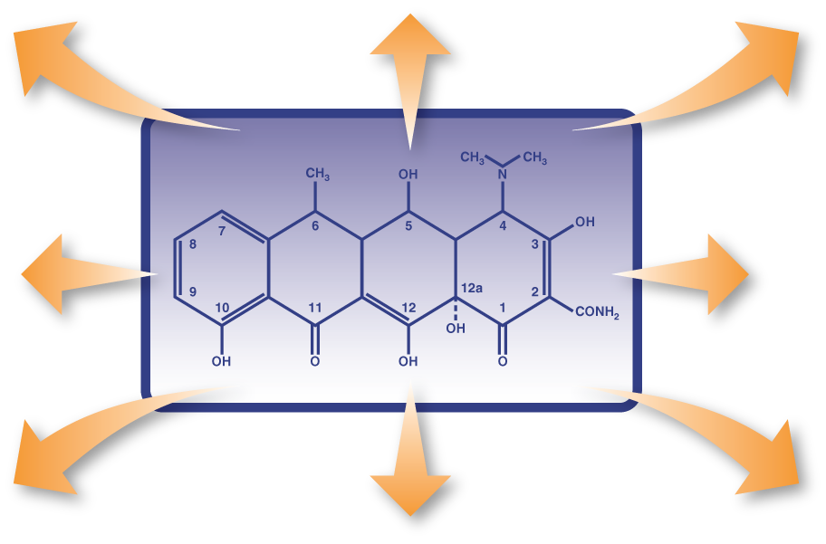
Tetracycline Class Anti-inflammatory Properties
↓ Matrix Metalloproteinases³
↓ Proinflammatory Cytokines¹
↓ Granulomatous Inflammation¹
↓ Cellular Migration, Proliferation²
↓ Phospholipase A2³
↓ NO Production⁴
↓ Angiogenesis⁶
↓ ROS⁵
NO, Nitric oxide; ROS, reactive oxygen species
1. Cazalis J, et al. J Periodontol. 2008;79:1762-1768. 2. Ueyama Y, et al. Br J Oral Maxillofac Surg. 1994;32:96-99. 3. Pruzanski W, et al. J Rheumatol. 1998;25:1807-1812. 4. Hoyt JC, et al. J Immunol. 2006;176:567-572. 5. Akamatsu H, et al. Acta Derm Venereol. 1992;72:178-179. 6. Dan L, et al. Curr Eye Res. 2008;33:653-660.
Notes:
33

Slide 34
Tetracycline Class
Absorption decreased by divalent cations (Calcium, magnesium, iron)
Tooth discoloration in children age < 8 y
 | Doxycycline | Minocycline | Sarecycline
FDA approved age | > 8 y | > 8 y | ≥ 9 y
Frequency | Once or twice daily | ER formulation: Once daily with or without food IR formulation: Once or twice daily | Once daily with or without food
Impact of food and dairy | Reduction in C_{max} 0-24% and AUC 0-13%, dose dependent | Minimal effect | “Unaffected”
Prescribing considerations | Photosensitization (most) Intracranial hypertension (rare) Esophagitis | Photosensitivity (significantly less than doxycycline) Intracranial hypertension (rare) Vestibular adverse effects Drug-drug induced lupus (rare) Autoimmune hepatitis (rare) | Photosensitization (least) Intracranial hypertension (rare) Low incidence of nausea, vomiting, candidiasis
Comment | Suspension available | Note multiple different products available all with different dosing Some can be opened, cut or crushed
ER, extended release; IR, immediate release
Zaenglein AL, et al. J Am Acad Dermatol. 2016;74(5):945-973. Odorici G, et al. AAI Pharma, Inc. for Medicis Pharmaceutical Corporation; 2006. Minolira [package insert]. Princeton, NJ: Dr. Reddy’s Laboratories Limited; 2017. Ximino [package insert]. Jacksonville, FL: Dr. Ranbaxy Laboratories Inc; 2015. Droxy [package insert]. Rockaway, NJ: Mayne Pharma International; 2013.

Slide 35
Extended-Release Minocycline
Dosed once daily at 1 mg/kg/day
Absorption is slower and C_{max} lower than immediate release¹
Fewer vestibular side effects^{2,3}
Lower daily dose results in less ADR related to cumulative dose (hyperpigmentation)⁴
ADR, Adverse event
1. Plott RT, et al. Cutis. 2006;78(4 suppl):6-10. 2. Del Rosso JQ. Cutis. 2006;77(3):153-156.
3. Fleischer AB, et al. Cutis. 2006;78(4 suppl):21-31. 4. Eisen D, Hakim MD. Drug Saf. 1998;18(6):431-440.

Slide 36
Alternative Systemic Antibiotics
Reserved for those unable to tolerate the tetracycline class:
Age <8 y
Pregnant
Allergic
None FDA approved for acne
Macrolides
Azithromycin
Erythromycin - avoid due to high rates of resistance
Other systemic antibiotics discouraged due to limited data and adverse effect profile
Trimethoprim-sulfamethoxazole
Trimethoprim
Rare/serious effects
Agranulocytosis
SJS/TENS
Methemoglobinemia
SJS, Stevens-Johnson Syndrome; TENS, toxic epidermal necrolysis
Eichenfield LF, et al. Pediatrics. 2013;131 Suppl 3:S163-S186
Zaenglein AL, et al. J Am Acad Dermatol. 2016;74(5):945-973.
NICE. Clinical knowledge summaries: acne vulgaris management. June 25, 2021. Accessed August 13, 2022. https://www.nice.org.uk/guidance/ng198/chapter/Recommendations#managing-acne-vulgaris

Slide 37
Antibiotic Use in Acne - US
Primary care setting¹
One in 4 patients given antibiotics (oral/topical) during initial acne consultation
Dermatology setting²
Duration of systemic antibiotics before switching to isotretinoin
331.3 days (283.1 d if single site, 380.2 d if transferred care)
Cohort study of dermatologists 2008-2016³
Antibiotic prescriptions dropped 36.6% overall
Antibiotic prescriptions for acne decreased 28.1%
2016 - 57.5% of prescriptions for extended course were for acne
1. Francis NA, et al. Br J Dermatol. 2017;176:107-115.
2. Nagler AR, et al. . J Am Acad Dermatol. 2016;74(2):273-279.
3. Barbieri JS, et al. JAMA Dermatol. 2019;155:290-297.

Slide 38
Antibiotic Resistance
Factors contributing to resistance
Under exposure
Poor adherence
Underdosing
Failure to reach target concentration in the follicle
Antibiotic monotherapy
Sequential antibiotic exposure
Treatment longer than 12-24 wks
Rates of resistance to Cutibacterium acnes
Topical macrolides ~ 50%
Topical clindamycin 20%-100%
Oral tetracyclines ~20%
Walsh TR, et al. Lancet Infect Dis. 2016;16:e23-e33.
Kircik LH. J Drugs Dermatol. 2013;12:s73-s76.
Nord CE, et al. Anaerobe. 2006;12:207-210.

Slide 39
Hormonal Acne Treatment
Medication | Dosing | Mechanism | Cautions and ADR | FDA approvals for acne
Spironolactone Dosing not equivalent between suspension and tablet | 25-200 mg/d | Androgen receptor blocker Decreases androgen production Inhibits 5-α reductase Increase SHBG | Caution in patients with renal and/or hepatic disease, Addison's disease ADR: Menstrual irregularities Gynecomastia Aldosterone antagonist → diuresis and lowering of blood pressure | Not approved in pediatrics
Oral contraceptives
Ethinyl estradiol/norgestimate | 1 tablet daily | Suppresses ovarian androgen production Increase SHBG | Numerous potential side effects and contraindications | Triphasic, age ≥15 y and after menarche
Drospirenone/ethinyl estradiol | 1 tablet daily |  |  | Age ≥14 y; Yaz®
Drospirenone/ethinyl estradiol/levomefolate calcium | 1 tablet daily |  |  | Age ≥14 y after menarche; Beyaz®
Ethinyl estradiol/norethindrone acetate | 1 tablet daily |  |  | Age ≥15 y, after menarche; Tri-Legest®21
Both have slow onset of action
SBGH, sex hormone binding globulin
Zaenglein AL, et al. J Am Acad Dermatol. 2016;74(5):945-973.
NICE. Clinical knowledge summaries: acne vulgaris management. June 25, 2021. Accessed August 13, 2022. https://www.nice.org.uk/guidance/ng198/chapter/Recommendations#managing-acne-vulgaris

Slide 40
Oral Contraceptive Contraindications – Take a History!
Pregnancy
Breast cancer (current)
Breast feeding <6 weeks postpartum
Age >35 y and heavy smoker (>15 cigarettes/d)
Hypertension
Diabetes mellitus with nephropathy, retinopathy, neuropathy, vascular disease
Deep vein thrombosis- history or current
History of heart disease
History of stroke
Migraine headaches (with focal neurological symptoms at any age or without focal neurological symptoms but age >35 y)
Cirrhosis or liver tumor (benign or malignant)

Slide 41
Spironolactone and Potassium
Retrospective review, 974 healthy 18-45 y women taking spironolactone for acne vs 1165 age-matched controls
13/1802 abnormal measurements (0.72%)
Baseline hyperkalemia in this population 0.76%
Conclusion: Routine monitoring unnecessary for healthy young women
Might be necessary for older women, abnormal renal function, concomitant medications affecting renin-angiotensin-aldosterone system
Plovanich M, et al. JAMA Dermatol. 2015;151(9):941-944.

Slide 42
Isotretinoin
Class | Dosing | Cautions | Adverse reactions | FDA approval
Systemic retinoid | 0.5-1 mg/kg/d | Teratogenic REMS prescribing requirements Pregnancy prevention requirements | Common Mucocutaneous changes Elevations triglycerides Elevations in liver enzymes Arthralgias Rare Pseudotumor cerebri | Nodulocystic acne (Severe), Recalcitrant ≥ 12 y
REMS, Risk Evaluation and Mitigation Strategies
Zaenglein AL, et al. J Am Acad Dermatol. 2016;74(5):945-973.
NICE. Clinical knowledge summaries: acne vulgaris management. June 25, 2021. Accessed August 13, 2022. https://www.nice.org.uk/guidance/ng198/chapter/Recommendations#managing-acne-vulgaris
Gieler U, et al. J Eur Acad Dermatol Venereol. 2020;34(6):1131-1133.

Slide 43
Isotretinoin: Risk of Depression
Meta-analysis of 31 studies of patients receiving isotretinoin
Relative risk of depression significantly declined 0.588 (95% CI 0.382-0.904) vs comparators post treatment compared to baseline
Mean depression score decreased -0.335 (95% CI -0.498 to -0.172)
Huang Y-C, et al. J Am Acad Dermatol. 2017;76:1068-1076.e9.

Slide 44
Pseudoacne Fulminans
< 200 reports in the literature
Explosive worsening of disease within first month of initiation of therapy
More common in males, severely inflamed acne, truncal involvement
Absence of systemic signs/symptoms of traditional acne fulminans
Scarring guaranteed
Image from: DermNet.org and may be accessed from: © DermNet. DermNet. Acne fulminans. April 2014. Accessed September 25, 20222. https://dermnetnz.org/topics/acne-fulminans
Greywal T, et al. J Am Acad Dermatol. 2017;77(1):109-117

Slide 45
Pseudoacne Fulminans Treatment
Avoid
Start high risk patients on low dose (10-20 mg/d) +/- prednisone
Manage
Stop or reduce isotretinoin dose by 50%, add prednisone 1 mg/kg
Slowly reinstitute isotretinoin
Greywal T, et al. J Am Acad Dermatol. 2017;77(1):109-117

Slide 46
Reassessment and Maintenance
Reassess as needed
Primary goals:
Maintain clear or almost clear skin
Avoid antibiotics
Maintenance retinoid with or without adjunctive therapy
Layton A, et al. JAAD Int. 2021;5:41-48.
Tan J, et al. JAAD Int. 2021;5:101-111.
NICE. Clinical knowledge summaries: acne vulgaris management. June 25, 2021. Accessed August 13, 2022. https://www.nice.org.uk/guidance/ng198/chapter/Recommendations#managing-acne-vulgaris

Slide 47
Acne Sequelae and Management

Slide 48
Acne-Induced Pigmentary Alterations
Hyperpigmentation
Incidence 45.5%-87.2%
Risk factors:
Darker Fitzpatrick skin phototype
Erythema
Lighter Fitzpatrick skin phototype
Layton A, et al. JAAD Int. 2021;5:41-48.
Elbuluk N, et al. Am J Clin Dermatol. 2021;22(6):829-836.

Slide 49
Risk Factors For Scarring
Increased acne severity
Delayed time to effective treatment
Relapse
Family history
Lesion manipulation
Male sex
SCAR-S, Score for Acne Scar Severity
1. Layton A, et al. JAAD Int. 2021;5:41-48.
2. Connolly D, et al. J Clin Aesthet Dermatol. 2017;10(9):12-23.
3. Tan JK, et al. J Cutan Med Surg. 2010;14(4):156-160.

Slide 50
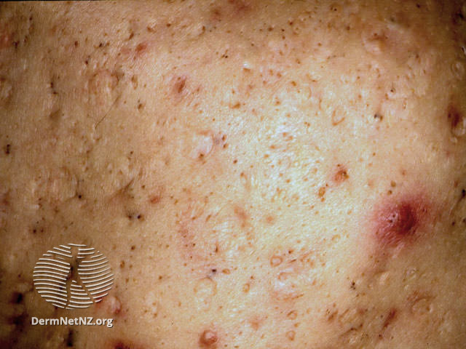
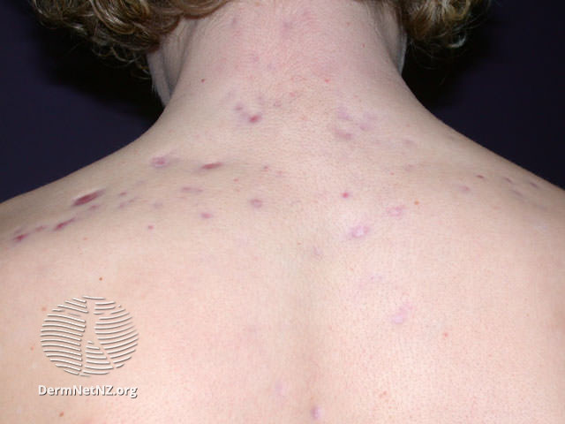
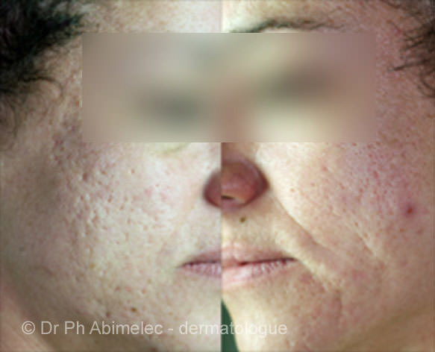
Incidence of Scarring
Develops in 43%-90.8% of patients
80%-90% of lesions are atrophic
60%-70% ice pick
20%-30% boxcar
15%-25% rolling
Hypertrophic or keloid lesions are less common
Ice pick
Box car
Images without modification from: DermNet and may be accessed at: https://dermnetnz.org/topics/acne-scarring
© DermNet. DermNet. Acne scaring. June 2014. Accessed September 25, 2022.
Rolling
© Dr Ph Abimelec
Keloid
Layton A, et al. JAAD Int. 2021;5:41-48.
Connolly D, et al. J Clin Aesthet Dermatol. 2017;10(9):12-23.
Bhargava, et al. Am J Clin Dermatol 2018; 19:459-477.

Slide 51
Treatment of Sequelae – Postinflammatory Hyperpigmentation
Topical retinoids
Azelaic acid
Hydroquinone
Superficial chemical peels
Laser
Sunscreen
Connolly D, et al. J Clin Aesthet Dermatol. 2017;10(9):12-23.
Eichenfield DZ, et al. JAMA. 2021;326:2055-2067.

Slide 52
Treatment of Sequelae – Scarring
Topical retinoids
Chemical peels
Intralesional trichloroacetic acid application
Surgical subcision/excision
Fractionated ablative carbon dioxide lasers
Nonablative lasers
Microneedling
Fillers
Connolly D, et al. J Clin Aesthet Dermatol. 2017;10(9):12-23.
Eichenfield DZ, et al. JAMA. 2021;326:2055-2067.

Slide 53
Ensuring Success

Slide 54
Patient Knowledge Base and Satisfaction With Care
Vast majority (94%) dissatisfied with information received from HCP¹
Overall knowledge of acne is poor²
84.6% presume dietary changes will reduce/prevent²
Increased water consumption
Increased consumption of fruits and vegetables ameliorative
HCP, healthcare provider
1. Tan J, et al. J Drugs Dermatol. 2021;20:600-606.
2. Yrulmaz A, et al. Curr Health Sci J. 2020;46:111-116

Slide 55
Managing Patient Expectations
Discuss their concerns about the effect of their disease and treatment
Highlight that improvement may only be observed in the long term (weeks to months)
Be realistic about outcomes
Emphasize the need for control of active acne to reduce the risk of developing sequelae
Emphasize the role of modifiable risk factors (eg, lesion excoriation, adherence to medication) in reducing the risk of developing sequelae
Discuss management options for sequelae
Layton A, et al. JAAD Int. 2021;5:41-48.
Tan J, et al. JAAD Int. 2021;5:101-111.

Slide 56
Personalizing Acne: Consensus of Expert Panel
Goals of treatment
Clear/almost-clear skin with minimal adverse effects
Prevent sequelae
Improve quality of life/Reduce disease burden
Recommendations
Early intervention to prevent sequelae
Early aggressive therapy with combination regimens targeting acne pathophysiology
Use of topical retinoids for every patient to prevent scarring
Layton A, et al. JAAD Int. 2021;5:41-48.
Tan J, et al. JAAD Int. 2021;5:101-111.

Slide 57
Optimizing adherence
Listen to your patient – obtain buy-in for treatment plan^{1,2,3}
KISS – Keep It Simple¹
Once daily dosing if possible
Fixed combinations
As few administration rules as possible
Rapid onset of action¹
Good tolerability^{1,2}
Set expectations¹
1. Snyder S, et al. Am J Clin Dermatol. 2014;15:87-94.
2. Ip A, Muller I, et al . Br J Dermatol. 2020;183:349-356.
3. Ip A, Muller I, et al. BMJ Open. 2021;11:e041794.

Slide 58
Dermatology Referral Considerations
Diagnostic uncertainty
Very severe acne
Acne with scarring
Failing conventional therapy
Impacting mental well-being
NICE. Clinical knowledge summaries: acne vulgaris management. June 25, 2021. Accessed August 13, 2022. https://www.nice.org.uk/guidance/ng198/chapter/Recommendations#managing-acne-vulgaris

Slide 59
Summary
Impacts majority of pediatric patients
Can have significant impact on quality of life
Antibiotic resistance rates are increasing
Not for use as monotherapy
Discontinue as soon as possible
Overall adherence rates are poor
Patient understanding of disease and medication therapy improves adherence
Help anticipate and manage adverse reactions
Effective treatment can improve mental health
Prevent sequelae
Delayed or inadequate treatment can increase risk of scarring

