Slide 2
Faculty
Caroline M. Apovian, MD, FACP, FTOS, DABOM
Co-Director, Center for Weight Management and Wellness, Brigham and Women’s Hospital, Boston, MA
Member of the Faculty, Harvard Medical School, Boston, MA
Robert Kushner, MD, MS, FACP, FTOS, DABOM
Professor of Medicine (Endocrinology) and Medical Education, Northwestern University Feinberg School of Medicine, Chicago, IL
Director, Center for Lifestyle Medicine, Northwestern Medicine, Chicago, IL

Slide 3
Red Line
Introduction to the Disease of Obesity
Notes:
Dr Apovian – red line

Slide 4
Obesity Recognized as a Chronic Disease
1998 NIH Guidelines
2002 Social Security Administration
2004 CMS removes “not a disease” verbiage
2012 American Association of Clinical Endocrinology
2008 The Obesity Society
2013 American Medical Association
Kyle T et al. Endocrinol Metab Clin North Am. 2016; 45(3): 511-520.
Notes:
2002 SSA guidelines meant that obesity could be a valid diagnosis when assessing for “disability”

Slide 5
Complex System Interplay
Energy dysregulation
Hormones
External influences
Berthoud HR, et al. Gastroenterology. 2017;152(7):1728-1738.
Notes:
Obesity is a disruption of energy regulation, and the defense of a higher body weight set point. It is an interplay of hunger, satiety, hormones, external cues, and genetics. All those factors mean that there is a lot of heterogeneity in obesity and that is noticeable when trying to find a treatment plan that works for a specific patient.

Slide 6
Food Regulation Hormones
Hunger
Ghrelin
Satiety
Glucagon-like peptide 1 (GLP-1)
Leptin
Amylin
Insulin
Gastric inhibitory polypeptide (GIP)
Greenway F. Int J Obes. 2015;39: 1188–1196

Slide 7
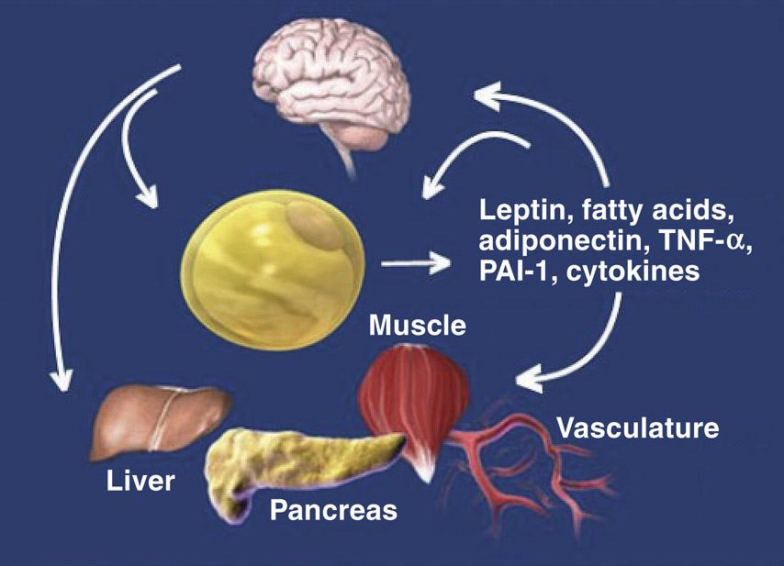
Endocrine Functions of Adipose Tissue
Not just fat storage
Secretory endocrine organ
PAI-1, Plasminogen Activator Inhibitor-1; TNF-α, Tumor Necrosis Factor
Kershaw E, et al. J. Clin. Endocrinol. Metab. 2004;89(6): 2548-2556.
Notes:
Adipose tissue was not previously viewed as an organ. It was regarded solely as an inert depot for energy storage. It is now known that adipose tissue secretes adipokines—bioactive peptides—that act locally and systemically. In other words, adipose tissue is an endocrine organ. It provides the metabolic communication mechanism with distant organs including the central nervous system.
An enhanced understanding of adipose tissue’s endocrine function could lead to better approaches to metabolic conditions such as obesity.

Slide 8
Increasing Prevalence Worldwide
World Obesity Federation. 2019. December 18, 2021. https://www.worldobesity.org/about/about-obesity/prevalence-of-obesity
Notes:
Obesity is now more prevalent worldwide than undernutrition

Slide 9
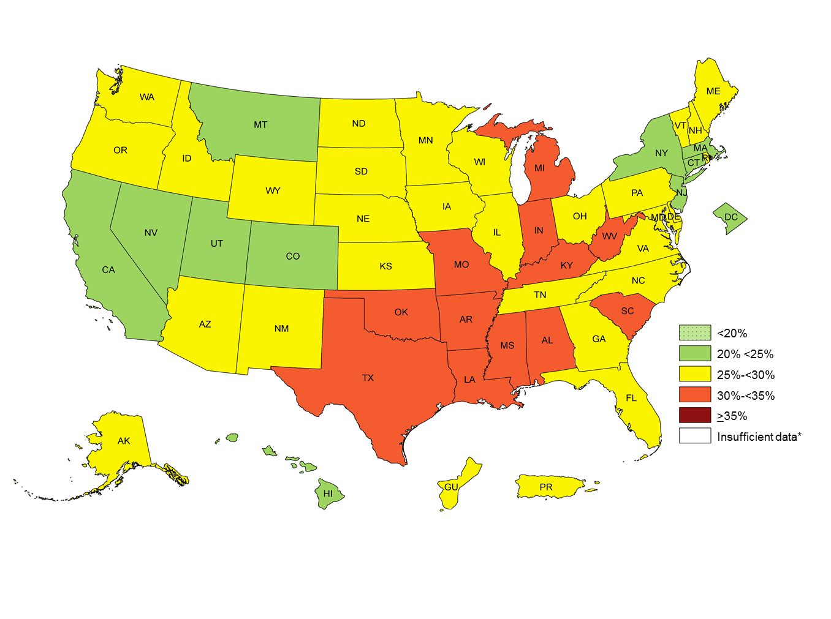
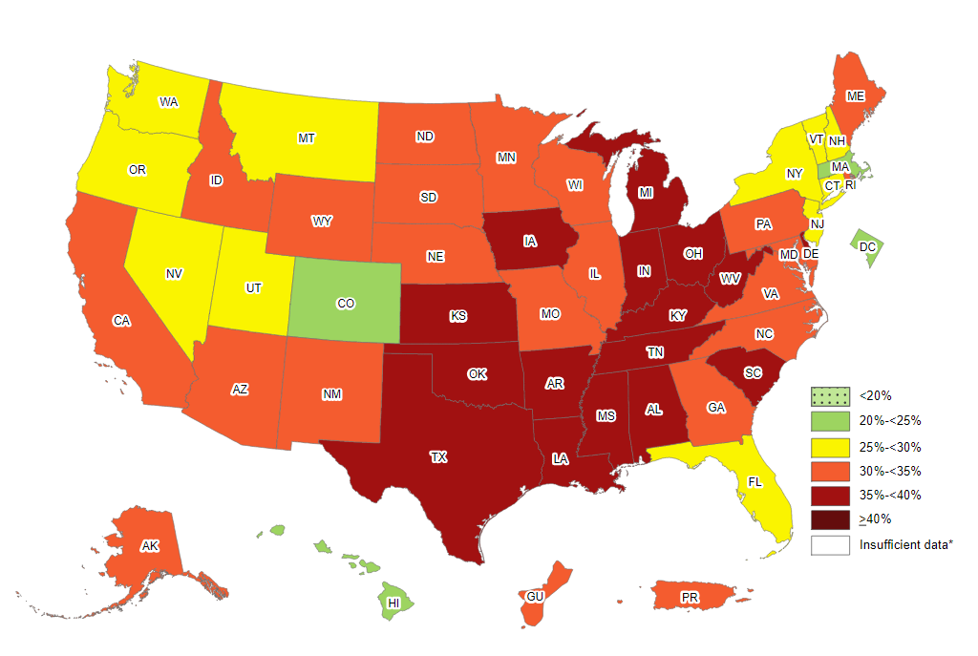
Increasing Prevalence in the United States
2011
2020
Data based on self-reported obesity
Center for Disease Control and Prevention (CDC). February 27, 2020. Accessed January 5, 2022.
https://www.cdc.gov/nccdphp/dnpao/data-trends-maps/index.html.

Slide 10
U.S. Prevalence Disparity by Race/Ethnicity
Center for Disease Control and Prevention (CDC). December 18, 2021. https://nccd.cdc.gov/dnpao_dtm/rdPage.aspx?rdReport=DNPAO_DTM.ExploreByTopic&islClass=OWS&islTopic=&go=GO
Notes:
Obesity disproportionately affects BIPOC

Slide 11
Healthcare Hesitancy and Under-utilization
Patients with obesity often fear:¹
Weight bias; assumptions
Lack of provider knowledge about obesity and available treatments
Low trust and poor communication
Under-utilization of treatment options
Estimated only 2.5% of patients with obesity on anti-obesity medications²
1. Alberga AS, et al. Primary Health Care Research & Development. 2019;20:e116.
2. Elangovan A, et al. Obes Surg. 2021;31(3):1105-1112.
Notes:
Patients with obesity experience substantial psychosocial burden, even from the medical community

Slide 12
Complications associated with obesity
Obesity
T2DM
Cancer
GERD
NAFLD
Stroke
CHD
T2DM
Sleep Apnea
Osteoarthritis
CHD, Coronary Heart disease; GERD, gastroesophageal reflux disease; NAFLD, Non-Alcoholic Fatty Liver disease; T2DM, Type II Diabetes Mellitus
Garvey WT, et al. Endocr Pract. 2016;22(suppl 3):1-205.
Notes:
Obesity affects every organ system.

Slide 13
The “Cost” of Obesity
Healthcare costs
Additional $1800 per year per person with obesity¹
Life-expectancy
2.6million deaths annually from noncommunicable diseases, many with ties to obesity²
1. Ward ZJ, et al. PLoS ONE 16(3): e0247307.
2. World Health Organization (WHO). February 2, 2021. December 18, 2021. https://www.who.int/data/gho/data/indicators/indicator-details/GHO/gho-ghe-ncd-deaths-in-thousands

Slide 14
Yellow Line
Obesity as a Cardiometabolic Risk Factor
Notes:
Dr Kushner – yellow line

Slide 15
Obesity and Type II Diabetes
Pancreatic β-cells compensate
Increased insulin production;
‘hyperinsulinemia’
Adipose tissue releases cytokines, hormones, and NEFAs
Insulin
resistance
Pancreatic β-cells can’t
compensate
Hyperglycemia
and T2DM
NEFA, Non-esterified fatty acid; T2DM, Type II Diabetes Mellitus
Kahn S, et al. Nature. 2006; 444: 840-846.
Notes:
Obesity is an independent risk factor for T2DM.

Slide 16
Obesity and Type II Diabetes
Percentage of patients within BMI category by diagnosis
Pantalone K, et al. BMJ Open 2017;7:e017583.
Notes:
Prevalence of pre-DM and T2DM increases as BMI increases.
Target adipose tissue as a driver of T2DM disease process.

Slide 17
Obesity and Dyslipidemia
Obesity effects on lipids¹
↑ free fatty acids in liver
↑ triglycerides
↑ small dense LDL
↓ HDL
HDL, high density lipoproteins ; LDL, low density lipoproteins
*Non-HDL-C ≥160 mg/dL or using cholesterol-lowering drug
1. Klop B, et al. Nutrients. 2013; 5(4): 1218–1240.
2. Saydah S, et al. Obesity (Silver Spring).2014;22:1888-1895.
Notes:
Obesity is an independent risk factor for dyslipidemia

Slide 18
Obesity and Hypertension
Obesity effects
↑ sympathetic nervous system activity
↑ renin-angiotensin-aldosterone system activity
↑ sodium reabsorption
↑ insulin resistance
Intentional weight loss strategies are important to reduce blood pressure in individuals with obesity.
Tanaka M, et al. Curr Hypertens Rep. 2019; 21(8): 63.
Notes:
Obesity is an independent risk factor for HTN via several different mechanisms.
Similar to the approach with T2DM, targeting adipose tissue targets the comorbidity as well.

Slide 19
Obesity and Cardiovascular Disease
Independent risk factor
↑ cardiac workload
Raised atherosclerotic lesions
Systemic and vascular inflammation
Endothelial dysfunction
Visceral adiposity – waist circumference
Extent and duration of obesity
Associated risk factor
Type II Diabetes
Dyslipidemia
Hypertension
Sleep disorders
Powell-Wiley TM, et al. Circ. 2021;143(21): e984-e1010.
Notes:
Obesity is an independent risk factor for CVD. The connection between obesity and T2DM, dyslipidemia, and HTN has an additive effect of increasing risk.

Slide 20
Obesity: chronic, low-grade systemic inflammation
↑ adipose tissue | Inflammatory marker changes¹ ↓ adiponectin ↑ TNF-α ↑ TNF-β ↑ IL-6 ↑ CRP ↑ EGF ↑ Prostaglandins ↑ PAI-1 | Complications from obesity-associated inflammation^{2,3} Insulin resistance Stroke Osteoarthritis Certain cancers CVD Sleep apnea PVD Asthma Thrombosis
CRP, C-reactive protein; CVD, Cardiovascular Disease; EGF, Epidermal Growth Factor; IL-6, Interleukin-6; PAI-1, plasminogen activator inhibitor-1; PVD, peripheral vascular disease; TNF-α, Tumor Necrosis Factor- α; TNF-β, Tumor Necrosis Factor - β
1.Fantuzzi G. J Allergy Clin Immuno. 2005;115(5): 911-919.
2.Kershaw EE, et al. J Clin Endocrinol Metab. 2004;89:2548-2556.
3.Hajer GR et al. European Heart Journal. 2008;29:2959–2971 .
Notes:
Obesity puts the body in a state of chronic, low-grade systemic inflammation. This is due to inflammatory marker changes, which are secreted by adipose tissue. Changes to these inflammatory markers have been associated with a wide variety of complications.

Slide 21
Cardiovascular Benefits of Anti-Obesity Meds
Medication | T2DM | Dyslipidemia | Hypertension | CVD outcomes | Notable trials
Orlistat^{1,2} | ↓BG; ↓ A1c | ↓TG; ↓LDL ↓total chol. | ↓SBP ↓DBP |  | XENDOS
Phentermine/ topiramate^{3,4} | ↓BG; ↓ annual incid. of T2DM | ↓TG; ↓LDL ↑HDL | ↓SBP ↓DBP |  | CONQUER SEQUEL
Bupropion/ naltrexone^{5,6} | ↓ A1c 0.6% | ↓TG ↓LDL ↑HDL | ↑SBP ↑DBP (both minimal) |  | COR-I COR-II COR-Diabetes
Liraglutide^{7,8} | ↓ cumulative incid. of T2DM ↓A1c 0.3% | ↓TG; ↓LDL ↑HDL | ↓SBP ↓DBP | ↓MACE by 13% (1.8mg dose) | SCALE LEADER
Semaglutide^{9,10} | ↓ A1c 1.6% | ↓TG | ↓SBP ↓DBP | ↓MACE by 26% (1mg dose) | STEP 1 SELECT SUSTAIN 6
BG, blood glucose; CVD, Cardiovascular Disease; DBP, diastolic blood pressure; HDL, high density lipoproteins; TG, LDL, low density lipoproteins; MACE, major adverse cardiovascular event; SBP, systolic blood pressure; T2DM, Type II Diabetes Mellitus; TG, triglycerides;
1.Hollander PA, et al. Diabetes Care. 1998;21(8):1288–1294. 2.Sahebkar A, et al. J Am Soc Hypertens. 2018;12(2):80-96. 3. Garvey WT, et al. Am J Clin Nutr. 2012;95(2):297-308. 4.Gadde K, et al. Lancet. 2011;377(9774):1341-1352. 5.Hollander P, et al. Diabetes Care. 2013;36(12):4022-4029. 6. Apovian C, et al. Obesity (Silver Spring). 2013;21(5):935-943. 7.Pi-Sunyer X, et al. N Engl J Med. 2015;373(1):11-22. 8. Victoza™ [package insert]. Novo Nordisk. 9.Wilding J, et al. N Engl J Med. 2021; 384:989-1002. 10.Marso SP, et al. N Engl J Med. 2016;375(19):1834-1844.
Notes:
Selected medications approved for long-term weight loss have been shown to reduce cardiovascular risk.

Slide 22
Clinically Relevant Weight Loss in Pre-Diabetes
5-15% weight loss goal¹
Diabetes prevention in pre-DM
Weight loss (3% at 3yrs) via diet and exercise lifestyle change
58% risk reduction of T2DM diagnosis at 3 years²
34% risk reduction of T2DM diagnosis at 10 years³
T2DM, Type II Diabetes Mellitus
1. Garvey WT, et al. Endocr Pract. 2016;22(suppl 3):1-205.
2. Knowler WC, et al. N Engl J Med. 2002;346:393-403.
3. Knowler WC, et al. Lancet. 2009;374(9702):1677-1686.
Notes:
Metabolic disorders can be greatly improved by moderate weight loss.

Slide 23
Clinically Relevant Weight Loss Effects
5-10% weight loss
↓ Type 2 diabetes risk¹
Improved health-related quality of life^{7,8}
↓ cardiovascular mortality²
Improved obstructive sleep apnea^{5,6}
Improved lipid profile³
↓ Blood pressure⁴
1. Knowler et al. N Engl J Med. 2002;346:393-403. 2. Li et al. Lancet Diabetes Endocrinol. 2014;2:474-480. 3. Datillo et al. Am J Clin Nutr. 1992;56:320-328. 4. Wing et al. Diabetes Care. 2011;34:1481-1486. 5. Foster et al. Arch Intern Med. 2009;169:1619-1626.
6. Kuna et al. Sleep. 2013;36:641-649. 7. Warkentin et al. Obes Rev. 2014;15:169-182. 8. Wright et al. J Health Psychol. 2013;18:574-586.
Notes:
Emphasis point that even a relatively small weight loss changes can have big effects on different disease states.

Slide 24
Green Line
Treatment Overview: Lifestyle, Diet, Surgery, Pharmacotherapy
Notes:
Dr Apovian – green line

Slide 25
Realistic Goals of Weight Loss/Management
Patients may have an unrealistic weight loss goal
Important to discuss the benefits and limitations of each treatment option
Clinically significant benefits with as low as 5% weight loss
Set specific modification goals
Bray G. Obesity (Silver Spring). 2013;21(5):893-9.
Notes:
Weight loss of 5% to 10% is associated with health benefits
Obesity heterogeneity means weight loss may require trial and error.

Slide 26
Lifestyle Changes – Physical Activity Only
Cardiometabolic advantages, independent of weight loss¹
High amount of exercise needed in the absence of dietary changes²
1.Swift D, et al. Prog. Cardiovasc. Dis. 2018;61:206-213.
2.Slentz C, et al. Arch Intern Med. 2004;164(1):31-39.

Slide 27
Lifestyle Changes – Diet Only
Certain diets have additional cardiovascular benefits¹
DASH
Mediterranean
Adherence matters more than macronutrients¹
1. Garvey WT, et al. Endocr Pract. 2016;22(suppl 3):1-205.
2. Shai I, et al. N Engl J Med. 2008;359:229-241.

Slide 28
Lifestyle Changes – Diet and Physical Activity
Combining physical activity with dietary changes leads to best chance of success
Foster-Schubert K, et al. Obesity (Silver Spring). 2012;20(8):1628-1638.

Slide 29
Bariatric Surgery
BMI ≥ 40 kg/m² without complications
BMI ≥35 kg/m² with at least 1 major obesity-related complication
BMI ≥30 kg/m² with T2DM or metabolic syndrome, with uncontrolled hyperglycemia
Indicated for:
Recommended for:
BMI, body mass index; T2DM, Type II Diabetes Mellitus;
Mechanick J, et al. Endocr Pract. 2019;25(12):1346-1359.
Notes:
Bariatric surgery is an effective treatment option for selected patients with obesity

Slide 30
Bariatric Surgery
Surgery type | Target weight loss | % of performed procedures
LAGB | 20-25% | 3%
LSG | 25-30% | 70%
RYGB | 30-35% | 25%
BPD-DS | 35-45% | 2%
BPD-DS, Biliopancreatic diversion with duodenal switch; LAGB, laparoscopic adjustable gastric band; LSG, laparoscopic sleeve gastrectomy; RYGB, Roux-en-Y gastric bypass
Mechanick J, et al. Endocr Pract. 2019;25(12):1346-1359.
Notes:
Bariatric surgery is an effective treatment option for selected patients with obesity

Slide 31
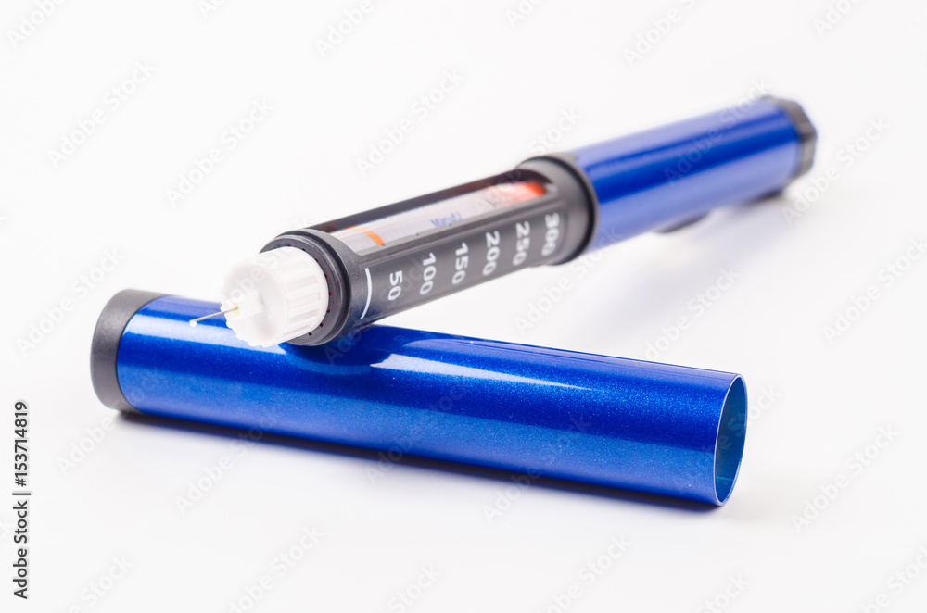
Why Anti-Obesity Medications?
“The rationale for use of medications is to help patients adhere to a lower calorie diet more consistently in order to achieve more sufficient weight loss and health improvements when combined with increased physical activity.”
Jensen MD, et al. Circulation. 2014;129(25 Suppl 2):S102-38.

Slide 32
Long-term Anti-Obesity Medications
Medication | % weight loss (placebo subtracted) | Indication | Contraindications/ warnings | Adverse drug events
Orlistat¹ | 3.8% | BMI ≥ 30 kg/m² or BMI ≥ 27 kg/m² with at least 1 obesity-related complication | Pg, Chronic malabsorption syndrome Patients need to take MVI | Fatty/oily stool Fecal urgency
Phentermine/ topiramate² | 8.6% |  | Pg – required REMS hyperthyroidism, glaucoma ↑HR, monitor electrolytes | Dizziness, dry mouth, insomnia, constipation, dysgeusia
Bupropion/ naltrexone³ | 4.8% |  | Pg, Uncontrolled HTN, hx of sz disorder, opiates for pain control May ↑ suicidal ideation | Nausea, vomiting, constipation, headache
Liraglutide⁴ | 5.4% |  | Pg, personal or family hx of medullary thyroid carcinoma or MEN2 Thyroid T-cell tumors, acute pancreatitis | Nausea, vomiting, abdominal pain
Semaglutide⁵ | 12.4% |  |  | Nausea, vomiting, diarrhea, constipation
BMI, body mass index; HR, heart rate; HTN, hypertension; hx, history; MEN2, Multiple Endocrine Neoplasia Syndrome Type 2; MVI, multivitamin; Pg, pregnancy; REMS, Risk Evaluation and Mitigation Strategy; sz, seizure
1.Xenical [package insert]. CHEPLAPHARM Arzneimittel GmbH. 2.Qsymia [package insert]. Vivus Inc. 3. Contrave [package insert].Nalpropion Pharmaceuticals LLC. 4.Saxenda [package insert]. Novo Nordisk. 5.Wegovy [package insert]. Novo Nordisk.
Notes:
Several medications in combination with lifestyle intervention have been shown to result in long-term weight loss of 5% to 10% in the majority of patients with obesity.
Differences among approved medications for long-term use enable treatment individualization.
Of note – pregnancy contraindication for bupropion/naltrexone was removed Aug 2020, it is just a warning.

Slide 33
Blue Line
Incretin-based Pharmacologic Options for Long-term Weight Loss and Management
Notes:
Dr Kushner – blue line

Slide 34
Treatment in Patients with T2DM
 | SGLT2 Inhibitors | GLP-1 Receptor Agonists
Weight loss | ↓ 1-3% body weight¹ | ↓ 5-13% body weight²
3-point MACE risk in CVD pts³ | ↓ 14% | ↓13%*
Heart failure hospitalization risk³ | ↓ 31% | ↓7% (not statistically significant)
Applicable trials⁴ | EMPA-REG CANVAS DECLARE-TIMI 58 | PIONEER-6 LEADER SUSTAIN-6 EXSCEL REWIND
*Excludes ELIXA trial in post-ACS only patients
ACS, acute coronary syndrome; CVD, Cardiovascular Disease; GLP-1, glucagon-like peptide-1; MACE, major adverse cardiovascular event; SGLT2, sodium-glucose cotransporter-2; T2DM, Type II Diabetes Mellitus
1.Ribola F, et al. Eur Rev Med Pharmacol Sci 2017;21(1): 199-211.
2.Lehmann E, et al. Cardiovasc. Res. 2021;117(10): e120-122.
3.Zelniker T, et al. Circ. 2019;139: 2022-2031.
4.American Diabetes Association. Diabetes Care. 2021;44(Suppl.1):S125–S150.
Notes:
Selected GLP-1 receptor agonists and SGLT-2 inhibitors have been shown to reduce cardiovascular risk in persons with T2DM
3-point MACE risk comparable between groups, but GLP-1 RAs lead to much greater weight loss and other benefits associated with that.

Slide 35
Reduced Energy Intake with GLP-1 RAs
↑ satiety and ↓ hunger
↓ food cravings
↑ food control
Changes in food preferences
Hypothalamus
NTS (hindbrain)
Hedonic reward centers
Receptor activation effects²
GLP-1 receptors in the brain¹
GLP-1 RAs, glucagon-like peptide-1 receptor agonists; NTS, nucleus tractus solitarus
1.Knudsen LB, et al. Front. Endocrinol. 2019;10:155.
2.Ard J, et al. Adv Ther. 2021;38: 2821–2839.
Notes:
Patients with obesity require long-term multi-modal treatment. Via receptors in the hypothalamus, GLP-1 RAs affect satiety and hunger, lower preference for energy-dense foods, alter food reward pathways, and decrease in food cravings, resulting in an improvement in eating control.

Slide 36
GLP-1 RAs in Patients Without T2DM
 | Liraglutide¹ | Semaglutide²
Route | Subcutaneous injection | Subcutaneous injection
Frequency | Daily | Weekly
Average weight loss | 4-6 kg | 15 kg
% of patients with ≥ 5% weight loss | 46-76%* | 86%
% of patients with ≥ 10% weight loss | 22-37% | 69%
*Range data obtained from multiple trials
GLP-1 RAs, Glucagon-like peptide-1 receptor agonists; T2DM, Type II Diabetes Mellitus
1.Mehta A, et al. Obes Sci Pract. 2017;3:3-14.
2.Wilding JPH, et al. N Engl J Med. 2021;384:989-1002.
Notes:
For the first half of 2022, semaglutide in the US will be for the continuation of existing patients, not new starts. This is due to a supply shortage.

Slide 37
STEP 8 Trial: Liraglutide vs Semaglutide
Total % body weight change over 68 weeks
Semaglutide (n=126)
-15.8%
Liraglutide (n=127)
-6.4%
Rubino D, et al. JAMA. 2022;327(2):138-150.
Notes:
Difference is statistically significant for all points on the slide – sema vs lira total % body weight lost, and for the % of participants who lost ≥10%, ≥15%, and ≥20% body weight.

Slide 38
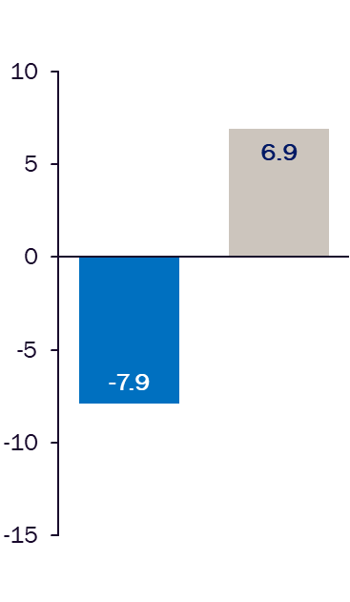
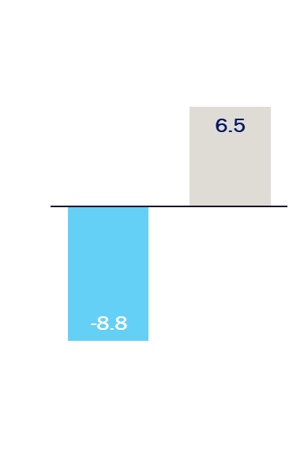
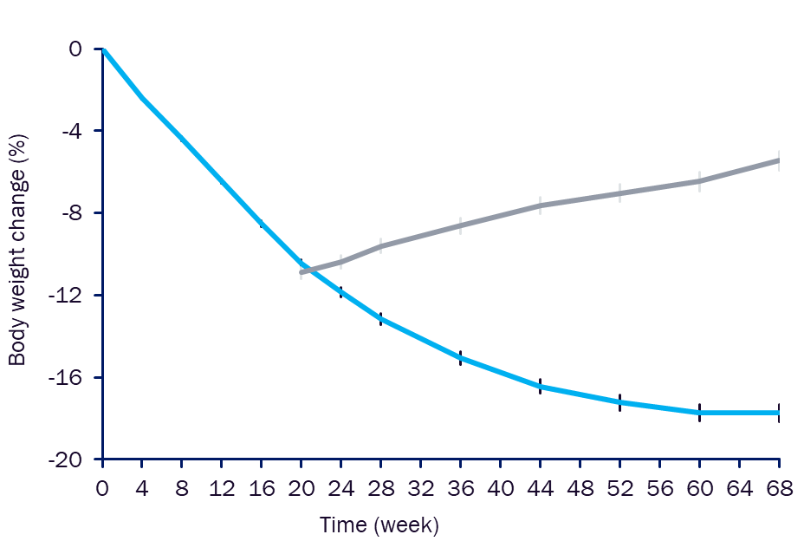
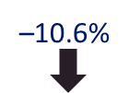
STEP 4: Semaglutide 2.4 mg weekly sc injection
Observed body weight change over time
Estimated change from week 20 to week 68
Mean at wk 0 =235 lbs.
Treatment policy estimand
Trial product estimand
Mean at wk 20 =211.8 lbs.
Run-in period
ETD: -14.8%
[95% CI: -16.0; -13.5]; p<0.0001
ETD: -15.3%
[95% CI: -16.5; -14.1]; p<0.0001
Data for the in-trial observation period. Error bars are ± standard error of the mean. CI, confidence interval; ETD, estimated treatment difference
Rubino D, et al. JAMA. 2021;325(14):1414-1425.
Notes:
Results really emphasize that obesity is a chronic disease that requires long-term treatment.

Slide 39
Oral Semaglutide*
Patients with Type II Diabetes¹
Patients without Type II Diabetes²
Average 3-5kg loss at 26 and 52 weeks
7mg dose: 19-27% of patients with ≥ 5% total body weight loss**
14mg dose: 30-44% of patients with ≥ 5% total body weight loss**
OASIS-1 Phase III trial
50mg daily dose
Estimated study completion May 2023
*Oral semaglutide is currently only approved for treatment of Type II Diabetes. Use for weight loss in any patient population is currently off label.
**Ranged data obtained from multiple studies
1.Rodbard H, et al. Am. J. Manag Care. 2020;26: S335-343.
2.ClinicalTrials.gov. Updated December 10, 2021. Accessed December 26, 2021. https://clinicaltrials.gov/ct2/show/NCT05035095?term=semaglutide&draw=6&rank=43
Notes:
Oral semaglutide in combination with lifestyle intervention results in an average 12% weight loss over 68 weeks

Slide 40
Orange Line
Strategies to Optimize Weight Loss and Maintenance
Notes:
Led by Dr Apovian, lots of discussion together – orange line

Slide 41
Obesity: Persistent Hormonal Adaptations
Biological adaptation following weight loss
↓ leptin
↑ food intake
↓ energy expenditure
↑ ghrelin
↑ hunger
↓ gut and pancreatic hormones that inhibit intake
PYY, CCK, GLP-1, Insulin, Amylin, Pancreatic Polypeptide
Hormone changes noted over 1 year post weight-loss even if the patient regained the weight
CCK, cholecystokinin; GLP-1, glucagon-like peptide 1; PYY, Peptide YY
Sumithran P, et al. N Engl J Med. 2011;365: 1597-1604.
Notes:
Obesity is a chronic disease requiring long-term treatment

Slide 42
Obesity as a Relapsing, Chronic Disease
Predisposing genetic factors
Biological adaptations
Behavioral challenges of balance
Kushner, R. Circ. 2012;126: 2870-2877.
Notes:
Obesity is a chronic disease requiring long-term treatment
Individualizing treatment and providing interprofessional care are effective to help patients overcome barriers for successful long-term treatment

Slide 43
Obesity Management in Primary Care
Ask
Assess
Advise
Agree
Assist
Ask permission to discuss weight
Assess BMI and weight-related complications
Advise on health risks and possible options
Agree on a reasonable goal and plan specifics
Assist with barriers, resources
Vallis M, et al. Can Fam Physician. 2013;59(1):27-31.

Slide 44
Efficacy in Primary Care
Patient is more likely to be counseled about diet and exercise and to be referred to a dietician¹
Patient is 4x more likely to attempt weight loss²
Documented obesity diagnosis
Weight-related counseling
1.Waring M, et al. J Am Board Fam Med. 2009;22(5): 544-552.
2.Rose S, et al. . Int J Obes (Lond). 2013;37: 118-128.
Notes:
Individualizing treatment and providing interprofessional care are effective to help patients overcome barriers for successful long-term treatment

Slide 45
Escalation from Lifestyle Intervention
Bariatric surgery
Anti-obesity medication
Diet, activity, and behavior modification

Slide 46
Individualizing Treatment
Body mass index
Waist circumference
Comorbidities
Previous weight loss attempts
Patient concerns, needs, and expectations
Patient-specific factors to consider
Notes:
Individualizing treatment and providing interprofessional care are effective to help patients overcome barriers for successful long-term treatment

Slide 47
Individualizing Treatment Based on Comorbidities
Comorbidity | Orlistat | Phentermine/ Topiramate | Bupropion/ Naltrexone | Liraglutide | Semaglutide
T2DM
HTN |  | Monitor HR | Monitor HR | Monitor HR | Monitor HR
Uncontrolled HTN
CAD |  | Monitor HR | Monitor HR | Monitor HR | Monitor HR
CHF | Insufficient data | Insufficient data | Insufficient data | Insufficient data | Insufficient data
CKD with CrCl ≥30 mL/min |  | Dose adjust for CrCl 30-50 mL/min | Dose adjust for CrCl 30-50 mL/min
Opioid use
Seizure disorder |  | Taper off slowly
CAD, coronary artery disease; CHF, congestive heart failure; CKD, chronic kidney disease; CrCl, creatinine clearance; HR, heart rate; HTN, hypertension; T2DM, Type II Diabetes Mellitus
Preferred therapy –
Avoid therapy -
American Association of Clinical Endocrinology. Updated 2020. Accessed December 29. 2021.
https://pro.aace.com/disease-state-resources/nutrition-and-obesity/slide-library/individualizing-weight-loss-therapy
Notes:
Differences among approved medications for long-term use enable treatment individualization

Slide 48
Gray Line
Putting it All Together
Notes:
Dr Apovian and Dr Kushner discussion together – gray line

Slide 49
Case Study 1
Jeanne is a 55-year-old woman who was diagnosed with Type 2 Diabetes 12 years ago.
Currently on metformin and sitagliptin
Jeanne wants to lose weight but has gradually noticed an increase in fatigue and shortness of breath, impacting her physical activity levels.
Notes:
Presented by Dr Kushner

Slide 50
Case Study 1: Laboratory Markers
BMI: 34 kg/m²
Waist circumference: 38 in.
Blood pressure: 137/82 mmHg
CrCl: 67 ml/min
A1c: 7.8%
No lipid panel since 2017

Slide 51
Case Study 1: Clinical History
Jeanne has had many unsuccessful attempts to lose weight.
Atkins diet - too difficult
HCG diet – lost but regained
OTC orlistat – hated the side effects
Goal: Discuss an individualized weight-loss plan for Jeanne based on her history, comorbidities, and current concerns.

Slide 52
Case Study 1: Treatment Approach
Order a lipid panel to further assess CV risk
Discuss different diet plans that Jeanne thinks she can adhere to
Avoid orlistat
Consider liraglutide or semaglutide
In addition to current meds for diabetes or in place of?

Slide 53
Case Study 2
Michael is a 40-year-old male diagnosed with hypertension and dyslipidemia, for which he is currently on medication.
Michael is at the office for his annual physical.
Notes:
Presented by Dr Apovian

Slide 54
Case Study 2: Laboratory Markers
BMI: 38 kg/m²
Blood pressure: 144/96 mmHg
CrCl: 87 ml/min
LDL: 127 mg/dl
HDL: 52 mg/dl
TGs: 167 mg/dl

Slide 55
Case Study 2: Medications
Rosuvastatin 10mg daily
Atenolol 100mg daily
Amitriptyline 25mg at bedtime
Men’s multivitamin daily
Acetaminophen as needed for body aches

Slide 56
Case Study 2: Discussion
How to approach the subject of weight loss and management?
Discuss the impact of weight/obesity on his comorbidities
Need additional information:
Does Michael want to lose weight?
If yes, what has he tried?
What has worked or failed? Why?
What is Michael’s weight loss goal?

Slide 57
Case Study 2: Treatment
Assess existing medications that may be causing weight gain
Lifestyle modification only or add pharmacotherapy?
Which treatment option?

