Slide 1
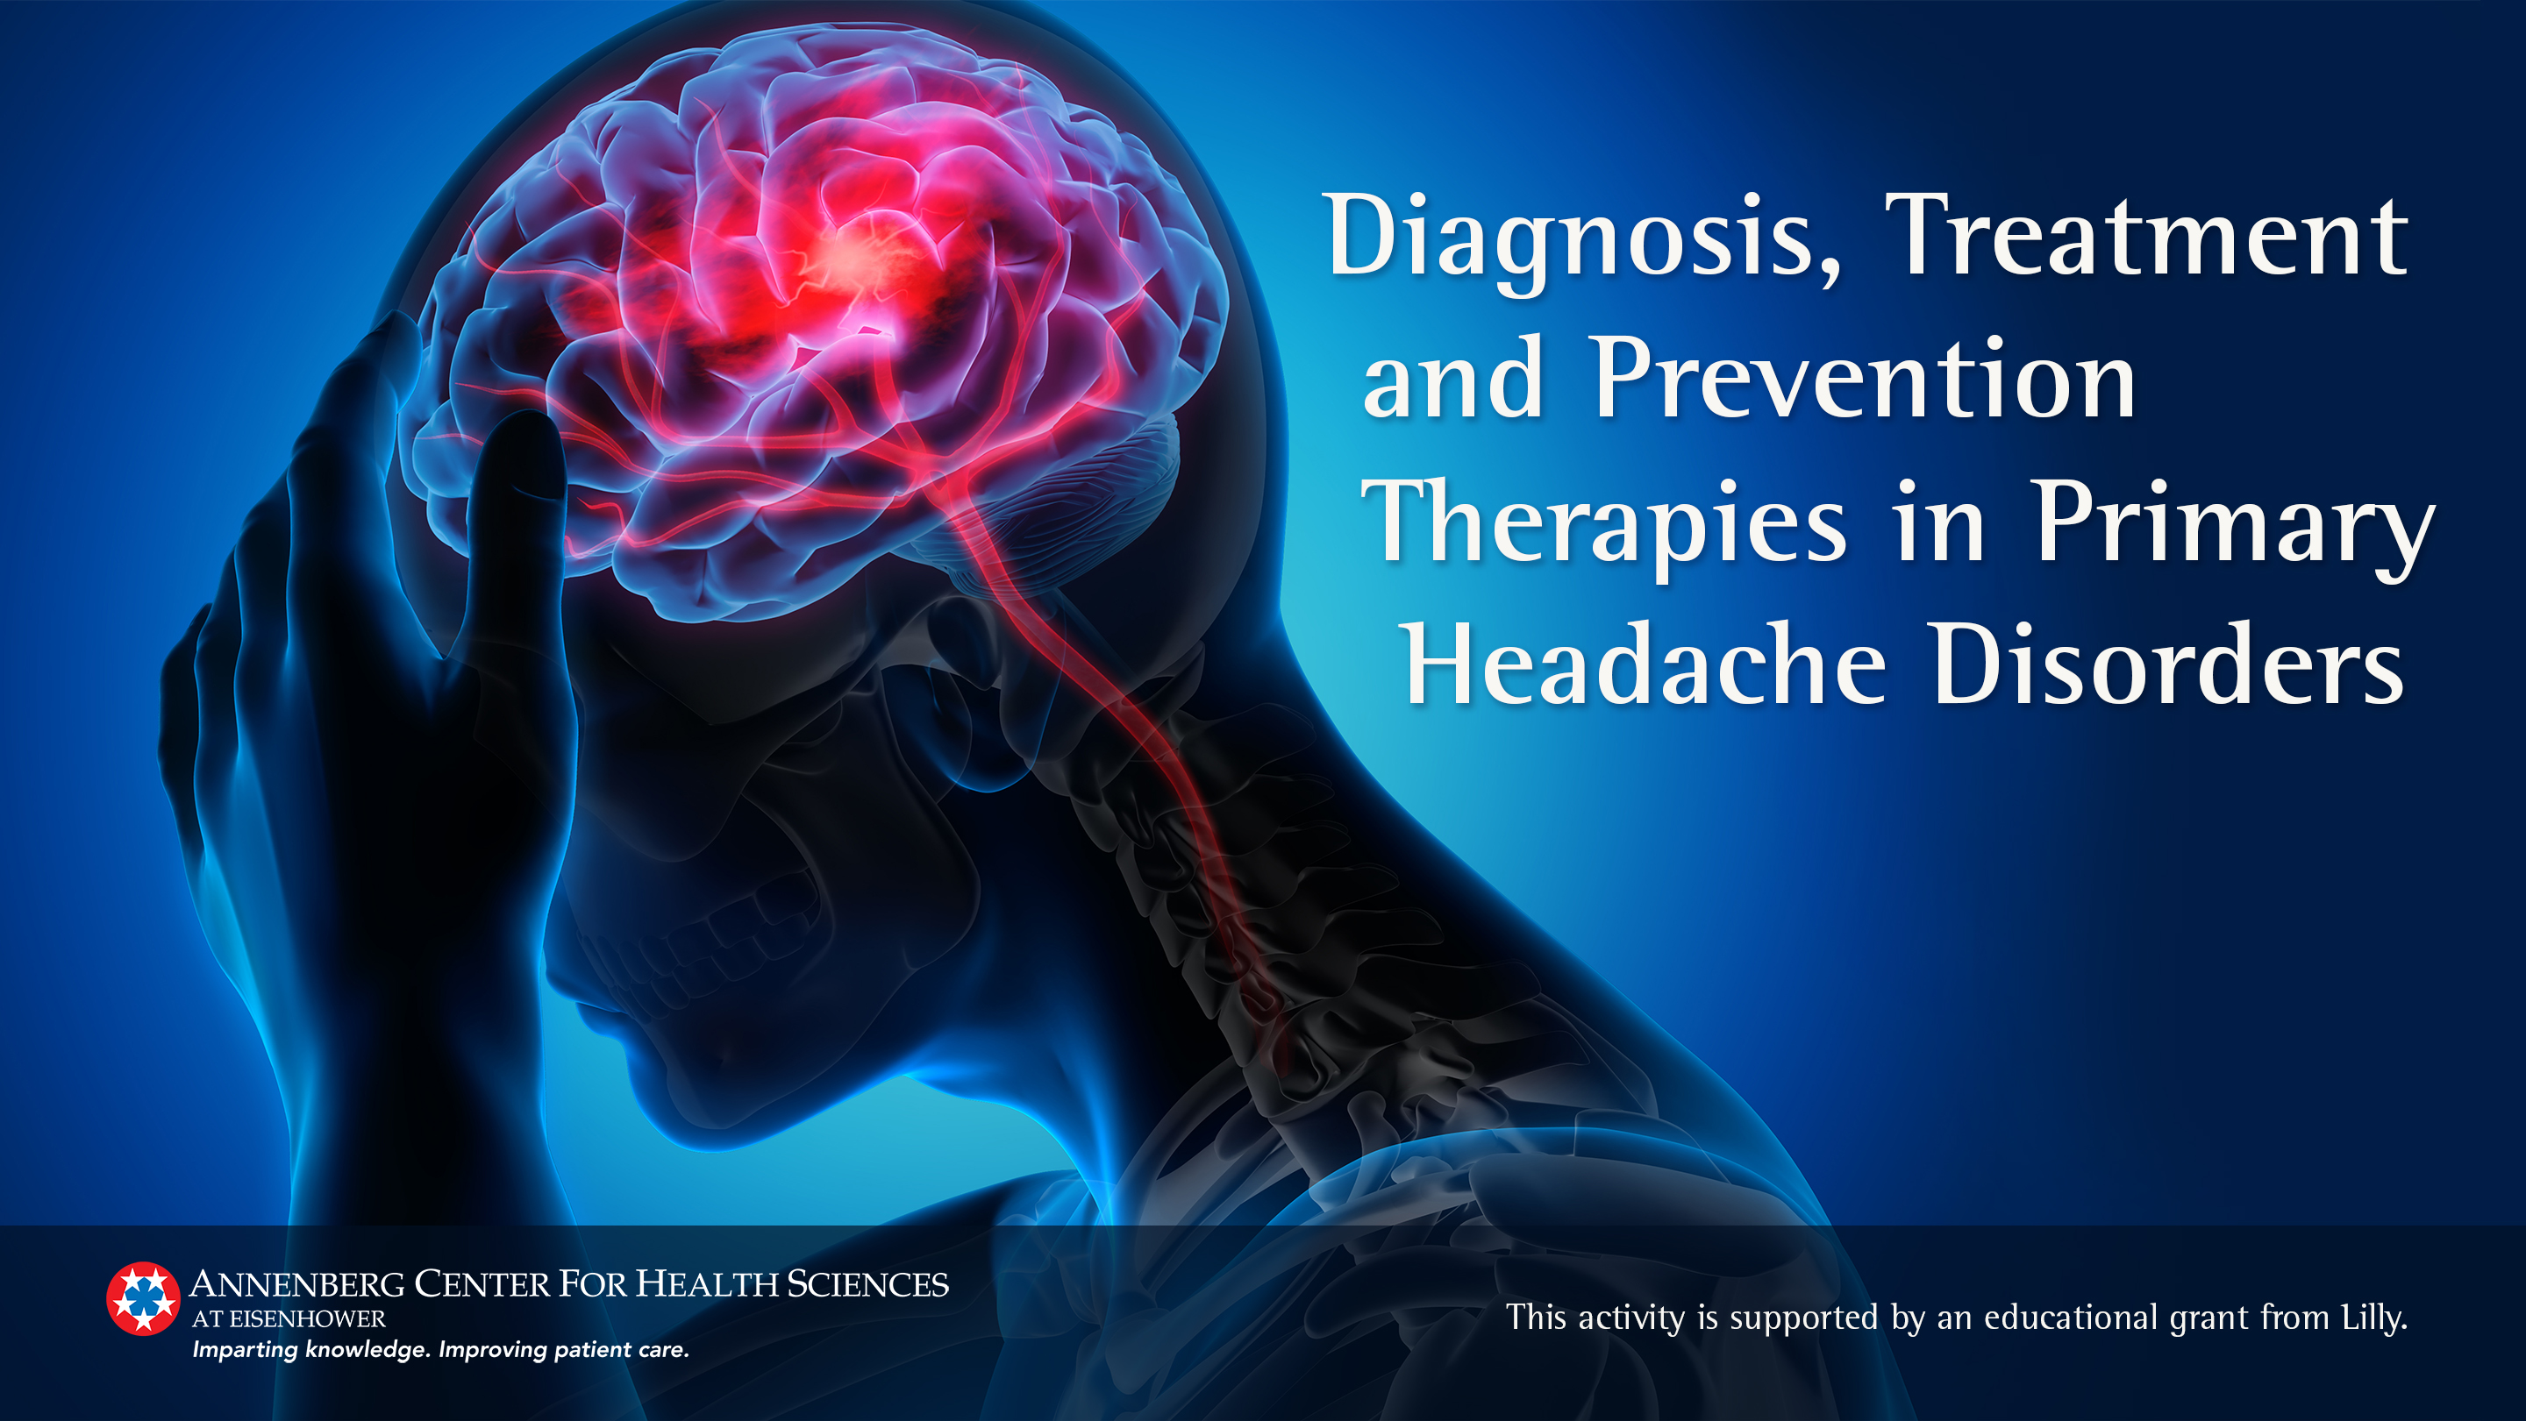

Slide 2
Learning Objectives
After participating in this activity, the clinician will be able to:
Apply guideline-based diagnostic and evaluation strategies to diagnose and differentiate migraine from cluster headache and other primary and secondary headache disorders (competence)
Evaluate acute and preventive pharmacologic therapies to develop an individualized treatment plan (competence)
Foster improved patient adherence through shared decision-making (competence)
Utilize the shared decision-making process with patients who have a primary headache disorder to individualize treatment (competence)

Slide 3
Headache Disorders
Primary | Secondary | Other
Migraine Tension-type Trigeminal autonomic cephalalgias Cluster Other | Traumatic Vascular Nonvascular intracranial Substance Infectious Metabolic/Homeostasis Facial/Cervical Psychiatry | Cranial nerves/Facial pain Other
International Headache Society. Cephalalgia. 2018;38(1):1-211.

Slide 4
Epidemiology
Migraine | Cluster
39 million US children, adults¹ 90% have a family history¹ Lifetime prevalence² Female 18% Male 9% Age at first occurrence¹ In most, adolescence or early adulthood Associated with ischemic stroke, myocardial infarction, hypertension, hyperlipidemia³ | Lifetime prevalence 0.12%⁴ Male:female ratio is 3 or 4 to 1^{4,5} Age at first occurrence^{5,6} In most, age 20 to 40 years In some, late life
1. Migraine Research Foundation. https://migraineresearchfoundation.org/about-migraine/migraine-facts/. Accessed September 24, 2020. 2. Burch RC, et al. Headache. 2015;55(1):21-34. 3. Schurks M, et al. BMJ. 2009;338:b3914. 4. Fischera M, et al. Cephalalgia. 2008;28(6):614-618. 5. International Headache Society. Cephalalgia. 2018;38(1):1-211. 6. Matharu MS, et al. J Neurol Neurosurg Psychiatry. 2002;72(Suppl 2):ii19-ii26.

Slide 5
Headache Disorders Are the 2nd Leading Cause of Disability Worldwide*
Females
Males
1
Low back pain
2
Headache disorders
3
Depressive disorders
4
5
Dietary iron deficiency
Diabetes
1
Low back pain
2
Headache disorders
3
Diabetes
4
5
Age-related hearing loss
Depressive disorders
*Years lived with disability
GBD 2017 Disease and Injury Incidence and Prevalence Collaborators. Lancet. 2018;392:1789-1858.

Slide 6
The Burden of Migraine is Enormous
High disease burden
Morbidity is not limited to attacks
  Between attacks, one-quarter report being anxious, not being free of headache symptoms, avoiding activities¹
1-in-8 report migraine had a negative impact on education¹
Children of parents with migraine report significant impact on their lives, eg, reverse caregiving, moderate-to-severe anxiety and depression²
1. Lampl C, et al. J Headache Pain. 2016;17:9.
2. Buse DC, et al. Headache. 2018;58(4):512-524.

Slide 7
Unmet Treatment Needs = Greater Disability = Greater Burden
2017 Migraine in America Symptoms and Treatment Study
  95.8% of respondents (3765/3930) had at least 1 unmet acute treatment need
    Rapid headache onset (65.3%)
    Moderate to severe disability (55.6%)
    Inadequate 2-hour pain freedom (49%)
    Headache recurrence within 24 hours (38%)
    The greater the number of unmet treatment needs, the greater the worsening psychological symptoms, attack-related cutaneous allodynia, and migraine symptom severity
Lipton RB, et al. Headache. 2019;59(8):1310-1323.

Slide 8
Poor Acute Treatment Associated with Chronic Migraine Risk: American Migraine Prevalence and Prevention Study
N=5,681 with EM in 2006 → 3.1% progressed to CM in 2007
Conclusion:
Inadequate acute treatment efficacy was associated with an increased risk of new onset CM over the course of 1 year
Optimal acute treatment might prevent migraine progression
CM, chronic migraine; EM, episodic migraine
Lipton RB, et al. Neurology. 2015;84:688-695.

Slide 9
What should be the goals of acute treatment?
What do patients want from acute migraine treatment?
Lipton RB, et al. Headache. 2002;42(Suppl 1):3-9.

Slide 10
The Burden of Cluster Headache Is Greater Than Migraine
Also called “suicide headache”
  Often described as a “red-hot poker in the eye”¹
High burden of disease^{2,3}
  Extensive disability, impaired quality of life
  Socioeconomic burden
During active periods, the quality of life of people with cluster headache is worse than for people with migraine, particularly related to usual activities and pain/discomfort⁴
Extensive morbidity is experienced between attacks⁵
1. Polson M, et al. Am J Manag Care. 2017;23(16):S295-S299. 2. D’Amico D, et al. Headache. 2020;60(4):809-818. 3. Snoer A, et al. Neurology. 2018;91(9):e822-e831. 4. Kim SK, et al. Neurology. 2019;92(15 Suppl):P5.10-009. 5. Pohl H, et al. Headache. 2020;60(2):360-369.

Slide 11
Early Identification of a Primary Headache Disorder Is Important
Primary care clinician
  Routine questioning about headaches and use of nonprescription analgesics
Pharmacists
  Identify patients who
    Frequently purchase nonprescription analgesics
    Ask what’s the best/strongest non-prescription analgesic for a headache
  Provide education about the importance of identifying type of headache disorder
  Refer or send note to primary care clinician

Slide 12
Diagnosis of Headache Disorders
Based on history/normal physical exam
Details can separate headache disorders
  Associated symptoms
  Description of pain and location
  Relation to events (head trauma, start of new medicine/activity/hormonal changes, major life stressors, weight gain)
  History of prior headaches and change over time
    People can have more than 1 headache disorder, especially with migraine
Diamond S. Postgrad Med. 1974;56(3):69-74

Slide 13
The Headache History: Focus on Headache Story
Start at the beginning
  Patients naturally discuss what bothers them NOW

Slide 14
The Headache History: Focus on Headache Story (continued)
Start at the beginning
  Patients naturally discuss what bothers them NOW
Move to current headache concerns
  “Tell me how your headaches changed over time.”
  “Did they become more frequent or more severe, did they change?”
  “The headache you have now, when did it start?”
Identify life changes/stress points through the history

Slide 15
The Headache History: Focus on Headache Symptoms
Description of pain
  Location, severity, quality of pain
How long does it last (untreated)
  Seconds/Minutes/Hours/Days
How often does it occur
  How many days do you NOT have a headache?
What improves/worsens symptoms
  Rest or movement
  Dark, quiet
Associated symptoms
  Nausea/Vomiting, light/sound sensitive
  Tearing, congestion, conjunctival injection, ptosis
  Pacing, agitation
Pre symptoms
  Vision changes, speech changes, other neurological symptoms
  Fatigue, yawning, irritability, food cravings, dizziness

Slide 16
The Headache History: Focus on Goals
Patient goals and fears
  What are their concerns?
  What are their goals for treatment?
    Cure (goal reset will be important here)
    “I want to make it to Thanksgiving dinner”
    “I want to be more reliable when making plans”
    “I want to be able to take my child to their swim meets”

Slide 17
The Headache History: Focus on Comorbidities
Comorbid conditions
  Mood disorder (depression/anxiety)
  Obesity
  Sleep disorder (insomnia/apnea)
  Other pain disorder (fibromyalgia/neck pain)
  Gastrointestinal (IBS/gastroparesis)
  Cardiovascular (hypertension, h/o stroke)
  Endocrine (thyroid/diabetes mellitus)
  Asthma/allergies

Slide 18
The Headache Physical Exam
General and neurological exam
  Focus on fundoscopic exam and visual fields
  Focus on musculoskeletal
    Jaw, neck, shoulders
    Nerve root tenderness, trigger points
Typical exam findings in patients with a headache disorder
  Neck or shoulder tightness
  Trigger points in neck or shoulder
  Tenderness over greater or lesser occipital nerve or a branch of trigeminal nerve

Slide 19
Primary Headache Disorders (continued)
Migraine
  Episodic and chronic
  With and without aura
  Status migraine
  Menstrual migraine
Tension-type
  Episodic and chronic
Trigeminal Autonomic Cephalgias
  Cluster
  Paroxysmal hemicrania
  Hemicrania continua
  Short-lasting unilateral neuralgiform headache (SUNHA)
Other
  Primary stabbing
  Primary cough
  Primary exercise
  Primary headache associated with sexual activity
  New daily persistent headache
  Nummular headache
International Headache Society. Cephalalgia. 2018;38(1):1-211.

Slide 20
Differentiating Among Primary Headache Disorders
Feature | Cluster | Migraine | Tension-Type
Typical age at onset | 20-40 y | Adolescence or menarche | Any
Sex ratio (M:F) | M > F | M < F | M = F
Pain | Severe to very severe; strictly unilateral- orbital, supraorbital, and/or temporal | Moderate to severe; unilateral; pulsating; aggravated by physical activity | Mild to moderate; bilateral; non-pulsating; not aggravated by physical activity
Behavior | Restless, agitated | Lying down, quiet | Modified to avoid pain
Common features | Conjunctival injection/lacrimation; nasal congestion/rhinorrhea; eyelid edema | Nausea and/or vomiting; phonophobia and photophobia | —
1. International Headache Society. Cephalalgia. 2018;38(1):1-211.
2. MedlinePlus. https://medlineplus.gov/. Accessed September 28, 2020.

Slide 21
Differentiating Among Primary Headache Disorders (cont)
Feature | Cluster | Migraine | Tension-Type
Attack duration | 15 to 180 minutes | 4 hours to 3 days | 30 minutes to 7 days
Periodicity | Occur in bouts between once every other day and 8 times per day; bouts may follow circannual periodicity; attacks may follow circadian periodicity | None except with menstrual-associated migraine | None
Triggers | Alcohol, histamine, nitroglycerin, heat, bright light | Dietary, alcohol, hormonal, dehydration, hunger, poor posture, weather changes | Stress, alcohol, jaw clenching, eye strain, caffeine, fatigue
1. International Headache Society. Cephalalgia. 2018;38(1):1-211.
2. MedlinePlus. https://medlineplus.gov/. Accessed September 28, 2020.

Slide 22
Migraine without Aura
≥5 attacks fulfilling criteria B-D
Attacks (untreated) last 4-72 hours
≥2 of the following 4 characteristics
  Unilateral location
  Pulsating quality
  Moderate or severe pain intensity
  Aggravation by or causing avoidance of routine physical activity
During headache ≥1 of the following
  Nausea and/or vomiting
  Photophobia and phonophobia
Not better accounted for by another ICHD-3 diagnosis
International Headache Society. Cephalalgia. 2018;38(1):1-211.

Slide 23
Migraine with Aura
≥2 attacks fulfilling B and C
≥1 of the following fully reversible aura symptoms
  Visual, sensory, speech/language, motor, brainstem, retinal
≥3 of the following 6 characteristics
  ≥1 aura symptom spreads gradually over 5 minutes
  ≥2 symptoms occur in succession
  Each individual aura symptom lasts 5-60 minutes
  ≥1 aura symptom is unilateral (eg, aphasia)
  ≥1 aura symptom is positive (eg, scintillations, pins and needles)
  Aura is accompanied, or followed within 60 minutes, by headache
Not better accounted for by another ICHD-3 diagnosis
International Headache Society. Cephalalgia. 2018;38(1):1-211.

Slide 24
Episodic vs Chronic Migraine
Episodic
Headache occurring
<15 d/mo
Chronic
Headache occurring ≥15 d/mo for >3 mos, which, on ≥8 d/mo, has the features of migraine with/without aura or believed by the patient to be migraine at onset and relieved by triptan/ergot
International Headache Society. Cephalalgia. 2018;38(1):1-211.

Slide 25
Trigeminal Autonomic Cephalalgias (TACs)
Attack duration
  Short: cluster, paroxysmal hemicrania, short-lasting unilateral headache attacks
  Continuous: hemicrania continua
Indomethacin responsive?
  Yes: paroxysmal hemicrania, hemicrania continua
  No: cluster, short-lasting unilateral headache attacks
Unilateral head pain in the distribution of the first division of the trigeminal nerve
Accompanied by ipsilateral cranial autonomic symptoms
International Headache Society. Cephalalgia. 2018;38(1):1-211.

Slide 26
Clinical Features of TACs
Feature | Cluster | Paroxysmal hemicrania continua | SUNHA* | Hemicrania continua
One-year prevalence | 0.02%- 0.1% | 0.05% | 0.1% | Unknown
One-year incidence | 0.002%-0.01% | Unknown | Unknown | Unknown
Female: Male | 1:3 | 1:1 | 1:1.5 | 2:1
Peak age onset | 3rd decade | 3rd to 4th decade | 5th decade | 3rd to 4th decade
Episodic: chronic | 9:1 | 3.5:6.5 | 1:9 | Unknown
Indomethacin responsive? | No | Yes | No | Yes
*Short-lasting unilateral headache attacks
Goadsby PJ. Continuum. 2012;18(4):883-895.
Wei DY, et al. Ann Indian Acad Neurol. 2018;21(Suppl 1):S3-S8.

Slide 27
Differential Diagnosis
Aneurysm
Dissection
Structural lesion- posterior fossa or pituitary
One of the other TACs
Trigeminal neuralgia
Primary stabbing headache
MRI/MRA all patients with suspected TAC
Goadsby PJ. Continuum. 2012;18(4):883-895.

Slide 28
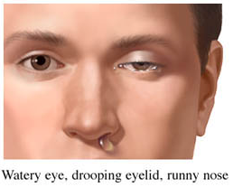
ICHD-3 Cluster Headache Diagnostic Criteria
A. At least 5 attacks fulfilling criteria B-D
B. Severe or very severe unilateral orbital, supraorbital and/or temporal pain lasting 15-180 minutes if untreated
C. Headache is accompanied by at least 1 of the following:
1. Ipsilateral conjunctival injection and/or lacrimation
2. Ipsilateral nasal congestion and/or rhinorrhea
3. Ipsilateral eyelid edema
4. Ipsilateral forehead and facial sweating
5. Ipsilateral miosis and/or ptosis
6. A sense of restlessness or agitation
D. Attacks have a frequency from 1 every other day to 8/d
E. Not attributed to another disorder
Episodic Cluster: pain-free remission periods of ≥3 months/year
Chronic Cluster: no pain-free period lasting ≥3 months/year
International Headache Society. Cephalalgia. 2018;38(1):1-211.

Slide 29
Cluster Headache Features
Cluster “attack”- episode of cluster headache
  Most often same time of day (late afternoon/after dinner/middle of night)
  Most often during REM sleep (under debate)
Cluster “cycle, bout, or period”- in episodic cluster, the period of time the patient will have attacks (chronic cluster has no cycles)
  Lasting between 2-12 weeks
  Seasonal variation
  90% have at least 1-month remission between cycles
  10% without remission period (chronic cluster headache)

Slide 30
Summary
Accurate diagnosis is imperative
Most patients with a headache disorder who seek care in clinic have a primary headache disorder
Key features of history can help in differential diagnosis
  Can also identify red flags for further work up
Associated symptoms and length of attacks can lead to appropriate primary headache disorder
Use ICHD-3 criteria to make diagnosis

Slide 31
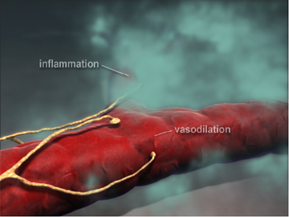
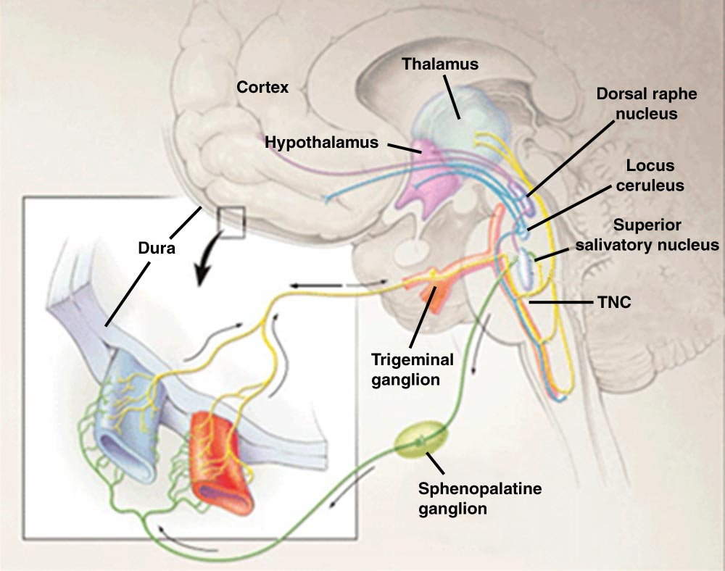
Migraine Pathophysiology
CGRP
CGRP, calcitonin gene-related peptide
Adapted with permission from Goadsby PJ, et al. N Engl J Med. 2002;346(4):257-270.
Pietrobon D, et al. Nat Rev Neurosci. 2003;4:386-398.

Slide 32
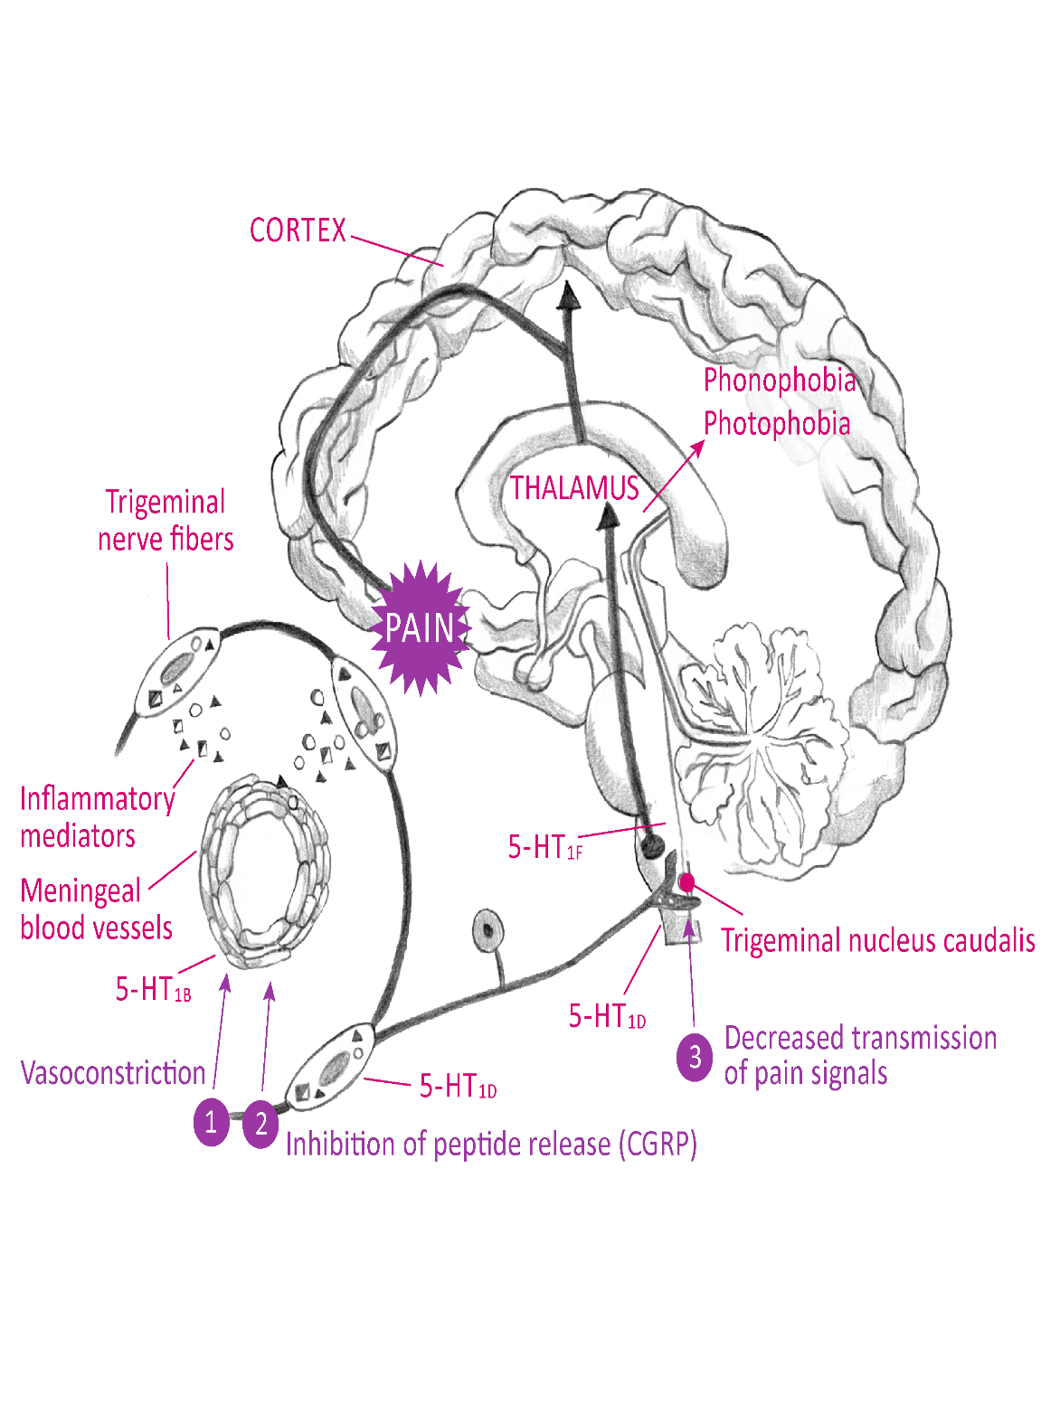
Serotonin and Migraine: 5-HT_{1B}, 5-HT_{1D}, 5-HT_{1F}
Lasmiditan: 5-HT_{1F} agonist
Lasmiditan:
5-HT_{1F} agonist
, 5-HT_{1F}
Triptans & ergots: 5-HT_{1B/1D} agonists
Hargreaves et al. Can J Neurol Sci. 1999;26(suppl 3):S12-S19. Kuca et al. Neurology. 2018;91(24):e2222-e2232.3; Goadsby et al. Brain. 2019;142:1894-1904. Oswald et al. J Pain Res. 2018;11:2221-2227.

Slide 33
Strategies for Migraine Treatment
Lifestyle interventions
Acute treatment
To stop pain and prevent progression
Preemptive treatment
To preempt a predictable headache with a time-limited trigger
Preventive treatment
To decrease frequency
Rescue treatment
When all else fails
Lipton RB, et al. Headache. 1998;38:87–96.
Silberstein SD, et al. Cephalalgia. 1997;17:67-72.
Lipton RB, et al. Headache. 1998;38:87–96.
Silberstein SD, et al. Cephalalgia. 1997;17:67-72.

Slide 34
Goals of Acute Treatment
Rapidly treat attack with minimal recurrence
Reduce use of additional rescue medications
Restore function
Minimize adverse effects
Reduce subsequent resource use
(office visit/urgent care/ED)
Cost effective
Silberstein SD, et al. Neurology. 2000;5(9 suppl 2):S46-S52.

Slide 35
Medications for Acute Treatment of Migraine
Level A
Level B
Triptans* | Combinations
DHE nasal spray* | Ditan*
NSAIDs (Aspirin, diclofenac, ibuprofen, naproxen) | Gepants*
Acetaminophen
Antiemetics (Chlorpromazine, metoclopramide, prochlorperazine) | Others (MgSO₄*)
Ergots (DHE IV/IM/SC*, ergotamine/caffeine*) | Combinations
NSAIDs (Flurbiprofen, ketoprofen, ketorolac)
*Specifically indicated for migraine; all others are investigational
Marmura MJ, et al. Headache. 2015;55(1):3-20.
American Headache Society. Headache. 2019;59(1):1-18.

Slide 36
Ubrogepant Phase 3 Trials in Episodic Migraine (ACHIEVE I & II): Efficacy
36
ACHIEVE I¹
ACHIEVE II²
*
*
*
**
**
*
*
*P=0.002 vs placebo.
**P<0.001 vs placebo.
*P=0.01 vs placebo
** P=0.03 vs placebo
MBS, most bothersome symptom (included photophobia, phonophobia, or nausea)
1. Dodick DW, et al. New Engl J Med. 2019;381:2230-2241.
2. Lipton RB, et al. JAMA. 2019;322:1887–1898.

Slide 37
Rimegepant Phase 3 Trials: Efficacy
Conventional oral tablet (N=1072)¹
ODT (N=1375)²
*
*
*
*
*
*P<0.0001 vs placebo.
Patients were randomized to oral rimegepant 75 mg or placebo. MBS included photophobia, phonophobia, or nausea.
ODT, orally disintegrating tablet.
1. Lipton RB, et al. N Engl J Med. 2019;381:142–149.
2. Croop R, et al. Lancet. 2019;394:737–745.

Slide 38
Safety & Tolerability of the Gepants
Ubrogepant
AEs<5%: Nausea, somnolence, dizziness, dry mouth^{1,2}
Prospective trial of ubrogepant QOD to assess liver function with no clinically relevant signal of hepatotoxicity³
Rimegepant^{4,5}
Nausea 0.7-2% over placebo
No liver signal
Ubrogepant and rimegepant are metabolized in the liver by CYP3A4
The gepants are remarkably well tolerated and appear very safe
1. Dodick D, et al. New Engl J Med. 2019;381:2230-2241. 2. Croop R et al. Lancet. 2019;394(10200):737-745. 3. Goadsby et al. Cephalalgia 2019;39(:1753-1761. 4. Lipton RB et al. NEJM. 2019;381:142-149. 5. Lipton RB, et al. JAMA. 2019;322:1887–1898.

Slide 39
Lasmiditan Integrated Phase 3 Trials: Efficacy
Pain-free 2h post-dose¹
Free from most bothersome symptom
2h post-dose¹
*
*
*
*
*
**
Patients (%)
Integrated analysis of data from 5236 patients randomized to treat a single migraine attack within 4 hours of onset with lasmiditan 50 mg (N=750), lasmiditan 100 mg (N=1498), or lasmiditan 200 mg (N=1495), or placebo (N=1493), in the SAMURAI² or SPARTAN³ study. Patients chose their most bothersome non-headache symptom from photophobia, nausea, and phonophobia.*P<0.001 vs placebo. **P<0.05 vs placebo.
1. Ashina M, et al. Headache. 2019;59:1788-1801.
2. Kuca B, et al. Neurology. 2018;91:e2222–e2232.
3. Goadsby PJ, et al. Brain. 2019;142:1894–1904.

Slide 40
Lasmiditan Adverse Events
  Most common were dizziness, paresthesia, and somnolence, generally mild to moderate and transient
  Patients advised not to drive/operate machinery for 8 hours after dosing even if no CNS adverse events (somnolence, dizziness)
  Incoordination in driving was not related to somnolence or dizziness and was likely a central lasmiditan effect
  Controlled substance Class V, same as pregabalin
Kuca et al. Neurology. 2018;91(24):e2222-e2232.3;
Goadsby et al. Brain. 2019;142:1894-1904.
Oswald et al. J Pain Res. 2018;11:2221-2227.

Slide 41
Who should receive a gepant or ditan for acute treatment of migraine?
Should be available to be prescribed by any licensed healthcare provider to patients who meet the following criteria:
Contraindications to triptans or
Lack of adequate response/lack of tolerability to ≥2 oral triptans or
Determined by either health care provider attestation or validated patient reported outcome (PRO) questionnaire
Treat with older meds for ≥2 attacks to evaluate efficacy and tolerability
American Headache Society. Headache. 2019;59(1):1-18.

Slide 42
Neuromodulation
FDA cleared for acute treatment
Supraorbital transcutaneous nerve stimulation- up to 1 hour during attack
Noninvasive vagal nerve stimulation- bilateral application, 2 minutes each side
Remote electrical neuromodulation - application to arm 45 minutes during attack
Consider in those who have (any of below)
Failed 2 triptans
Contraindications to standard therapy
Overusing standard treatment
Prefer nondrug therapy
Singh RH, et al. Headache. 2019;59(Suppl 2):33-49.
Yarnitsky D, et al. Headache. 2019;59(8):1240-1252.

Slide 43
When to Offer Prevention
Attacks significantly interfere with patient’s daily routine despite acute treatment
Frequent attacks (≥1 migraine headache day/week)
Contraindication to, failure, or overuse of acute treatments, with overuse defined as:
  ≥10 days/mo for ergot derivatives, triptans, opioids, combination analgesics, and a combination of drugs from different classes that are not individually overused
  ≥15 days/mo for non-opioid analgesics, acetaminophen, and NSAIDs
Adverse events with acute treatments
Patient preference
American Headache Society. Headache. 2019;59(1):1-18.

Slide 44
Goals of Preventive Treatment for Migraine
Reduce attack frequency, severity, duration
Reduce reliance on poorly tolerated, ineffective, or unwanted acute treatments
Reduce overall cost
Improve health-related quality of life
Reduce headache-related distress and psychological symptoms
Improve responsiveness to and avoid escalation in use of acute treatment
Improve function and reduce disability
Enable patients to self-manage to enhance a sense of personal control
Prevention ≠ Cure
American Headache Society. Headache. 2019;59:1-18.

Slide 45
Principles of Preventive Treatment
Start with low dose and increase slowly*
Need adequate trial (2-3 mos)
Avoid drug overuse and interfering drugs
Evaluate therapy
Use calendar
Taper (stop?) if well controlled for ≥6 mos
Avoid pregnancy
Ascertain birth control use
*Except for onabotulinumtoxinA and CGRP monoclonal antibodies

Slide 46
Medications for Preventive Treatment of Episodic Migraine
Level A: Effective | Level B: Probable | Level C: Possible | Level U: Inadequate/conflicting
Antiepileptics Divalproex* Valproate* Topiramate* β-blockers Metoprolol Propranolol* Timolol* ARB Candesartan¹ CGRP mAbs Erenumab* Eptinezumab* Fremanezumb* Galcanezumab* | SNRI/TCA Amitriptyline Venlafaxine β-blockers Atenolol Nadolol | ACE-I Lisinopril Antihistamine Cyproheptadine | Antiepileptic Gabapentin TCA Protriptyline CCB Nifedipine Verapamil
*Specifically indicated for migraine; all others are investigational
¹Classified as possibly effective in original 2012 guideline; recent evidence indicates candesartan is effective for the preventive treatment of episodic migraine
Silberstein SD, et al. Neurology. 2012;78:1337-1345.

Slide 47
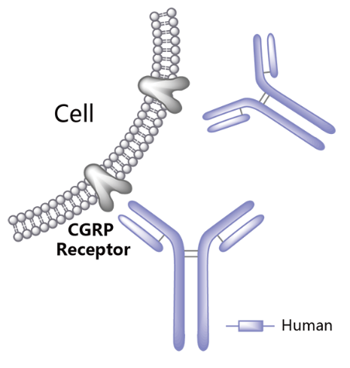
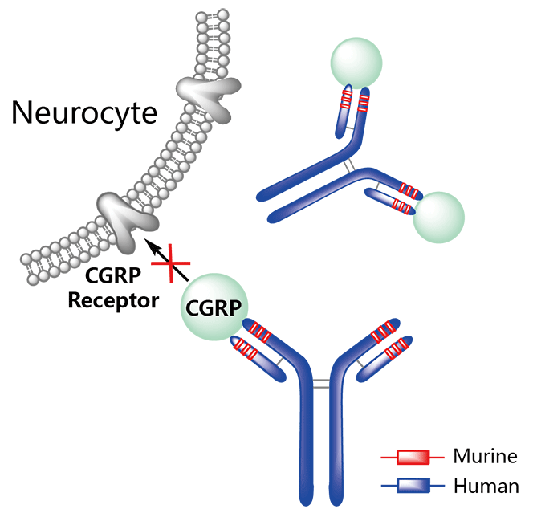
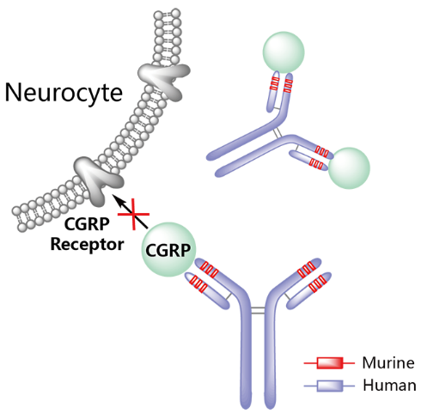
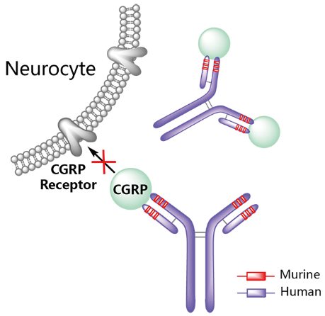
4 Injectable mAbs to CGRP or Its Receptor
 | Erenumab | Fremanezumab | Galcanezumab | Eptinezumab
Studied for | EM, CM | EM, CM | EM, CM, eCH | EM, CM
Target | CGRP receptor | CGRP peptide or ligand | CGRP peptide or ligand | CGRP peptide or ligand
EM, episodic migraine; CM, chronic migraine; eCH, episodic cluster headache
Tepper SJ. Headache. 2018;58 (suppl 3):238-275. Tepper SJ. Headache. 2018;58(suppl 3):276-290. Edvinsson L. Headache. 2018;58(suppl 1):33-47. Aimovig [package insert]. Thousand Oaks, CA: Amgen Inc.; April 2020. Vyepti [package insert]. Bothwell, WA: Lundbeck Seattle BioPharmaceuticals, Inc.; February 2020. Ajovy [package insert]. North Wales, PA: Teva Pharmaceuticals USA, Inc.; June 2020. Emgality [package insert]. Indianapolis, IN: Eli Lilly and Company; December 2019.

Slide 48
CGRP mAb Phase 3 Trials for Episodic Migraine*
A
Erenumab¹
Fremanezumab²
0.5
0
Placebo
675 mg / Placebo / Placebo (quarterly)
225 mg/ 225 mg / 225 mg (monthly)
-0.5
Primary Endpoint
-0.5
Placebo
70 mg
140 mg
-1.0
-1.5
*
-1.8 days
-1.5
Change in Migraine Days
Per Month
LS Mean (+/- SE)
Change from
Baseline
-2.5
*
*
*
-2.0
-3.2 days
*
*
-2.5
-3.5
*
*
-3.7 days
-3.0
Placebo: -2.2 Days
-3.4, P=.0013
-3.7, P<.0002
-4.5
*
*
*
*
-3.5
-4.0
-5.5
-4.5
Baseline
1
2
3
4
5
6
Base-
line
1
2
3
Month
Week
1
2
3
Month
Fremanezumab was equally
effective in preventing EM and
CM whether administered subcutaneously monthly or
quarterly (primary endpoints)
TEV-48125 225 / 225 / 225 mg
<.0001
<.0001
<.0001
<.0001
<.0001
.0002
TEV-48125 675 mg / Placebo / Placebo
<.0001
<.0001
.0003
<.0001
.0009
.0013
C
Galcanezumab³
D
Eptinezumab⁴
0
Placebo
120 mg
240 mg
0
-1
-0.5
Placebo IV (n=222)
100 mg IV (n=221)
300 mg IV (n=222)
-1.0
-2
-1.5
Improvement
LS Mean Change
from Baseline
-2.0
-3
***
Mean Change in
Monthly Migraine Days
from Baseline
-2.6
***
***
-2.2 Days*
-4.73 Days*
-4.57 Days*
-2.5
-3.2
-3.2
-4
***
-3.0
***
***
***
***
-3.5
-4.0
-4.0
-3.9**
-5
***
***
***
-4.0
-6
***
-4.5
-4.1
-4.4
-4.3*
-5.0
Baseline
1
2
3
4
5
6
0
1-4
5-8
1-12
Month
Weeks
*Primary endpoint: reduction in monthly migraine days
1. Goadsby PJ, et al. N Engl J Med. 2017;377(22):2123-2132.
2. Dodick DW, et al. JAMA. 2018;319(19):1999-2008.
3. Stauffer VL, et al. JAMA Neurology. 2018;75(9):1080-1088.
4. Ashina M, et al. Cephalalgia. 2020;40(3):241-254.

Slide 49
4 Injectable mAbs to CGRP or Its Receptor (continued)
 | Erenumab | Fremanezumab | Galcanezumab | Eptinezumab
Studied for | EM, CM | EM, CM | EM, CM, eCH | EM, CM
Target | CGRP receptor | CGRP peptide or ligand | CGRP peptide or ligand | CGRP peptide or ligand
Route and dosing | Monthly subcutaneous (SC) 70, 140 mg | Monthly or quarterly SC; 225 mg monthly, or 675 mg Q3 months | For migraine: monthly SC; 240 mg loading dose, then 120 mg SC monthly thereafter. For eCH: 300 mg SC, then 300 mg monthly to cycle end | 100 mg or 300 mg Q3 months intravenous
EM, episodic migraine; CM, chronic migraine; eCH, episodic cluster headache
Aimovig [package insert]. Thousand Oaks, CA: Amgen Inc.; April 2020.
Vyepti [package insert]. Bothwell, WA: Lundbeck Seattle BioPharmaceuticals, Inc.; February 2020.
Ajovy [package insert]. North Wales, PA: Teva Pharmaceuticals USA, Inc.; June 2020.
Emgality [package insert]. Indianapolis, IN: Eli Lilly and Company; December 2019.

Slide 50
CGRP mAb Phase 3 Trials for Chronic Migraine*
Month
Mean Change from Baseline in Monthly Migraine Days (placebo-subtracted)
Mean Change in Monthly Migraine Days (placebo-subtracted)
†
†
†
†
*
†
*P<0.01
†P<0.001
Week
Week 12
†
†
†
†
†
†
†P<0.001
†P<0.0001
1. Tepper S, et al. Lancet Neurol. 2017;16:425–434. 2. Detke HC, et al. Neurology. 2018;91(24):e2211-e2221.
3. Silberstein SD, et al. N Eng J Med. 2017;377:2113-2122. 4. Lipton, et al. Neurology. 2020; 94:e1365-e1377.

Slide 51




CGRP mAbs: Safety Considerations
 | ERENUMAB (SC 70 or 140 mg once monthly) | FREMANEZUMAB (SC 225 mg monthly; 675 mg quarterly) | GALCANEZUMAB (SC 240 mg loading dose, then 120 mg monthly) | EPTINEZUMAB (IV 300, 100 mg quarterly)
Treatment Groups | Injection site reactions Ph 3 RCTs (6, 5%) Constipation (1, 3%) Cramps, muscle spasms (<1, 2%) | Injection site reactions (43, 45% Ph 3 RCTs) (6, 4% FOCUS study] | Injection site reactions Ph 3 RCTs (18%) | URI (11, 7, 6, 7%) Dizziness (2, 10, 3, 12%) Nausea (7, 7, 3, 5%)
Placebo Group | Injection site reactions (3%) Constipation (1%) Cramps, muscle spasms (<1%) | Injection site reactions (38%) | Injection site reactions (13%) | URI (5%) Dizziness (7%) Nausea (7%)
Liver: So far, LFT abnormalities have not been seen in excess of placebo
URI: So far, not with every product and not always in excess of placebo
Constipation: Warning in US erenumab prescribing information (PI); noted for galcanezumab in EU PI
Hypertension: Warning in US erenumab prescribing information
Intravenous erenumab 140 mg given to patients with angina and no infarctions, no worsening on stress tests, no CV signals from 1-5-y open-label treatment trials
MaassenVanDenBrink A, et al. Trends Pharmacol Sci. 2016;37(9):779-788. US Food and Drug Administration. https://www.accessdata.fda.gov/scripts/cder/daf/index.cfm. Accessed Sept 10, 2020. Dodick DW, et al. Cephalalgia. 2019;39(9):1075-1085. Depre C, et al. Headache. 2018;58(5):715-723. Kudrow D, et al. Neurology. 2020;94(5):e497-e510. Tepper SJ, et al. Cephalalgia 2020;40(6): 543–553.

Slide 52
Number Needed to Treat; Number Needed to Harm
Therapeutic Gain (TG) = Active response – placebo response
NNT = 1/TG
  For NNT: the lower the value, the better
Therapeutic Harm (TH) = Active AEs – placebo AEs
NNH = 1/TH
  For NNH: the higher the value, the better
The NNH/NNT (or LLH) describes the value of an intervention as a benefit/risk analysis number
  For NNH/NNT: the higher the value, the better
AEs, adverse events; LLH, likelihood of being helped or harmed; NNH, number needed to harm; NNT, number needed to treat

Slide 53
Number Needed to Treat; Number Needed to Harm: Data from Migraine Prevention RCTs
Identifying the benefit of CGRP mAbs from some other preventive treatments
 | Chronic Migraine |  |  |  |  |  | Episodic Migraine
 | GMB^{1,2} 120 mg | EREN³ 70 mg | EREN³ 140 mg | TPM³ 100 mg | TPM³ 100 mg | OnabtA³ 155 Units | EVOLVE-1 GMB^{1,2} 120 mg | EVOLVE-2 GMB^{1,2} 120 mg | EREN³ 70 mg | EREN³ 140 mg | TPM³ 100 mg | PROP³ 160 mg
NNT ≥50% RR (95% CI) | 9 (6, 16) | 7 (5, 13) | 6 (4, 12) | 13 (NE, NE) | 4 (3, 10) | 9 (6, 15) | 5 (4, 6) | 5 (4, 6) | 6 (5, 10) | 6 (4, 9) | 5 (4, 6) | 5 (4, 10)
NNH % D/C due to AE (95% CI) | 1,000 (NA, NA) | 1,000 (NE, NE) | 250 (NE, NE) | 21 (NE, NE) | 13 (NE, NE) | 39 (23, 100) | 93 (22, +∞) | 210 (29, +∞) | 1,000 (NE, NE) | 1,000 (NE, NE) | 8 (6, 13) | 11 (6, 72)
LHH NNH/NNT (95% CI) | 122 (NA, NA) | 143 (14, 289) | 42 (5, 302) | 2 (0, 113) | 3 (1, 365) | 4 (2, 11) | 12 (-203, 209) | 14 (-307, 311) | 167 (7, 269) | 167 (9, 299) | 2 (1, 3) | 2 (1, 15)
NOTE: Data not from head-to-head trials
AE, adverse event; CGRP, calcitonin gene-related peptide; CI, confidence interval; D/C, discontinued; EREN, erenumab; GMB, galcanezumab; LHH, likelihood of being helped or harmed; mAb, monoclonal antibody; NA, not applicable; NE, not estimable; OnabtA, onabotulinumtoxinA; PROP, propranolol; RR, responder rate; TPM, topiramate.
Ruff DD, et al. Presented at the 19th Congress of the International Headache Society (IHC); Dublin, Ireland; September 5-8, 2019. 2. Data on file, Eli Lilly and Company. 3. Vo P, et al. Cephalalgia. 2019;39:608-616.
Notes:
.

Slide 54
Who Should Receive a CGRP mAb for Migraine Prevention?
Should be available to be prescribed by any licensed healthcare provider to patients who meet the following criteria:
Lower-frequency EM (4–7 headache days/month)
  Lack of success with 2:
  AEDs (VPA, TPM), TCAs (amitriptyline, nortriptyline), beta-blockers, SNRIs, other level A or B migraine preventive medications
  Documented at least moderate disability or impact by the migraines
High-frequency EM (8–14 days/month)
  Same requirements as 1, but no need to document disabilities, as they are clearly impacted
CM (≥15 days/month)
  Same requirements as 1, or onabotulinumtoxinA as an additional choice, and no need to document disabilities, as they are clearly impacted
AEDs, anti-epileptic drugs; AHS, American Headache Society; CM, chronic migraine; EM, episodic migraine; SNRIs, serotonin-norepinephrine reuptake inhibitors; TCAs, tricyclic antidepressants; TPM, topiramate; VPA, valproate
American Headache Society. Headache. 2019;59(1):1-18.

Slide 55
Lifestyle Modifications
Diet
–Trigger elimination
–Do carefully- don’t “over eliminate”
Exercise
–Regular and moderate
–Hydration important
Sleep
–Regular sleep/wake times
–6-8 h/night
–Address insomnia behaviorally
Relaxation/Meditation
–Biofeedback & CBT supported by good evidence
–Key is to find option to which patient will adhere
CBT, cognitive behavioral therapy

Slide 56
Adherence to Acute Treatment: CaMEO Study
Longitudinal, internet-based survey of 13,624 patients with modified ICHD-3 migraine
4840 patients (36%) had ever used acute prescription medication
36% were discontinued users
  Reasons:
    Switch to OTC analgesic (46%), concerns about efficacy (28%) or tolerability (25%)
  62% reported monthly headache frequency of 0-4 days
  1-in-5 reported being able to work or function normally with a headache
  42% had moderate/severe disability (Migraine Disability Assessment Test)
  88% had stopped having their headaches managed by a physician for ≥12 mos
Lipton RB, et al. Headache. 2019;59(10):1762-1772.

Slide 57
Strategies to Improve Patient Adherence
Organizational strategies
  Develop systematic scheduling and procedure policies
Provider-monitoring
  Ask patients about treatment adherence at every visit
Self-monitoring
  Headache diary
Regimen strategies
  Reduce treatment complexity
Seng EK, et al. Curr Pain Headache Rep. 2015;19(6):24.

Slide 58
Strategies to Improve Patient Adherence (continued)
Patient education
  Teach patients about the importance of adherence for treatment efficacy
Cognitive-behavioral therapy techniques
  Recognize cognitive errors that lead to emotional distress and less adaptive behaviors
  Restructure/reframe
Involve staff and multidisciplinary care team
  Key roles: provide/reinforce education, identify barriers to treatment
  Some managed care companies provide comprehensive services tailored to the patient with migraine or cluster headache
Seng EK, et al. Curr Pain Headache Rep. 2015;19(6):24.

Slide 59
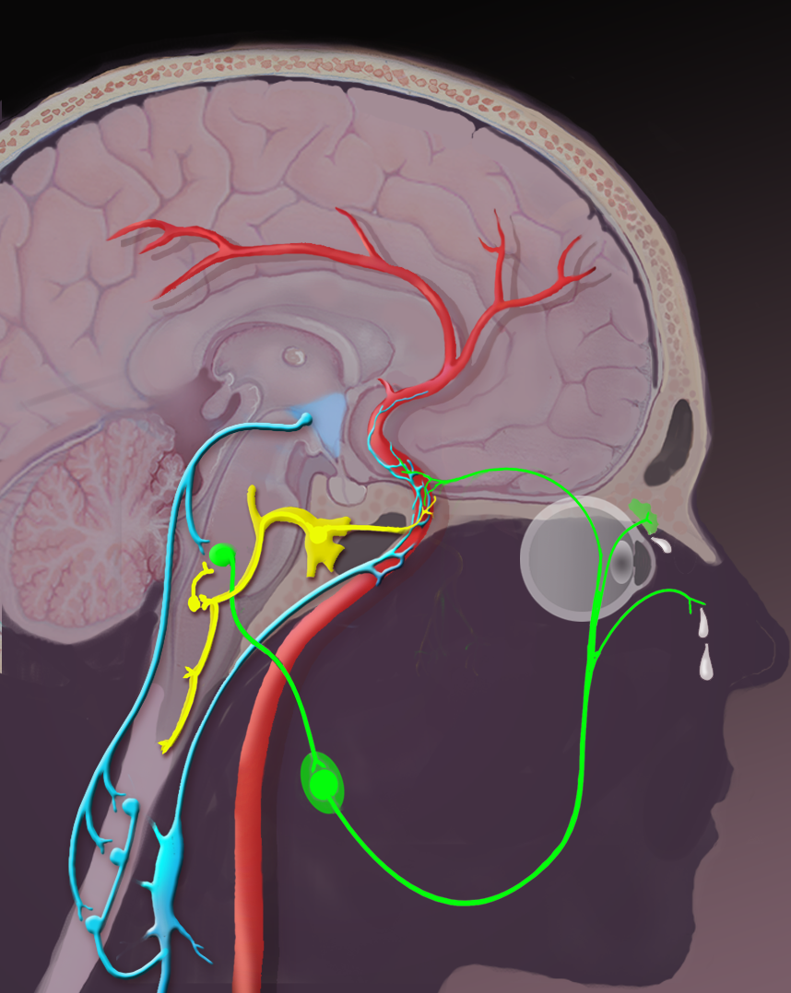
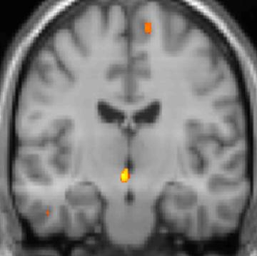
Cluster Pathophysiology: Ipsilateral Posterior Hypothalamus Activation
Triggers:
alcohol, smells
Triggers:
Photoperiod stress
Sleep-wake cycle alteration
Post/Inferior
Hypothalamus
VIP
CGRP
SSN
Trigeminal
ganglion
Sphenopalatine ganglion [SPG]
Superior cervical ganglion
CGRP, calcitonin gene-related peptide; SSN, superior salivatory nucleus; VIP, vasoactive intestinal peptide
Edvinsson L, et al. Cephalalgia. 1994;14(5):320-327.
May A, et al. Neurology. 2000;55(9):1328–1335.

Slide 60
The Role of CGRP in Cluster Headache
N=27 received IV CGRP
Patients with episodic cluster headache at baseline:
  In the active phase, 8/9 administered CGRP developed a CH attack; 1/9 with IV placebo
  Time to onset after IV CGRP: 13- 70 minutes
  In the remission phase, none developed a CH attack after IV CGRP or placebo
Patients with chronic cluster headache at baseline:
  In the active phase, 7/14 administered CGRP developed an attack; none after IV placebo
  Time to onset after IV CGRP: 10-60 minutes
Vollesen ALH, et al. JAMA Neurol. 2018;75(10):1187-1197.

Slide 61
Patient video describing treatment experience
Cluster
https://www.bing.com/videos/search?q=cluster+headache+symptoms+video&&view=detail&mid=40C8F9621948C6D4257F40C8F9621948C6D4257F&&FORM=VRDGAR&ru=%2Fvideos%2Fsearch%3Fq%3Dcluster%2520headache%2520symptoms%2520video%26qs%3Dn%26form%3DQBVR%26sp%3D-1%26pq%3Dcluster%2520headache%2520symptoms%2520video%26sc%3D1-31%26sk%3D%26cvid%3D9CBD42436D644FD49F2252A11EF812DC
  5:29 to 6:05

Slide 62
Medications for the Acute Treatment of Cluster Headache
Established Efficacy and/or FDA Approved | Probably Effective
Oxygen Dihydroergotamine* Triptans Sumatriptan SC* Zolmitriptan nasal** | Triptans Sumatriptan nasal Zolmitriptan oral
*Approved by the US Food and Drug Administration
**Approved in EU, not in US
Robbins MS, et al. Headache. 2016;56:1093-1106.

Slide 63
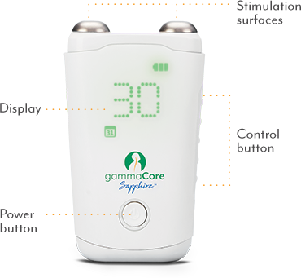
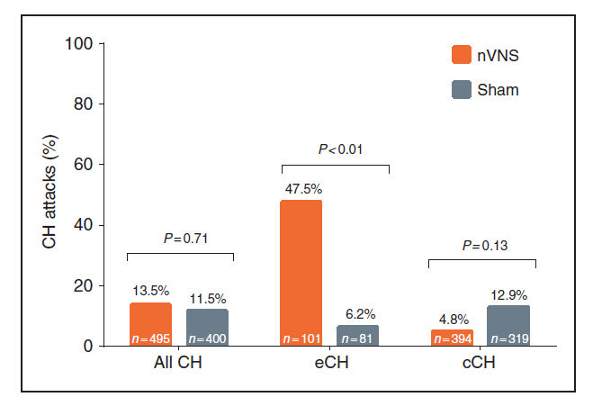
Noninvasive Vagal Nerve Stimulation for Acute Treatment of Episodic Cluster Headache (ACT 1 & 2)
Three 120-sec pulses ipsilateral to pain
Acute episodic cluster dosing:
  3 2-minute stimulations
  Wait 3 minutes and do 3 more 2-minute stimulations, if needed
  Up to 4 attacks or 24 stimulations/day
Goadsby PJ, et al. Cephalalgia. 2018;38(5):959-969.

Slide 64
Transitional Treatment
High-dose oral steroids for 7-10 days while you get the preventive treatment in place
Occipital nerve blocks with steroids
  Lidocaine 1%-4%, 10-20 mg/mL plus either:
    Combination of betamethasone acetate for quick onset and betamethasone phosphate for long effect; 6 mg in 1 mL
      Also provides lower viscosity for easier injection
    Triamcinolone acetonide; 40 mg in 1 mL
High-dose melatonin (no good evidence)
Blumenfeld A, et al. Headache. 2013;53(3):437-446.
Miller S, et al. Cephalalgia. 2019;39(12):1488-1499.

Slide 65
Medications Used – But Not US FDA-Approved – for Preventive Treatment of Cluster Headache
Verapamil
Lithium (therapeutic levels for bipolar disorder)
Valproate (therapeutic levels for seizures)
Consideration for:
  Topiramate
  Gabapentin
  Cyproheptadine

Slide 66
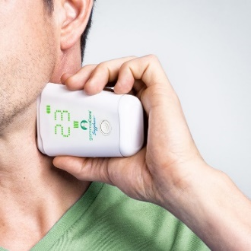
Cluster Preventive Treatment
Preventive medications¹
  Galcanezumab approved by US FDA for prevention of episodic cluster headache²
Neuromodulation³
  Noninvasive vagal nerve stimulation (nVNS)
  Cleared by US FDA for:
    acute treatment of episodic cluster headache
    adjunctive add-on for prevention of both episodic and chronic cluster headache
1. Francis GJ, et al. Neurology. 2010;75(5):463-473.
2. Goadsby P, et al. N Engl J Med. 2019:381(2):132-141.
3. Tepper SJ, et al. Pract Neurol. 2018;17:42-45.

Slide 67
Galcanezumab Is the Only Medication Approved by the US FDA for Prevention of Episodic Cluster Headache
P=0.04
Patients (N=106) were randomized to receive either galcanezumab 300 mg or placebo at baseline and at 1 month
Goadsby PJ, et al. N Engl J Med. 2019;381(2):132-141.

Slide 68
Galcanezumab Is the Only Medication Approved by the US FDA for Prevention of Episodic Cluster Headache (cont)
 | Galcanezumab | Placebo
Serious adverse event | 0% | 0%
Discontinuation due to an adverse event | 4% | 2%
Injection site pain | 8% | 0%
Nasopharyngitis | 6% | 2%
Injection site swelling | 4% | 0%
Pyrexia | 4% | 2%
Alanine aminotransferase >ULN | 5% | 2%
Aspartate aminotransferase >ULN | 2% | 0%
Abnormal total bilirubin | 0% | 2%
Goadsby PJ, et al. N Engl J Med. 2019;381(2):132-141.

Slide 69

Noninvasive Vagal Nerve Stimulation Cleared by US FDA for Adjunctive Preventive Treatment of Cluster Headache (PREVA Study)
Prevention dose: 3 2-minute nVNS stimulations BID
Reduced attack frequency
Reduced use of sumatriptan and O₂
SoC, standard of care
Gaul C, et al. Cephalalgia. 2016;36:534-546.

Slide 70
Summary: Cluster Headache
  ICHD-3 criteria for diagnosis of episodic cluster headache now require ≥3 months of no attacks per year
  The cluster headache generator is the ipsilateral posterior hypothalamus
  New treatments cleared/approved by the FDA for cluster headache include:
    nVNS for acute treatment of episodic cluster and adjunctive preventive treatment of cluster
      Dosing:
        Acute treatment for episodic: 3 2-minute stimulations, up to 24/day prn
        Preventive dosing for episodic and chronic: 3 2-minute stimulations twice daily
    Galcanezumab for preventive treatment of episodic cluster
      Dosing: 3x100 mg [300 mg] SC across abdomen monthly for duration of cluster cycle

Slide 71
Shared Decision-Making
What is it?
  A process wherein the healthcare provider and patient work together to make a healthcare decision that is best for the patient
What’s involved?
  Engaging the patient in a collaborative process
  Evidence-based information about available options
  Provider’s knowledge and experience
  Patient’s values and preferences
Notes:
.

Slide 72
Shared Decision-Making: 5 Steps
5
Seek your patient’s participation
Help your patient explore and compare treatment options
Reach a decision with your patient
4
Evaluate your patient’s decision
3
2
Assess your patient’s values and preferences
1
Agency for Healthcare Research and Quality. https://www.ahrq.gov/health-literacy/professional-training/shared-decision/index.html. Accessed October 2, 2020.

Slide 73
Step 1: Seek your patient’s participation
Start by summarizing your understanding of their headache disorder based on the diagnostic evaluation
Show empathy and offer hope
Ask patient to participate
Explain that there may be more than 1 treatment option
Ask if patient understands he or she is being invited to ask questions, obtain answers, discuss options, and offer thoughts and concerns
Agency for Healthcare Research and Quality. https://www.ahrq.gov/health-literacy/professional-training/shared-decision/index.html. Accessed October 2, 2020.

Slide 74
Step 2: Help your patient explore and compare treatment options
It is often helpful to begin by asking what the patient already knows about the options
The key step in exploring treatment options is for the clinician to describe the benefits and risks of available treatment options with related evidence
  One approach is to say, “Let me tell you what the research says about the benefits and risks of the treatments that we might consider.”
  For migraine, this would involve the 2019 guidelines developed by the American Headache Society, as well as more recent evidence related to the gepants, CGRP monoclonal antibodies, and ditan
  For cluster, this would involve the 2016 guidelines developed by the American Headache Society, as well as more recent evidence related to galcanezumab
It is critical to avoid using complex medical terms and to discuss the benefits and limitations of the treatment options in plain language
Comorbidities are important to consider
Agency for Healthcare Research and Quality. https://www.ahrq.gov/health-literacy/professional-training/shared-decision/index.html. Accessed October 2, 2020.

Slide 75
Step 3: Assess your patient’s values and preferences
Patient treatment decisions often change after becoming well informed about the benefits and risks of available options
Listen closely about the patient’s current disease burden and past experience with different treatment options
Ask the patient what matters the most and what outcomes are the most important
  Some patients with migraine or cluster headache, especially if extremely disabling, value treatment efficacy over safety
  A possible question to ask is “As you think about your options for treatment, what’s important to you?
It is vital to ask what barriers to treatment the patient anticipates, eg, cost
Agency for Healthcare Research and Quality. https://www.ahrq.gov/health-literacy/professional-training/shared-decision/index.html. Accessed October 2, 2020.

Slide 76
Step 4: Reach a decision with your patient
Ask if the patient is ready to make a treatment decision
  “Are you ready to make a treatment decision or do you have more questions or need more time?”
Agency for Healthcare Research and Quality. https://www.ahrq.gov/health-literacy/professional-training/shared-decision/index.html. Accessed October 2, 2020.

Slide 77
Step 4: Reach a decision with your patient (cont)
Ask if the patient is ready to make a treatment decision
  “Are you ready to make a treatment decision or do you have more questions or need more time?”
Confirm the treatment decision
  “It is my understanding that you wish to… Is that correct?”
Agency for Healthcare Research and Quality. https://www.ahrq.gov/health-literacy/professional-training/shared-decision/index.html. Accessed October 2, 2020.

Slide 78
Step 5: Evaluate your patient’s decision
The general purpose of this is so that you as the clinician can support your patient’s decision so that treatment has the best impact possible on the patient’s health outcomes
Evaluating the patient’s decision also helps identify education and other support the patient needs to achieve the treatment goals
  Reinforce the importance of treatment adherence and its impact on headache outcomes
  Provide a written action plan
Support might include involving the multidisciplinary care team as appropriate, such as for psychosocial support, treatment of comorbidities, and adherence support. Communication between headache specialist and the primary care clinician, as well as other members of the team, is important
Arrange for follow up at an appropriate time as dictated by the treatment plan and the patient’s need for ongoing support
Continuing to provide support and nurturing hope are critical roles for the clinician
Agency for Healthcare Research and Quality. https://www.ahrq.gov/health-literacy/professional-training/shared-decision/index.html. Accessed October 2, 2020.

Slide 79
Shared Decision-Making: Helpful Resource
MigrainePro
  Available from the National Headache Foundation
  Patient-centered, shared decision-making app that shows patients how to analyze their migraine attacks and how to better implement acute treatment
National Headache Foundation. https://headaches.org/resources/migrainepro/. Accessed September 29, 2020.

