Slide 2
Meet the faculty
Gregory D. Cascino, MD
Juliann M. Paolicchi, MD
Lucretia Long, C-ANP

Slide 3
Audience response What should be the goal of the treatment the patient receives from caregivers and first responders?
Pick up to 3 responses
Use smallest benzodiazepine dose
Avoid unnecessary benzodiazepine
Provide supportive treatment
Reduce seizure activity
Terminate seizure quickly
Terminate seizure safely
Prevent recurrent seizures
Shorten seizure
Reduce seizure severity
Avoid seizures lasting >30’

Slide 4
Audience response How could the medical treatment the patient received have been improved?
Pick up to 3 responses
Sooner rescue medication
IV treatment from EMS
Faster transport
Faster EMS response
Rescue medication from EMS
Rescue medication from caregivers
Better emergency plan
Better caregiver response
Faster treatment in ED

Slide 5
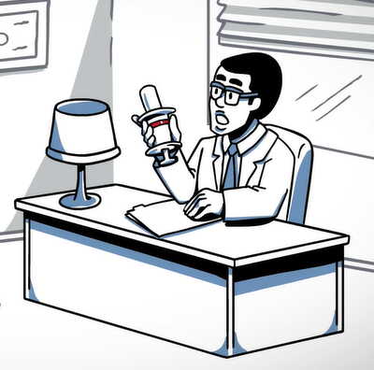
Audience response How could the healthcare system better prepare caregivers to manage seizure emergencies?
Pick up to 3 responses
Training from a specialist
Seizure action plan training
More rescue medication training
Referral for training
Better rescue medications
Easier rescue medications
Status epilepticus education
EMS training

Slide 6
Program overview
Overview of care for seizure emergencies
Pediatric perspective
Advances in prehospital management of ARS
Faculty discussion: unanswered questions and emerging trends
Focus on caregivers and healthcare providers
Optimal management of seizure emergencies for caregivers
Key points summary
Faculty Q&A panel

Slide 7
MODULE 2—STATUS EPILEPTICUS DISEASE BURDEN

Slide 8
Overview of care for seizure emergencies
Gregory D. Cascino, MD, FAAN, FANA, FACNS, FAES
Whitney MacMillan Jr, Professor of Neuroscience
Mayo Clinic Alix School of Medicine
Enterprise Director of Epilepsy
Consultant
Department of Neurology
Mayo Clinic
Rochester, Minnesota

Slide 9
Epilepsy introduction
Epilepsy is common
Twice the prevalence as autism spectrum disorders, multiple sclerosis, and Parkinson’s combined
Incidence: 200,000 per year
Overall goals of treating epilepsy
Seizure free
Avoid neurological morbidity
Eliminate lifestyle limitations
England MJ, et al. Epilepsy Across the Spectrum: Promoting Health and Understanding. The National Academies Collection: Reports funded by National Institutes of Health. Washington (DC)2012.

Slide 10
Morbidity and mortality
Annual
Seizure
Seizure
Morbidity
Mortality
Injury
Depression
and Physical Trauma
25,000 TO
Status Epilepticus
Anxiety and
50,000
Sudden Unexplained Death in Epilepsy
Cognitive Disorders

Slide 11
When is epilepsy treatment not successful?
47%
13%
4%
36%
Respond to 1st AED
Respond to 2nd or 3rd AED
Refractory
Most patients with new-onset epilepsy respond to treatment
30%-40% of patients do not respond to medical treatment
Persistent seizures are more likely in patients with symptomatic epilepsy
Brodie MJ, et al. Neurology. 2012;78:1548-53. Kwan P, Brodie MJ. N Engl J Med. 2000;342:314-19.

Slide 12
Defining seizure emergencies
 | Duration | Criteria
Brief seizures | <5 minutes
Status epilepticus (SE) | >30 minutes | Continuous seizure activity ≥2 sequential seizures without full recovery of consciousness Cerebral autoregulation and neuronal damage after 30 minutes
Prolonged seizures | Last 5-30 minutes
Acute repetitive seizures |  | Mental status preserved between seizures ≥3 within 24 hours (in patients whose habitual seizure frequency is ≤3 per day) Increased risk of prolonged seizures Physically and socially disabling Common concern for patients with intractable epilepsy
Glauser T, et al. Epilepsy Curr. 2016;16:48-61.

Slide 13
Rationale for the 5- and 30-minute definitions
Most seizures are brief
After 5 minutes of seizure activity, risk of a prolonged seizure increases
5-minute threshold minimizes
Risk of prolonged seizures
Adverse outcomes from needless intervention during brief, self-limited seizures
30-minute definition
Duration of convulsive status epilepticus that may lead to permanent neuronal injury
Glauser T, et al. Epilepsy Curr. 2016;16:48-61.

Slide 14
Pathophysiology of prolonged seizures
Loss of cerebral autoregulation and neuronal damage in 30ʹ
Hippocampal and neocortical neuronal loss
Complications
Hyperthermia
Acidosis
Hypotension
Respiratory failure
Rhabdomyolysis
Perks A, et al. BJA Br J Anaesth. 2012;108:562–571.

Slide 15
Status epilepticus presentations
Convulsive | Repeated generalized tonic-clonic seizures Persistent postictal depression of neurologic function between seizures Myoclonic
Nonconvulsive | Subtle status epilepticus Continuous or fluctuating epileptic twilight state Spike-wave-stupor
Repeated partial | Focal motor signs, focal sensory symptoms, or focal impairment of function Not associated with altered awareness (epilepsia partialis continua)
Glauser T, et al. Epilepsy Curr. 2016;16:48-61.

Slide 16
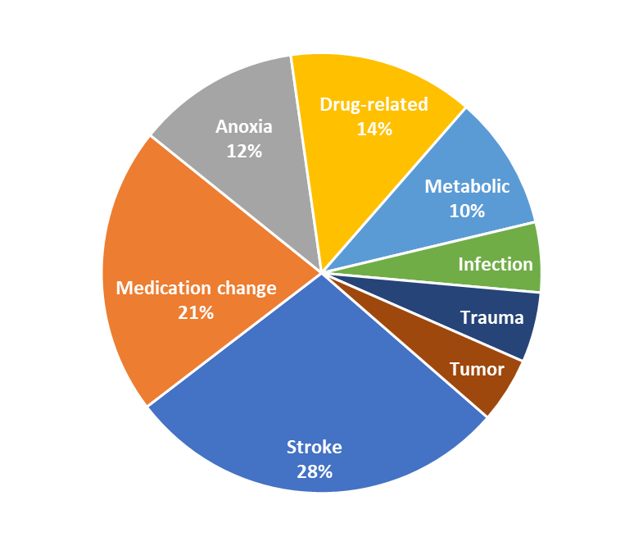
Who is at risk for SE?
Epilepsy Causes (adults)
Risk is related to age
Very young and elderly
Precipitating events for SE
Acute insults
Neurologic abnormality
Risk in patients with epilepsy
10% with epilepsy present with SE
25% of SE occurs in those with epilepsy
15% of epilepsy patients experience SE
SE, status epilepticus
DeLorenzo RJ, et al. Epilepsia. 1992;33(S4):S15-25.

Slide 17
Mortality risk following status epilepticus
55,000 deaths per year
Overall incidence of SE between 102,000 and 150,000
25% of SE cases are nonconvulsive
Risk is related to
Seizure type and etiology
Patient age
Bimodal mortality distribution
Overall 26% risk in adults  38% over 60 years old  50% over 80 years old
Seizure duration
AED, antiepileptic drug; SE, status epilepticus
Behrouz R, et al. J Am Osteopath Assoc. 2009;109:237-245. Boggs JG. Epilepsy Curr. 2004;4:25-27. Neligan A, Shorvon SD. Arch Neurol. 2010;67:931-940.

Slide 18
Seizure duration is a risk factor for mortality
SE, status epilepticus
Behrouz R, et al. J Am Osteopath Assoc. 2009;109:237-245. Boggs JG. Epilepsy Curr. 2004;4:25-27.

Slide 19
Mortality: Rochester population-based studies (1965-1984)
30-day mortality
First-episode SE (N=184)
Deaths: 38 of 201 episodes
(19%, or 21% of patients)
Characteristics of fatal cases
Nonfebrile acute symptomatic SE
>65 years of age
10-year mortality
30-day survivors (N=145)
Deaths: 63 (43%)
Rate 3x general population
High-risk characteristics
Myoclonic SE
Duration >24 hours
Acute symptomatic SE
SE, status epilepticus
Logroscino G, et al. Epilepsia. 1997;38: 1344-1349. Logroscino G, et al. Neurology. 2002;58:537-41.

Slide 20
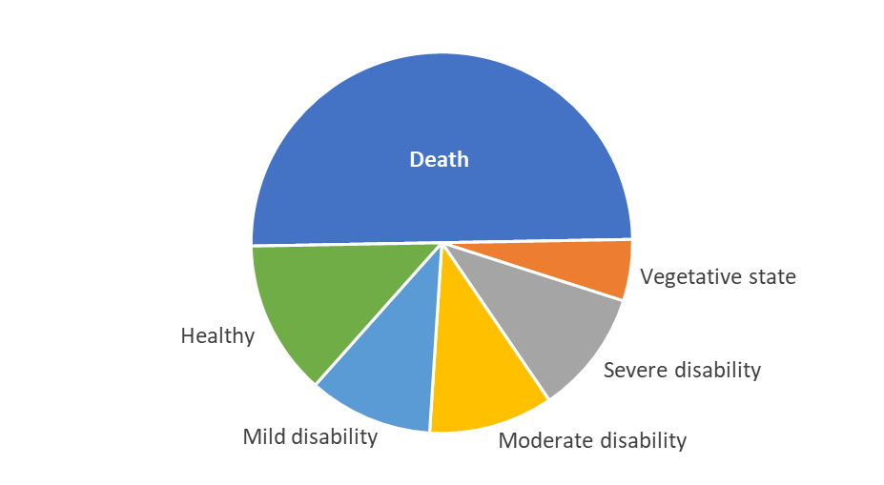
Refractory status epilepticus
Outcomes in patients with generalized convulsive SE (n=45)
SE, status epilepticus
Pandian JD, et al. Arch Neurol. 2004;61:1090-1094.

Slide 21
Morbidity: Rochester population-based studies (1965-1984)
Morbidity and mortality in Rochester studies
MORBIDITY
SE, status epilepticus
Cascino GD, et al. Epilepsia. 1998;39:829-832. Logroscino G, et al. Epilepsia. 1997;38: 1344-1349. Logroscino G, et al. Neurology. 2002;58:537-41.

Slide 22
Status epilepticus imaging findings
Focally increased T2 signal
Focally reduced ADC
Transient cytotoxic and vasogenic edema
Secondary hippocampal sclerosis
ADC, apparent diffusion coefficient

Slide 23
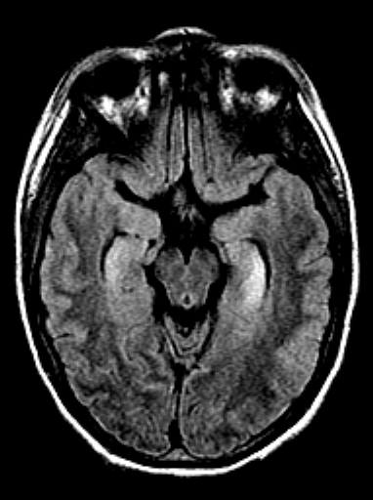
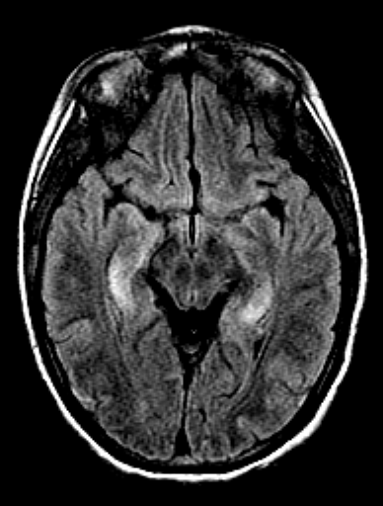

Slide 24
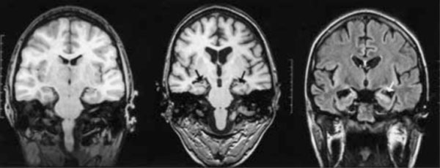

Slide 25
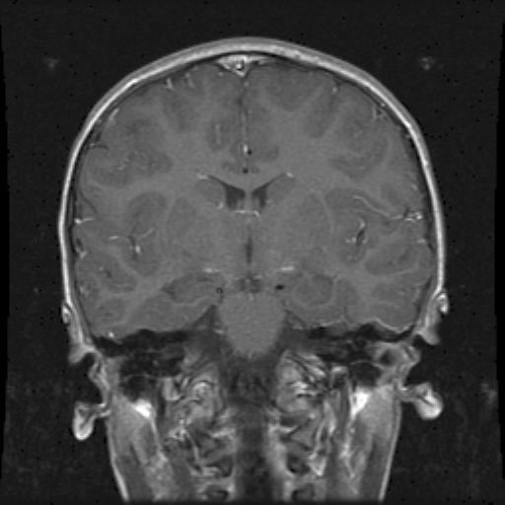
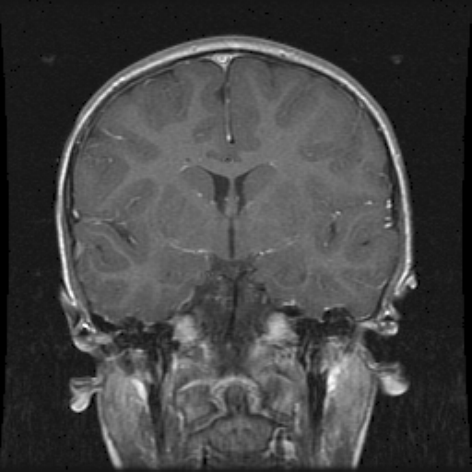
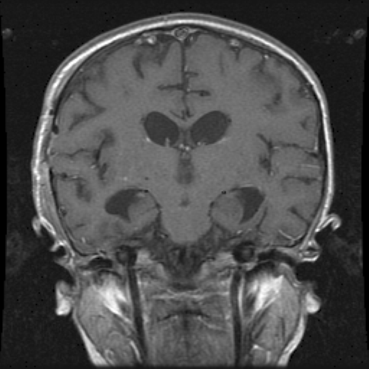
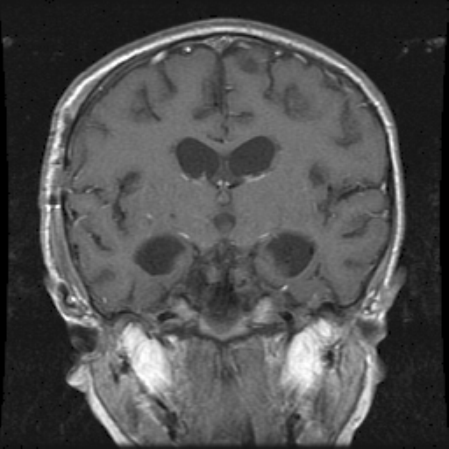

Slide 26
MODULE 3—GUIDELINES FOR MANAGING STATUS EPILEPTICUS

Slide 27
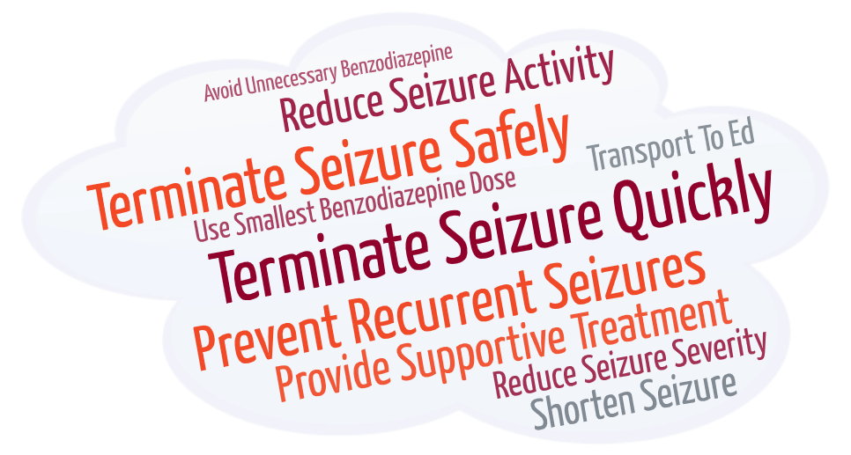
Audience response What should be the goal of the treatment the patient receives from caregivers and first responders?

Slide 28
The goal of therapy is the rapid termination of both clinical and electrical seizure activity, since appropriate and timely therapy of status epilepticus reduces the associated mortality and morbidity
Glauser T, et al. Epilepsy Curr. 2016;16:48-61.

Slide 29
Pitfalls in achieving optimal treatment
Basic critical care and emergency principles apply and are widely accepted, but
Pharmacologic management varies
Patients may not receive adequate treatment because
Therapy is aimed at reducing rather than terminating seizures
Inefficient therapies are used (eg, sedatives or paralytics)
Insufficient anticonvulsant doses are used
Prehospital care is neglected
Acute rescue medication is underutilized
Glauser T, et al. Epilepsy Curr. 2016;16:48-61.

Slide 30
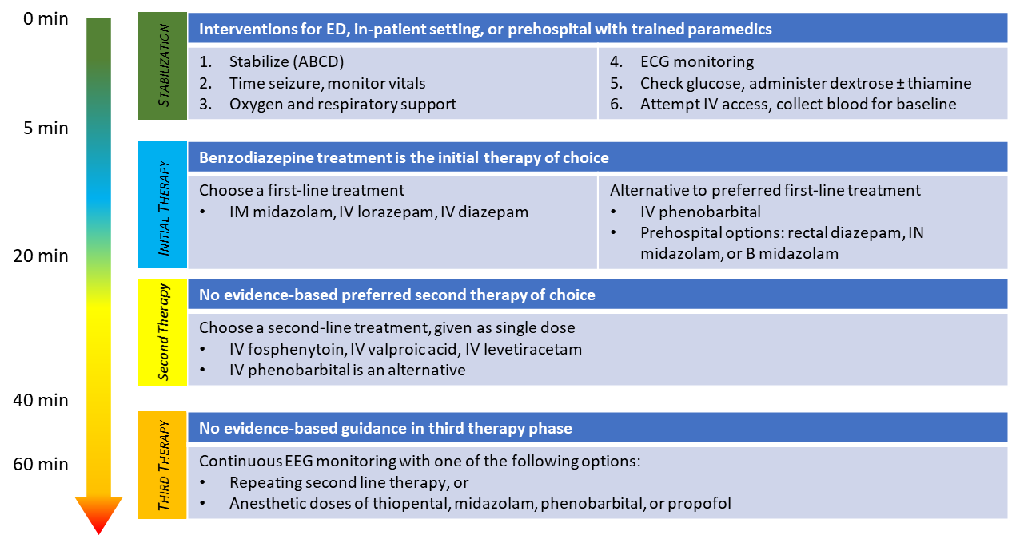
SE treatment algorithm overview*
*Summary of guidelines; see publication for complete recommendations; ABCD, Airway, Breathing, Circulation, Disability (Neurologic); B, buccal; ECG, electrocardiogram; ED, emergency department; EEG, electroencephalogram; IM, intramuscular; IN, intranasal; IV, intravenous; SE, status epilepticus.
Glauser T, et al. Epilepsy Curr. 2016;16:48-61.

Slide 31
Initial-therapy phase highlights
1998 VA SE Study (adults)
Equivalent treatments IV lorazepam = IV diazepam = IV phenobarbital
Superiority IV lorazepam > IV phenytoin
2001 Alldredge trial (adults, prehospital)
Treatments IV lorazepam ≳ IV diazepam > IV placebo
2011 RAMPART study (adults and children, prehospital)
Treatments IM midazolam > IV lorazepam when no IV access established
≳, indicates non-significant trend; IM, intramuscular; IV, intravenous
Treiman DM, et al. N Engl J Med. 1998;339:792–798. Alldredge BK, et al. N Engl J Med. 2001;345:631-637. Silbergleit R, et al. Epilepsia. 2013;54:74–77.

Slide 32
Adverse events (adults)
Respiratory and cardiac symptoms are most common TEAEs
Respiratory depression
Lower in patients treated with benzodiazepine than with placebo
May be a consequence of untreated SE
No substantial difference between benzodiazepines and phenobarbital in the incidence of cardiorespiratory AEs
AE, adverse events; TEAEs, treatment-emergent adverse events; SE, status epilepticus
Glauser T, et al. Epilepsy Curr. 2016;16:48-61.

Slide 33
Initial phase treatment conclusions (adults)
Without IV access
IM midazolam > IV lorazepam
No significant difference between lorazepam and diazepam
Benzodiazepines preferred over phenobarbital because of slower administration rate
New approvals
IM, intramuscular; IV, intravenous
Glauser T, et al. Epilepsy Curr. 2016;16:48-61.

Slide 34
Second-therapy phase highlights
1998 VA SE Study, second blinded treatment (adults)
Equivalent treatments
IV lorazepam followed by IV phenytoin | IV phenobarbital followed by IV phenytoin | IV phenytoin followed by IV lorazepam | IV diazepam + phenytoin followed by IV lorazepam
Treiman DM, et al. N Engl J Med. 1998;339:792–798.

Slide 35
Trials in second phase therapies: ESETT
Established Status Epilepticus Treatment Trial (ESETT)
Endpoint: Absence of clinically evident seizures and improved responsiveness at 60 minutes (N=384)
Levetiracetam (60 mg/kg) | Fosphenytoin (20 mg/kg) | Valproate (40 mg/kg)
47% | 45% | 46%
Adverse events Similar incidences with all treatments Nonsignificant difference in hypotension and endotracheal intubation (fosphenytoin) Nonsignificant difference in deaths (levetiracetam)
Kapur J, et al. N Engl J Med. 2019;381:2103-2113.

Slide 36
Trials in second phase therapies: TRENDS Trial
Treatment of Recurrent Electrographic Nonconvulsive Seizures Trial (TRENDS)
Endpoint Absence of electrographic seizures for 24 hours (N=74) Noninferiority
Lacosamide (400 mg) | Fosphenytoin (20 mg/kg)
63% | 50%
Adverse events Similar incidence
Husain AM, et al. Ann Neurol. 2018;83:1174-1185.

Slide 37
Third-phase therapy
Begin when seizure duration reaches 40 minutes
No clear evidence to guide selection
Considered substantially less effective than previous phases of therapy
Treatment options
Repeat second phase therapy or anesthetic doses of thiopental, midazolam, pentobarbital, propofol
Glauser T, et al. Epilepsy Curr. 2016;16:48-61.

Slide 38
MODULE 4—PEDIATRIC PERSPECTIVE ON CARE FOR SEIZURE EMERGENCIES

Slide 39
Pediatric perspective on care for seizure emergencies
Juliann M. Paolicchi, MA, MD, FAES, FANA
Co-Director, Clinical Research
Pediatric Epileptologist
Northeast Regional Epilepsy Group
Professor, Pediatrics and Neurology
Hackensack-Meridian Medical School
Seton Hall University
Hackensack, New Jersey

Slide 40
Seizure emergencies in children: developing brain at risk!
Epidemiology
Generalized seizures more common in children (60%) than adults (40%)
Pediatric seizure syndromes are uniquely defined by their intractability:
Congenital malformations such as hemimeganencephaly, Sturge-Weber syndrome, or Rasmussen’s encephalitis, where 40-100 seizures a day are not an unusual occurrence despite maximal medical therapy compared to 1 per month in adult syndromes
Etiology
Pediatric epilepsy more varied etiology
Febrile seizures, cortical dysplasias, infection-related, hypoxia, genetic and congenital malformations, intrauterine and postnatal insults, anoxic injuries, vascular malformations and compromise (eg, ischemia), trauma, and tumors
Concomitant respiratory disease common in children
Adult epilepsy: MTS most common
MTS, mesial temporal sclerosis

Slide 41
Seizure emergencies in children: special considerations in treatment
Adjust dosing for body weight
Specific medication precautions (eg, propofol)
Little direct clinical research in pediatric patients
“Bioequivalent” is not equal
Rapid metabolism, especially in very young children

Slide 42
Outcome of SE in pediatric patients: a global issue
Outcomes based on 6 prospective studies in pediatric SE (UK, USA, sub-Saharan Africa)
One-year recurrence after the first-ever CSE (prolonged febrile or afebrile) | 16% (95% CI: 10-24)
Percentage with recurrence within 4 years | 20%
Case fatality during hospitalization
UK, US | 2.7-5.2%
Sub-Saharan Africa | 15%
Subsequent epilepsy, 9 years post-CSE (cumulative incidence) | 25% (95% CI: 16-36)
Neurological, cognitive, and behavioral impairments outside of epilepsy are detectable within 6 weeks of CSE, and by 9 years follow-up, at least 1/3 of patients have some consequence Long-term mortality ranges from 5-17%, with the true estimate at 9 years follow-up to be 8% with standardized mortality ratio of 46
CSE, convulsive status epilepticus; SE, status epilepticus
Chin RFM. Epilepsy Behav. 2019;101(Pt B):106286. doi: 10.1016/j.yebeh.2019.04.039.

Slide 43
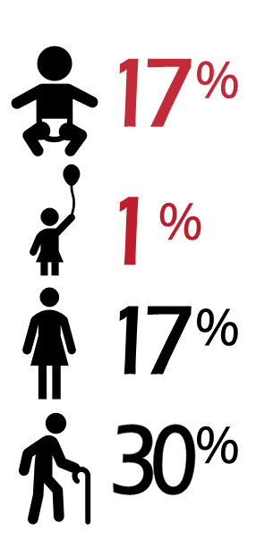
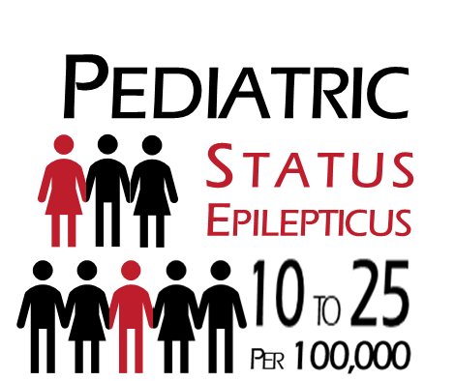
30-day Mortality Risk
Logroscino G, et al. Epilepsia. 1997;38: 1344-1349.

Slide 44
Antiseizure medicine adherence differences based on age
3
2-5 years
6-12 years
P<0.05
13-17 years
18-25 years
Level of Adherence Barrier Endorsement (1-4)
2
P<0.001
P<0.001
1
Taste
Forget
Swallow
Embarrassed
Refuse
Activity
Run Out
Pharmacy
Adherence Barrier Type
Gutierrez-Colina AM, et al. Epilepsy Behav. 2018;80:229-234.

Slide 45
2-5 YEARS
Caregivers
6-12 YEARS
Caregivers
13-17 YEARS
Caregivers
13-17 YEARS
Adolescents
Run out of meds
Forget to give meds
Competing activities
Run out of meds
Forget to give meds
Difficult to obtain from pharmacy
Run out of meds
Competing activities
Difficult to swallow
Dislikes taste
Competing activities
Refuses to take med
Adherence
Dislikes taste
Difficult to swallow
Ran out of meds
Difficult to swallow
Embarrassed to take
Forget to give meds
Refuses to take
Competing activities
Difficult to swallow
Difficult to obtain from pharmacy
Dislikes taste
Competing activities
Seizures
Dislikes taste
Difficult to obtain from pharmacy
Forget to give med
Run out of meds
Forget to give meds
Competing activities
Dislikes tastes
Difficult to swallow
Difficult to obtain from pharmacy
Forget to take meds
Dislikes taste
Competing activities
HRQOL
Gutierrez-Colina AM, et al. Epilepsy Behav. 2018;80:229-234.

Slide 46
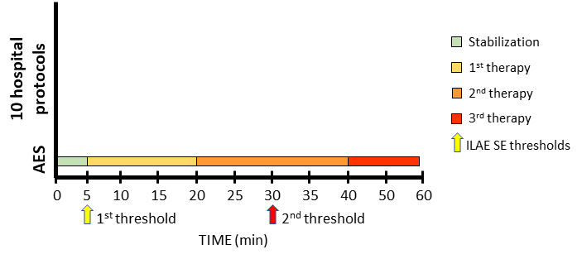
Treatment escalation may be more aggressive than recommended by the AES
AES, American Epilepsy Society 2016 Evidence Based Guidelines protocol for managing SE; ILAE, International League Against Epilepsy timepoints that define brief seizures and seizures that have increased risk for neurological damage; SE, status epilepticus
Glauser T, et al. Epilepsy Curr. 2016;16:48-61. Vasquez A, et al. Pediatr Neurol. 2018;86:33-41.

Slide 47
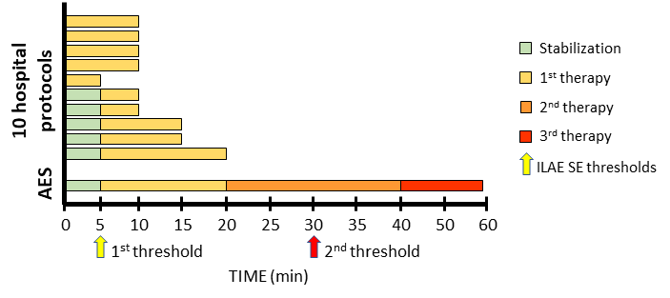
Treatment escalation may be more aggressive than recommended by the AES
AES, American Epilepsy Society 2016 Evidence Based Guidelines protocol for managing SE; ILAE, International League Against Epilepsy timepoints that define brief seizures and seizures that have increased risk for neurological damage; SE, status epilepticus
Glauser T, et al. Epilepsy Curr. 2016;16:48-61. Vasquez A, et al. Pediatr Neurol. 2018;86:33-41.

Slide 48
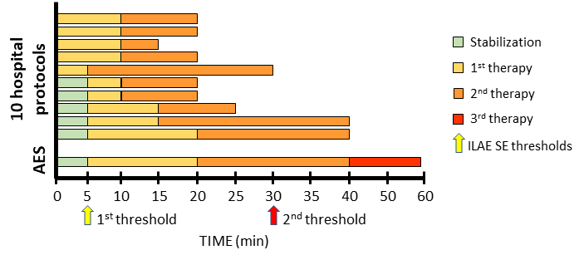
Treatment escalation may be more aggressive than recommended by the AES
AES, American Epilepsy Society 2016 Evidence Based Guidelines protocol for managing SE; ILAE, International League Against Epilepsy timepoints that define brief seizures and seizures that have increased risk for neurological damage; SE, status epilepticus
Glauser T, et al. Epilepsy Curr. 2016;16:48-61. Vasquez A, et al. Pediatr Neurol. 2018;86:33-41.

Slide 49
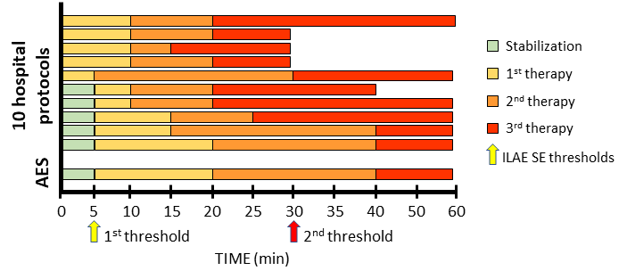
Treatment escalation may be more aggressive than recommended by the AES
AES, American Epilepsy Society 2016 Evidence Based Guidelines protocol for managing SE; ILAE, International League Against Epilepsy timepoints that define brief seizures and seizures that have increased risk for neurological damage; SE, status epilepticus
Glauser T, et al. Epilepsy Curr. 2016;16:48-61. Vasquez A, et al. Pediatr Neurol. 2018;86:33-41.

Slide 50
AES summary for pediatric patients: initial-therapy phase highlights
2014 Chamberlain study (children)
Equivalent treatments IV diazepam = IV lorazepam
2011 RAMPART study (children, prehospital)
Equivalent treatments* IM midazolam = IV lorazepam when no IV access established
Other studies
Probably effective treatments** PR diazepam, IM midazolam, IN midazolam, and B midazolam
Insufficient data IN lorazepam, SL lorazepam, PR lorazepam, valproic acid, levetiracetam, phenobarbital, and phenytoin
B, buccal; IM, intramuscular; IN, intranasal; IV, intravenous; PR, rectal; SL, sublingual
*Small number of children enrolled limited statistical power; **Based on small and/or lower quality studies
Chamberlain JM, et al. J Am Med Assoc. 2014;311:1652-1660. Silbergleit R, et al. Epilepsia. 2013;54:74–77. Glauser T, et al. Epilepsy Curr. 2016;16:48-61.

Slide 51
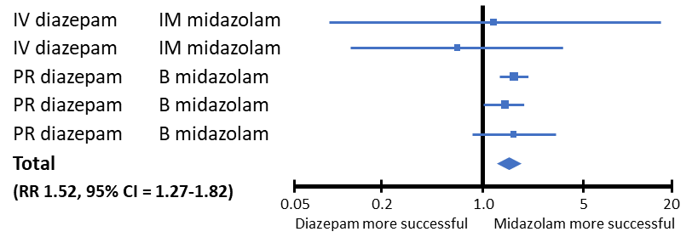
Pooled meta-analysis: midazolam vs diazepam in children and young adults
Erratic absorption of PR diazepam  low/delayed peak plasma drug concentration
AES conclusion: non-IV midazolam is probably more effective than IV or PR diazepam
B, buccal; IM, intramuscular; IN, intranasal; IV, intravenous; R, rectal; SL, sublingual
McMullan J, et al. Acad Emerg Med. 2010;17:575-582. Glauser T, et al. Epilepsy Curr. 2016;16:48-61.

Slide 52
AES summary for pediatric patients: second-therapy phase highlights
2014 Chamberlain study (children)
Equivalent treatments Efficacy: IV valproic acid = IV phenobarbital Tolerability: IV valproic acid > IV phenobarbital
EcLiPSE trial (2019); ConSEPT (2019)
Non-inferior/Equivalent Phenytoin or levetiracetam
Established Status Epilepticus Treatment Trial (ESETT)
Included pediatric patients (<18 years of age, n=225)
IV, intravenous
Glauser T, et al. Epilepsy Curr. 2016;16:48-61. Lyttle MD, et al. Lancet. 2019;393:2125. Dalziel SR, et al. Lancet. 2019;393:2135.

Slide 53
AES summary for pediatric patients: adverse events
2014 Chamberlain study (children)
Equivalent AE risks Assisted ventilation: IV lorazepam (17.6%) ≈ IV diazepam (16.0%) Aspiration pneumonia: IV lorazepam (n=2) = IV diazepam (n=2) Sedation: IV lorazepam (66.9%) > IV diazepam (50%)
AE, adverse event; IV, intravenous
Chamberlain JM, et al. J Am Med Assoc. 2014;311:1652-1660.

Slide 54
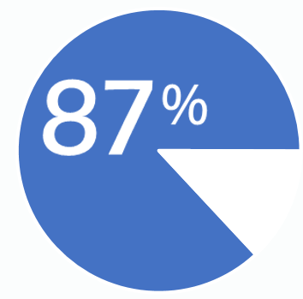
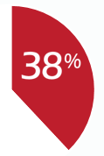
Importance of prehospital care
SE, status epilepticus
Alldredge BK, et al. N Engl J Med. 2001;345:631-637. Chin RF, et al. Lancet Neurol. 2008;7:696–703. McKee HR, et al. CNS Drugs. 2015;1:55–70. Sanchez Fernandez I, et al. Neurology. 2015;23:2304–2311.

Slide 55
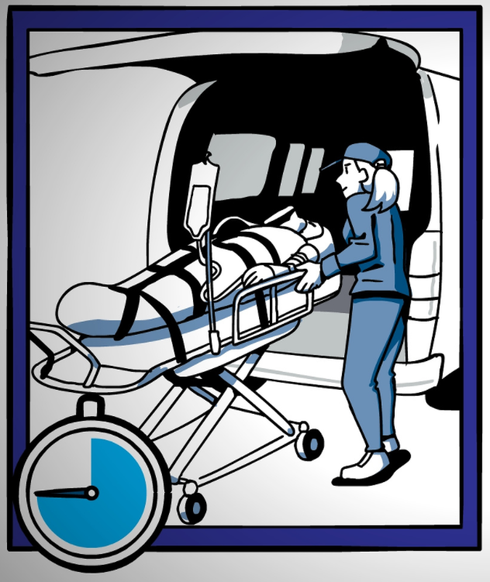
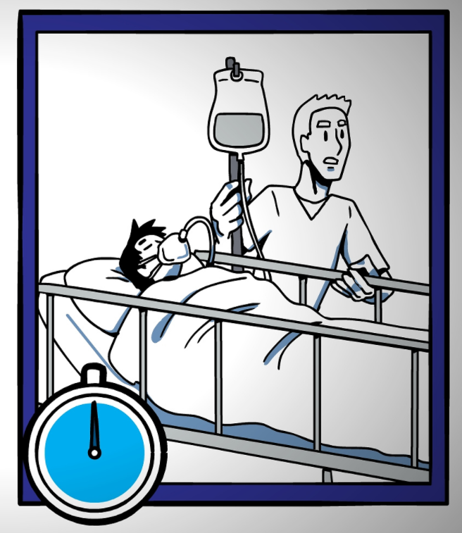
Importance of prehospital care
When prehospital care is neglected…
SE, status epilepticus
Alldredge BK, et al. N Engl J Med. 2001;345:631-637. Chin RF, et al. Lancet Neurol. 2008;7:696–703. McKee HR, et al. CNS Drugs. 2015;1:55–70. Sanchez Fernandez I, et al. Neurology. 2015;23:2304–2311.

Slide 56
Prehospital treatment may reduce seizure duration
Factors associated with SE lasting >60 min | Adjusted Odds Ratio (95% CI) |  | P value
No prehospital treatment vs prehospital treatment | 2.4 (1.2-4.5) |  | 0.008
Time from onset to arrival at ED | 1.05 (1.03-1.06) |  | <0.0001
>2 benzodiazepine doses vs ≤2 | 3.6 (1.9-6.7) |  | <0.0001
Intermittent vs continuous SE | 2.5 (1.4-4.8) |  | 0.003
CI, confidence interval; ED, emergency department; SE, status epilepticus
Chin RFM, et al. Lancet Neurol. 2008;7:696-703.

Slide 57
Prehospital management affects outcomes
Prehospital treatment
Duration of SE
Rate of SE Recurrence
With
32 min
58%
Without
60 min
85%
SE, status epilepticus
Alldredge BK, et al. Pediatr Neurol. 1995;12:213–216.

Slide 58
PSERG Trial: multicenter observational study of pediatric patients (N=218) with RCSE
First-line benzodiazepine treatment timing Within 10 min Delayed treatment | 74 (33.9%) 144 (66.1%)
Multivariate analysis of delayed group Risk of death Need for continuous infusion Increased convulsive seizure duration Risk of hypotension | Adjusted Odds Ratio (95% CI) 11.0 (1.43 to ∞) 1.8 (1.01-3.36) 2.6 (1.38-4.88) 2.3 (1.16-4.63) | P-value 0.02 0.047 0.003 0.02
AOR, adjusted odds ratio; CI, confidence interval; RCSE, recurrent convulsive status epilepticus
Gaínza-Lein M, et al. JAMA Neurol. 2018;75(4):410–418. doi:10.1001/jamaneurol.2017.4382.

Slide 59
Conclusions and relevance Among pediatric patients with RCSE, an untimely first-line benzodiazepine treatment is independently associated with a higher frequency of death, use of continuous infusions, longer convulsion duration, and more frequent hypotension. Results of this study raise the question as to whether poor outcomes could, in part, be prevented by earlier administration of treatment.
Gaínza-Lein M, et al. JAMA Neurol. 2018;75(4):410–418. doi:10.1001/jamaneurol.2017.4382.

Slide 60
Rapid initiation and escalation of SR treatment has been associated with shortened seizure duration and more favorable outcomes. Current evidence-based guidelines for management of status epilepticus propose medication algorithms with suggested times for each management step. [PSERG and other studies have shown that] time to antiseizure medication administration for pediatric status epilepticus remains delayed in both the pre- and in-hospital settings. Barriers to timely treatment include suboptimal preventive care, inaccurate seizure detection, infrequent or restricted use of home rescue medications by caregivers and pre-hospital emergency personnel, delayed summoning and arrival of emergency personnel, and use of inappropriately dosed medications….
Conclusion: Improved preventive care, seizure detection, and rescue medication education may advance pre-hospital management….
Stredny CM, et al. Seizure. 2018;58:133-140. doi: 10.1016/j.seizure.2018.04.011.

Slide 61
Rapid initiation and escalation of SR treatment has been associated with shortened seizure duration and more favorable outcomes. Current evidence-based guidelines for management of status epilepticus propose medication algorithms with suggested times for each management step. [PSERG and other studies have shown that] time to antiseizure medication administration for pediatric status epilepticus remains delayed in both the pre- and in-hospital settings. Barriers to timely treatment include suboptimal preventive care, inaccurate seizure detection, infrequent or restricted use of home rescue medications by caregivers and pre-hospital emergency personnel, delayed summoning and arrival of emergency personnel, and use of inappropriately dosed medications….
Conclusion: Improved preventive care, seizure detection, and rescue medication education may advance pre-hospital management….
Stredny CM, et al. Seizure. 2018;58:133-140. doi: 10.1016/j.seizure.2018.04.011.

Slide 62
Rapid initiation and escalation of SR treatment has been associated with shortened seizure duration and more favorable outcomes. Current evidence-based guidelines for management of status epilepticus propose medication algorithms with suggested times for each management step. [PSERG and other studies have shown that] time to antiseizure medication administration for pediatric status epilepticus remains delayed in both the pre- and in-hospital settings. Barriers to timely treatment include suboptimal preventive care, inaccurate seizure detection, infrequent or restricted use of home rescue medications by caregivers and pre-hospital emergency personnel, delayed summoning and arrival of emergency personnel, and use of inappropriately dosed medications….
Conclusion: Improved preventive care, seizure detection, and rescue medication education may advance pre-hospital management….
Stredny CM, et al. Seizure. 2018;58:133-140. doi: 10.1016/j.seizure.2018.04.011.

Slide 63
Rapid initiation and escalation of SR treatment has been associated with shortened seizure duration and more favorable outcomes. Current evidence-based guidelines for management of status epilepticus propose medication algorithms with suggested times for each management step. [PSERG and other studies have shown that] time to antiseizure medication administration for pediatric status epilepticus remains delayed in both the pre- and in-hospital settings. Barriers to timely treatment include suboptimal preventive care, inaccurate seizure detection, infrequent or restricted use of home rescue medications by caregivers and pre-hospital emergency personnel, delayed summoning and arrival of emergency personnel, and use of inappropriately dosed medications….
Conclusion: Improved preventive care, seizure detection, and rescue medication education may advance pre-hospital management….
Stredny CM, et al. Seizure. 2018;58:133-140. doi: 10.1016/j.seizure.2018.04.011.

Slide 64
Rapid initiation and escalation of SR treatment has been associated with shortened seizure duration and more favorable outcomes. Current evidence-based guidelines for management of status epilepticus propose medication algorithms with suggested times for each management step. [PSERG and other studies have shown that] time to antiseizure medication administration for pediatric status epilepticus remains delayed in both the pre- and in-hospital settings. Barriers to timely treatment include suboptimal preventive care, inaccurate seizure detection, infrequent or restricted use of home rescue medications by caregivers and pre-hospital emergency personnel, delayed summoning and arrival of emergency personnel, and use of inappropriately dosed medications….
Conclusion: Improved preventive care, seizure detection, and rescue medication education may advance pre-hospital management….
Stredny CM, et al. Seizure. 2018;58:133-140. doi: 10.1016/j.seizure.2018.04.011.

Slide 65
MODULE 5—RESCUE MEDICATION OPTIONS

Slide 66
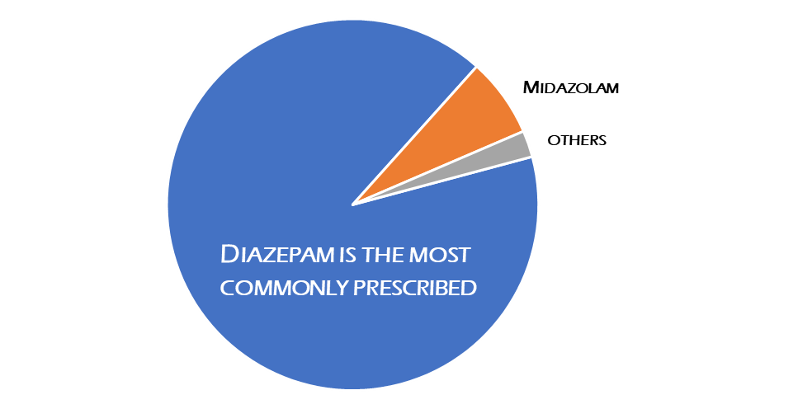
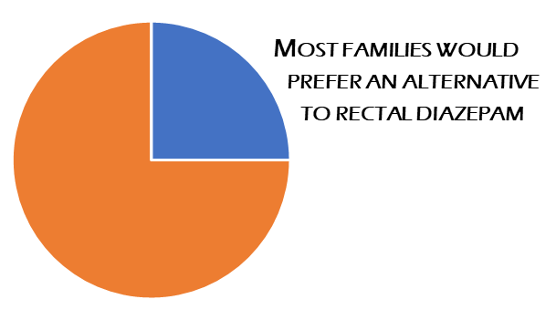
Current standard of care for prehospital management
Satisfied with rectal diazepam
Prefer non-rectal route
Gainza-Lein M, et al. Seizure. 2017;52:188-194. de Haan GJ, et al. Epilepsia. 2010;51:478–482. Holsti M, et al. Arch Pediatr Adoles Med. 2010;164:747–753.

Slide 67
Off-label options sometimes used for SE
Nonrectal benzodiazepine formulations
Buccal midazolam
Compounded midazolam
Acidity can cause irritation
Limitations of device (eg, not preloaded/premeasured)
Shelf-life and storage limitations
Clonazepam orally-disintegrating tablets
VNS magnets
VNS, vagal nerve stimulating

Slide 68
Characteristics of an ideal prehospital treatment for SE
Immediate duration of action
Rapid cessation of seizures
Easy to use
Safe, without causing discomfort
Low inter- and intra-patient variability
Long shelf life
Maglalang PD, et al. Epilepsia. 2018;59:207-215.

Slide 69
Intranasal vs other administration routes
High perfusion = Rapid absorption
Easy, minimal training, low risk
Rapid distribution into CNS
Small volume vs rectal
CNS, central nervous system
Maglalang PD, et al. Epilepsia. 2018;59:207-215.

Slide 70
New approvals for seizure rescue medications
Midazolam nasal spray
Patients ≥12 years of age with epilepsy
5 mg dose
Diazepam nasal spray
Patients ≥ 6 years of age with epilepsy
5 mg, 10 mg, 15 mg, 20 mg doses
Midazolam nasal spray package insert, 2019. Diazepam nasal spray package insert, 2020.

Slide 71
ARTEMIS 1 phase 3 trial
Part 2: Comparative phase (N=201)
Part 1: test dose phase
Efficacy outcomes
Outpatient, administered by caregivers
Caregiver training = Patient Management Plans
Drug administration training
When to administer, requirements for second dose, and emergency rescue protocol
Double-blind first dose: MDZ-NS or placebo
Optional, open-label second dose: MDZ-NS
Safety outcomes
Open-label, in-clinic
2 doses 5 mg MDZ-NS
Primary outcome
Composite endpoint: treatment success
Seizure termination within 10 mins
No seizure recurrence 10 min to 6 hrs after treatment
MDZ-NS, midazolam nasal spray
Detyniecki K, et al. Epilepsia. 2019;60:1797-1808.

Slide 72
ARTEMIS 1 efficacy outcomes
 | MDZ-NS |  | Placebo |  | P-value
Treatment success Seizure termination within 10 mins No seizure recurrence 10 min-60 hrs | 53.7% |  | 34.4% |  | 0.01
Seizure recurrence | 38.1% |  | 59.7% |  | 0.004
MDZ-NS, midazolam nasal spray
Detyniecki K, et al. Epilepsia. 2019;60:1797-1808.

Slide 73
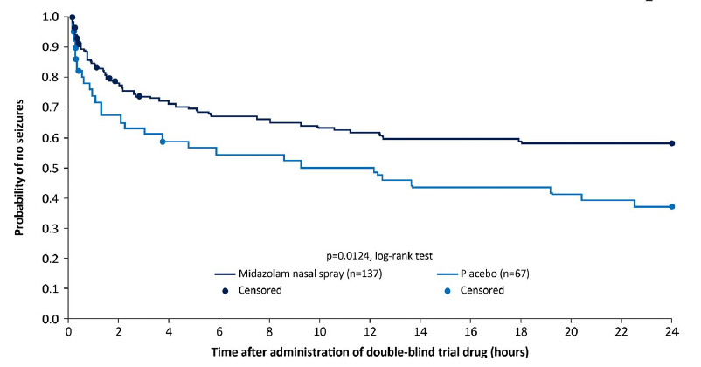
ARTEMIS 1 efficacy outcomes
21% difference
Detyniecki K, et al. Epilepsia. 2019;60:1797-1808.

Slide 74
ARTEMIS 1 safety outcomes
TEAEs
Consistent with known benzodiazepine AEs (eg, sedation)
Expected from IN administration (eg, nasal discomfort)
Low rate of respiratory depression type events (0.7%)
No discontinuations due to TEAE
TEAEs, treatment associated adverse events; AE, adverse event; IN, intranasal
Detyniecki K, et al. Epilepsia. 2019;60:1797-1808.

Slide 75
ARTEMIS 1 extension trial
Open-label extension of ARTEMIS 1
N=175 patients enrolled
1998 seizure cluster episodes
Up to 2 doses MDZ-NS 5 mg during seizure clusters
Outcome
Treatment success, first dose | 55.5%
Patients requiring a 2nd dose | 40%
Treatment success, 2nd dose | 80%
Median time to return to full baseline functionality | 1.2 hours
MDZ-NS, midazolam nasal spray
Wheless JW, et al. Epilepsia. 2019;60:1809-1819.

Slide 76
Diazepam nasal spray FDA approval
Summary of Presubmission/Submission Regulatory Activity
…demonstration of comparable bioavailability between rectal and IN diazepam in the healthy adults … reasonably congruent results between ictal/peri-ictal and interictal PK in adults (adults in Study 01.04), and no notable differences between the PK in healthy adults and adult patients with epilepsy in a cross-study comparison would be necessary, as well as chronic safety data...
NDA 211635 (Diazepam nasal spray). Available at https://www.accessdata.fda.gov/drugsatfda_docs/nda/2020/211635Orig1s000MedR.pdf

Slide 77
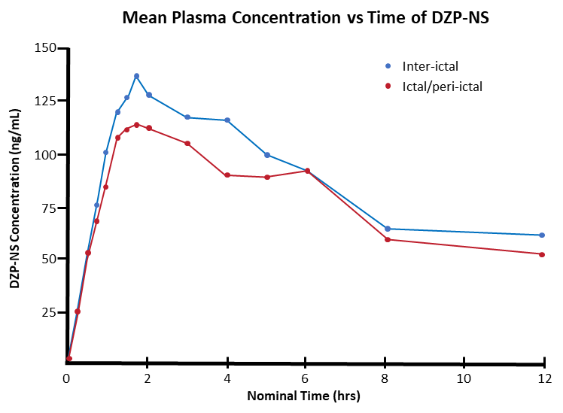
DZP-NS phase 1 PK and safety study
Diazepam nasal spray formulation
Vitamin E (increases solubility)
Proprietary nonionic surfactant (increases transmucosal bioavailability)
Open-label phase 1 study (N=57)
Administration of DZP-NS during ictal/peri-ictal and inter-ictal periods
Dosing based on patient age and weight (5, 10, 15, or 20 mg doses)
PK conclusions
Profile comparable to PR diazepam
Lower interpatient variability
DZP-NS, diazepam nasal spray; PR, rectal
Hogan R, et al. Presented at the American Academy of Neurology Annual Meeting. Toronto. April 25-May1, 2020.

Slide 78
DZP-NS phase 1 PK and safety study
No TEAEs resulted in discontinuation
Most TEAEs were consistent with events expected with nasal administration
No clinically significant abnormalities in vital signs
No changes in respiratory rate after DZP-NS administration
No clinically significant changes in clinical laboratory tests or ECGs
DZP-NS, diazepam nasal spray; TEAEs, treatment emergent adverse events; ECG, electrocardiogram
Hogan R, et al. Presented at the American Academy of Neurology Annual Meeting. Toronto. April 25-May 1, 2020.

Slide 79
DZP-NS phase 3 study interim analysis
Safety and tolerability stratified by frequency of use
Moderate (1-2 doses/mo) vs frequent (>2 doses/mo)
No trends noted after 2274 episodes (N=132)
No trend observed with higher use frequency
Nasal irritation was mild and transient
Smell tests showed olfactory changes were minimal and transient and were not related to usage frequency
DZP-NS, diazepam nasal spray; TEAEs, treatment emergent adverse events; ECG, electrocardiogram
Miller I, et al. Presented at the American Academy of Neurology Annual Meeting. Toronto. April 25-May 1, 2020.

Slide 80
MODULE 6—FACULTY DISCUSSION: ADDRESSING TREATMENT GAPS

Slide 81
MODULE 7—FOCUS ON CAREGIVERS AND HEALTHCARE PROVIDERS: IMPROVING PREHOSPITAL CARE

Slide 82
Focus on caregivers and healthcare providers: improving prehospital care
Lucretia Long C-ANP, FAES
Clinical Assistant Professor of Neurology
Epilepsy Nurse Practitioner
Department of Neurology
Division of Epilepsy
The Ohio State University Medical Center
Columbus, Ohio

Slide 83
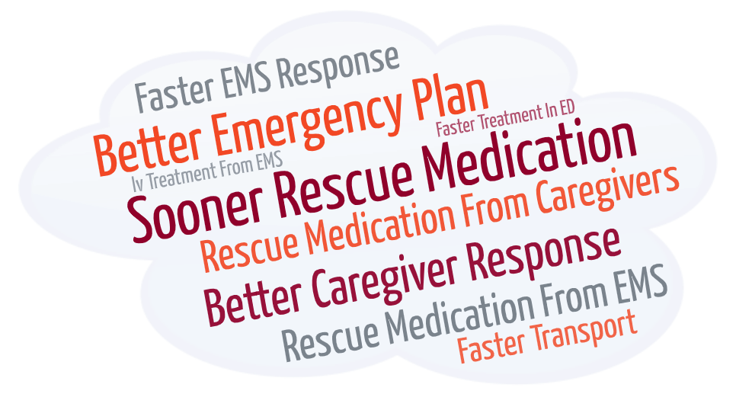
Audience response How could the medical treatment the patient received have been improved?

Slide 84
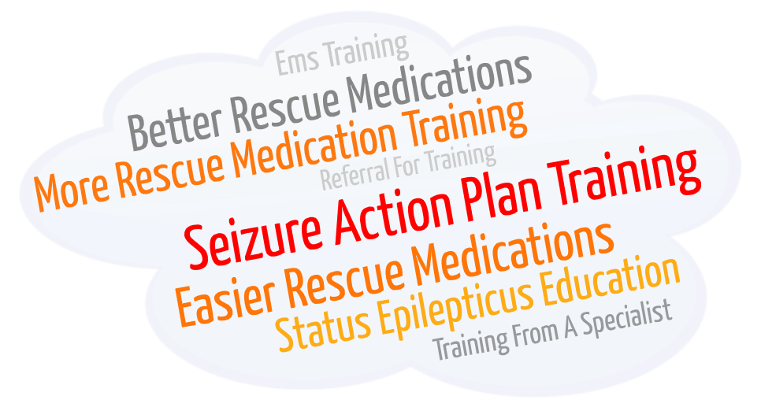
Audience response How could the healthcare system better prepare caregivers to manage seizure emergencies?

Slide 85
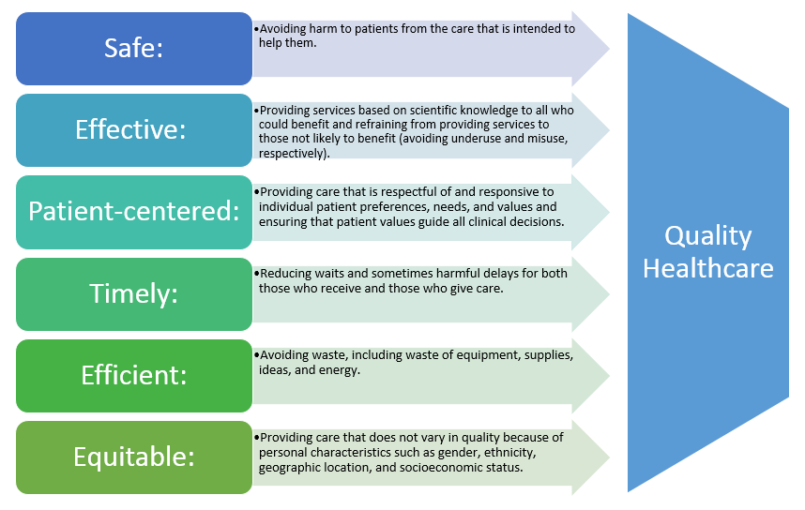
Institute of Medicine Crossing the Quality Chasm
Institute of Medicine (IOM). Crossing the Quality Chasm: A New Health System for the 21st Century. Washington, D.C: National Academy Press; 2001.

Slide 86
Basic critical care and emergency principles of therapy…have achieved widespread acceptance and are routinely implemented…
Glauser T, et al. Epilepsy Curr. 2016;16:48-61.

Slide 87
…approaches to the pharmacologic treatment of status epilepticus continue to vary dramatically [and] patients still receive inadequate treatment for a variety of reasons including…use of inefficient therapies such as sedatives and paralytics, and administration of insufficient anticonvulsant doses.
Glauser T, et al. Epilepsy Curr. 2016;16:48-61.

Slide 88
Delays in antiseizure medication are frequent
Pediatric patients (N=81)
1st AED treatment
2nd AED treatment
3rd AED treatment
AES Recommendations
Stabilization
1st therapy
2nd therapy
3rd therapy
Sanchez Fernandez I, et al. Neurology. 2015;84:2304–11.

Slide 89
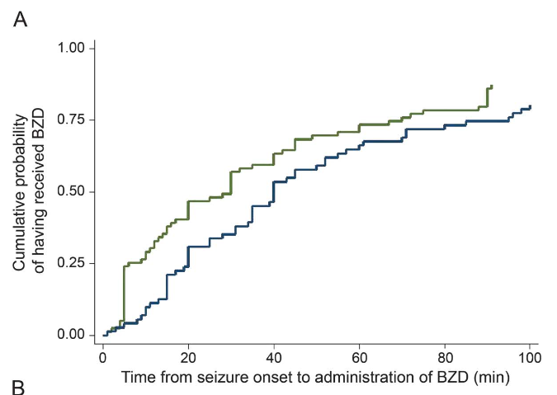
Delays in antiseizure medication are frequent
Treatment delays also happen in patients with a prior epilepsy diagnosis or prior SE episodes
Out-of-hospital seizure onset in patients with epilepsy diagnosis (N=27)
Only 12 received 1st BZD before arriving to hospital
Family administered in 7 cases
EMS administered in 5 cases
Consistent with other studies
Families are reluctant to administer rescue medication
EMS may not administer rescue medication
EMS may not consider non-IV administration
1st BZD dose
2nd BZD dose
BZD, benzodiazepine; IV, intravenous; SE, status epilepticus
Sanchez Fernandez I, et al. Neurology. 2015;84:2304–11. Capovilla G, et al. Epilepsia. 2013;54:23–34. Chin RF, et al. Presented at the annual meeting of the American Epilepsy Society; 2004: 89. Gainza-Lein M, et al. Seizure. 2017;52:188-194.

Slide 90
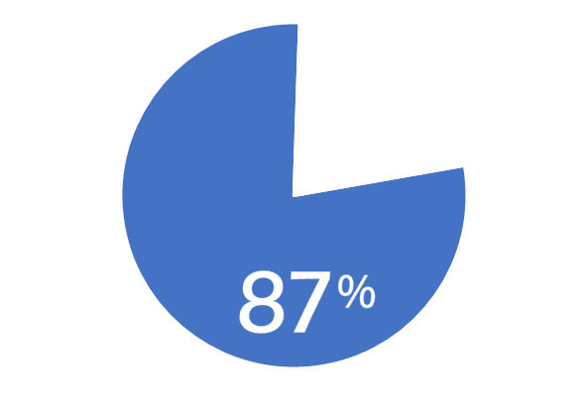
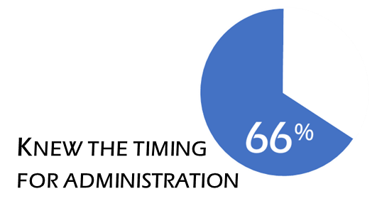
Caregiver education is a barrier to early administration of rescue medications
have a
rescue medication
Chart review and survey of families of pediatric patients (N=100)
Gainza-Lein M, et al. Seizure. 2017;52:188-194.

Slide 91
A Seizure Action Plan lowers the barriers to caregivers administering rescue medication
Patients with a Seizure Action Plan
Had an SAP
Patients without a Seizure Action Plan
Didn’t have an SAP
P<0.01
Knew the correct rescue medication
Chart review and survey of families of pediatric patients (N=100)
SAP, Seizure Action Plan
Gainza-Lein M, et al. Seizure. 2017;52:188-194.

Slide 92
A Seizure Action Plan lowers the barriers to caregivers administering rescue medication
Patients with a Seizure Action Plan
Patients without a Seizure Action Plan
Had an SAP
Didn’t have an SAP
P<0.01
Knew when to give rescue medication
Chart review and survey of families of pediatric patients (N=100)
SAP, Seizure Action Plan
Gainza-Lein M, et al. Seizure. 2017;52:188-194.

Slide 93
A Seizure Action Plan lowers the barriers to caregivers administering rescue medication
Patients with a Seizure Action Plan
Had an SAP
Patients without a Seizure Action Plan
Didn’t have an SAP
P<0.01
Informed school of patient’s diagnosis
Chart review and survey of families of pediatric patients (N=100)
SAP, Seizure Action Plan
Gainza-Lein M, et al. Seizure. 2017;52:188-194.

Slide 94
A Seizure Action Plan lowers the barriers to caregivers administering rescue medication
Patients with a Seizure Action Plan
Had an SAP
Patients without a Seizure Action Plan
Didn’t have an SAP
P<0.01
School had access to rescue medication
Chart review and survey of families of pediatric patients (N=100)
SAP, Seizure Action Plan
Gainza-Lein M, et al. Seizure. 2017;52:188-194.

Slide 95
A Seizure Action Plan lowers the barriers to caregivers administering rescue medication
Patients with a Seizure Action Plan
Patients without a Seizure Action Plan
Had an SAP
Didn’t have an SAP
P<0.01
Knew what to do if rescue medication failed
Chart review and survey of families of pediatric patients (N=100)
SAP, Seizure Action Plan
Gainza-Lein M, et al. Seizure. 2017;52:188-194.

Slide 96
SAPs work, but they aren’t widely being used
Parents who recalled having an SAP
(Parents not using an SAP)
Chart review and survey of families of pediatric patients (N=100)
SAP, Seizure Action Plan
Gainza-Lein M, et al. Seizure. 2017;52:188-194.

Slide 97
Seizure Action Plans
Detailed information about patient’s epilepsy symptoms
Instructions for how to respond during a seizure
Rescue medication administration
Other treatments (eg, vagus nerve stimulator)
A clear definition of what constitutes a seizure emergency
Reduces unnecessary treatment
Reduces treatment delays
American Academy of Pediatrics. Available at https://www.healthychildren.org/English/health-issues/conditions/seizures/Pages/Children-with-Epilepsy-at-School.aspx. Accessed November 17, 2020.

Slide 98
Resources for Seizure Action Plans
Epilepsy Foundation
https://bit.ly/3nHjqJr
Child Neurology Foundation
https://bit.ly/2IE7Qjn
Expert Opinion Consensus Recommendations for Development of Acute Seizure Action Plans (ASAPs)
Penovich P, Glauser T, Becker D, et al. Neurol Clin Pract (submitted).

Slide 99
Caregiver training can be improved
Quality of training
Preference for training by neurologist
Training by other medical staff also good
(Small but significant difference)
Parents asked for
More hands-on training
Refresher training after a few years
Seizure Action Plans
Educational materials for other caregivers
Parents Trained on Rescue Medication Administration
Patient Age (years)
Chart review and survey of families of pediatric patients (N=100)
Gainza-Lein M, et al. Seizure. 2017;52:188-194.

Slide 100
Caregiver training is still needed
School nurses (N=83)
Had enough information about individual student’s seizures and management
Terry D, et al. J Child Neurol. 2016;31:1602-1606.

Slide 101
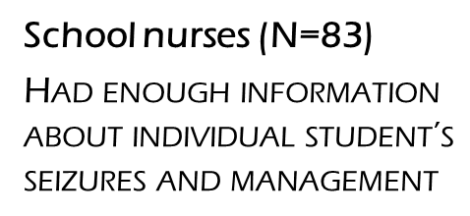
Caregiver training is still needed
Trained to administer PR Diazepam
Trained to administer IN Midazolam*
IN, intranasal; PR, rectal
*Off-label IN midazolam
Terry D, et al. J Child Neurol. 2016;31:1602-1606.

Slide 102
Keeping SAPs up to date
Patients whose rescue medication dose was within accepted guideline range
low
correct
high
51%
41%
8%
Weight changes in children
Availability of dose
Concerns about overdosing
Concerns about respiratory complication risk
Chart review and survey of families of pediatric patients (N=100)
Gainza-Lein M, et al. Seizure. 2017;52:188-194.

Slide 103
Critical junctures are training opportunities
At diagnosis | During first year after diagnosis
Change in developmental status Beginning school Transition from pediatric to adult care Transition from adult care to geriatric care | Change in seizure pattern Change in seizure frequency Change in seizure type Breakthrough seizures
New treatment-related concerns Change in medication Side effects Nonadherence | Change in health status Pregnancy Injury Mental, neurological, somatic comorbid conditions
Employment or social change Life stressor Travel
England MJ, et al. Epilepsy Across the Spectrum: Promoting Health and Understanding. The National Academies Collection: Reports funded by National Institutes of Health. Washington (DC)2012.

